Slide 1
Review of WG
“Yoga” Strategies…Strategies that merely stretch
“Disney” Strategies…Strategies that imagine (scenario planning)
“Numero” Strategies….analysis (see. Vladimir Shiltsev)
“Archimedes” strategies…Strategies that leverage core forte (this pitch)
……..Hopefully this will lead to decisions and more “outsight”.

Slide 2
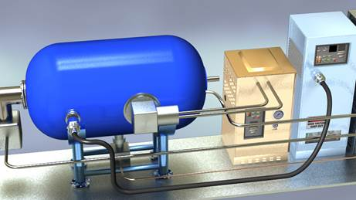
Catapulting cost cut by: 10 x – 100 x “If you think nobody cares if you're alive, try missing a couple of car payments.” – Earl Wilson
Push for low-cost RF technologies from $10-15 per W - $1 per W (x 10)
SRF thrust
Material cost of Nb is almost half the cost
High Tc coatings on copper (e.g. Nb on copper, MgB2 on copper) (See Sam Posen talk)
Cryo becomes simpler and cost reduction by at least a factor of x 10.
Muti-W cryocooler
Double Whammy -> Trifecta (material, cryo, few “extras”)
High average current cathodes - multi- A
Beam quality: 10-fs micro-crystallography (LCLS-II in < 5 m )
https://physics.aps.org/articles/v10/39
Thanks to Bob Kephart on inputs

