Slide 1
PIP-II Project Manager’s Report
Steve Holmes
PIP-II Project Management Group
17 May 2017

Slide 2
Outline
Goals
Financials
ES&H/NEPA
Technical/R&D
India Collaboration
Project Management
CD-1 Status

Slide 3
Project Goals
Milestone | Planned | Actual or Forecast
CD-0 | Q1 FY2016 | November 12, 2015 (A)
CD-1 | FY2017 | Q2FY2018
CD-2/3a | FY2019 | FY2019
CD-3 | FY2020 | FY2020
CD-4 | FY2026 | FY2026
Funding profile as contained in the approved Mission Need Statement, adjusted for FY2017 actual
Moved $4.3M from FY25 to FY19 per DOE guidance of 2/6/17
Corresponds to cost range upper bound

Slide 4
Goals for FY17
New goal is to achieve CD-1 in early 2018
RLS
ICR
Documentation
Financial Goals
Live within the provided budget: $21.03M (includes FY16 carryover)
Cross the FY17/18 border with ~$0.75M unobligated (carryover)
ES&H Goals
Be prepared to initiate Environmental Assessment on 10/1/17
R&D Goals
Release CDR
Complete PIP2IT MEBT
Keep HWR and SSR1 on track for CY2018 delivery
India Collaboration Goals
Meet 2017 deliverable milestones
Establish confidence between the partners
Management Goals
Complete all CD-1 documentation and successfully navigate required reviews
Fill missing positions on organization chart

Slide 5
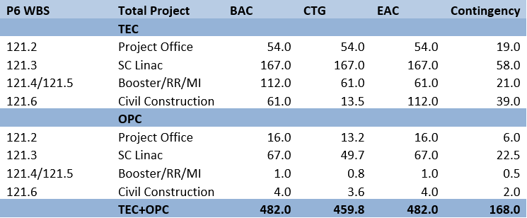
Financials (inception through 4-30-17)
Spending since CD-0
OPC/Project Office, Civil Const, and SC Linac are only areas of activity to date
4.6% complete

Slide 6
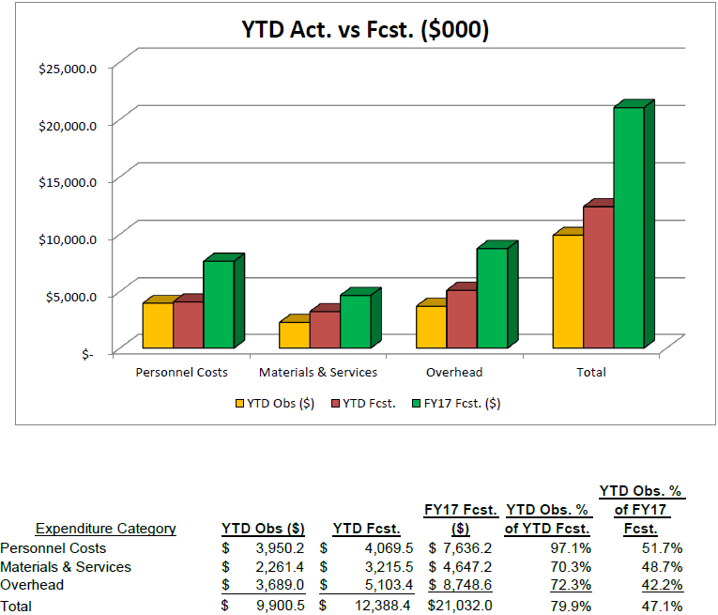
FY17 Financials (through 4-30-17)
RIPs: $538K
Current Management Reserve: $245K
Demands against Management Reserve: $572K

Slide 7
FY17 Financials/Management Reserve
Budgets adjusted following FY17 forecast-to-complete in April
Several funding change requests were approved, most notably
HB650 cavity dressing + contract designer (shared with SSR)
RFQ new couplers/tuners
Current Management Reserve: $245K
Includes $130K of uncosted obligation on Pavac contract that DOE has agreed to move from GARD to PIP-II (in June)
Unfunded Requests: $572K
SSR1 CM parts $251K
PIP2IT RFPI $15K
LLRF $56K
Partially funded
Environmental Assessment $250K
Not shown in MR: Anticipate SWF underrun of up to $2M

Slide 8
ES&H/NEPA
Wetlands Jurisdictional Determination
Site-wide request for determination to USACE
If accepted, the wetlands located in the PIP-II footprint would be designated non-jurisdictional
Process should take ~ 1 year
Some uncertainty as to whether non-jurisdictional determination would relieve Fermilab of obligation to create or procure mitigating acreage
FSO has submitted the application package to USACE (Apr 27)
Fermilab personnel met with USACE representative to provide overview (May 12)
If denied, a new wetlands permit application would be submitted in FY2018 to allow USACE the 1 year review period in order to meet a PIP-II start work date of late FY2019/early FY2020.
Environmental Evaluation Notification Form (EENF) ready for submission to DOE/FSO
Expect to forward to FSO this summer and initiate selection of PIP-II NEPA/EA contractor

Slide 9
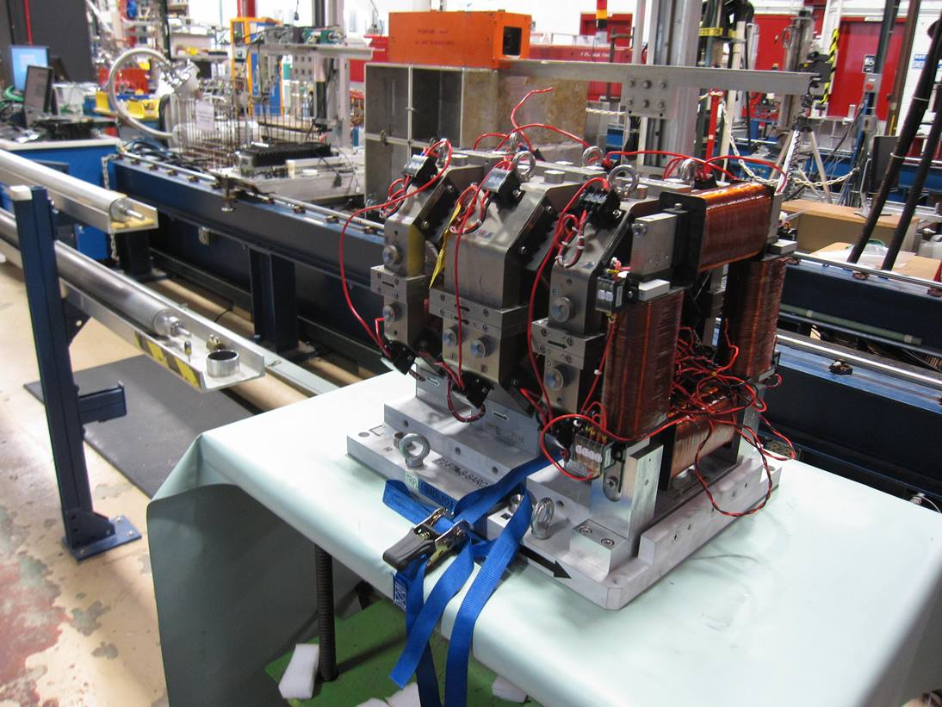
Technical/R&D Status
PIP2IT
2017 goal to complete MEBT and commission with beam
5 mA × 1 ms × 20 Hz to dump
Measure kickers’ effects on the beam
LEBT has been successfully commissioned with
beam following installation of dipole
Currently shut down for MEBT
installation following (partial) receipt
of magnets from India
Balance of magnets due to ship 5/15

Slide 10
Technical/SRF R&D Status
HB650
Goal is to qualify and dress four cavities in FY17
Two cavities are qualified
Third near spec
Going through “nitrogen infusion” processing
Fourth went through second vertical test last month
High FE; will require reprocess
Couplers
New RFQ coupler design has been completed and reviewed
Procurement initiated
HB650 couplers are being prepared for RFP
Best value procurement with pre-qualified vendors

Slide 11
India Collaboration
Joint R&D Project Document
Addendum II: Documentation of Fermilab engineering deliverables.
DAE comments received March 20
Mostly concern specific documents they are having difficulties locating
Returned to DAE with minor modifications and recommendation to accept as is (May 8).
Addendum I: Modification to DAE deliverable dates to reflect delays in R&D program to FY2020
DAE to make Addendum I consistent with Addendum II
Visitors
Attempting to get the visitors program restarted
First cohort of long term visitors departs Fermilab over Sep–Nov
Wish list for second round has been developed by DAE
Upcoming Visits
Leonardo Ristori et al will be visiting BARC in August for:
Witnessing of SSR1 He vessel welding
Review of SSR2 cavity design

Slide 12
Project Management/CD-1
Assumptions Document approved (Mar 9)
Functional Requirements Specification approved (Mar 17)
Lab MOU in development
Critical path is:
RLS (see L. Lari presentation)
BOEs (see P. Derwent presentation)
Risk Management
138 approved risks
Undertaking initial calculation of associated contingency

Slide 13
Project Management/CD-1
Agreement with AD on division of scope between PIP-I+ and PIP-II
Scope removed from the PIP-II CD-0 configuration includes:
Booster Damper Upgrade
Booster LCW Upgrade
Booster Collimators Upgrade
Main Injector gamma-t jump
Scope retained from the PIP-II CD-0 configuration includes:
New Booster 800-MeV injection area, including higher strength gradient magnets (assumed to be required)
Booster 20 Hz upgrade (magnets, power supplies, controls)
New Recycler RF cavities
Main Injector RF power upgrade
Associate cost impact/savings is:
Point estimate: $17M
Upper cost range: $21M

Slide 14
Project Management/CD-1 Strategy
We are currently developing a “technically limited” RLS, where technically limited means PIP-II completion coincident with completion of the LBNF shutdown (Q2FY26).
Attempting to complete this RLS asap
BOEs in parallel
We will share the resource requirements from this RLS with DOE
DOE/HEP has informed us that they will be able to provide the funding profile to be utilized for CD-1 at the end of August.
Upon receipt we will iterate the RLS to match the CD-1 profile
Dates
Director’s Review November
DOE IPR/ICR January/February 2018
ESAAB (CD-1) March/April 2018
Note: The technically limited schedule will require a CD-3a in FY18, i.e. in advance of CD-2
Nb and initial cavity procurements
Site prep

Slide 15
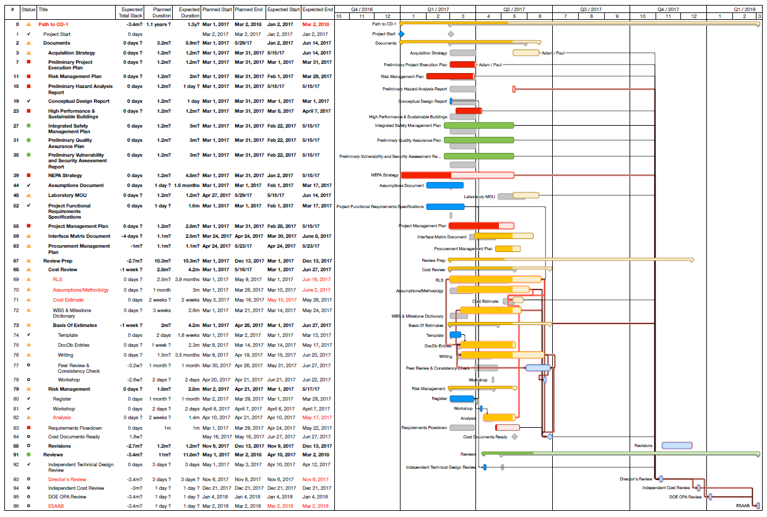
CD-1 Timeline/Status
CD-1 Profile from HEP
RLS
BOEs

Slide 16
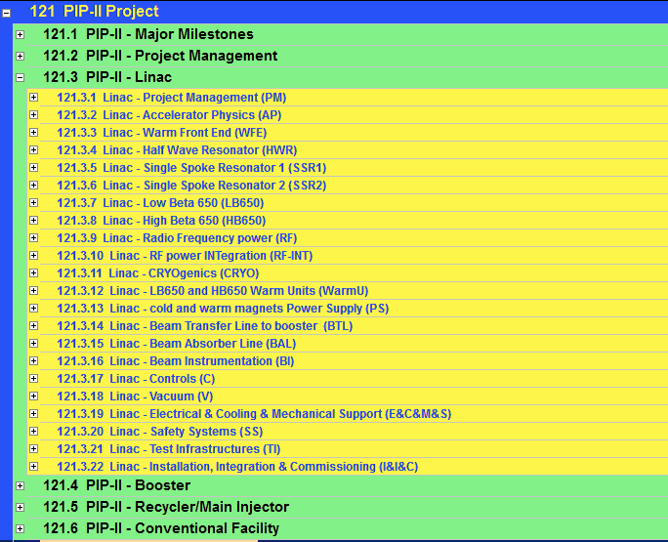
RLS status
Close to ready/ready
Advanced
Preliminary
In P6
Detailed Plan
WBS for BOE
~70% of Total PIP-II Project costs

Slide 17
Project Management
Personnel
Close to publicly announcing the new Project Engineer
Working on job description
Don M will stay for a transition period
Donato Passarelli succeeding Leonardo Ristori as L3M for SSRs
Leonardo to devote 75% of time to LHC crab cavities
Will spend 25% supporting Donato on SSRs
Issues that are impeding progress
STC operations have not been reliable lately
Lab2 cleanroom not complete – requires further investment to make usable
Engineering support for SRF
Tom N (Mu2e) and Chuck G (LCLS-II) have very minimal availability
Much of the slack is being taken up by Vikas Jain (RRCAT visitor)
He returns to India in October → need to identify a replacement
New guest engineer arriving this month to support SSR1
Long-term issue: how to support M&O of srf test/fabrication infrastructure

Slide 18
Summary
Moving toward CD-1, with a newly-modified plan
Delaying by ~4 months to allow alignment of schedule and funding profile.
India collaboration is taking a lot of attention
Improving interactions and information exchange
Need to add more staff prior to CD-1
Essentially there

