Slide 1
Status of Resource Loaded Schedule
Luisella Lari
PIP-II PMG meeting
17 May 2017
Thanks to L3/L2 managers
PIP-II project management team
and project controls specialist

Slide 2
Outline
PIP-II RLS: a reminder of the PIP-II project scope
PIP-II RLS: the WBS revised from L4
PIP-II RLS status
PIP-II RLS next steps

Slide 3
PIP-II RLS: A reminder
Added constraints from LCLS-II activities completed in CMTS/CMTS ready for PIP-II
The PIP-II Project requires a complex RLS
Scope changed (see Steve’s talk)

Slide 4
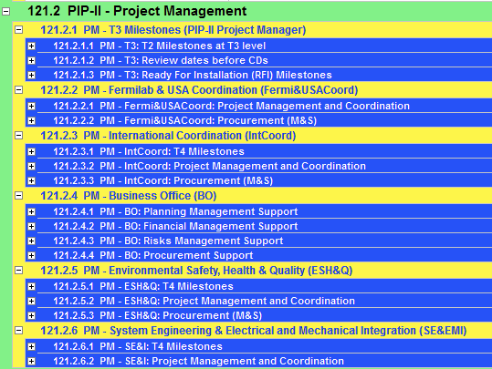
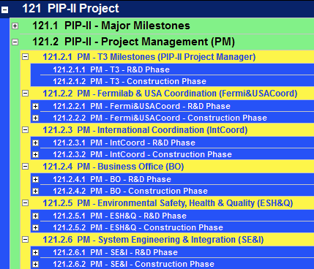
PIP-II RLS: the WBS revised
In order to make the RLS more flexible to allocate changes in funds (e.g. OPC vs PED or TEC) on March the 29th the PIP-II Management team has agreed on changing the PIP-II WBS from L4.
Before
After

Slide 5
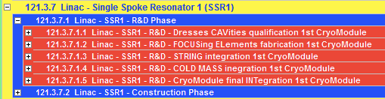
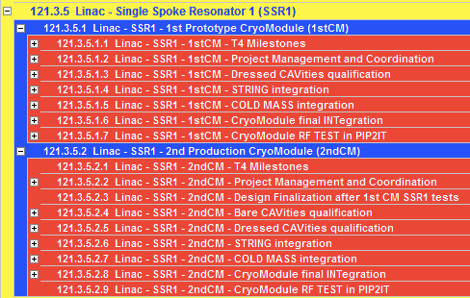
PIP-II RLS: the WBS revised (example 2)
Before
After

Slide 6
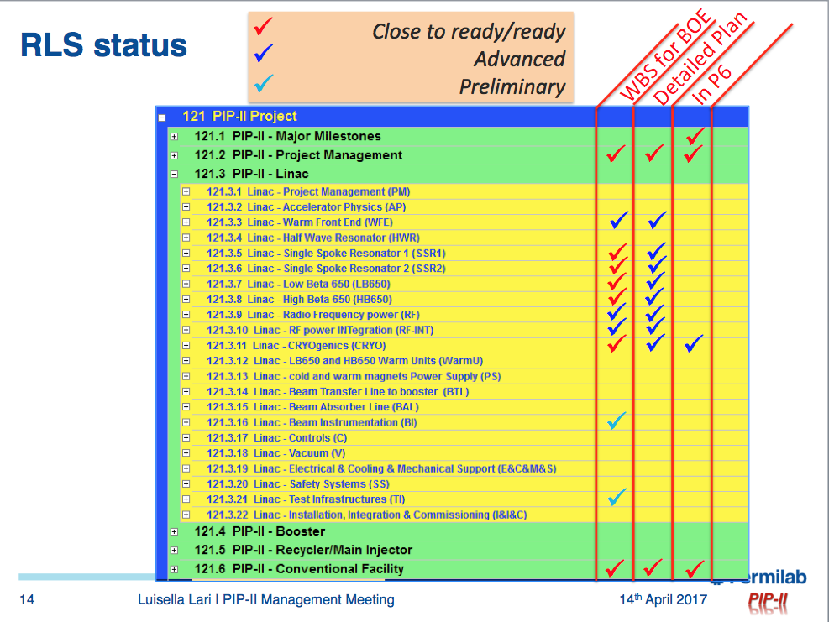
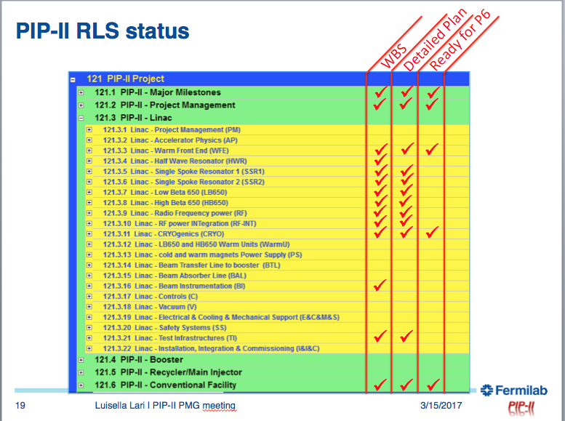
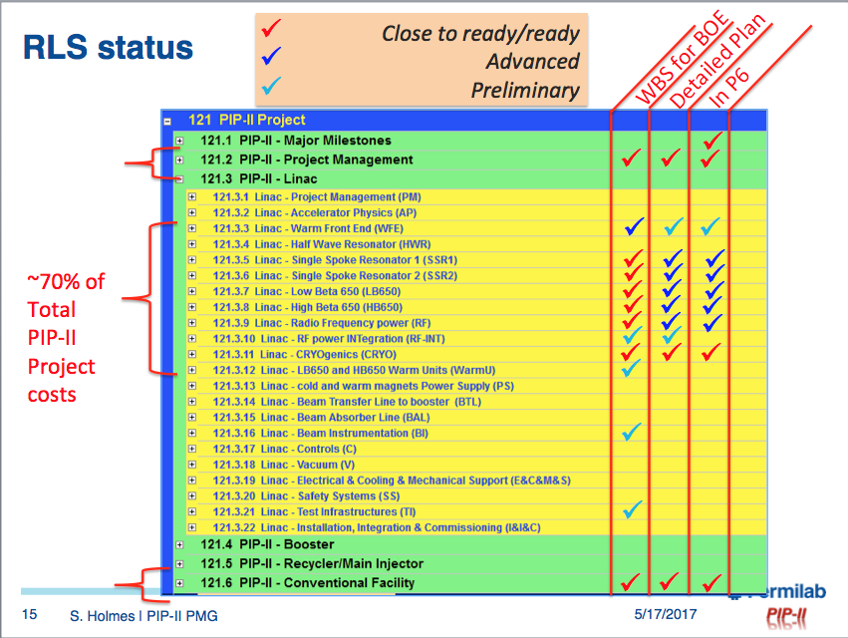
RLS status
Ref: S. Holmes – 19 April 2017
Ref: L. Lari – 15 March 2017
Today

Slide 7
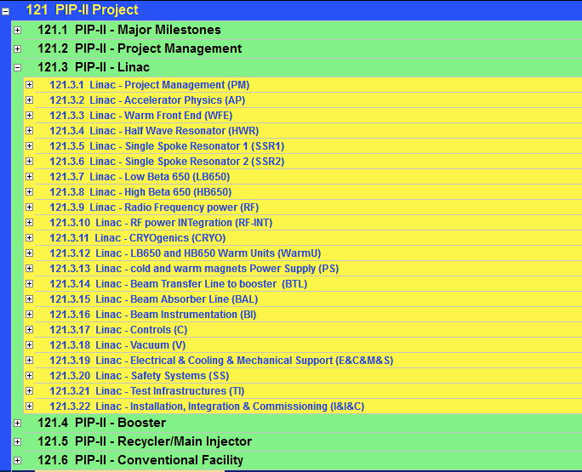
RLS status
Close to ready/ready
Advanced
Preliminary
In P6
Detailed Plan
WBS for BOE
~70% of Total PIP-II Project costs

Slide 8
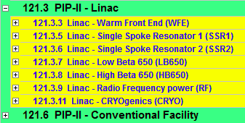
RLS status
Working in Progress to identify Major (> 5 M$),
Significant (> 0.5 M$) and Critical contracts
For PIP-II a Critical procurement is defined as a procurement that satisfies one or more of the following criteria:
Procurement actions that require complex evaluation systems;
Procurements that have high technical, cost, or schedule risk;
Contracts Draft Total
4
15
23
6
16
27
2
8
Major | 8
Significant | 25
Critical | 68
Total | 101

Slide 9

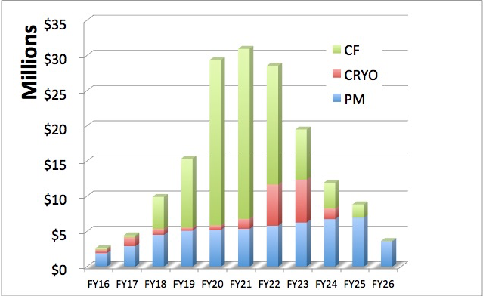
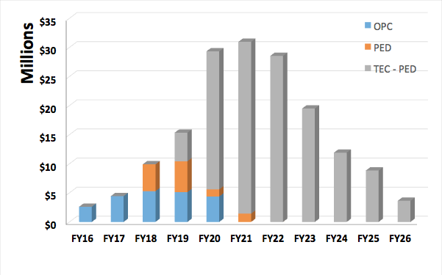
RLS status: PM + CRYO + CF under revision
M&S + FTE
Bars includes escalation & overhead and excludes uncertainties contingency and risks based contingency
M&S + FTE
PIP-II P6 RLS Status Review
on May 19th 9:00 – 12:00 PM

Slide 10
PIP-II RLS next steps
The PIP-II RLS is a technically limited schedule.
  PIP-II project is completed at the same time of LBNF shutdown (Q2FY26).
The implementation in P6 is on-going and the target is to complete the major sub-projects by the end of May, followed by Status Reviews.
The preliminary analysis shows that contracts for CF & CMs (Nb & Cavities) should be opened earlier than what foreseen @ CD-0.
The scope for a CD-3a can potentially coincide with CD-1, i.e. in advance of CD-2.

