Slide 1
PIP-II staff plan
PIP-II RLS is in reasonable shape in terms of logical structure, and M&S, for ~80% of the scope of work
PIP-II staff plan is a potential bottleneck.
For CD-1 a staff profile has to be produced. It is the result of the sum of each sub-project FTE contribution.
In order to have a first screening on staff for your sub-project, use the schedule as a driver and try to quantify them per BOE
112
ESS Example

Slide 2
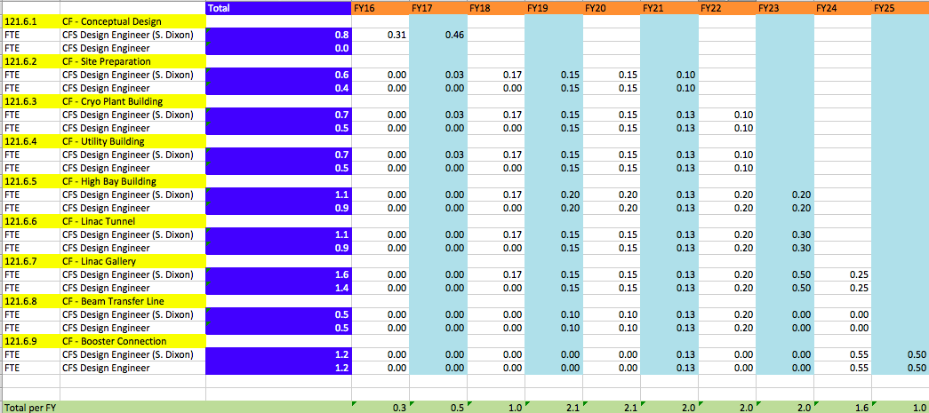
Example CF

Slide 3

Guideline
Fix the “regular” FTE per all the FY (e.g. L2/L3 managers)
Add per FY of key FTEs, using your schedule as guideline
  At the BOE level
Example Cryogenics

