Slide 1
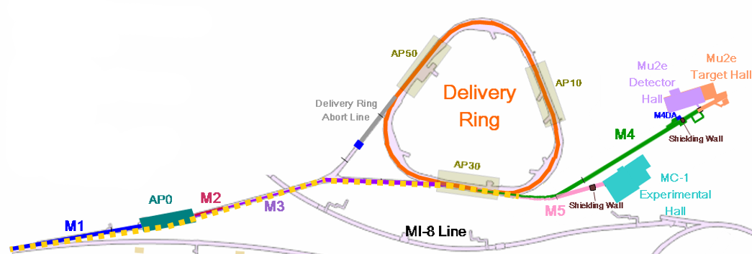
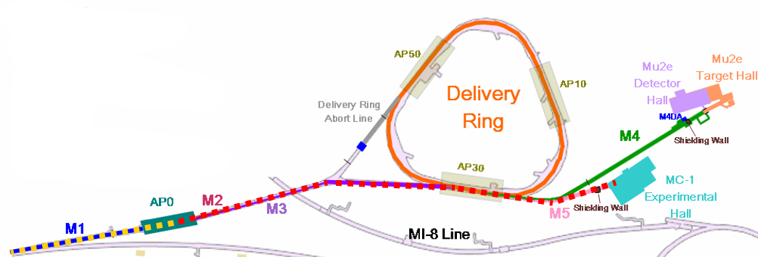
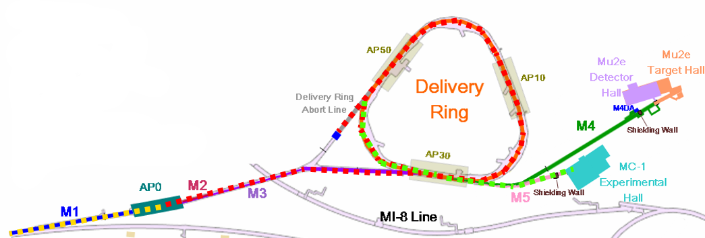
g-2 beam commissioning overview
8 GeV protons bypass target, through shared M4
If time also around Delivery Ring
8 GeV protons to target, 3.1 GeV secondaries to g-2 ring (100:1 protons to muons)
8 GeV protons to target, 3.1 GeV secondaries around Delivery Ring, proton removal, muons to g-2 ring - after shutdown
✓

Slide 2
Status and plans
Established 8 GeV beam into the M4 line
M5 line not designed to take 8 GeV beam
Established beam more than 1 turn around Delivery Ring
Can work on refining injection/extraction and orbits
Issues with target station pulsed power supplies and dump
Now expected to be ready ~May 19
Very tight for commissioning secondary beam and providing 3 weeks of data to the experiment for detector commissioning before the shutdown

