Slide 1
MI/RR Machine Status
Kyle J. Hazelwood
09:00 Meeting
April 28, 2017

Slide 2
Main Injector Performance

Slide 3
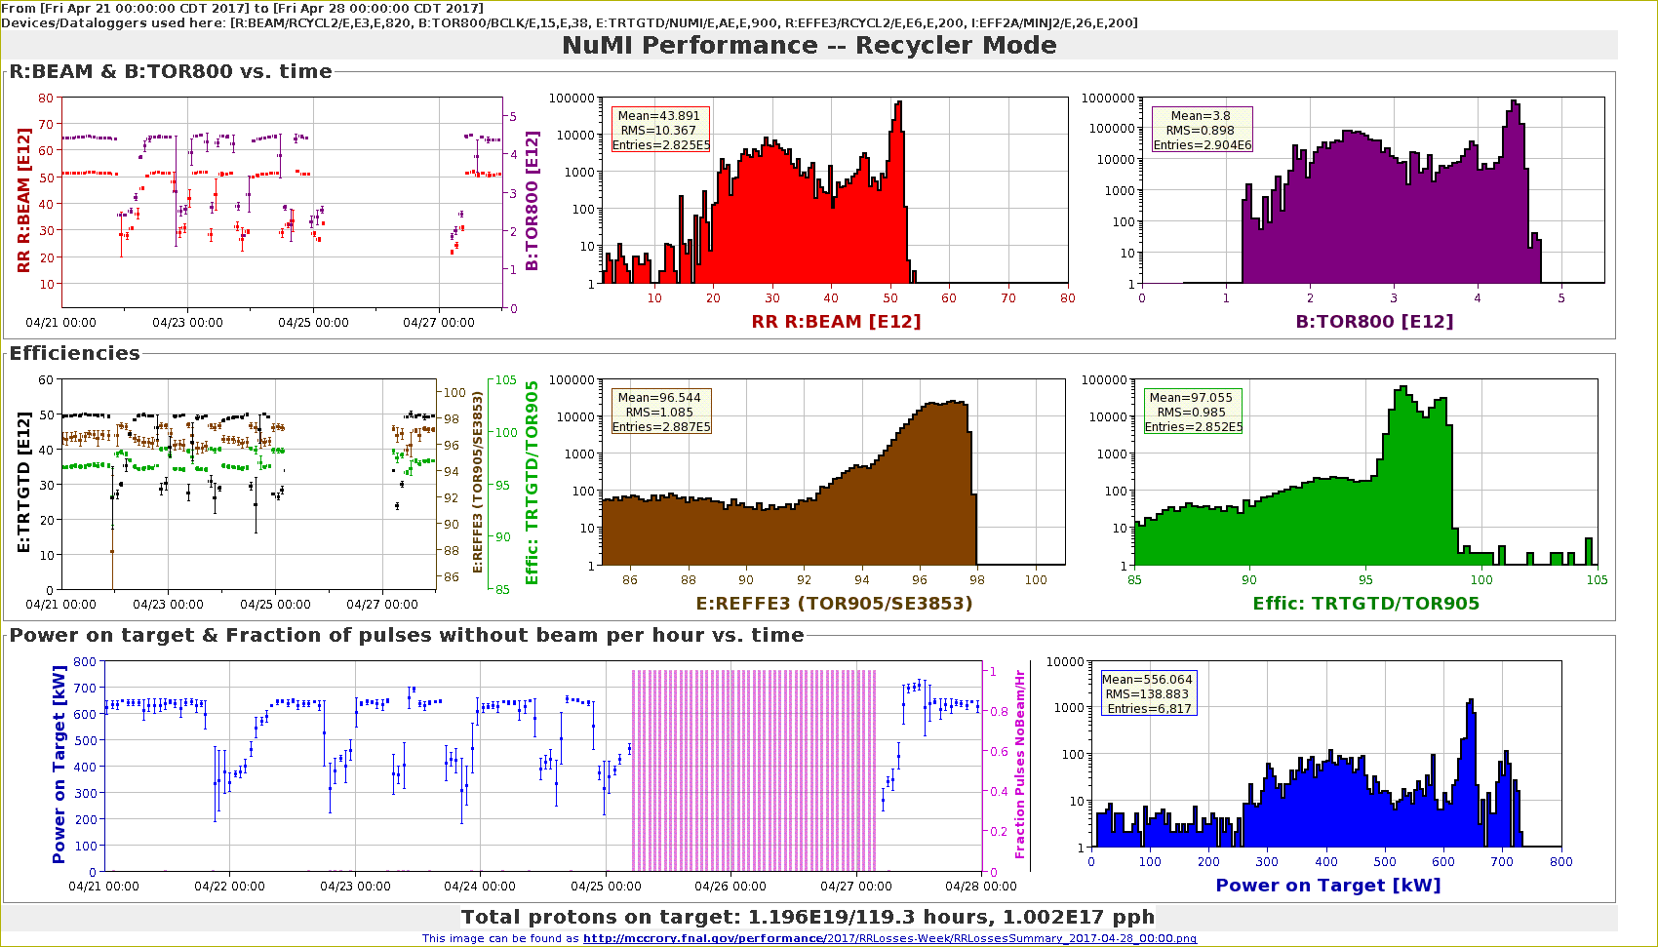
Recycler Performance

Slide 4
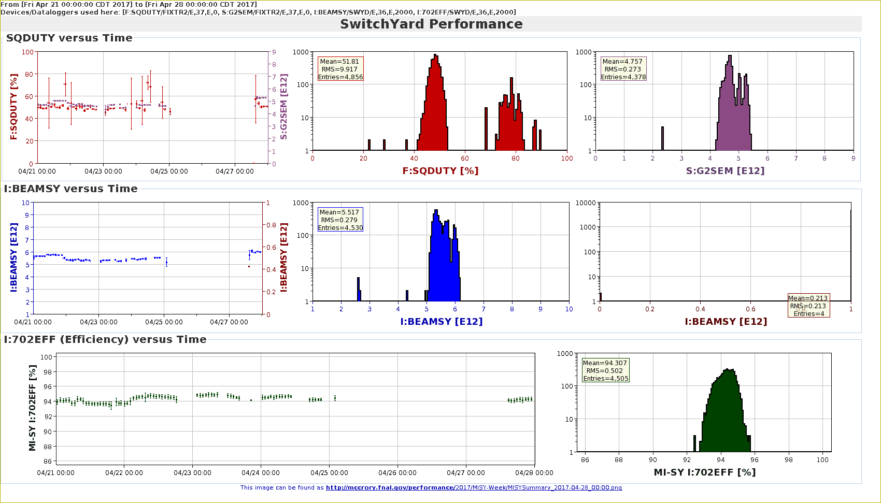
Switchyard Performance

Slide 5
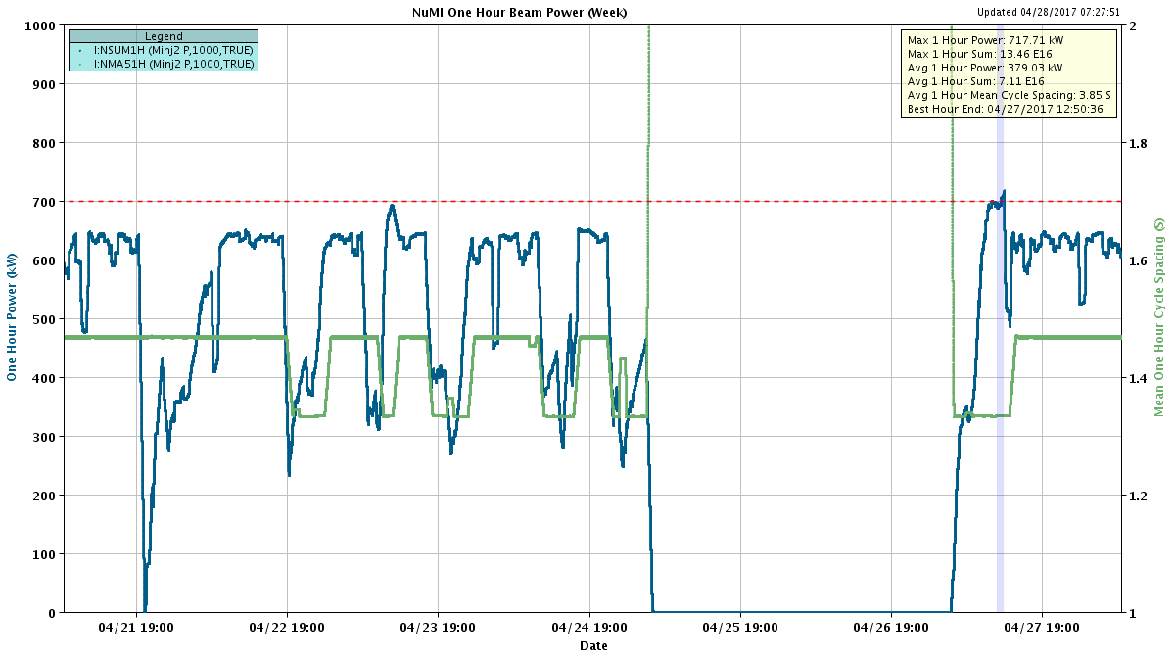
NuMI Power

Slide 6
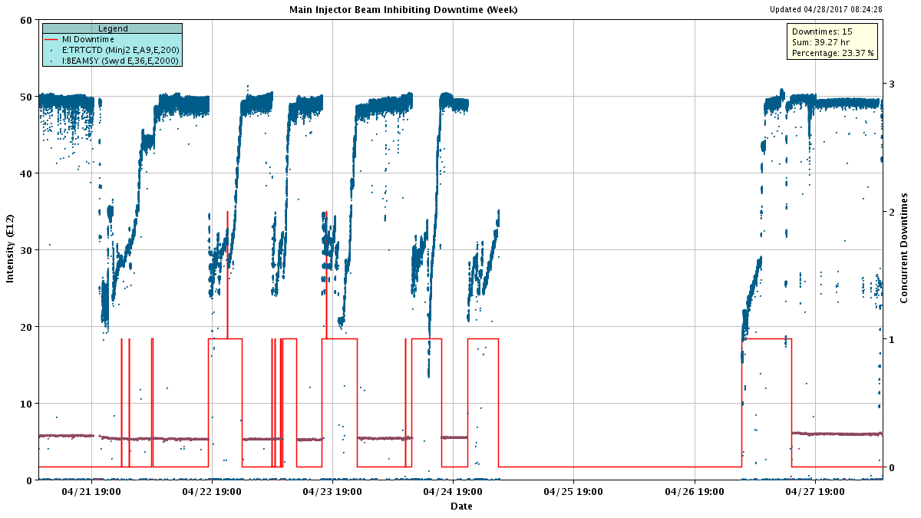
Main Injector Downtime

Slide 7
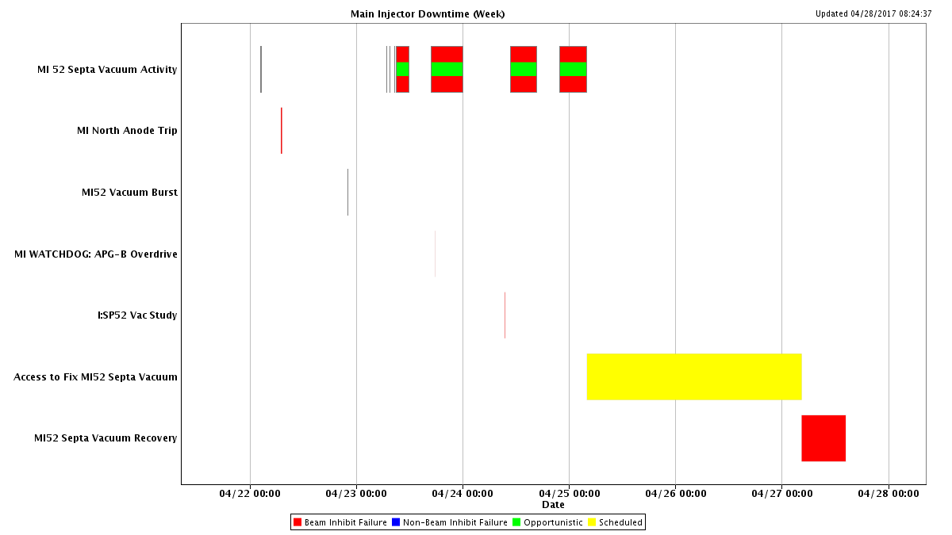
Main Injector Downtime

Slide 8
Recycler Downtime

Slide 9
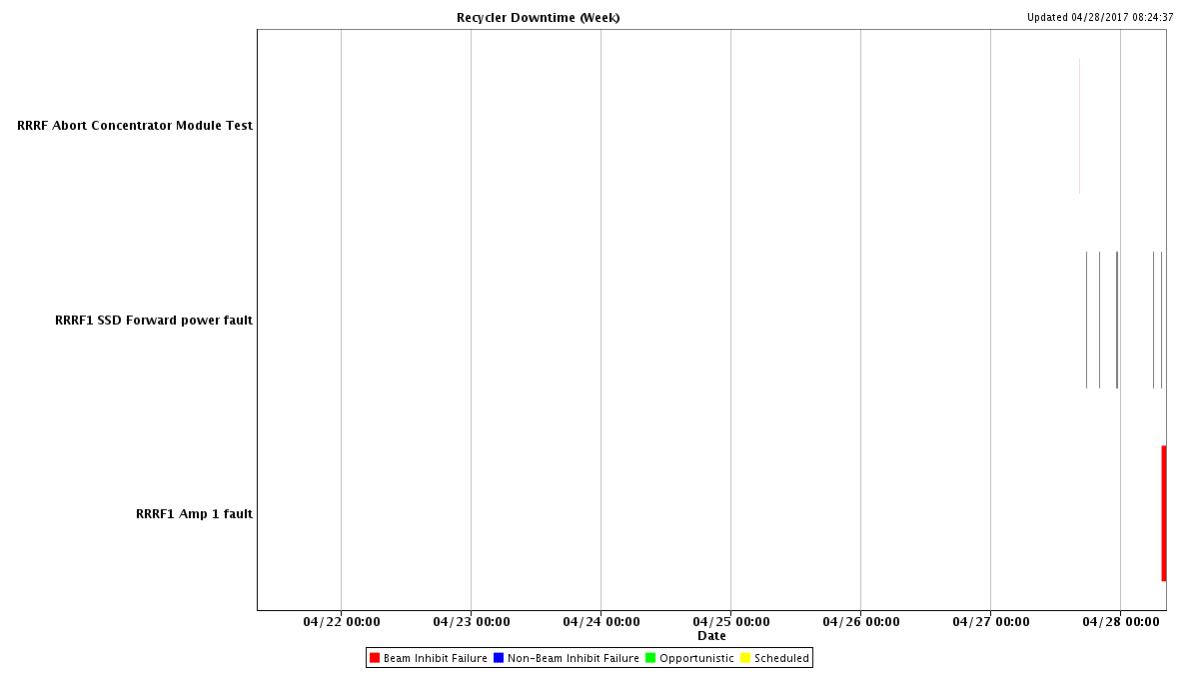
Recycler Downtime

Slide 10
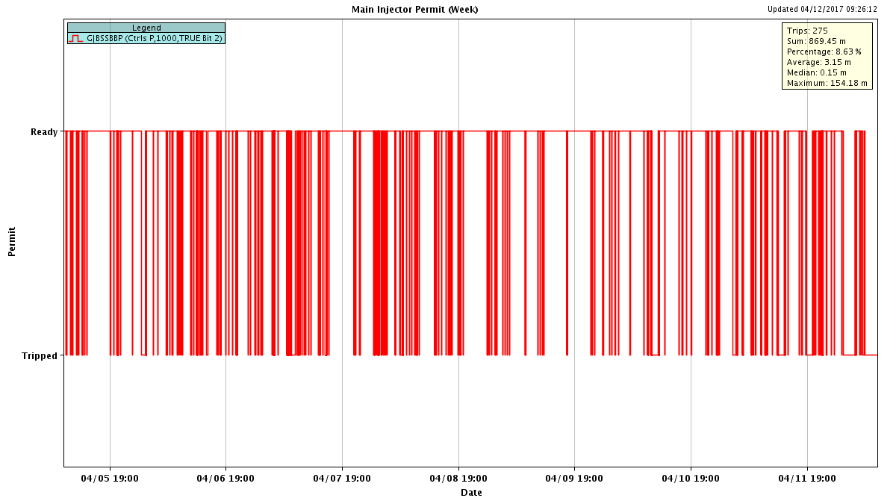
Main Injector Permit

Slide 11
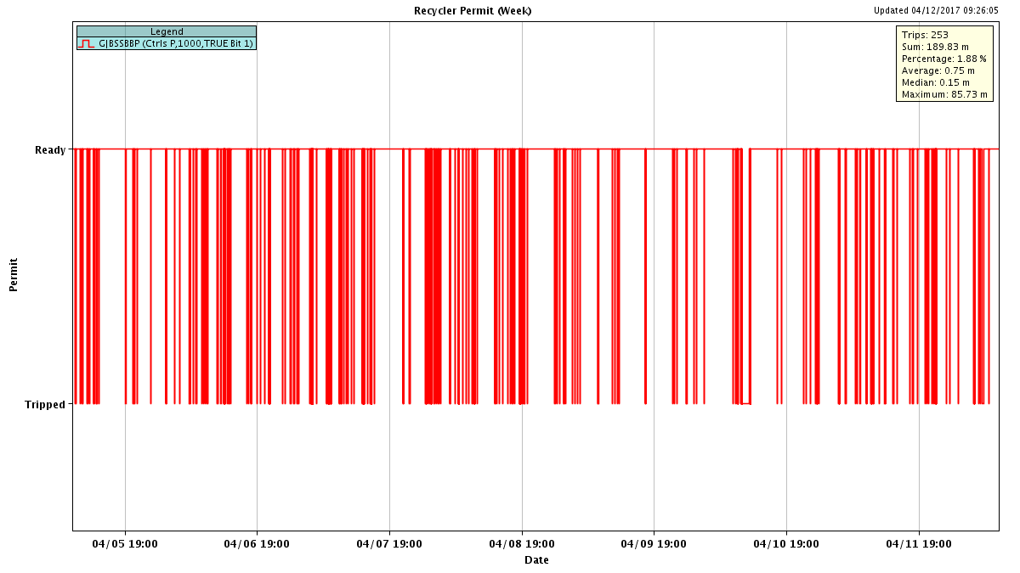
Recycler Permit

Slide 12
Summary
BLM node failures
Less frequent
MI 520 vacuum
Started having trouble Friday night
Had problems all weekend
Monday started not being able to recover
Tuesday access to investigate
Tuesday evening found O-ring leaking in 521 ecloud section
Wednesday morning replaced O-ring but didn’t hold
Wednesday afternoon welded beam pipe flanges
Beam to NuMI by Thursday morning
Beam to Switchyard Thursday afternoon
Tuesday-Wednesday access
Repairing 520 vacuum
MI20 LCW supply temp RTD replaced
MI52 sump discharge confirmed broke
Scoped discharge end. Were only able to look 31 ft in before blocked by gravel and mud
SEY measurement
DALE run
Confirmed some broken sumps in MI RF region

