Slide 1
Accelerator Division Status
Duane Newhart
All Experimenters’ Meeting/Lab Status Meeting
01 May 2017

Slide 2
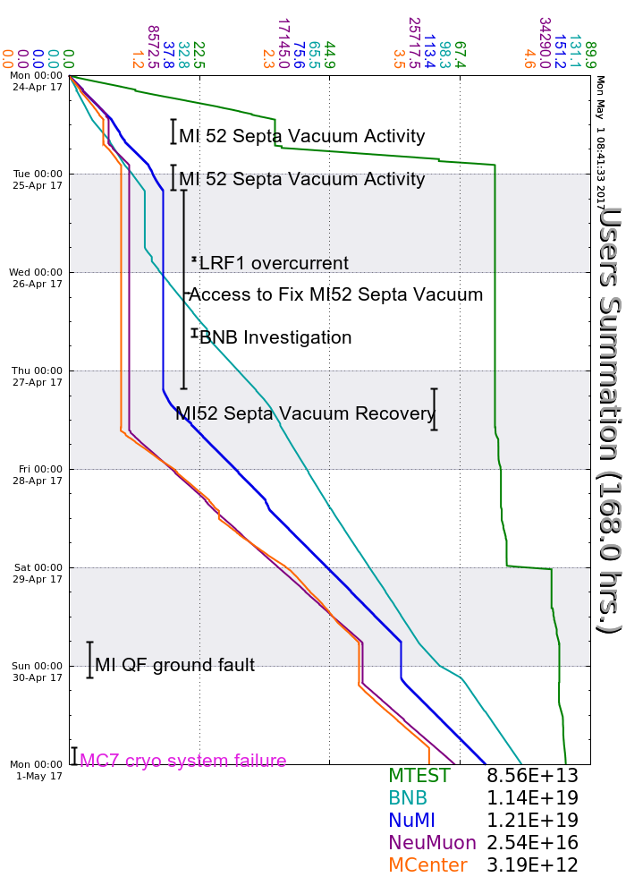
Accelerator Operations Summary
From: April 24, 2017 (0000 hours)
To: May 01, 2017 (0000 hours)
Calendar Week # 17
NuMI Weekly Integrated Intensity 1.21 E19 protons
Beam Hours To NuMI 107.9 hours
BNB Weekly Integrated Intensity 1.06 E19 protons
Beam Hours To BNB 148.5 hours
NMuon Weekly Integrated Intensity 2.54 E16 protons
Beam Hours To NMuon 86.2 hours
MTest Weekly Integrated Intensity 8.55 E13 protons
Beam Hours To MTest 42.8 hours
MCenter Weekly Integrated Intensity 3.10 E12 protons
Beam Hours To MCenter 77.5 hours

Slide 3
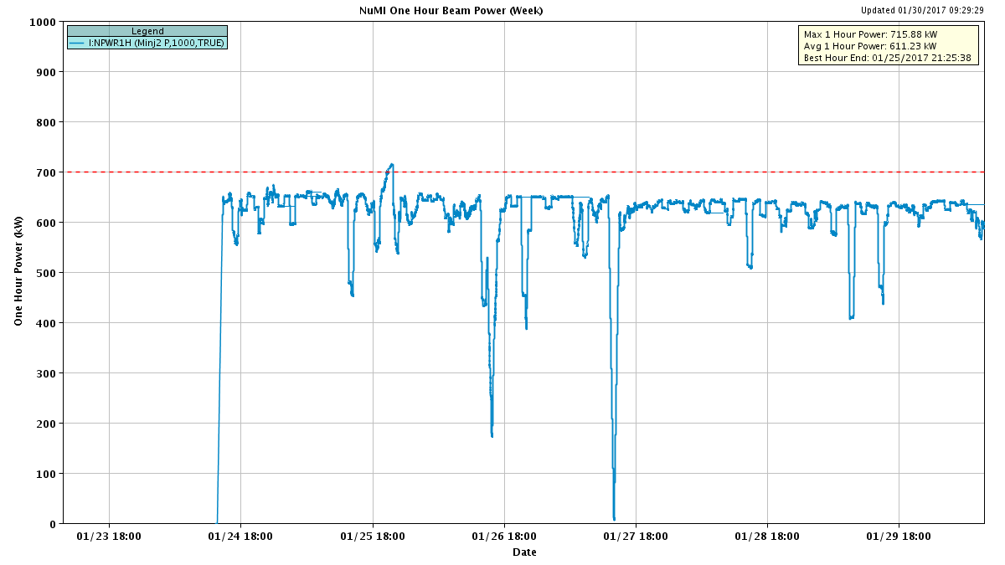
NuMI Beam Power
635.6kW NuMI with SY => 700 KW NuMI only
1 hour beam power record: 715.88 kW (1/25/17 20:25 to 21:25)

Slide 4
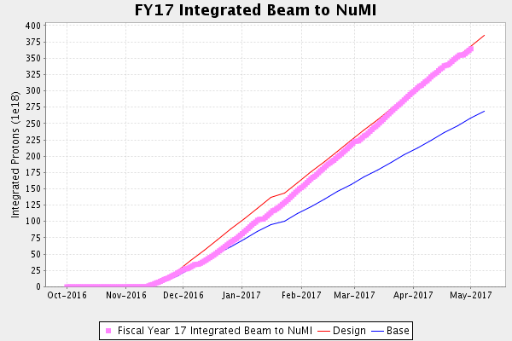
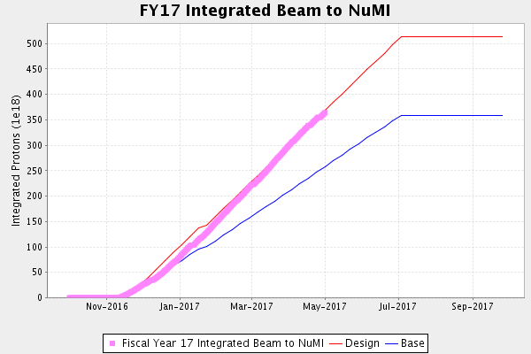
NuMI Operation

Slide 5
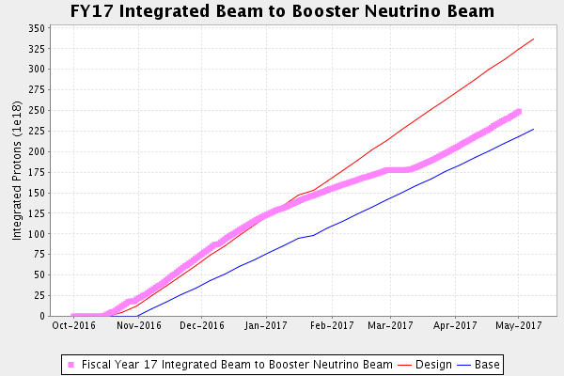
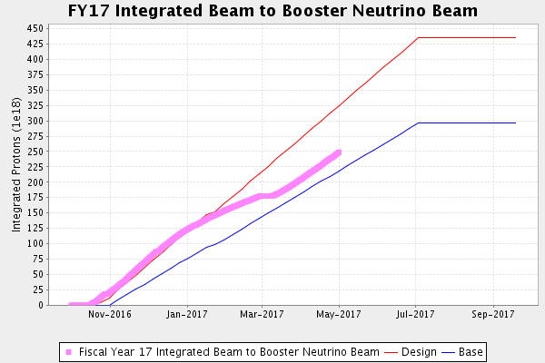
BNB Operation

Slide 6
Complex Status
LINAC
  Running well
Booster
  Booster DDS LLRF
    Investigating problems with the system
MI/RR
  MI52 vacuum
    Flange in e-cloud area
  MI60 penetration ground fault
    Cleared enough to run
NuMI
  Focusing on staying above 641kW with Switchyard running
Booster Neutrino Beamline (BNB)
  Running well
Switchyard
  MTest, Mcenter, SeaQuest
  F2 Sump excavation
    Two breaks repaired, but still not working
Muon Campus Commissioning
    8 GeV beam around the Delivery ring
General
  Downtime
    Access for vacuum on 25th
      Established new multi-mode signal from MI12 to MiniBooNe for Neutrino experiments

Slide 7
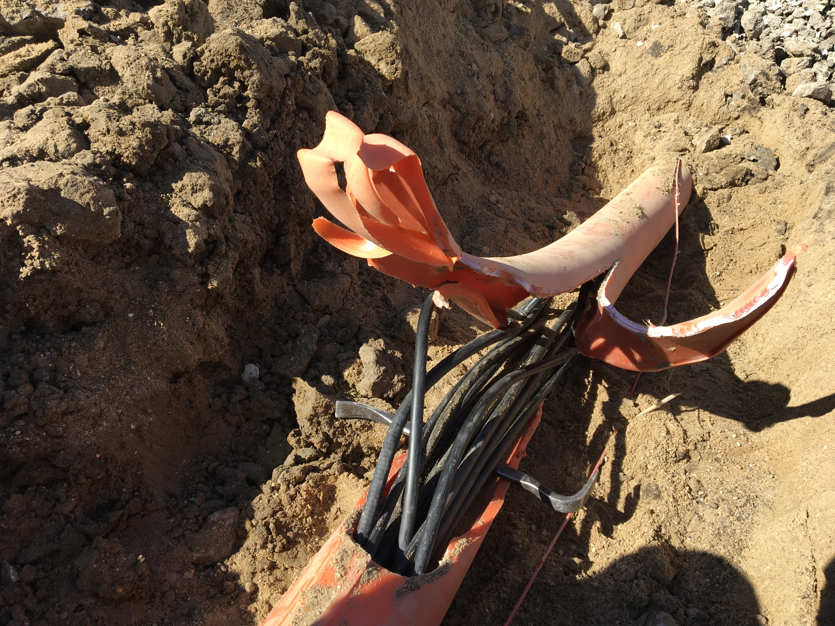
MI-12 Communication Duct
Summary
Emergency Repair Plan In Place
  Need 2 hour notification
  Vendor has cable
New Communications Duct Plan
  Communications duct installation
    New duct installed
  New fiber cable has been delivered
    Electricians notified
    Installation pending
  Hope to move to new cable in March
    Coordinate downtime with Master SubStation outages
Damaged on 10/24/16
Protected from further damage
Provides timing/date to Neutrino Experiments
Experiments running fine

Slide 8
PIP-II Injector Test & FAST Status
PIP-II Injector Test
  Shutdown
    Install full of MEBT
      2nd week of 6-10 week shutdown
FAST
  300 MeV beamline construction continues:
    The new Cave interlock system has been tested.
    Cable pulls for interlocked detectors are underway.
    The electrical ORC walkthrough occurred on Wednesday of last week and we were given permission to power magnets.
    The first 300 MeV TPM was installed at the 505 location.
    The third layer of shielding blocks has been installed.
    Alignment of magnets, TPMs, and beamtube continues.
    85% of BLMs have been installed.
    Vacuum system controls installation is complete and the beamline from 455 to 506 was pumped down for the first time.
    Termination of magnet cables should be completed this week.

Slide 9
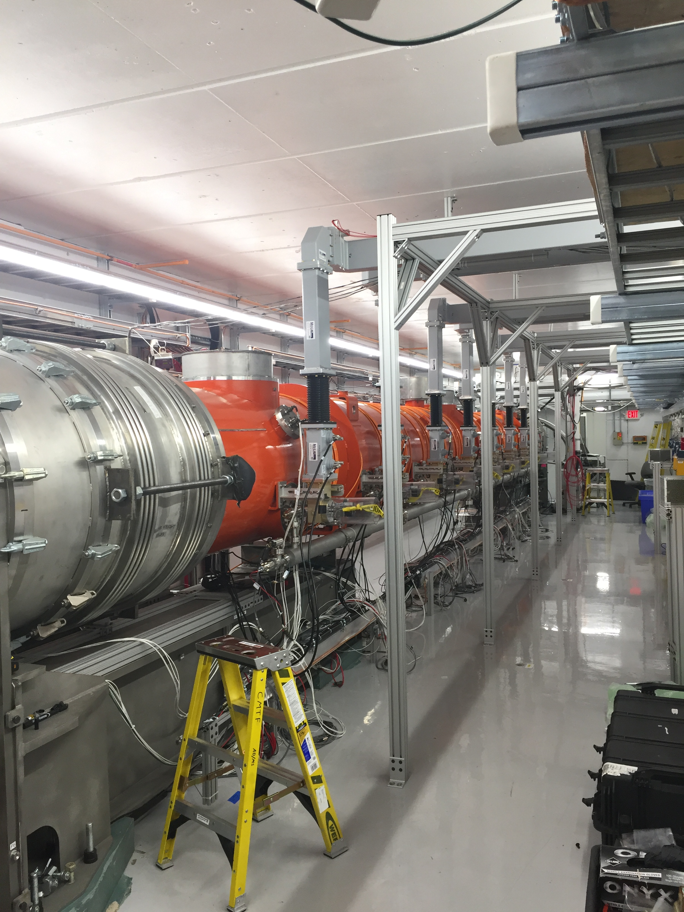
CMTS1 Status
LCLSII Prototype Cryo Module
  F1.3-02.
    Cooled down last week
    Cryomodule at 2K
    Power testing this week and next

Slide 10
Schedules and Links
Schedule can be accessed from the Operations Department Home Page
  Schedules -> Operations Schedule
Direct link to schedule
  http://www-ad.fnal.gov/ops/schedule.html

Slide 11














Collaborations / Partnerships / Members [22pt Bold]

