Slide 1
Accelerator Status Report
Friday
5-1-17

Slide 2
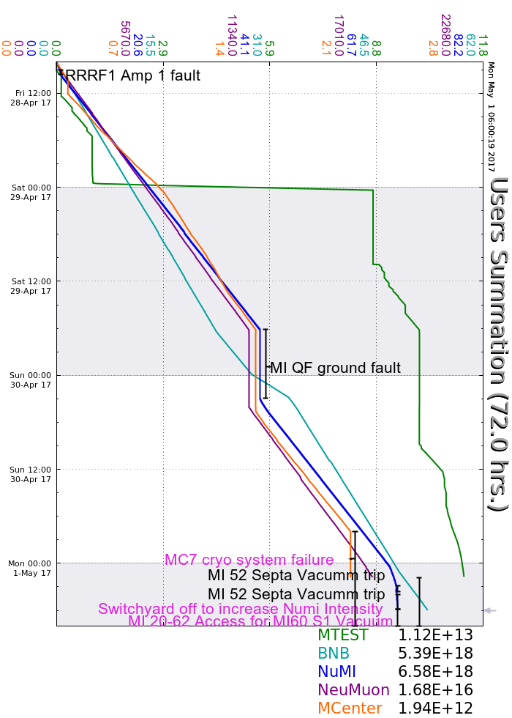
Friday Day
F2 manhole to check sump (Meson)
RRRF1 issues
Friday Evening – quiet
Saturday Owl - quiet
Saturday Day +
MIPS QF ground fault, ~15kΩ.
--somewhere between penetration &607.
--went away during isolation process
Sunday Owl+
Beam by 0300
Vacuum a little high at septa (delay swyd)
Access F2 manhole to hook up Grindex.
Sunday Day+
MC7 ODH alarm
--disable beam, fix today.
Monday Owl+
MI-52 vacuum problems
--go to BNB only.
MI20-62 access at 0700.
Weekend accelerator summary

