Slide 1
Main Injector/Recycler
D. Capista
Friday Operations Meeting
3 May 2017

Slide 2
NuMI Performance RR

Slide 3
SY120 Performance

Slide 4
RR Downtime
No data found

Slide 5
MI Downtime

Slide 6
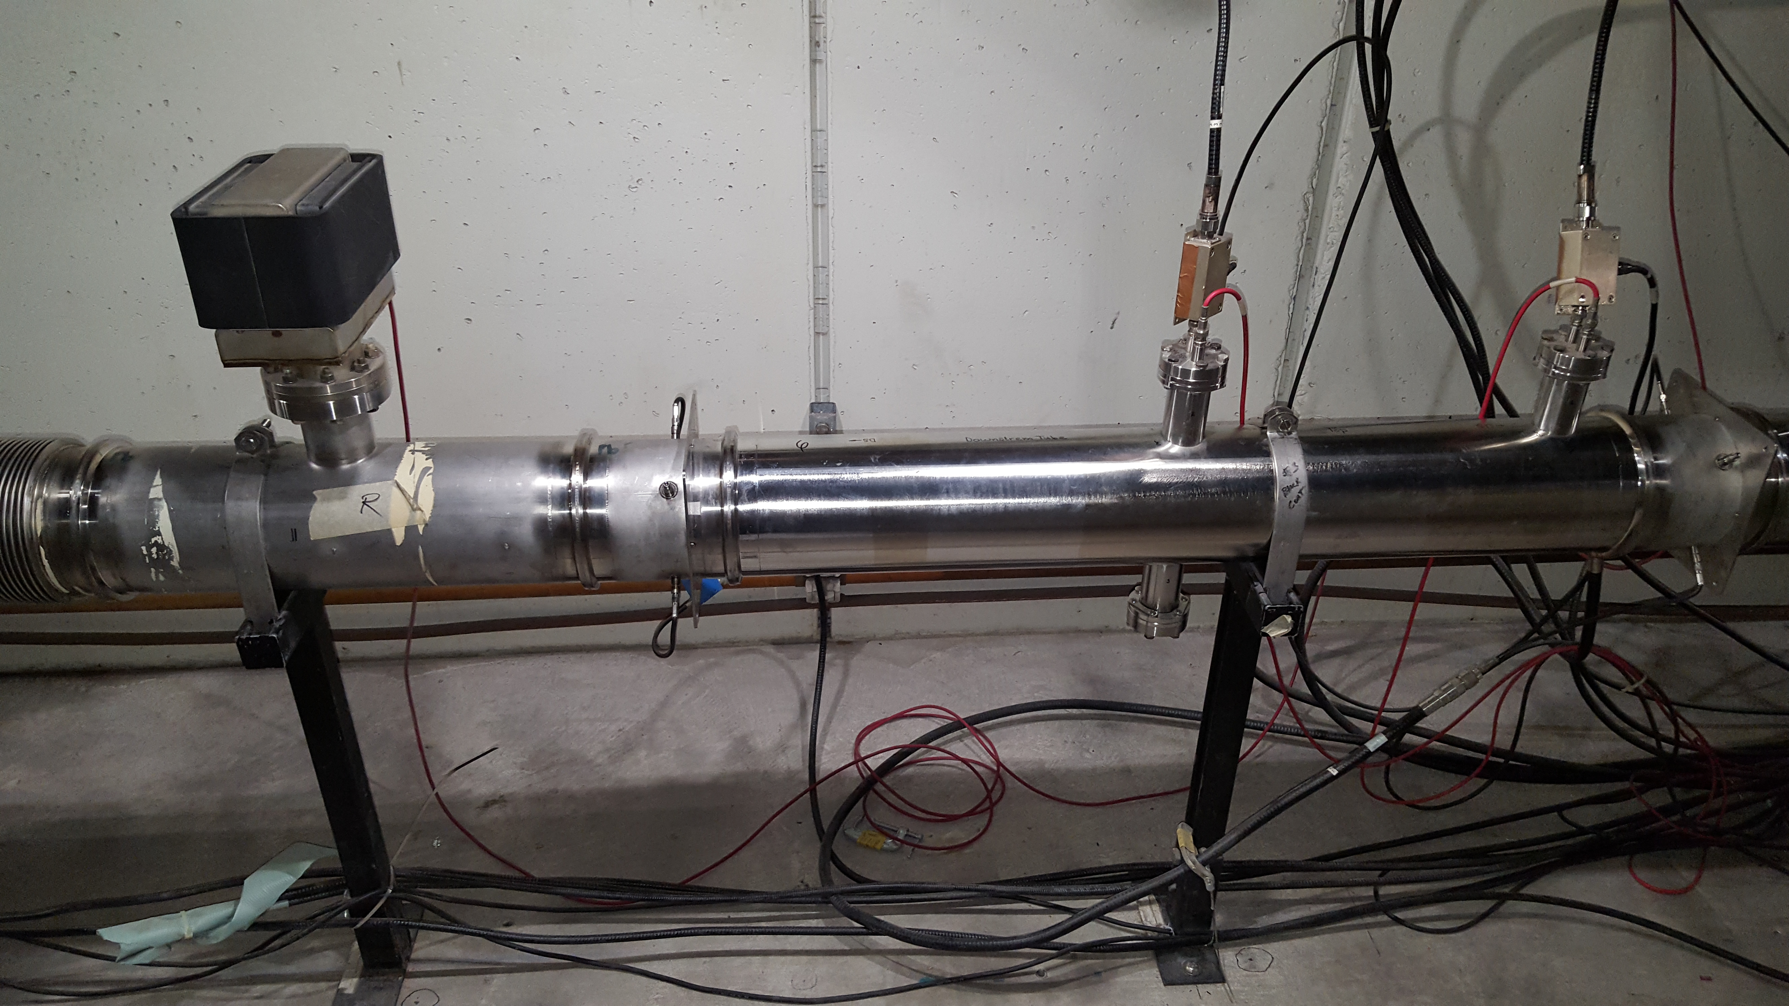
MI52 Vacuum
Last weeks access found a leak on a quick disconnect and we welded it shut
Current access found two additional leaks on quick disconnects so we welded all the quick disconnects shut (8 total)

Slide 7
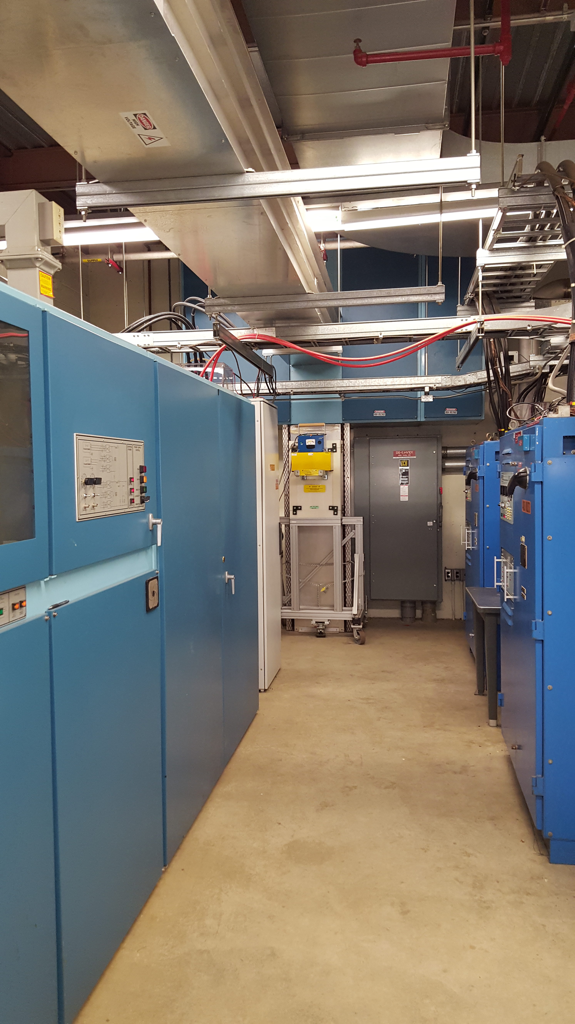
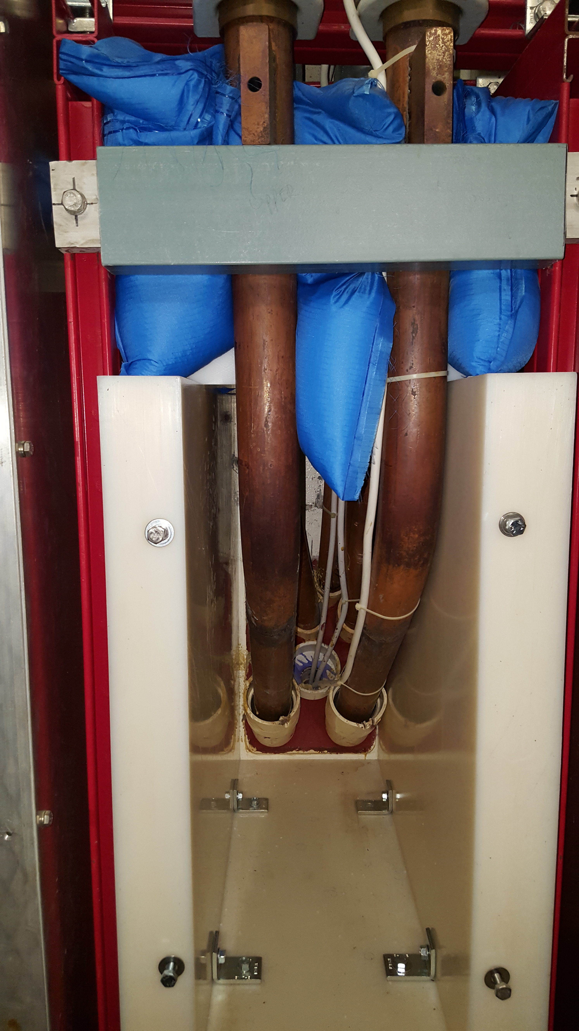
MI Ground Fault
Isolated between Q608 and the power supply at MI60N
Includes Q608, bus penetration, transductor box, mode resistor cable and bus coffin

