Slide 1
Monday 9:00
2017-05-08

Slide 2
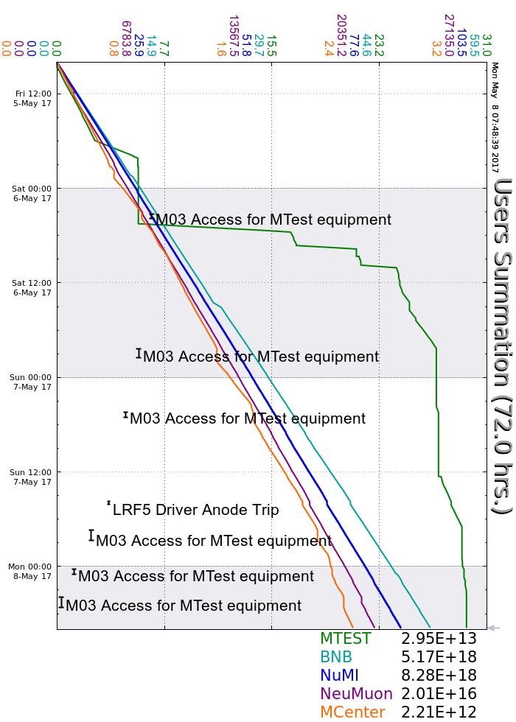
Friday
Smooth running
Throughout the weekend
M03 Accesses to install and remove experiment
Booster RF sparking
Source B sparking
Monitored CMTF Cryomodule
Saturday
R:LAM52 trip on PS internal overtemp
Sunday
R:LAM52 investigated, air filters cleaned
LRF5 Marx trip required local reset
Current Conditions
Beam to NuMI, BNB, SeaQuest, MTest and MCenter

