Slide 1
Technical Board Meeting, 10/5/2017

Slide 3
Joint TB-SB meeting (next week taken by the DUNE meeting)
Report by Yannis on follow up of beam-line simulations and beam instrumentation.
For the H4 line beam instrumentation there was a review in the same week of our Technical design review (see https://indico.cern.ch/event/617305/)
ProtoDUNE-DP Technical Design review final report distributed this Saturday (also on this Indico). Response to recommendations expected in a couple of weeks (see next slides on how to handle responses)
Follow up of Field Cage module zero results. Update by Jae on better measurements on the machining accuracy (internal consistency of the pattern of holes and slots)
The experience from modules zero is satisfactory and we can give green light on our side to the FC production readiness review → written document for Eric James in attachment on this Indico page, to be completed with the results of a last test to be performed tomorrow by Adamo
Update by Animesh on voltage divider boards

Slide 4
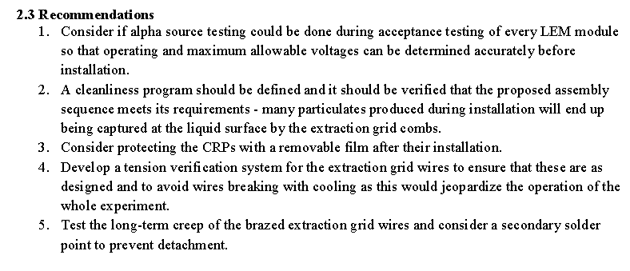
Technical Design Review committee recommendations
→ short replies to recommendations due in an excel file to Steve Kettel and Eric James in two weeks. Eric and Steve will keep track of the process, the Review Committee is over
Tentative assignment to formulate replies:
CRP, electronics, DAQ
Marco, Eddy, Sebastien
Adamo, Sebastien
Dominique, Benjamin
Dominique, Benjamin
Dominique, Benjamin

Slide 5
Photon Detection System, Slow Control
Adamo, Ines
Ines, Thorsten
Adamo , Ines
Note: the PMT attachment with cryogenic glue was already considered in our design
Laura
Laura
Adamo, Laura
Laura, Franco
Franco, Yann
(already discussed in preliminary grounding document provided to committee)

Slide 6
Planning:
1) Discuss the replies to recommendations with the listed people within next week and fill the excel document (template on this INDICO page)
2) Endorse the final content of the excel document at the next TB, after the DUNE GM
In parallel, as stressed by the committee (not in the formal list of recommendations) for the safety aspects we need to provide the documentation to the CERN safety (Sebastien, Dominique)

