Slide 1
H2 Beam status
Yannis Karyotakis
10 May 2017

Slide 2
Main activities
Understudying and shielding background.
Long simulation process, identifying the origin, shield, start over
Version -1 numbers in KHz
The detector vertical position is critical for the muon halo
Implementation of the H4 Beam line in the same geometry as H2. Estimate the H4 induced background to H2 when running simultaneously
Latest simulation version available this week. New ‘final’ simulation data for all energies next week

Slide 3
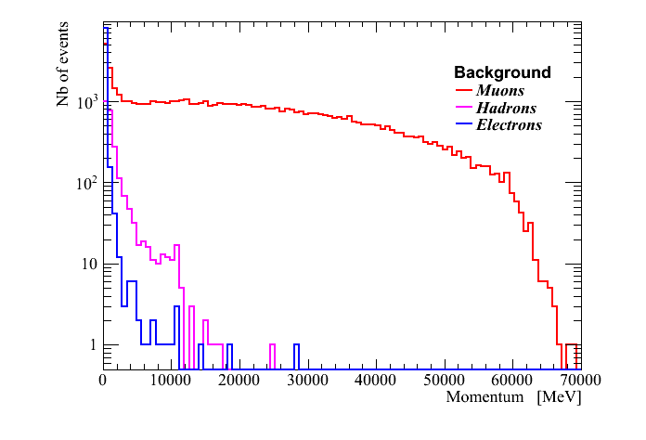
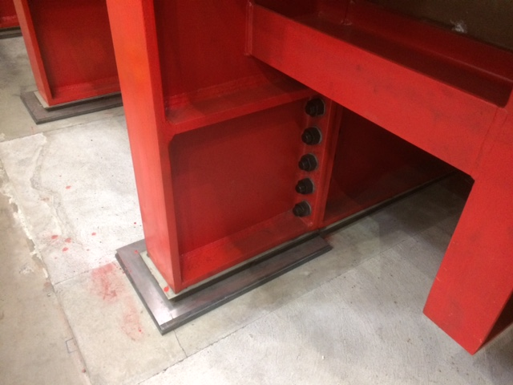

Slide 4
Hardware status
Beam profile fiber detectors
First 2-3 prototypes available in October for beam profile monitors and trigger counters. Same fibers but different read-out scheme (SiPMs and PMs)
Two high pressure Cherenkovs will be available by April 2018. Two possible gases, CO₂ or R134a
Beam Data : Profile monitors and Cherenkovs will be handled by CERN and tagged with WR. We must extract them from CERN DB
TOF, 2 options
SiPM read-out, expect <1ns resolution. Probably DAQ problems and compatibility with WR
Use the trigger counters and electronics + WR TDC. Expect 1.5-2 ns resolution
Data handling is OUR responsibility

Slide 5
Tests foreseen
TOF(b) with LEDs ASAP. All material in hands, measure resolution
TOF(b) + profile monitors + WR + DAQ at T9 PS, October – November
Manpower issues
DAQ person to handle beam data.
Retrieve CERN beam data and store them on our side
Read WR TOF board and store data
Installation issues
Signals from CERN BI to our counting room
NIM crate to handle ‘raw’ signals (S1, S2, S3, Ch1, Ch2) and form the trigger
Dedicated PC for TOF + Beam Data retrieval

