Slide 1
Accelerator Division Status
Duane Newhart
All Experimenters’ Meeting/Lab Status Meeting
15 May 2017

Slide 2
Accelerator Operations Summary
From: May 08, 2017 (0000 hours)
To: May 15, 2017 (0000 hours)
Calendar Week # 19
NuMI Weekly Integrated Intensity 1.64 E19 protons
Beam Hours To NuMI 150.4 hours
BNB Weekly Integrated Intensity 1.15 E19 protons
Beam Hours To BNB 157.7 hours
NMuon Weekly Integrated Intensity 4.20 E16 protons
Beam Hours To NMuon 145.0 hours
MTest Weekly Integrated Intensity 2.09 E13 protons
Beam Hours To MTest 70.0 hours
MCenter Weekly Integrated Intensity 6.80 E12 protons
Beam Hours To MCenter 130.2 hours

Slide 3
NuMI Beam Power
635.6kW NuMI with SY => 700 KW NuMI only
1 hour beam power record: 715.88 kW (1/25/17 20:25 to 21:25)

Slide 4
NuMI Operation

Slide 5
BNB Operation

Slide 6
Complex Status
LINAC
Running well
Booster
Running well
MI/RR
MI52 vacuum
Plagued with vacuum issues again
NuMI
Focusing on staying above 641kW with Switchyard running
Booster Neutrino Beamline (BNB)
Running well
Switchyard
MTest, Mcenter, SeaQuest
Muon Campus Commissioning
8 GeV beam around the Delivery ring
Began On Target Operation late last week
3 GeV secondaries into the ring
General
Downtime
May 15th
ComEd Switch 2002 repair
Shutdown Planning
Preparing to adjust schedule

Slide 7
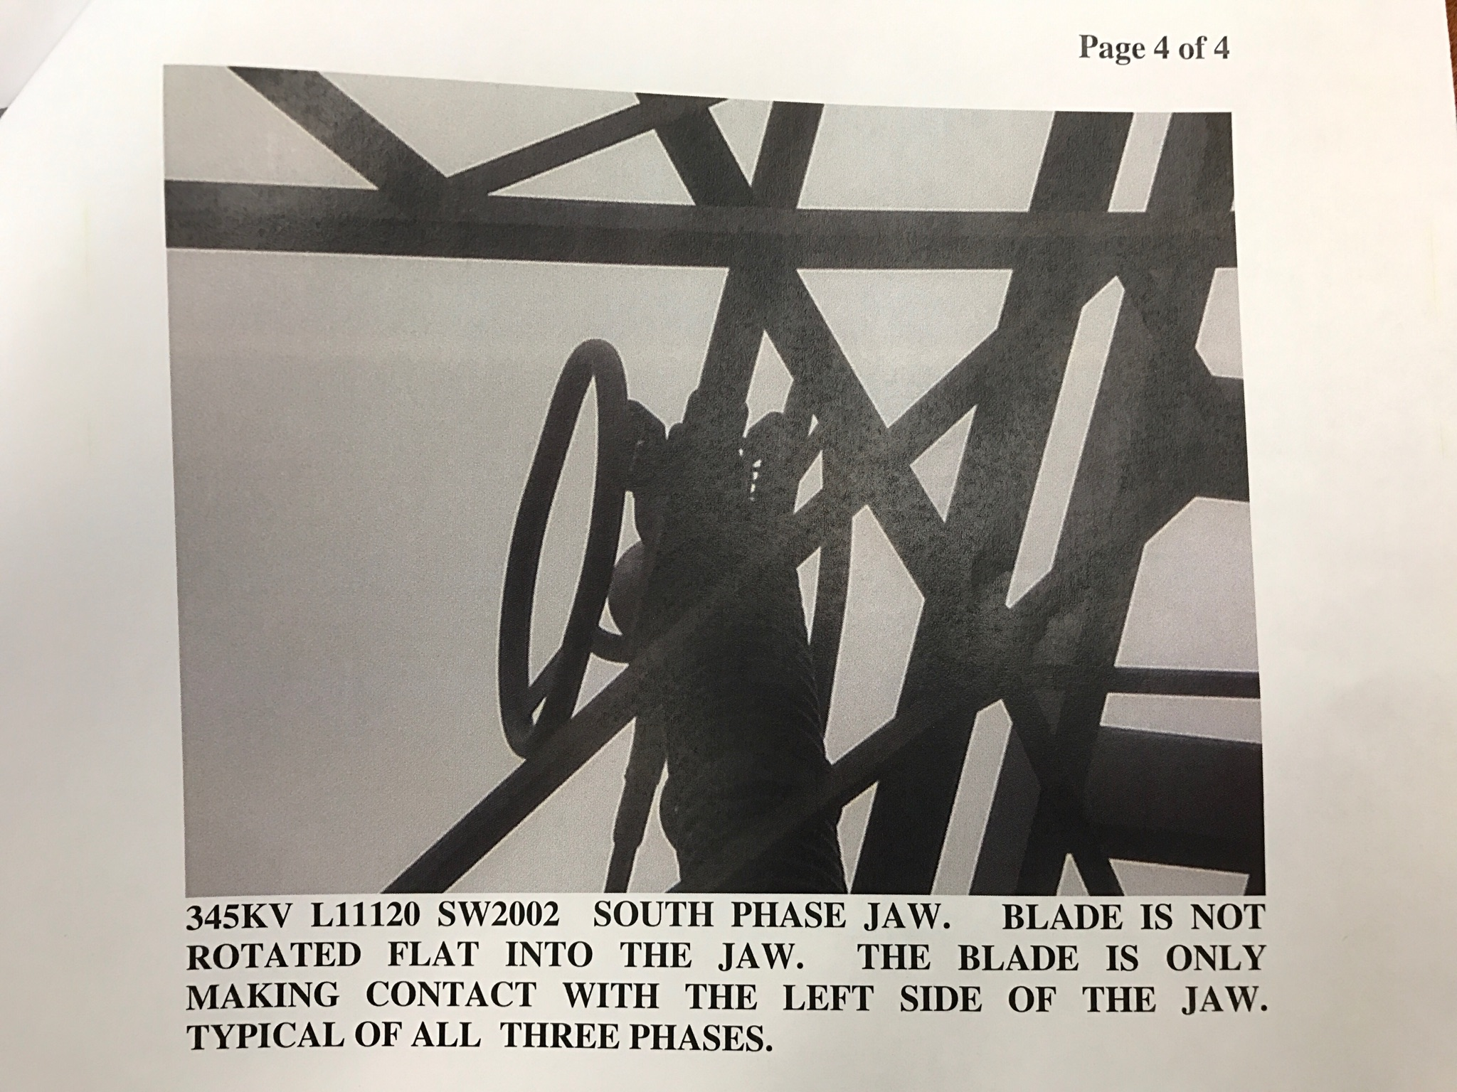
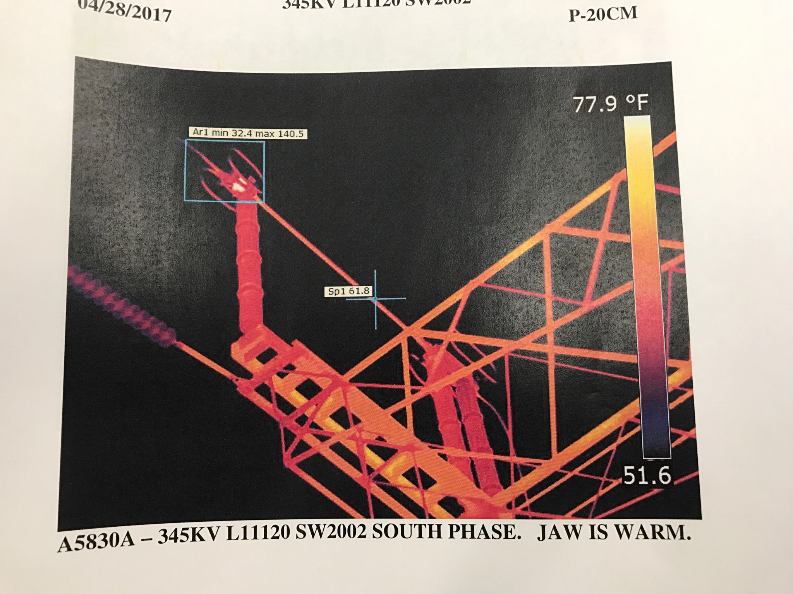
ComEd Switch 2002: 345kV feed to MSS
During thermal scans ComEd found that one phase of the switch is hot, about 200 F. Further investigation showed the contact for the hot phase is not seated properly an is only making contact with about 50% of the conductor. The risk of course is the contactor may fail either by continuing to overheat or just open.

Slide 8
Current Plan: Monday, May 15th
0600: Turn Accelerators/Controls/Cooling off.
0630-0700: Transfer Master Substation loads to Kautz Road Substation
30 minute outage for Master Substation loads
0700~1500: ComEd repairs/replaces switch
1630: CUB Cooling off, Controls down
1700-1730: Transfer Master Substation loads from Kautz Road Substation
30 minute outage for Master Substation loads
1800: Turn on begins
This scenario allows the switch to be repaired, and for the site to continue being fed from two 345kV lines, L11120 & L14419.
MSS powers the majority of the site!
KRS powers MI buildings and currently Feeder 46A (A0 Cryo Compressors)

Slide 9
MI-12 Communication Duct
Summary
Emergency Repair Plan In Place
Need 2 hour notification
Vendor has cable
New Communications Duct Plan
Communications duct installation
New duct installed
New fiber cable has been delivered
Electricians notified
Installation pending
Hope to move to new cable in March
Coordinate downtime with Master SubStation outages
Damaged on 10/24/16
Protected from further damage
Provides timing/date to Neutrino Experiments
Experiments running fine

Slide 10
PIP-II Injector Test & FAST Status
PIP-II Injector Test
Shutdown
Install full of MEBT
4th week of 6-10 week shutdown
FAST
300 MeV beamline construction continues:
300 MeV quadrupoles were valved into the LCW system.
2 quads had leaks on braze joints; mitigated the leaks.
The beamline is currently pumping down from 441 to 609.
The key cores were installed in the interlocked gates and doors.
The Cave will become ODH Class 1 this week.
Cave will go from Open Access to Supervised Access
Magnet checkouts should begin next week.
A newly purchased UHV rated sapphire window failed leak check.
The window is for a 300 MeV synchrotron radiation experiment so a smaller window was located our A0 inventory. It is going through leak check now.
The beamtube was connected from the 50 MeV line to the Cryomodule and aligned.
The remaining beamtube section left to install is the beryllium window spool piece at the high energy absorber.
The fast-acting valve test and installation will occur this week.

Slide 11
CMTS1 Status
LCLSII Prototype Cryo Module
F1.3-02.
Ran the entire cryomodule (8 cavities + magnet package) at nominal voltage (>128 MV) and current (20 A) for several hours with no issues.
Q0 was measured on each cavity.
LLRF and microphonics were studied.
Currently the cryoplant is off due to power outages.
It is expected to cool back down Tuesday,
resume operation as soon as practical, and complete testing by week's end.

Slide 12
Schedules and Links
Schedule can be accessed from the Operations Department Home Page
Schedules -> Operations Schedule
Direct link to schedule
http://www-ad.fnal.gov/ops/schedule.html

Slide 13
Collaborations / Partnerships / Members [22pt Bold]

