Slide 1
SLI Update

Slide 2
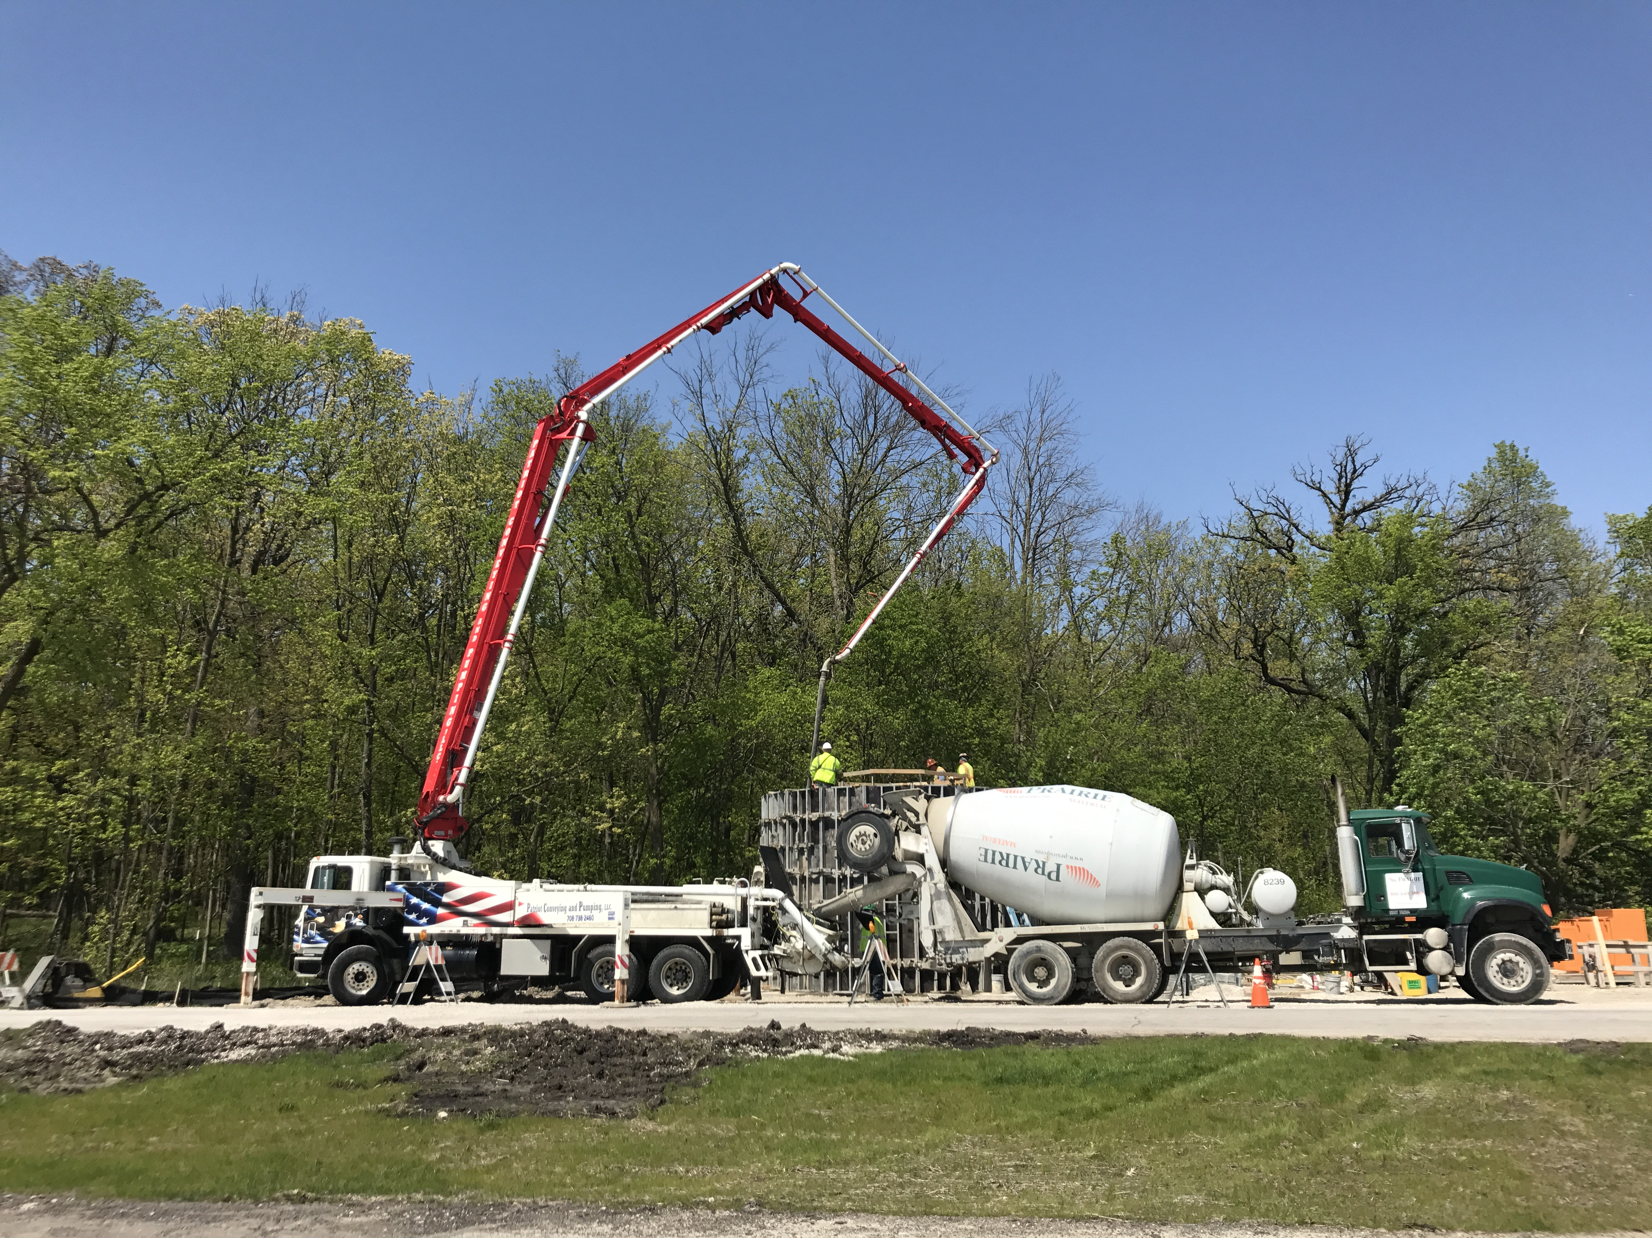
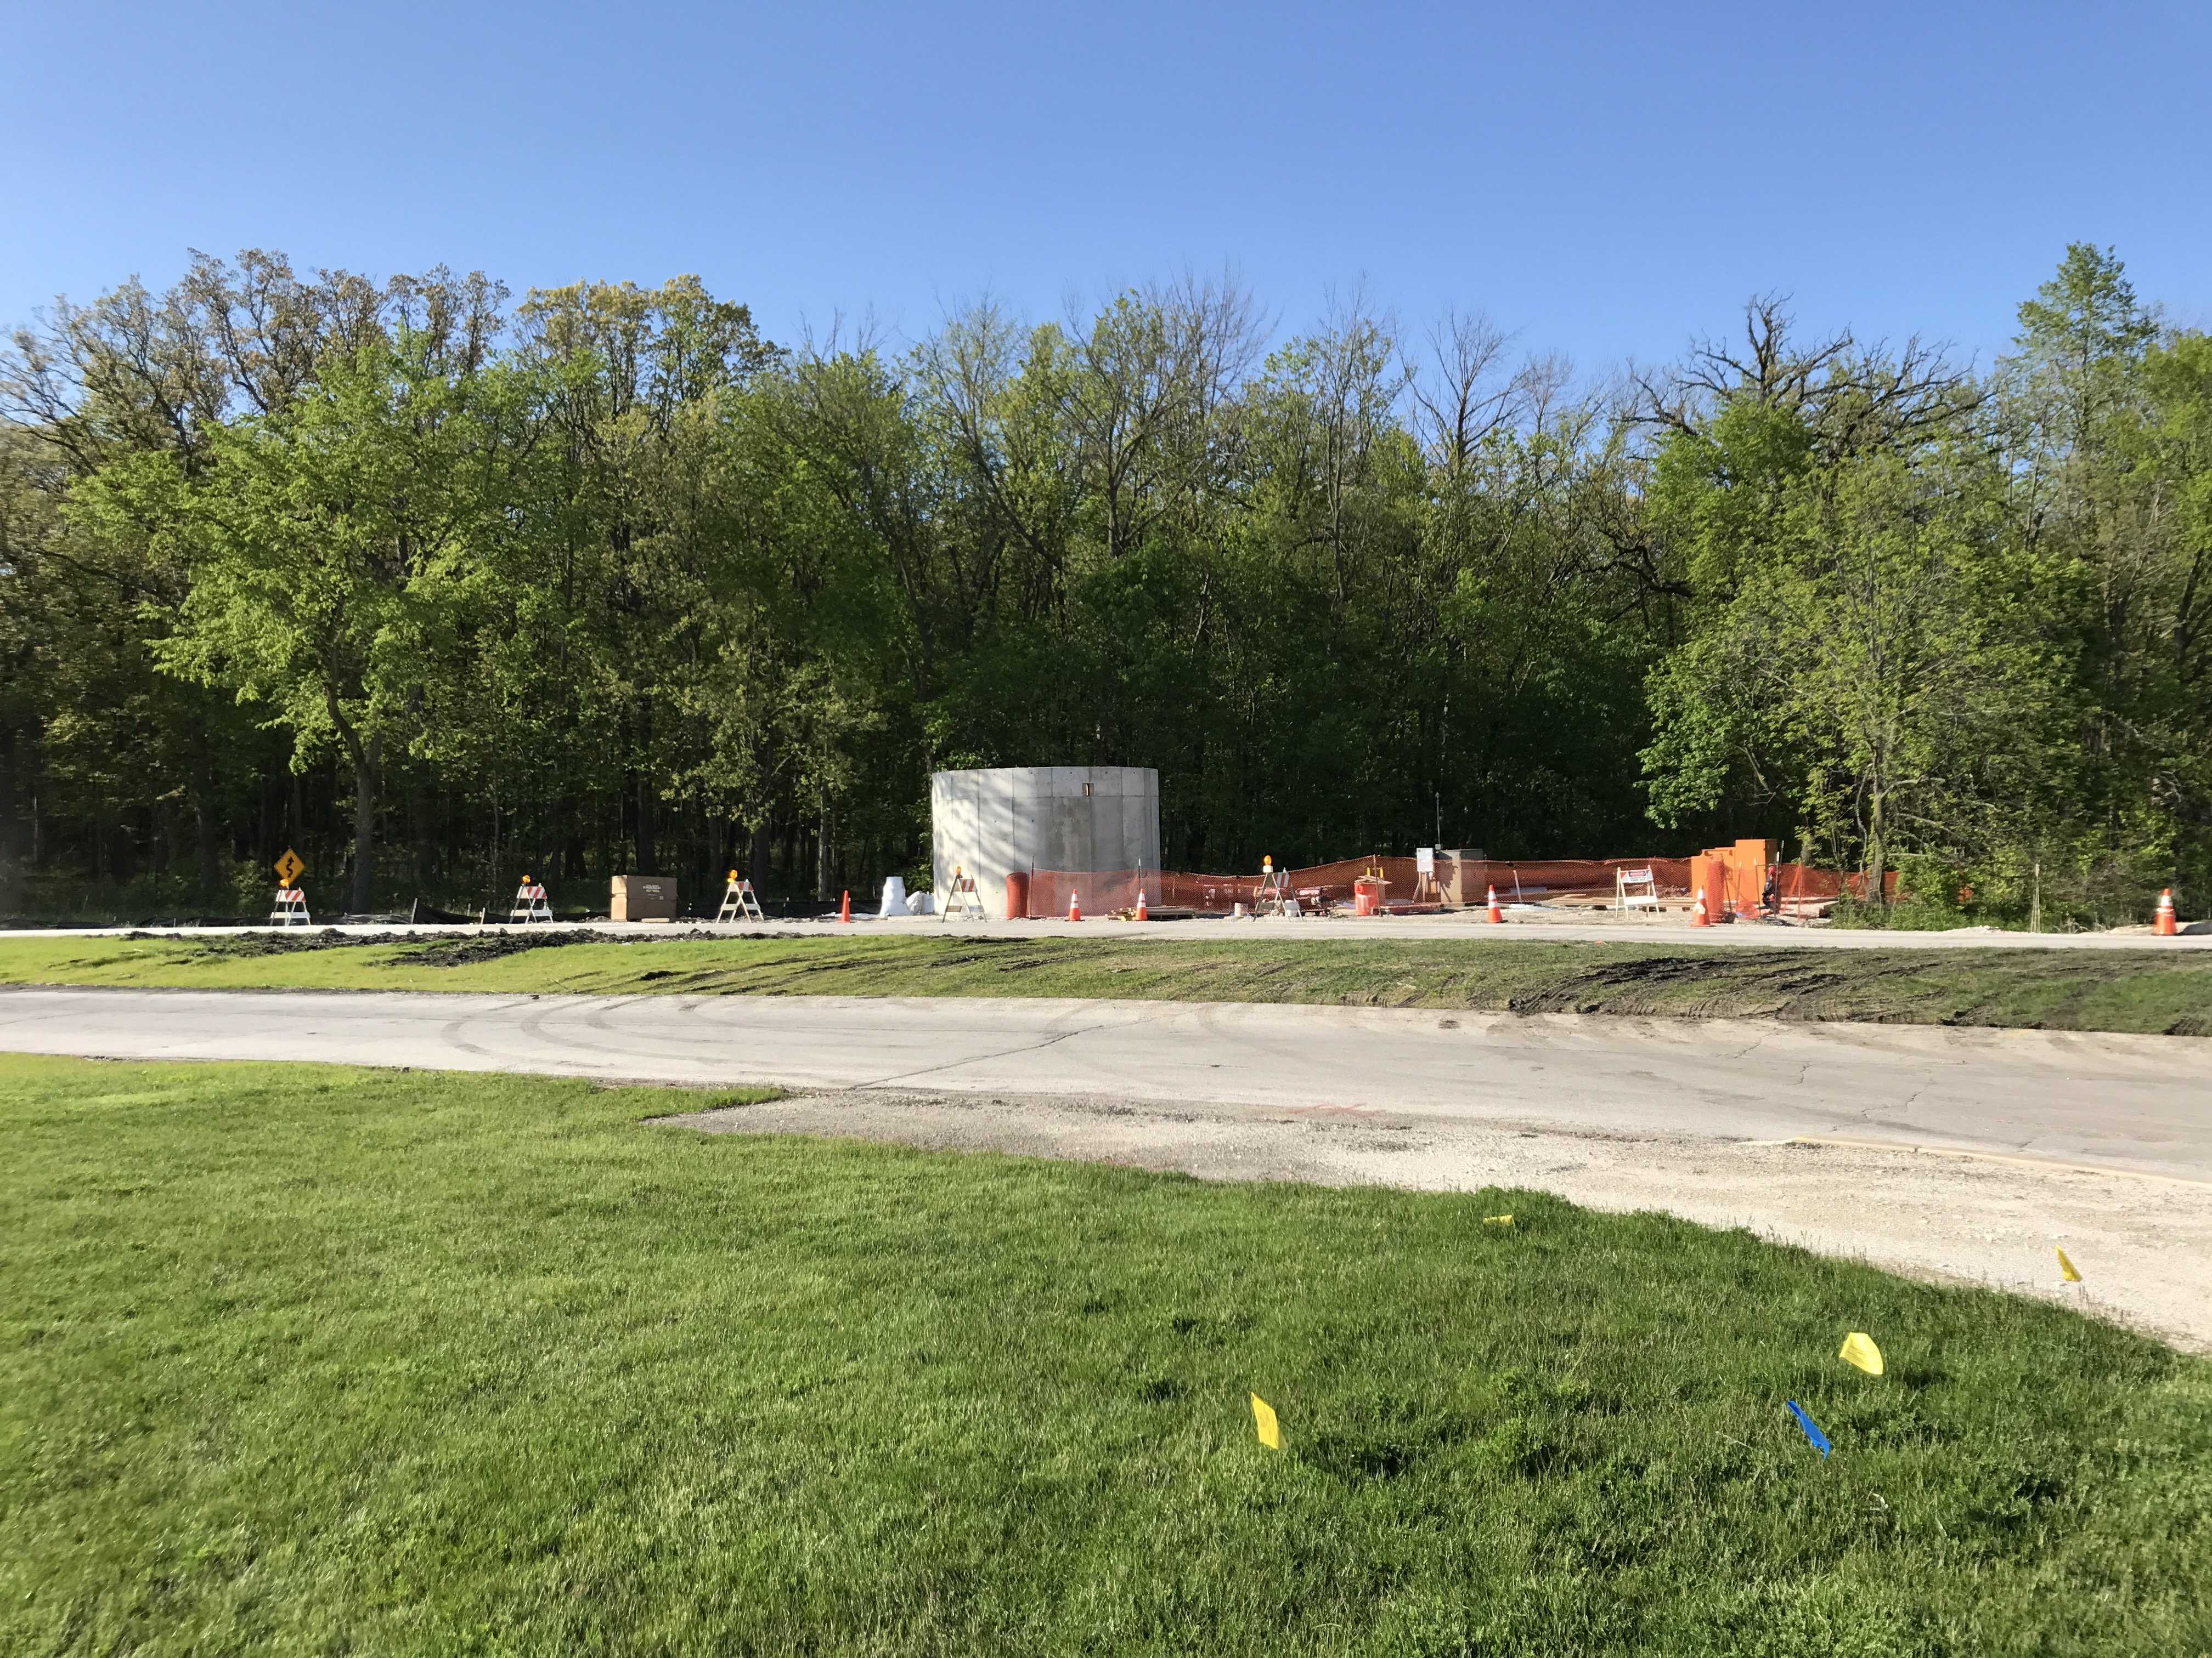
Swan Lake Pump House Construction Activities:
Concrete Placement of Swan Lake Pump House
Electrical Room Walls Electrical Room

Slide 3
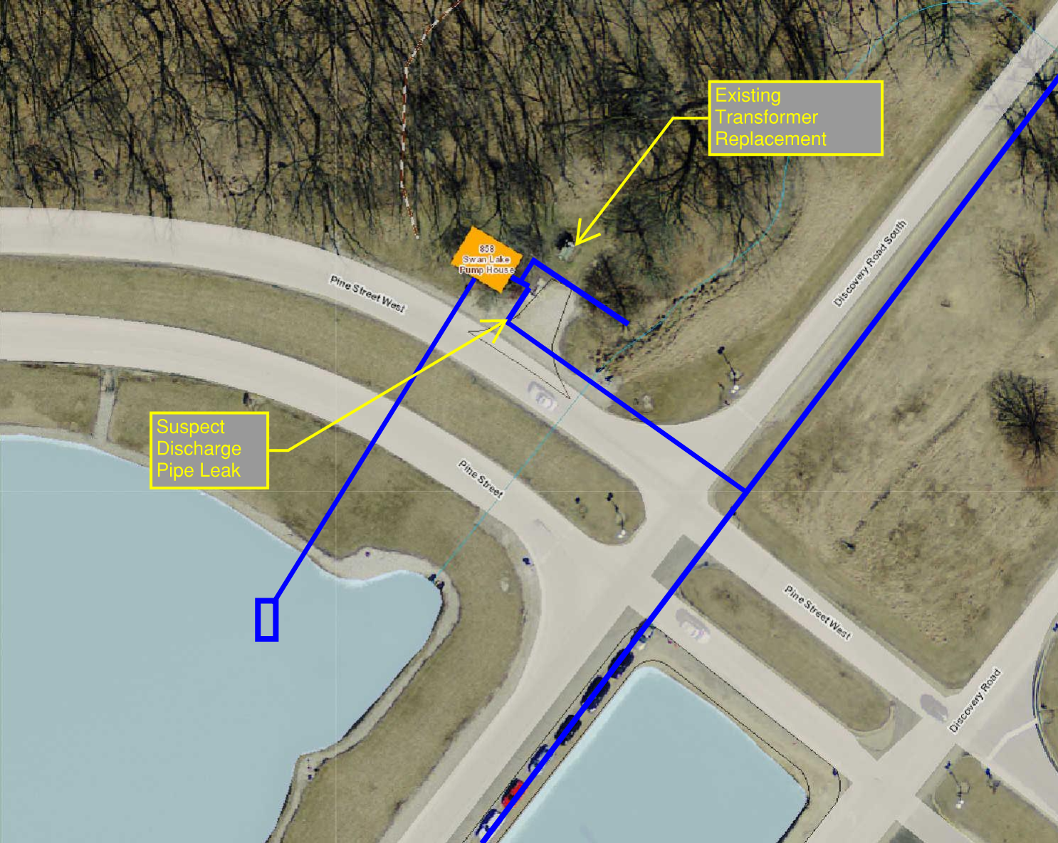
Swan Lake Pump House Construction Activities:
Lower Portion / Pump Room set : March 31
Upper Portion / Electrical Room concrete walls completed: May 8
Electrical Room interior finish to be complete: May 15
Electrical equipment to be set inside room: May18
Suspect Discharge Pipe leak repaired: May 19 - (Pine Street West Closing)
Steel Roof Deck & Monorail system inside Electrical Room complete: May 26

Slide 4
Installation of RCP culvert / Discovery Road Closing / May 16 & 17
Install new Reinforced Concrete Pipe culvert (RCP) across closed Discovery Road
Two Way Traffic – Discovery Road South
No Parking along Discovery Road South or Discovery Road
Stop Sign & Right Turn only at intersection of Pine street and Discovery Road South (Flagman at this location)
No U – Turn will be allowed at Discovery Road & Pine Street West

Slide 5
ICW Utilities Upgrade Project

Slide 6
ICW Reduction and Demolition Work at Casey’s Pond

Slide 7
Casey’s Pond

Slide 8
Casey’s Pond Archimedes Spiral joining new strainer Vaults

Slide 9
New VWS34 Strainer, 10,000 GPM @ 3psi drop

Slide 10
Casey’s Pond New and Improved West Strainer Vault

Slide 11
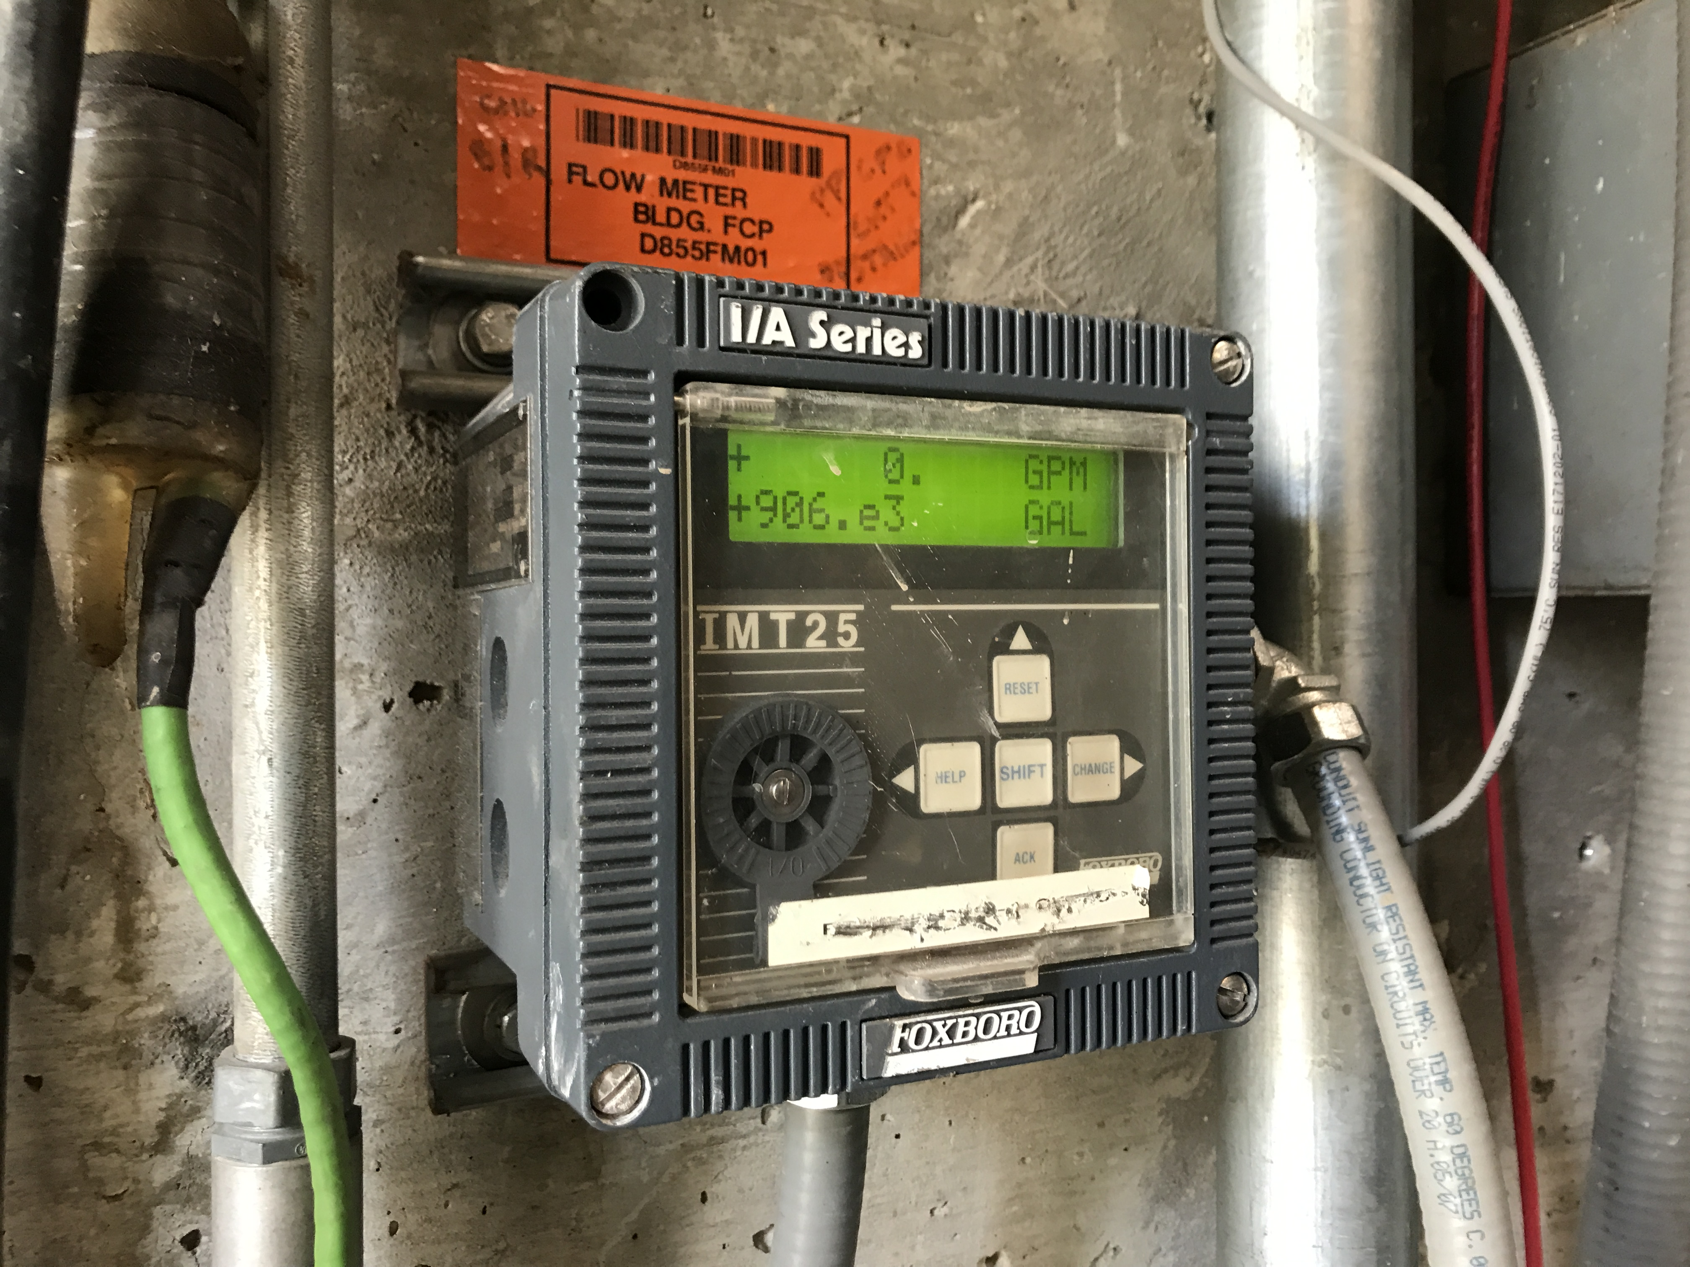

Slide 12
Andy’s Pond Pump House

Slide 13
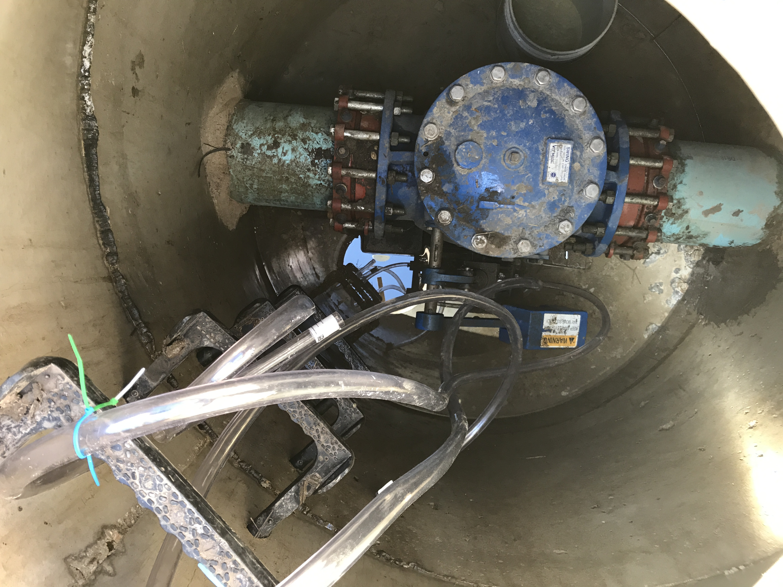

Slide 14
Andy’s Pond Pump Station CL17 Analyzers

Slide 15
Andy’s Pond/CMTF Pump Station Loop Check Valve

Slide 16
Swan Lake Pump Station

Slide 18
Swan Lake Pump Station Back-wash Discharge

Slide 19
Swan Lake Pump Station Revealed

Slide 21
Well 4 Pump Head

Slide 22
Well 4 Piping Connections

Slide 23
Well 4 Back Flow Preventer Pit Piping

Slide 24
Well 4 Backflow Preventer Pit Piping

Slide 25
A Scent of MINOS (MORGUL)
Foul Odor Investigation in MINOS Hall
MINOS Muck primary suspect
Backwashing of Line from MINOS to CUB done as prelim to treating the Sump
Marty Murphy, Lee Hammond, Steve Hahn on case
Something didn’t smell right, a new menace scented
Olfactory odyssey led to odorous observances
Fire Suppression System SRB’s were olfactometer offenders

Slide 26
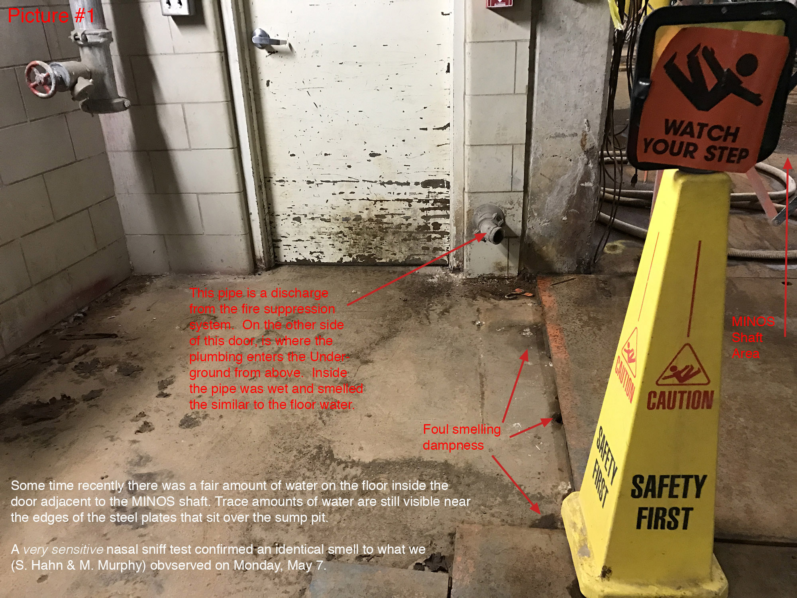

Slide 27
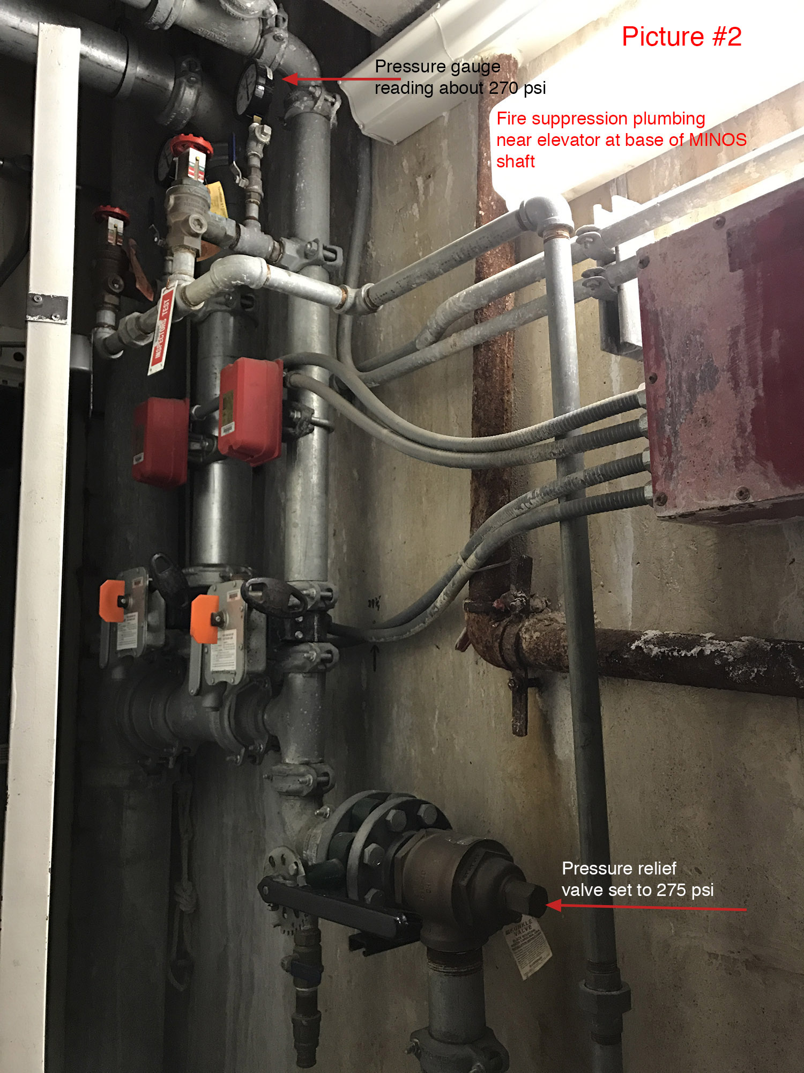

Slide 28
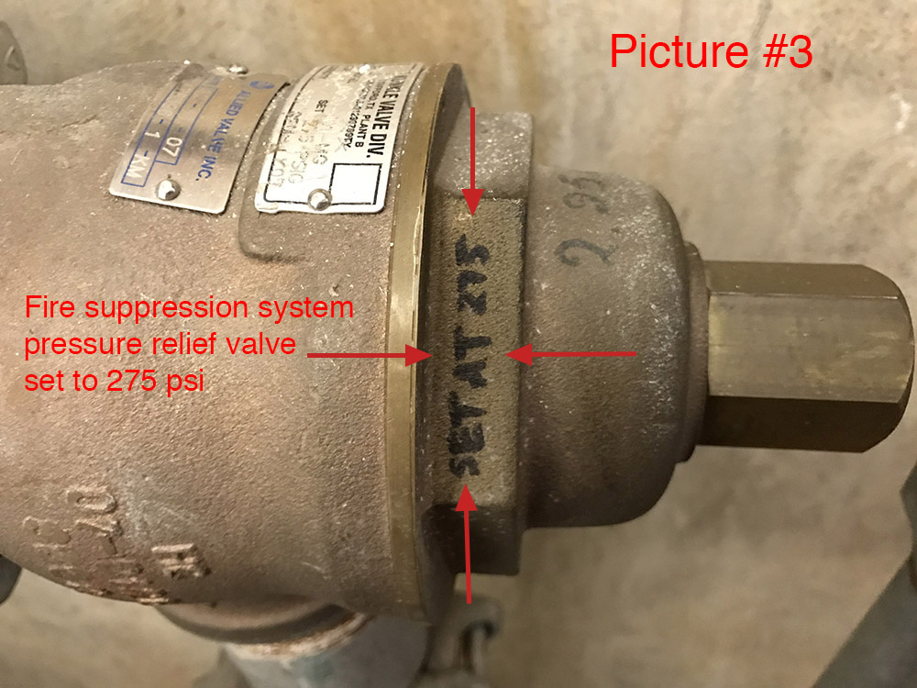

Slide 29
