Slide 1
Operations Summary
John Kuharik
09:00 Meeting
5/12/2017

Slide 2
48 Hours
Wednesday
MI20-62 access for MI52 septa vacuum issues.
Storm/lighting related electrical issues at BNB.
MTA cryo communication problem.
E:V118 back on Bulb regulator.
Ops made MI12 rad readings for Safety.
Thursday
Delivery Rings/Extraction enclosure interlocks dropped. Interlocks group repaired a problem with the box.
Network problems caused problems loading ACNET pages/devices for a few minutes.
Friday
Smooth running…

Slide 3
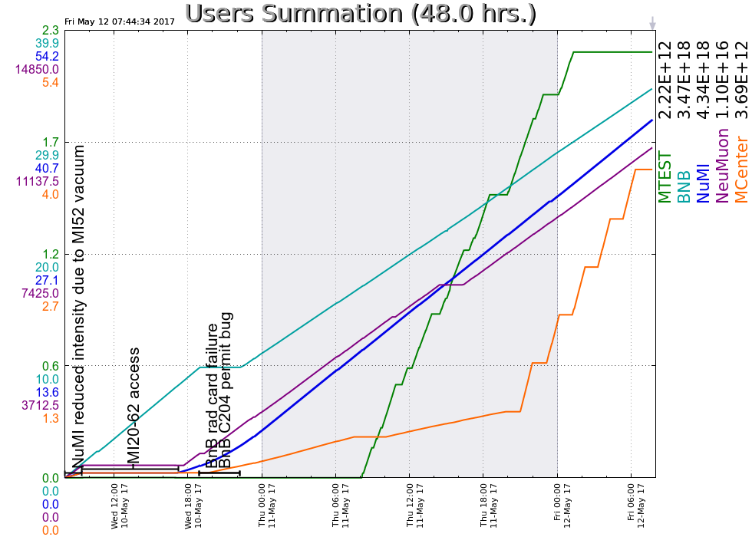
Beam Plot:
Current Status
Numi: 49.51 e12 p, 648kW
BNB: 7.1 e16 p/hr
NM: 5.1 e12 p
MC: 8.3 e8 p
MT: Establishing beam.

