Slide 1
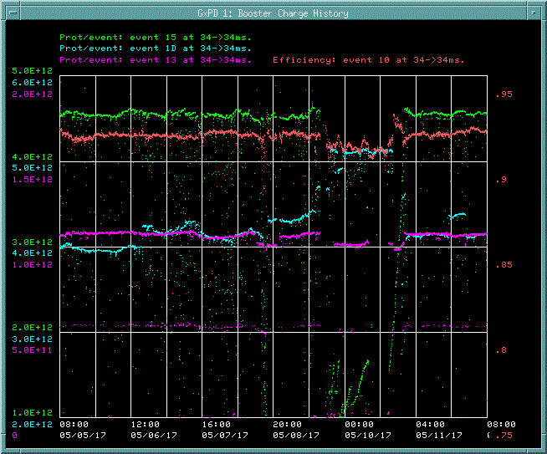
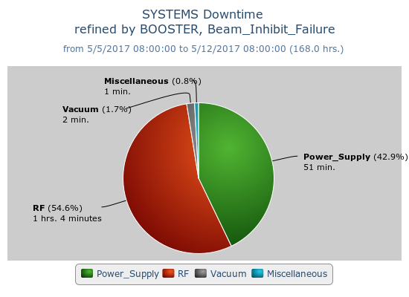
Booster Operations 05/5/17 – 05/12/17
MI 52 SEPTA
Intensity reduction
Downtime:
400MeV Chopper Off-tube 50 Resister fail
VME LLRF Card swap and new code loaded
Misc RF station sparking (suspect LLRF, new code fixed)
BRF04 Modulator replaced weak tube
Misc Beam quality issues.
Total~2hrs
This week:
Good week. 2.92E19 protons for week
Beam to BnB, NuMI, SY120 , Muon commissioning
Currently, $1D ~4.1c3E12 @92%, $15 ~ 4.5E12 @ 91.6%,
TLGBDF back to ~13.5Hz
Studies this week:
Booster energy acceptance
Booster Lattice Studies
Request:
Orbit/Lattice correction studies.
Synchrotron Freq. measurement Study(one-shot)
Booster energy acceptance (one-shot)

