Slide 1
Albert Einstein and the Modern Physics Revolution
Dr. Elliott S. McCrory
Saturday Morning Physics
Lecture number 2
October 7, 2017

Slide 2
Feedback
http://tinyurl.com/SMPFeedback-Fall17

Slide 3
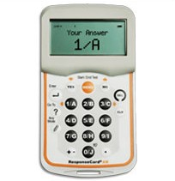
Use the clicker for multiple choice
Click a number on the key pad to wake it up
Select your answer
1
2

Slide 4
I am from Columbia. Which one?
Colombia, South America [49,365,000]
Columbia, West Virginia [16]
Columbia, South Carolina [134,000]
Columbia, Illinois [10,000]
Columbia, Mississippi [6000]
Columbia, Maryland [99,000]

Slide 5
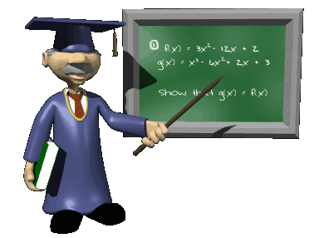
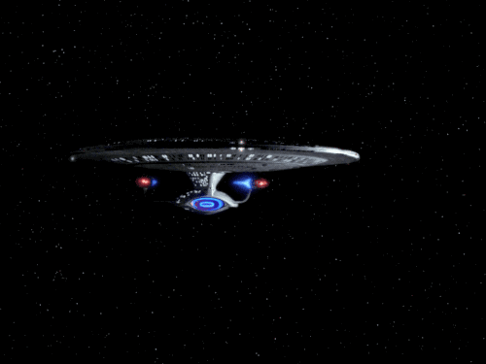
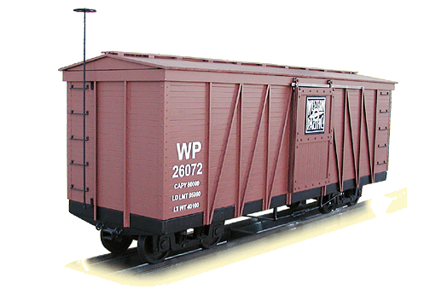
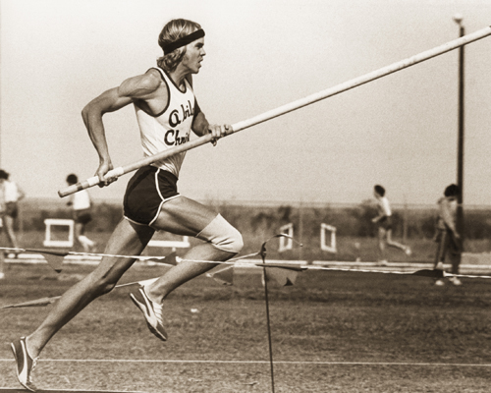
Concepts for today
Intuition
Transformations
Special Relativity
Simultaneity
If time allows
Mass equals energy
Spacetime
Utilizing
Clickers
The metric system
Algebra
Star Trek
Trains
Pole vaulters

Slide 6
Which of these math classes have you had?
Pre-algebra
Geometry
Algebra 1
Algebra 2
Pre-Calculus
Calculus

Slide 7
We will be using some algebra
But I’ll go slow
Scientific Method?

Slide 8
Think about this question …
Which is your favorite Star Trek TV series?
Original
Series
Next
Generation
Deep
Space 9
Voyager
Enterprise
Discovery

Slide 9
Prof. Dan Hooper
September 30, 2017
But what is “Science”?

Slide 10
Prof. Dan Hooper
September 30, 2017
Are There Alternatives to the Scientific Method?
Reliance on tradition or authority
This is something of a straw man opponent to science; few would argue that science conducted sufficiently fairly and carefully will often lead to conclusions that are likely to be false
Many instances of reliance on tradition are actually a weak form of reliance on social science – if many people held position X in the past, then this provides a limited degree of empirical evidence that holding position X is likely to be helpful or advantageous
Reliance on pure reasoning (mathematics, philosophy)
Many people think of mathematics as a part of science, but it is fundamentally not grounded in empiricism (a central part of the scientific method)
Although philosophers of science hold a range of opinions on this issue, my view is that math helps to illuminate the relationships between ideas and can help to clarify our thinking, but does not itself tell us anything about our world

Slide 11
Scientific Method
Includes:
Make Observations
Think of interesting Questions
Formulate hypotheses
Intuition

Slide 12
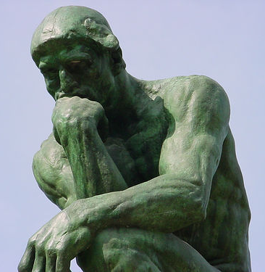
We are guided by our intuition
Must be careful!
Ptolemeic view of the “universe” based on beliefs and on intuition
Experience, observation and intuition are linked
Intuition grows as we gain experience and make observations

Slide 13
Counter-intuitive
But some things are …
Define?
Examples?

Slide 14
Modern Physics: Our intuition is incomplete
Much is, at first, counter-intuitive
We must develop new intuition

Slide 15
Relativity Terminology: A quantity is said to be
Invariant
If different observers would obtain the same result from a measurement of this quantity.
The mass of an object.
Relative
If different observers would obtain different result from a measurement of this quantity.
The speed of an object.
Why?

Slide 16
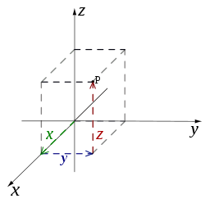
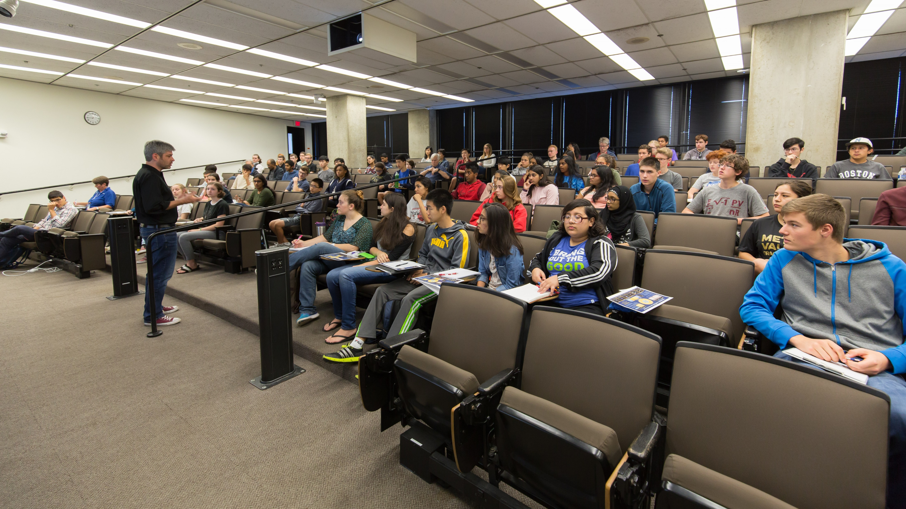
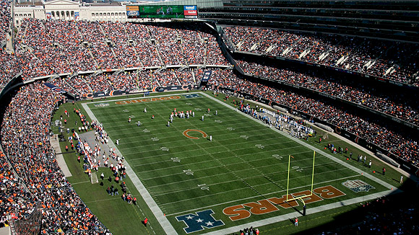
Terms: Frame of Reference
A coordinate system and some way to fix stuff into that coordinate system.
A football field
This room
y
z
x

Slide 17
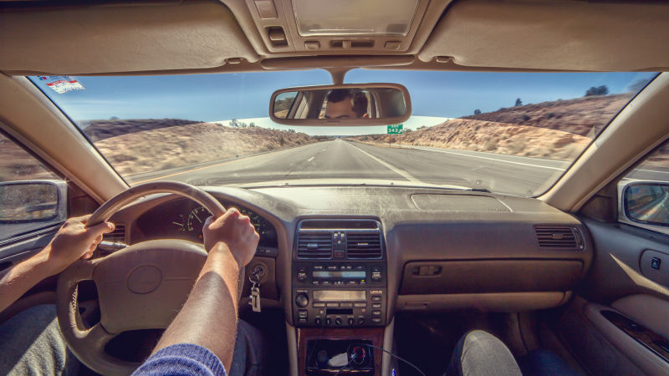
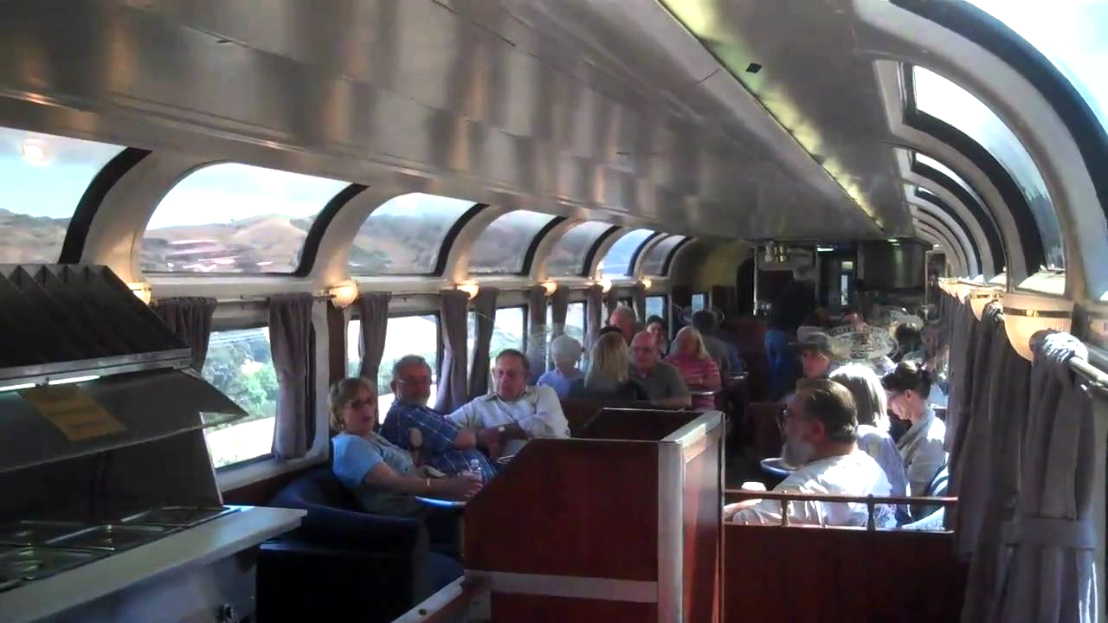
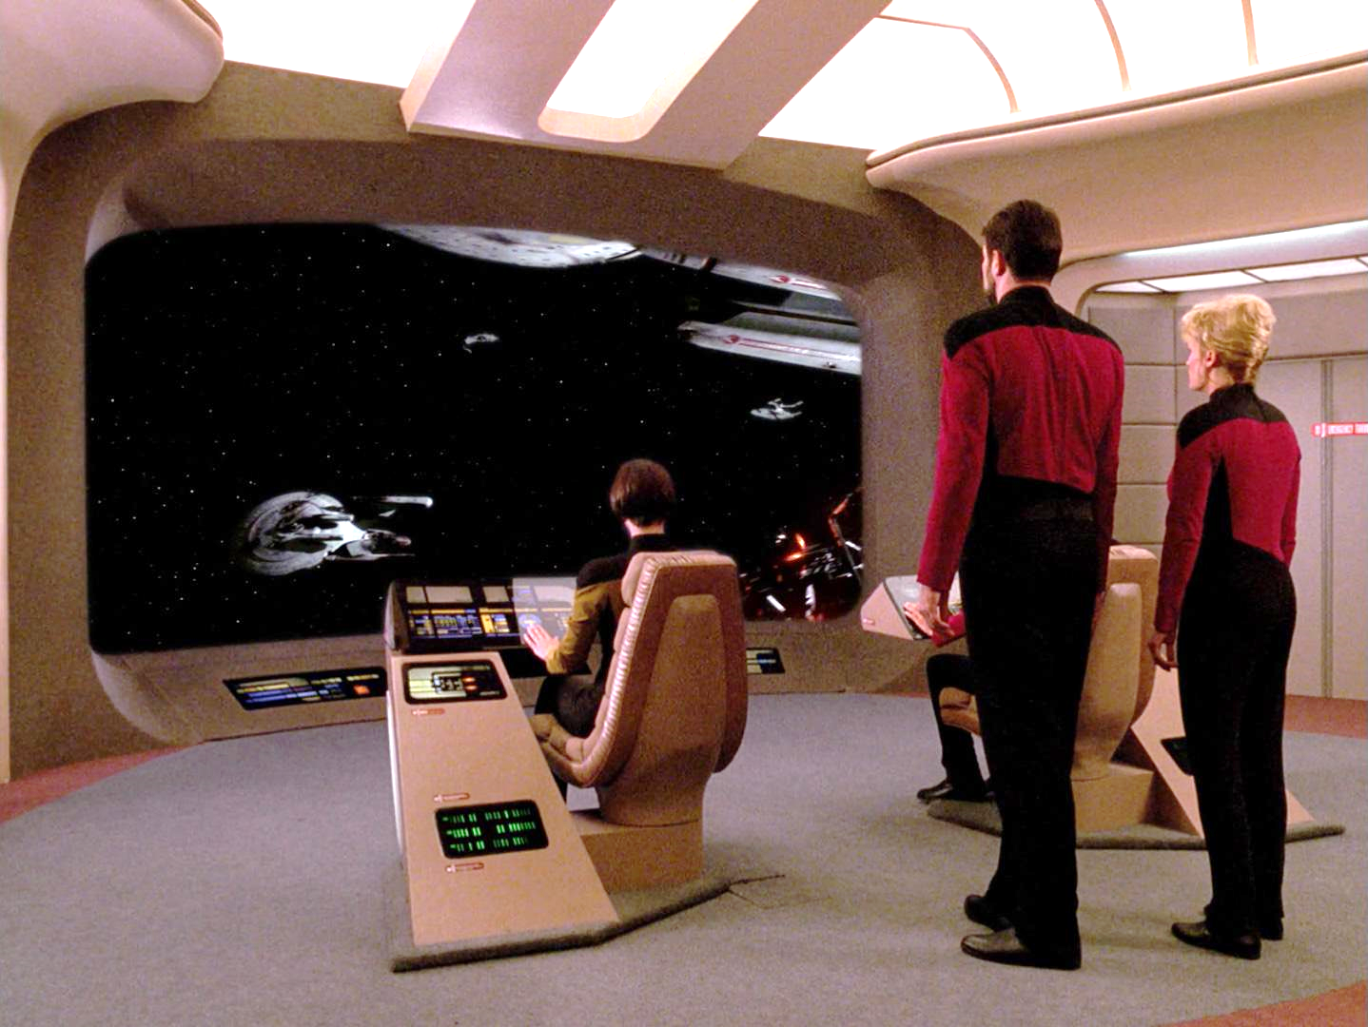
Terms: Inertial Frame of Reference
A frame of reference in which the stuff in it has no forces acting on them.
The stuff is at rest or it moves at a constant velocity in a straight line.
Examples:
The car that brought you here this morning, moving steadily
A train car moving steadily
The bridge of the Enterprise (maybe?)

Slide 18
Recap so far
Intuition
Scientific Method
Invariant
Relative
Frame of reference
Inertial frame of reference

Slide 19
v d t
What are these symbols?
ß
γ

Slide 20
Physics Velocity : v Distance : d Time : t
What are these symbols?
Greek letters Beta : ß
Gamma : γ

Slide 21
Frame of reference

Slide 22
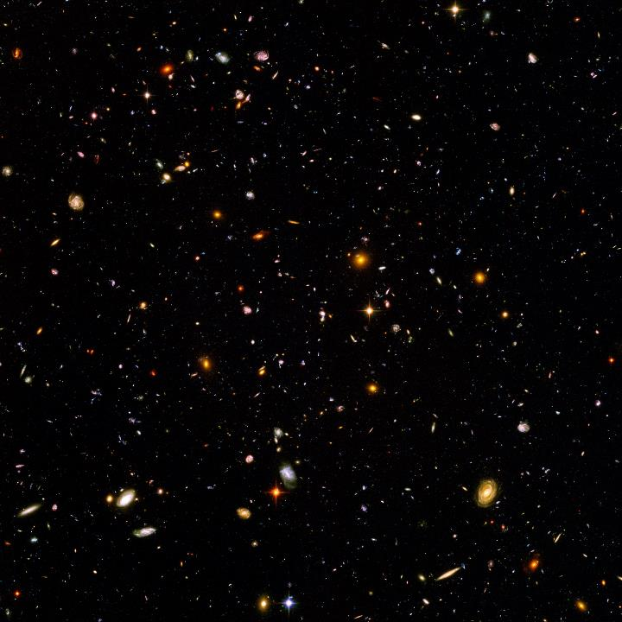
From the point of view of the tree
y
x
y
x

Slide 23
From the POV of the Thinker
y
y
x
x

Slide 24
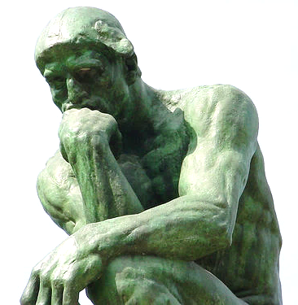
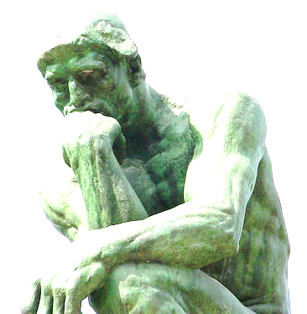
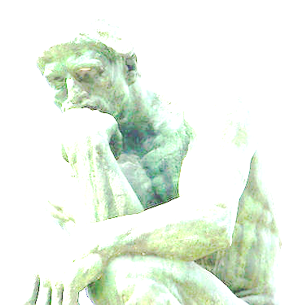
Another term: Coordinate Transformations
A regular transformation:
We call this the
“Galilean Transformation”

Slide 25
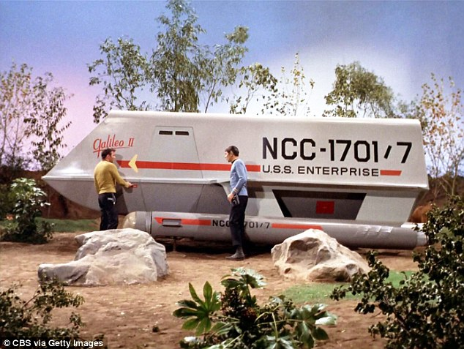
Galileo?

Slide 26
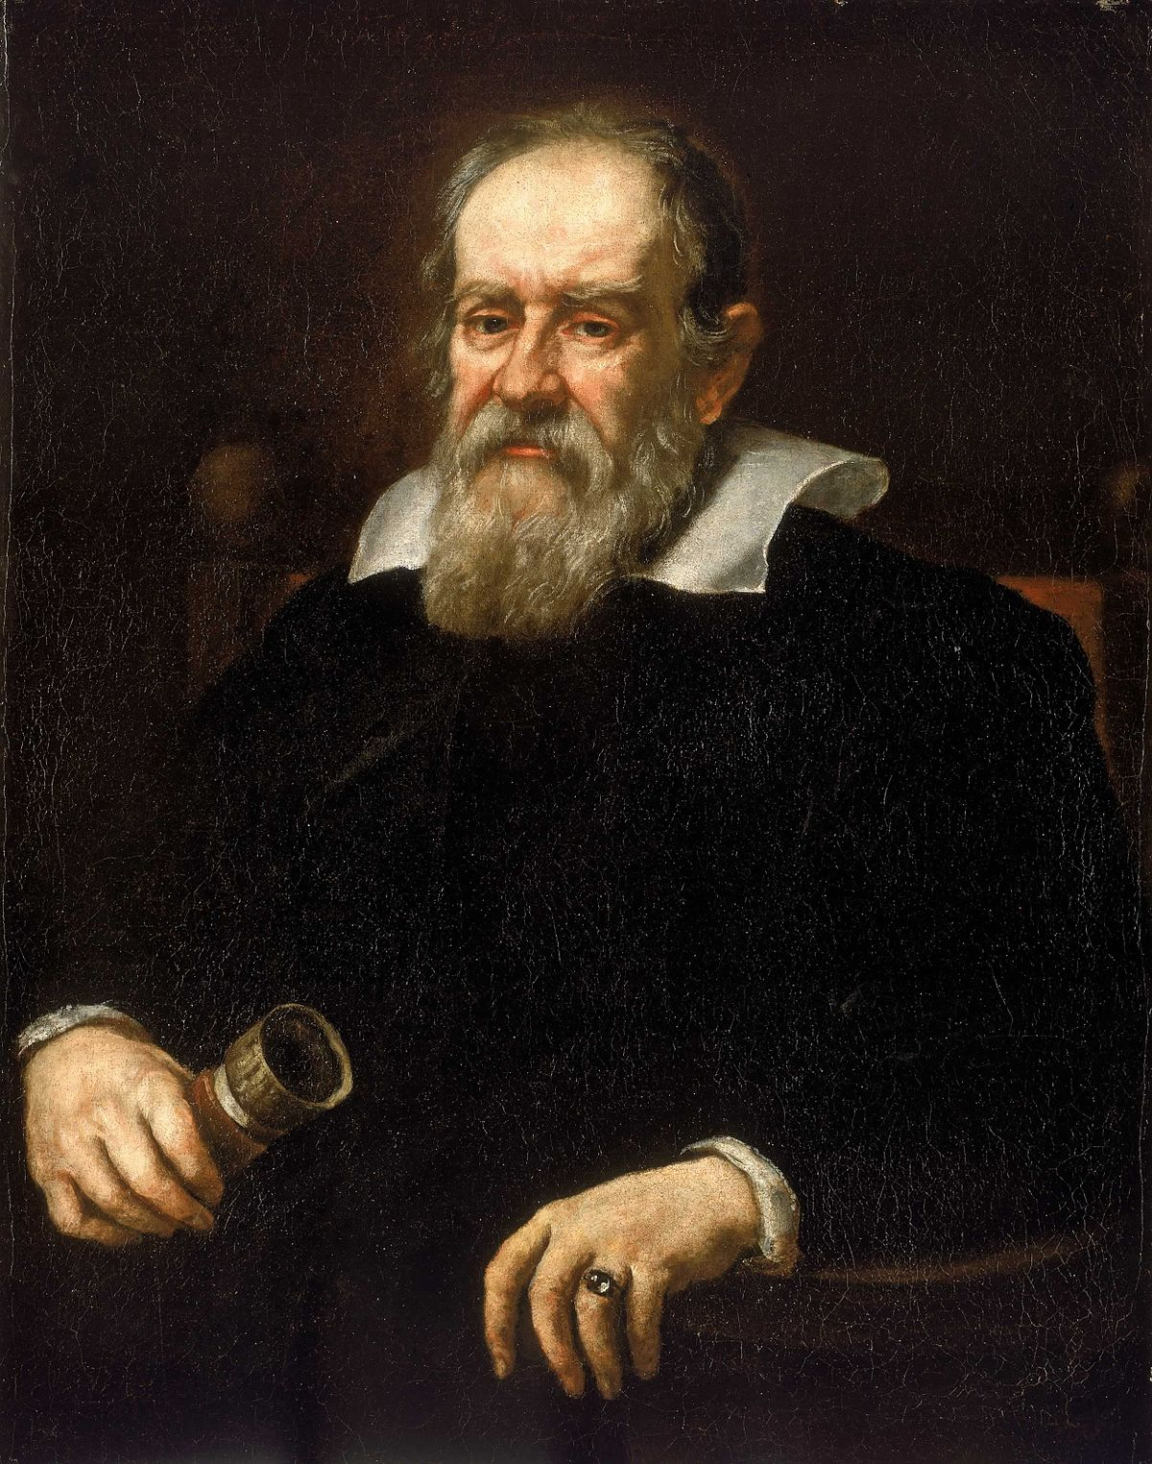
Galileo Galilei:
1564-1642
Italian astronomer
Physicist
Engineer
philosopher
mathematician.
He has been called
"father of observational astronomy",
"father of modern physics",
"father of the scientific method", and
"father of science".
Galileo studied speed and velocity, gravity and free fall, the principle of relativity, inertia, projectile motion and also worked in applied science and technology, describing the properties of pendulums and "hydrostatic balances", inventing the thermoscope and various military compasses, and using the telescope for scientific observations of celestial objects.

Slide 27
Example of a coordinate transformation
y₀
y
v = 5 [m/s]
t₀ = 10 [sec]
x₀ = 0
What is t?
t = t₀ = 10 [sec]
v
x_{o}
x
Answer under here

Slide 28
Use the clicker for numeric input
Click a number on the key pad to wake it up
Click on the pencil button
Enter your answer
For example, 3 . 1 4 1 5 9 2 6 5 3 5
Press the enter button
1
2
3
4

Slide 29
What is the value of x?
y₀
y
v = 5 [m/s]
t₀ = 10 [sec]
x₀ = 0
v
Rank | Responses
1 | 50
2 | 0
3 | 1
4 | 10
5 | 10.5
6 | Other
x_{o}
x

Slide 30
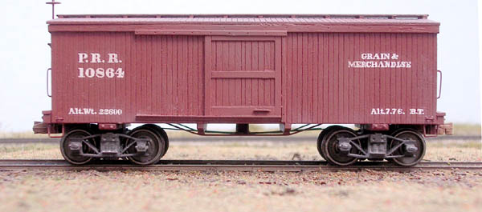
Coordinate Transformation Example: Shooting a ball from a moving train car

Slide 31
Coordinate Transformation Example: Shooting a ball from a moving train car
v_{ball} = -v_{train} = 70 MPH
What is the velocity of the ball
when it emerges from the train?

Slide 33
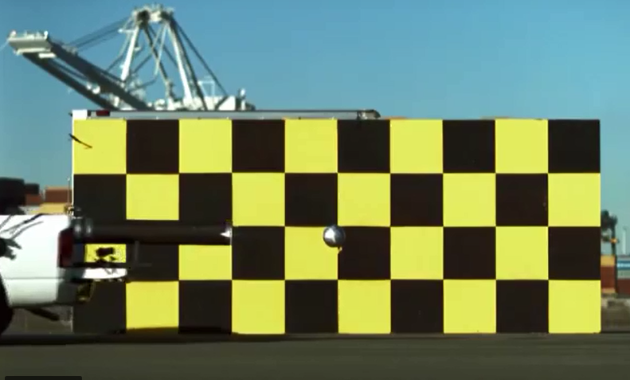
Recap: Frame of reference

Slide 34
Questions?

Slide 35
1905
The Year

Slide 36
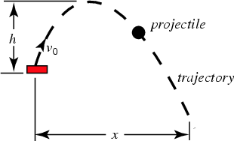
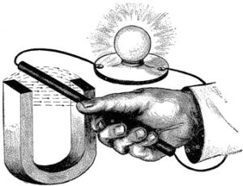
Physics into 1905: Many successes!
Newton’s laws of mechanics are known and are very accurate
The laws of electricity and magnetism were discovered and have been determined to be very accurate

Slide 37
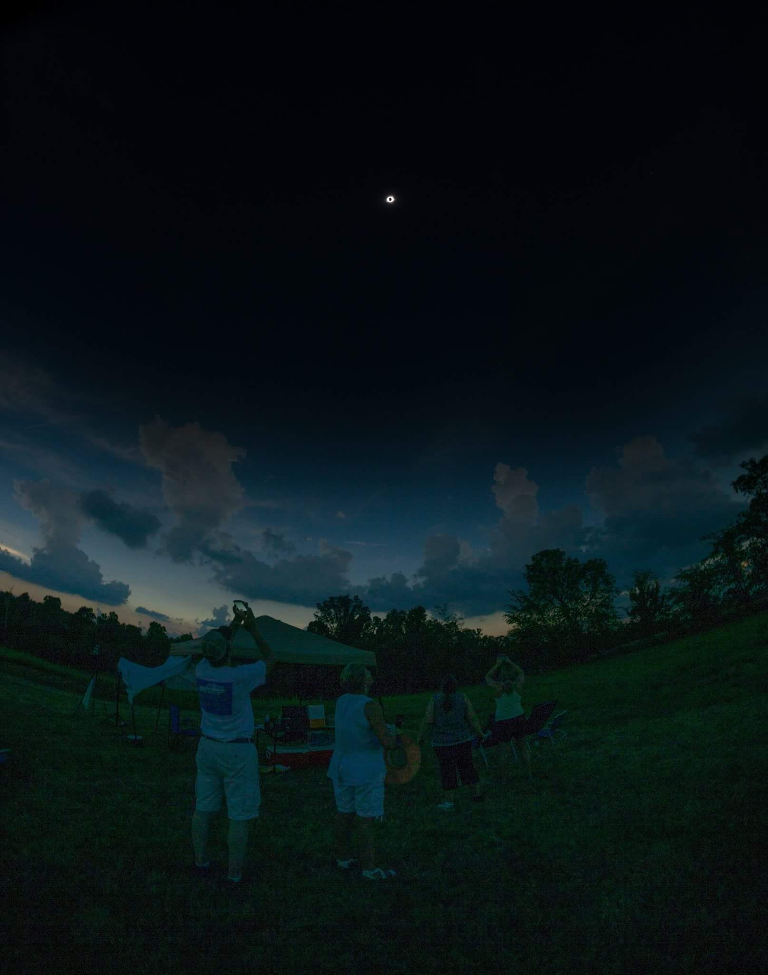
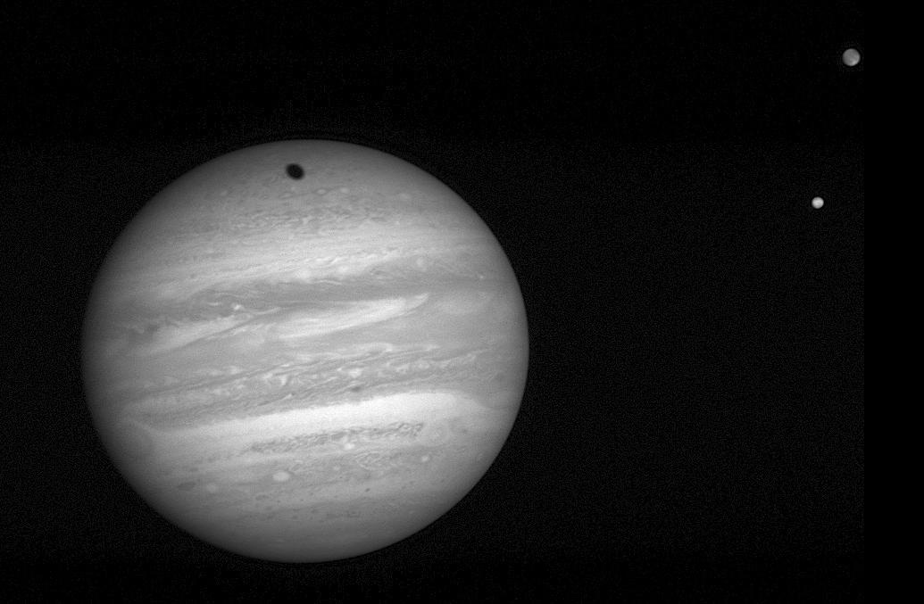
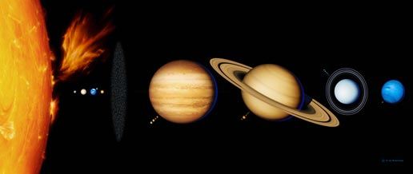
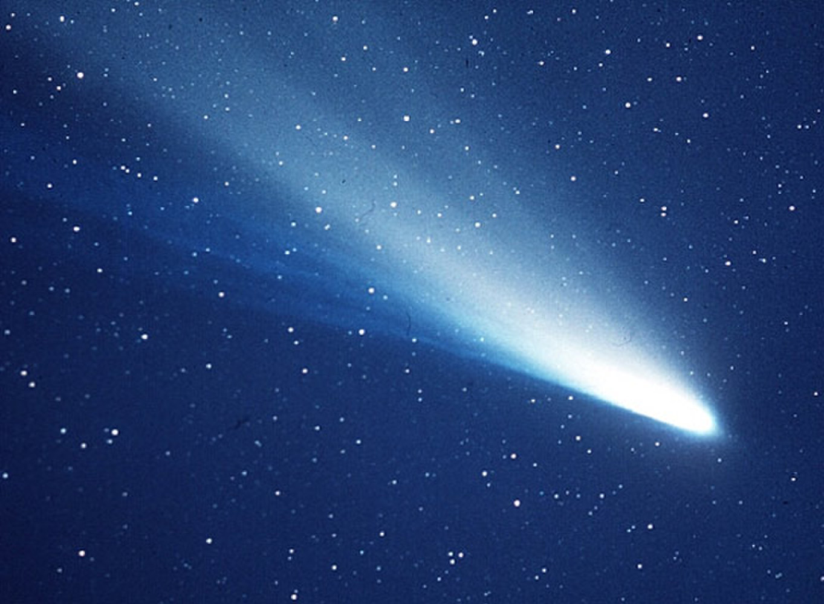
Physics into 1905: Many successes!
Newton’s laws of gravity are very accurate
Predicts orbits of the planets and their moons
Predicts appearance of comets
Predicts eclipses

Slide 38
But ..
There are a few loose ends to tidy up.
A big one is contained within
Maxwell’s Equations of Electricity and Magnetism

Slide 39
Electricity and magnetism: Maxwell’s Equations
A quick dip into the world of …

Slide 40
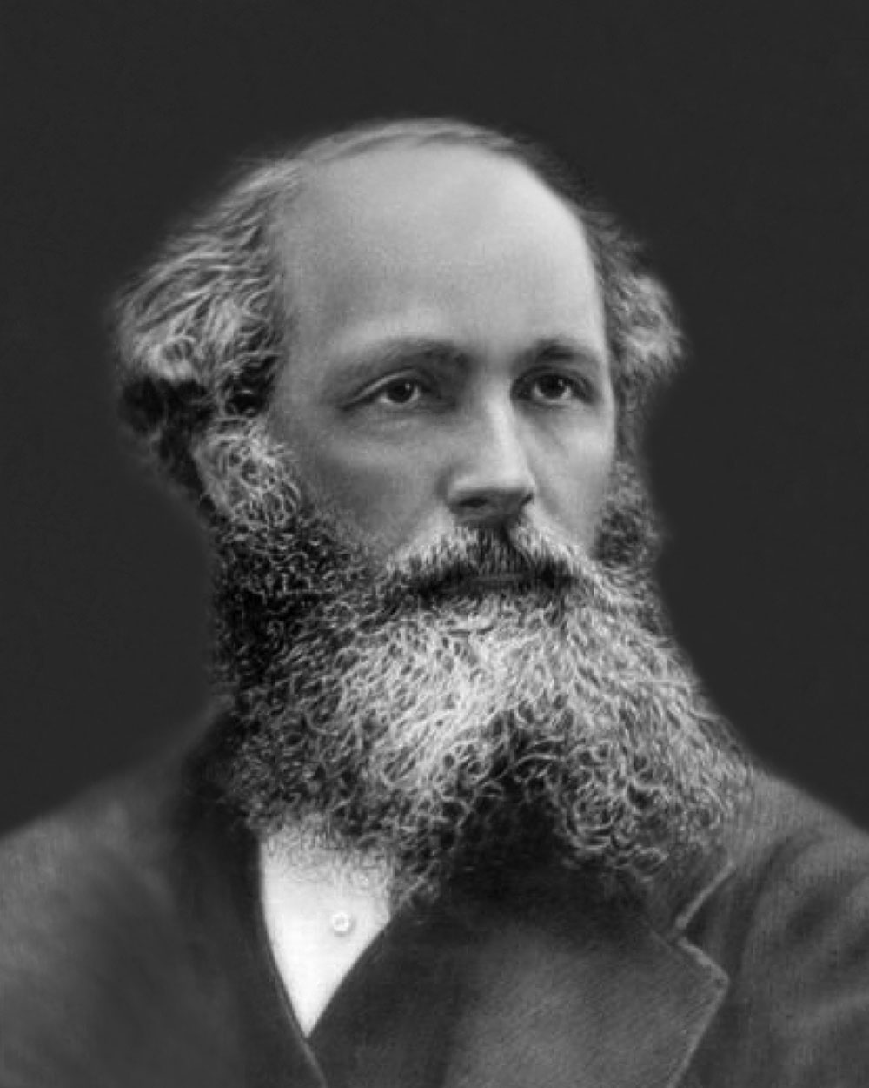
Maxwell’s Equations, 1862
James Clerk Maxwell, 1831-1879
Form the foundation of classical electromagnetism, quantum field theory, classical optics, and electric circuits.

Slide 41
Maxwell’s Equations (for reference)
Note that the speed of light, c, is part of these equations

Slide 42
Maxwell’s Equations: Powerful and accurate
Electricity and magnetism are the same thing
Predict the existence of light waves.
Light is a form of electromagnetism
Light travels with a velocity of 299,792,458 meters per second (“the speed of light”, c)
Wow! That’s Fabulous!

Slide 43
But Maxwell’s Equations have some strange features
The speed of light is the same for all observers
The equations are not invariant under a
Galilean coordinate transformation

Slide 44
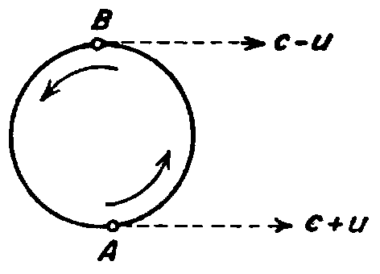
The Speed of Light
It seems like* speed is relative:
Maxwell's Equations say that the speed of light is invariant
The de Sitter Double Star Experiment
* Intuition

Slide 45
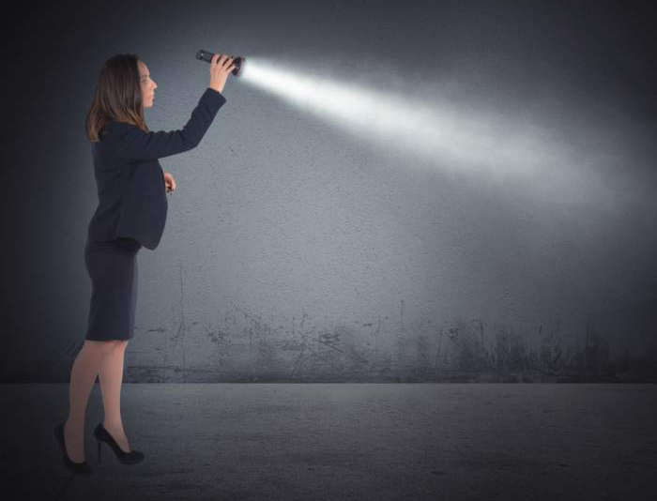
What? That’s Freaky!
Surely: v_{light} = c - v_{train} , right??
Like the Mythbusters cannon?

Slide 46
That’s not what Maxwell’s Equations say
This puzzled scientists for almost 40 years
Mathematicians give a glimpse at what is happening …

Slide 47
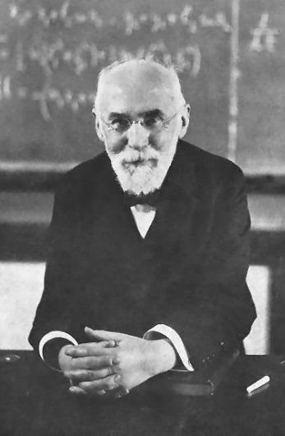
Hendrik Lorentz (1823-1928)
Lorentz developed a coordinate transformation that kept Maxwell’s Equations invariant
By doing deep math on these complicated equations – amazing!
Maxwell’s Equations are invariant under the Lorentz transformation.

Slide 48
Coordinate Transformations
Galilean transformation:
Lorentz transformation:

Slide 49
Understanding of Lorentz Transformations in 1905
Even at the speed of an orbiting GPS satellite, 14,000 KPH (3889 m/s), the gamma factor is almost irrelevant:
* Intuition

Slide 50
Understanding of Lorentz Transformations in 1905
However, for speeds close to the speed of light, Lorentz transformation predicted weird things.
This seemed* so radical that scientist were reluctant to accept it
For example, what happens when v=c?
Or worse: when v>c??
Then there came along a patent clerk in Bern, Switzerland ...
* Intuition

Slide 51
Recap: Lorentz Transformations
Maxwell’s Equations: The speed of light is invariant
Lorentz Transformations work on Maxwell’s Equations
Lorentz Transformation = Galilean transformations
For velocities of everyday life, even really fast stuff

Slide 52
Questions?

Slide 53
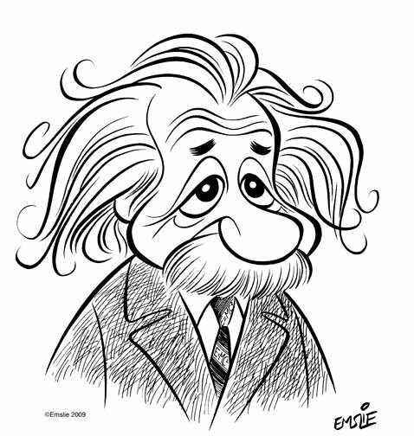
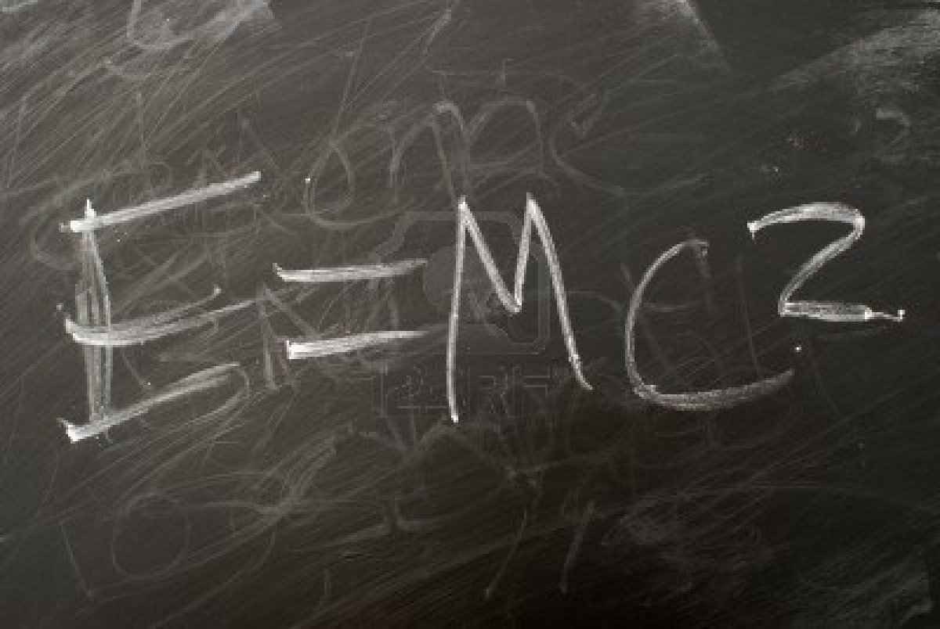
“Einstein”
Einstein. Einstein. Einstein. Einstein. …
Does that word/name have meaning anymore?
“Einstein” = “Bagels”?
“Einstein” = “Genius”?
“Einstein” = “Scientist with crazy hair”?
“Einstein” = “Relativity”?
Let’s see who this man was and what he did.

Slide 54
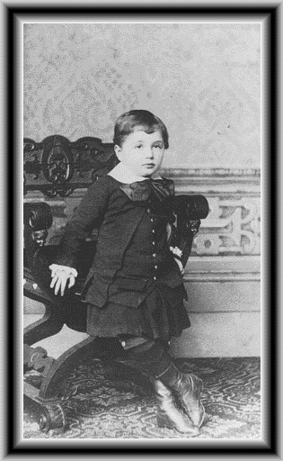
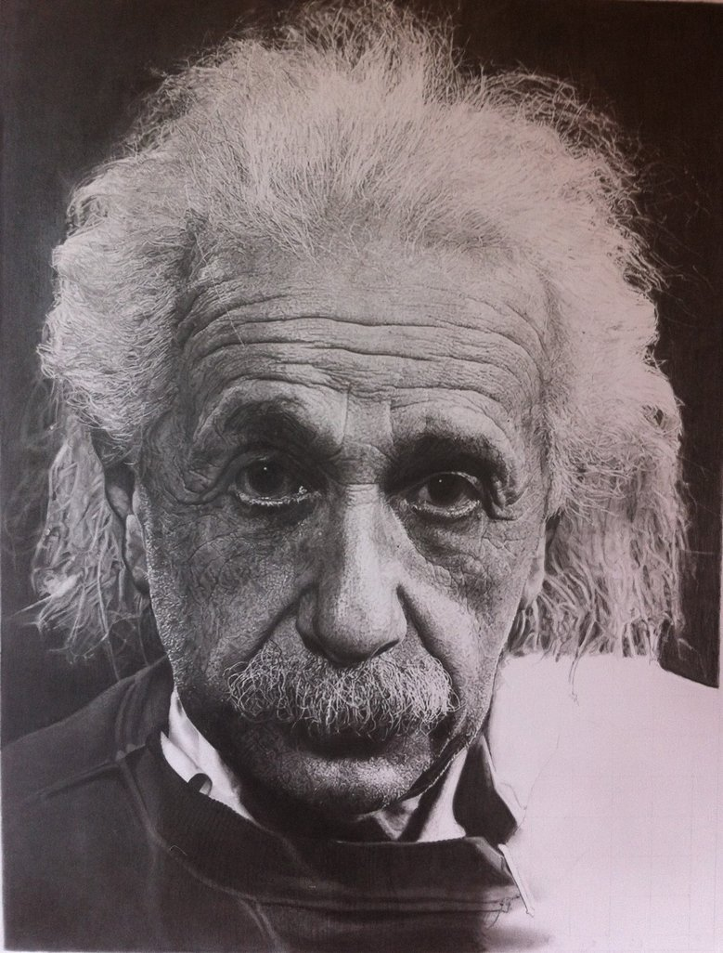
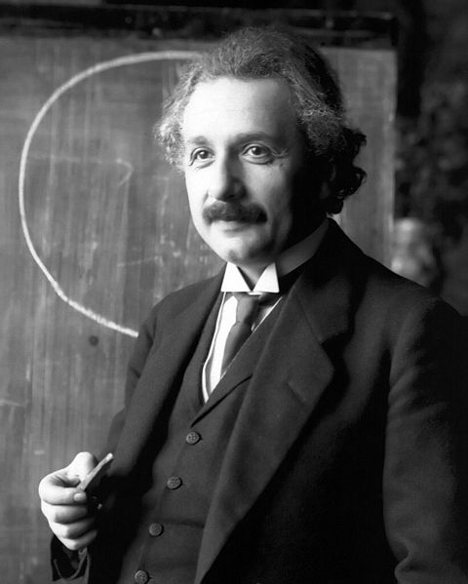
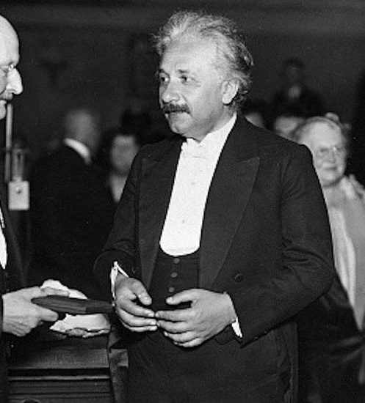
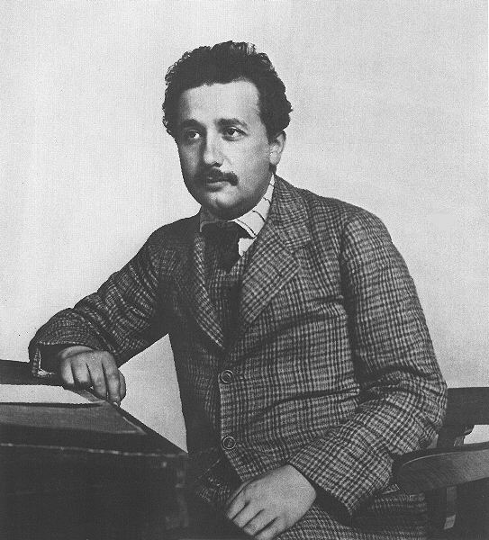
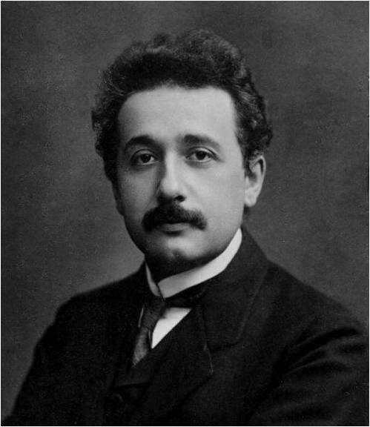
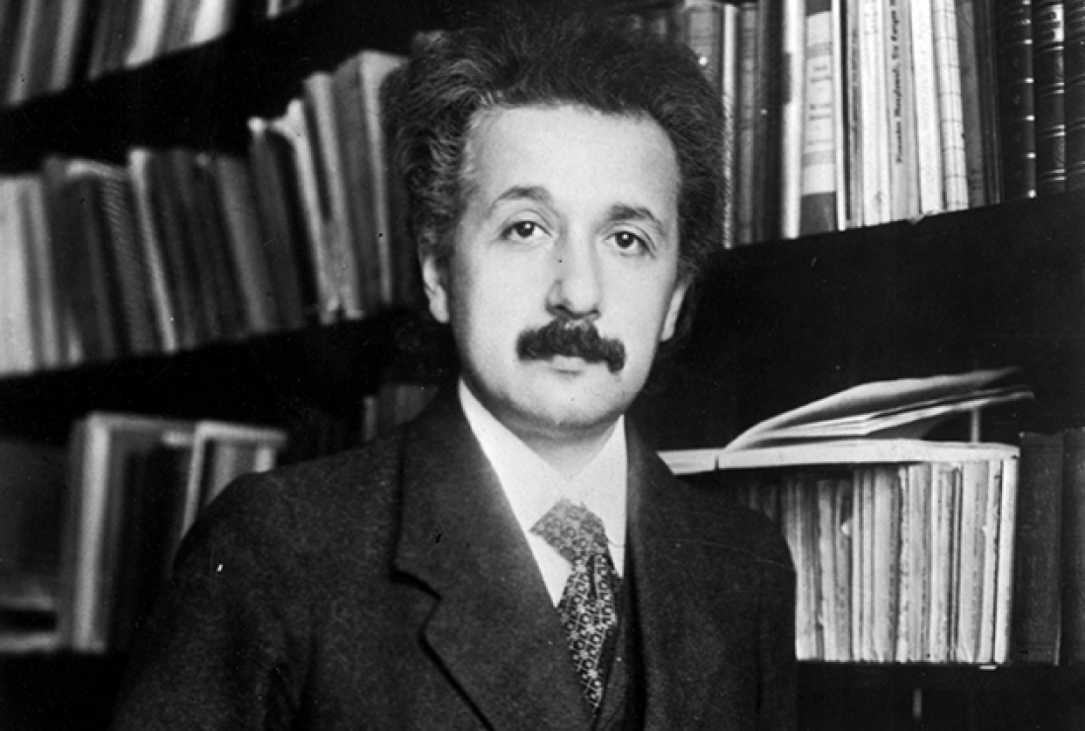
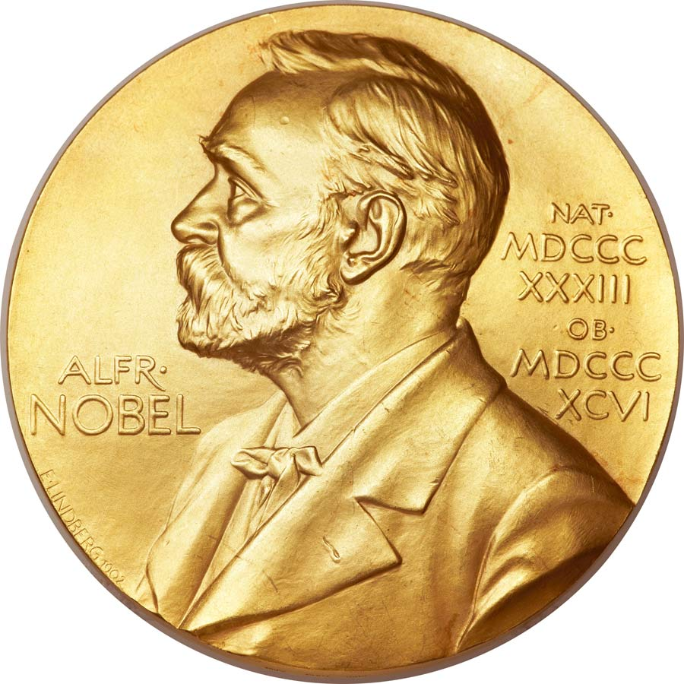
Albert Einstein (1879 – 1955)
At age 4 (1883)
At 23 (1902): Patent clerk
At 26 (1905): Published 4 papers that changed everything
At 29 (1908): Professor at U Bern
At 36 (1915): Published The General Theory of Relativity
At 42 (1921): Nobel Prize
At 54 (1933): Emigrated to America
At 76 (1955): Completes The Meaning of Relativity, 5th edition

Slide 55
1905: Einstein’s Extraordinary Year
https://en.wikipedia.org/wiki/Annus_Mirabilis_papers
Annus Mirabilis = Extraordinary year
Einstein published four spectacular papers, which derived explanations for:
The Photoelectric Effect
Brownian Motion
Coordinate transformations in Maxwell’s Equations (Special Relativity) 
Mass-energy equivalence 

Slide 56
1905: Old Memes - Gone
He introduced to humans:
Quantum Mechanics
Special Relativity
E=mc²

Slide 57
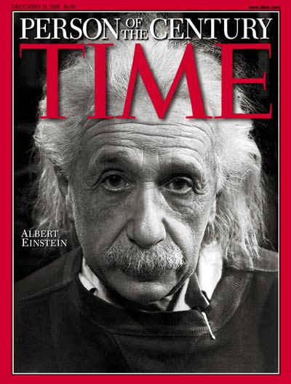
4 papers: More than a century of physics
Each of these papers, individually, would have turned physics on its head
All of them together from one person, in one year, is (to me) incomprehensible!

Slide 58
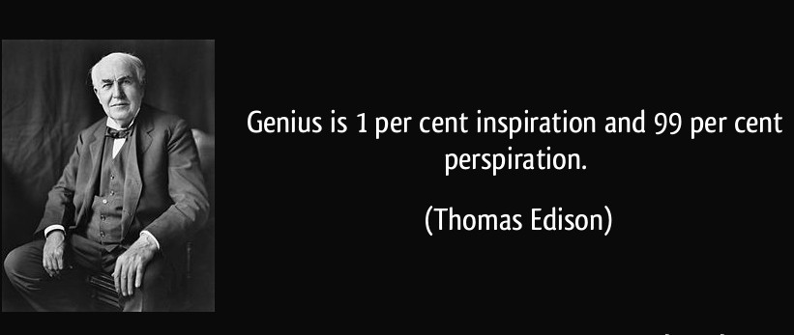
Genius
Einstein was one of the hardest-working scientists of the 20th Century
Thomas Edison, 1903

Slide 59
Questions?
Get out your clickers

Slide 60
Which is your favorite Star Trek TV Series?
The Original Series
The Next Generation
Deep Space Nine
Voyager
Enterprise
Discovery
What is Star Trek?
Original
Series
Next
Generation
Deep
Space 9
Voyager
Enterprise
Discovery

Slide 61
What is the value of x?
Rank | Responses
1 | 2
2 | 1
3 | -1
4 | -2
5 | 4
6 | Other

Slide 62
The solution

Slide 63
Introduction over. Let’s do some physics.
All you need is Algebra
Questions?

Slide 64
Physics: Velocity (v), Distance (d) and Time (t)
Hint: Use the units
[meters per second] = [meters] ÷ [second]
[m] = [m/s]  [s]
[s] = [m] ÷ [m/s]

Slide 65
Special Relativity
And now …

Slide 66
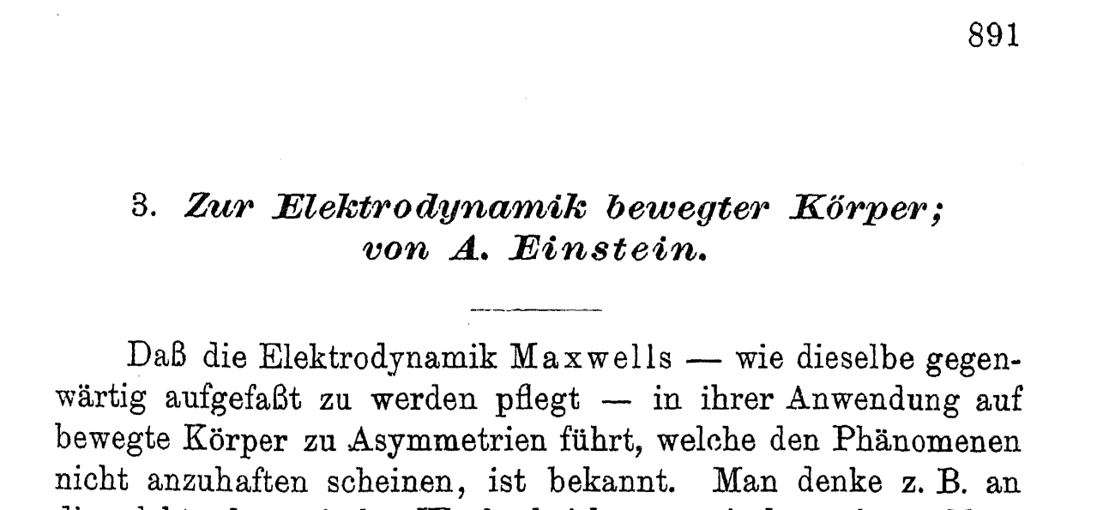
"On the Electrodynamics of Moving Bodies”
Special Relativity

Slide 67
Einstein stipulated
The laws of nature are the same in all inertial frames of reference.
Intuition
The speed of light in the vacuum is the same in all inertial frames of reference.
Recognized as a (counter-intuitive?) feature of Maxwell’s Equations

Slide 68
What can we predict* from these two assumptions?
Let invent a new type of clock and see
* Scientific method

Slide 69
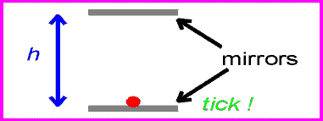
The Light Clock

Slide 70
Time = distance / velocity
The clock ticks at a rate of 2h/c seconds
For a clock that ticks every t seconds, the mirrors are ½ tc apart

Slide 71
For the clock to tick at 1 second

Slide 72
The Light Clock
(150 million meters: 1/3 of the way to the moon)

Slide 73
Questions?

Slide 74
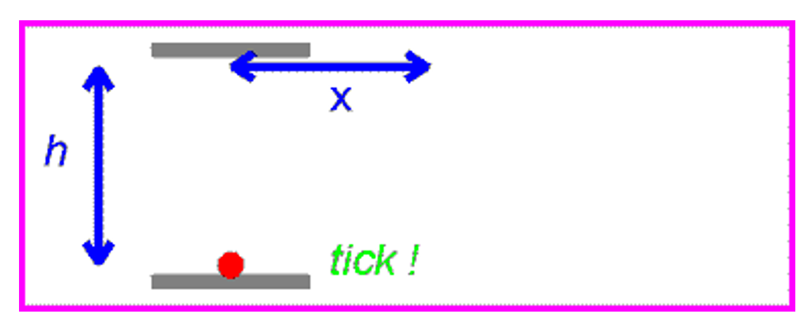
For a fast-moving observer …

Slide 75
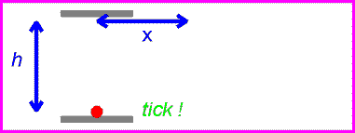
… the light path is longer

Slide 76
Remember, we assumed The speed of light is the same for all observers

Slide 77
“The Greek letter beta is defined to be v over c”
“The Greek letter gamma is defined to be one over the square-root of one minus beta squared”

Slide 78
From the perspective of the Light Clock
v_{Enterprise} < c

Slide 79
From the perspective of the Enterprise
t=0
t=t₁
t=2t₁
v
x

Slide 80
From the perspective of the Enterprise
t=0
t=x/v
t=2x/v
h
v
x
x

Slide 81
How long does it take for the initial “Tock”?
t=0
t=x/v
t=2x/v
h
v
Constant!
x
x

Slide 82
A little algebra …
t=0
t=x/v
t=2x/v
h
v
x
x

Slide 83
A little more algebra …

Slide 84
Lorentz Transformation of time!
The time for the light
to travel this path
is longer to the Enterprise observer
than it is
to the observer sitting on the clock!
The time is “dilated”

Slide 85
Dilate?
v.tr.
To make wider or larger; cause to expand.
v.intr.
1. To become wider or larger; expand.
2. To speak or write at great length on a subject; expatiate.

Slide 86
The passage of time on the Enterprise has to be slower than the passage of time on the mirrors!
In other words …
For the observer on the Enterprise and the observer on the mirrors to see the light to go between the mirrors the same way, …

Slide 87
Once again:

Slide 88
Recap: Time dilation
The time observed on the
moving clock is longer than
the observer’s clock
The time on the observer’s
clock is shorter than the
moving clock

Slide 89
Questions?
Skip clicker question

Slide 90
How long is one second, as seen from the Earth, on the Enterprise for v = 0.25c ? *
0.9682
3.1416
0.7071
1.0328
1.1412
c/4
* ST:TNG Technical Manual: “High relativistic speeds are to be avoided unless absolutely necessary; impulse power should be limited to a maximum of ¹⁄₄ lightspeed”

Slide 91
How long is one second, as seen from the Earth, on the Enterprise for v = 0.25c ? *
c/4

Slide 92
Light Clock also leads to length contraction
d
v = ßc
The algebra

Slide 93
Special Relativity Summary
Time Dilation
With,
Length Contraction

Slide 94
A nice velocity
Questions?

Slide 95
Simultaneity
Noun form of “simultaneous”
Two events happen simultaneously when you see/observe that they have occurred at the same time.
The fact that the speed of light is the same to all observers means that our intuitive understanding of simultaneity needs to be extended.
Let’s see why

Slide 96
A thought experiment: Stationary train car
7.3 m (24 feet)
A light pulse
12 nanoseconds
3 nanoseconds
6 nanoseconds
9 nanoseconds

Slide 97
The light pulses hit the ends simultaneously
About 7.3 m (24 feet)
12 nanoseconds

Slide 98
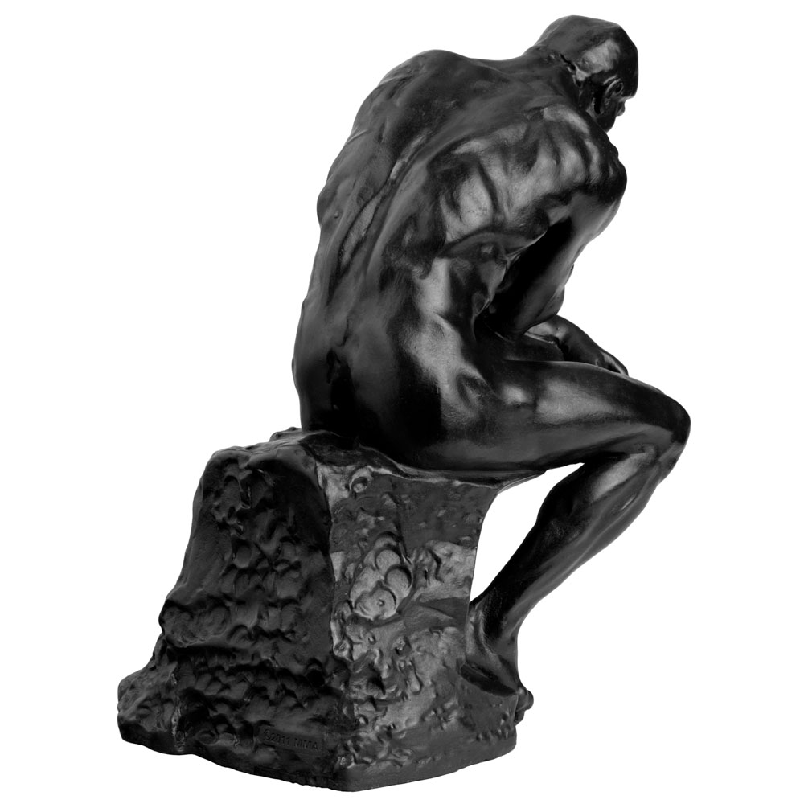
A thought experiment: Moving train car

Slide 99
A thought experiment: Moving train car

Slide 100
A thought experiment: Moving train car

Slide 101
A thought experiment: Moving train car

Slide 102
A thought experiment: Moving train car

Slide 103
A thought experiment: Moving train car

Slide 104
The light hits the back of the train car first
Repeat this animation

Slide 105
Simultaneity is different (!!!)
Because the speed of light is the same for all observers …
The observer on the train sees the light hit the ends of the train simultaneously
The observer on the ground sees the light hit the ends of the train at different times.

Slide 106
What? That’s Freaky!
Questions?

Slide 107
Scientists tried to disprove counter-intuitive aspects of Special Relativity

Slide 108
A pole vaulter

Slide 109
Physicist’s view of a pole vaulter
10 meters
Velocity: v

Slide 110
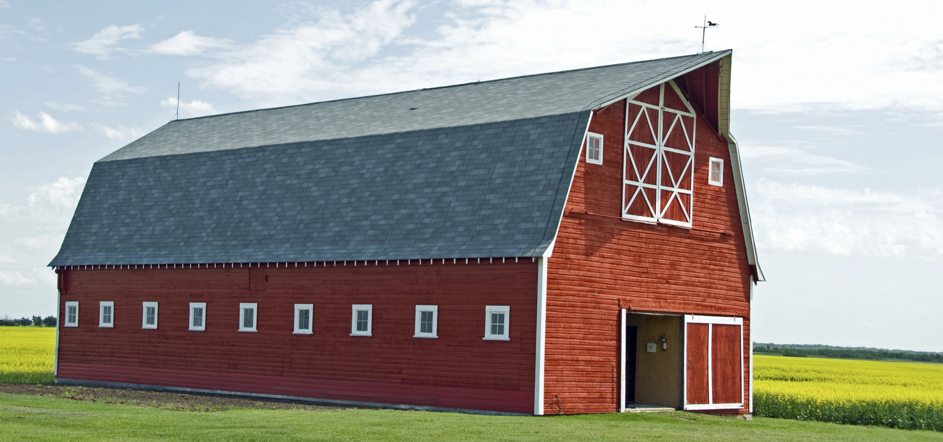
A barn
Back Door
Front Door

Slide 111
Physicist’s view of a barn
5 meters
7 October 2017
McCrory: Einstein's 1905 Revolution
111

Slide 112
A pole vaulter and a barn
5 meters
10 meters

Slide 113
Let the speed of vaulter be 0.866c (γ = 2)
5 meters
5 meters

Slide 114
He is running very fast
5 meters
v=0.866c

Slide 115
Running …
5 meters
v=0.866c

Slide 116
Running …
5 meters

Slide 117
Barn, with doors shut, fully contains vaulter
5 meters

Slide 118
And the vaulter keeps running, pole in tact
5 meters

Slide 119
Who sees the problem?
Feedback
Repeat this animation

Slide 120
From the point of view of the vaulter
2.5 meters
10 meters
v=0.866c

Slide 121
Wait! Tis Faulty!
Repeat this animation

Slide 122
A Paradox?
Either the pole gets smashed by the doors or it does not!
It cannot be both whole and broken.
Resolving this is a little tricky.
Questions?

Slide 123
What causes the doors to close?
5 meters

Slide 124
causality
noun
The relationship between cause and effect.
causal
adjective
Relating to or acting as a cause.

Slide 125
Nothing can travel faster than the speed of light
Even the connection between cause and effect (causality)
So, let’s use a light-based signal to cause the doors to close

Slide 126
What causes the doors to close?
5 meters
Sensor

Slide 127
The signal propagates to the doors …
5 meters
Sensor

Slide 128
The signal propagates to the doors …
5 meters
Sensor

Slide 129
The signal propagates to the doors …
5 meters
Sensor

Slide 130
… And causes doors to close
5 meters
Sensor
Just like the train car, previously!

Slide 131
And vaulter continues with an unbroken pole
5 meters
Sensor
Repeat this animation
Questions?

Slide 132
From the point of view of the vaulter
2.5 meters

Slide 133
The front door closes (quickly)

Slide 134
The front door opens

Slide 135
The front door opens

Slide 136
Running…

Slide 137
Running…

Slide 138
Back door closes when the signal reaches it

Slide 139
And vaulter continues with an unbroken pole
Repeat this animation

Slide 140
The paradox is resolved through careful application of cause-and-effect in Special Relativity
5 meters
10 meters

Slide 141
More on this apparent paradox …
https://en.wikipedia.org/wiki/Ladder_paradox
YouTube: “Relativity 5b - pole and barn paradox”, by viascience.
https://www.youtube.com/watch?v=0TU1tKTOIj4
At first, this seemed counter-intuitive
We have improved our intuition

Slide 142
Questions?
Skip E=mc² ??

Slide 143
Equivalence of mass and energy

Slide 144
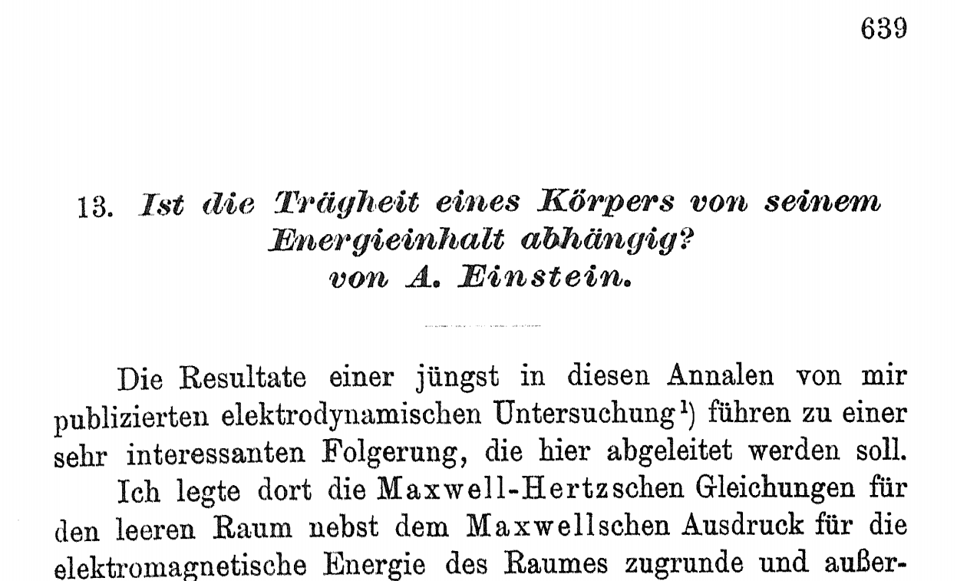
“Does the Inertia of a Body Depend Upon Its Energy Content?”
E = mc²

Slide 145
Special Relativity: E = mc²
It is possible to derive this formula using algebra
Energy = force  distance
Force = the change in the momentum of an object
Lorentz transformations of time (that is, the velocity)
But it is easier (and cleaner) to use calculus
http://www.emc2-explained.info/Emc2/Deriving.htm

Slide 146
E = mc²
Derived using only math (mostly algebra) and the two conjectures:
The laws of nature are the same in all inertial frames of reference.
The speed of light in the vacuum is the same in all inertial frames of reference.
Mind: Blown!
Wonderful Theoretical Fun!

Slide 147
Energy and mass are the same thing
In depth:
E, momentum and mass
Skip the implications of E=mc²

Slide 148
An aside: Our nomenclature at Fermilab
Physicists at Fermilab set the speed of light equal to one
E = m
This is only a change in units
Emphasizing even more clearly that energy is the same thing as mass

Slide 149
What does this mean? E = mc²
What is the energy of 1 gram of matter?
E = 0.001 [kg](2.998  10⁸ [m/s])²
E = 1  10⁻³ 8.988004  10¹⁶ [kg m²/sec²]
E = 8.988004  10¹³ [Joules]
E ≈ 90 Terajoules
→ Burning 691,538 gallons of gasoline
→ Exploding 42,964,554 pounds (21.5 kilo-tons (kT)) of TNT

Slide 150
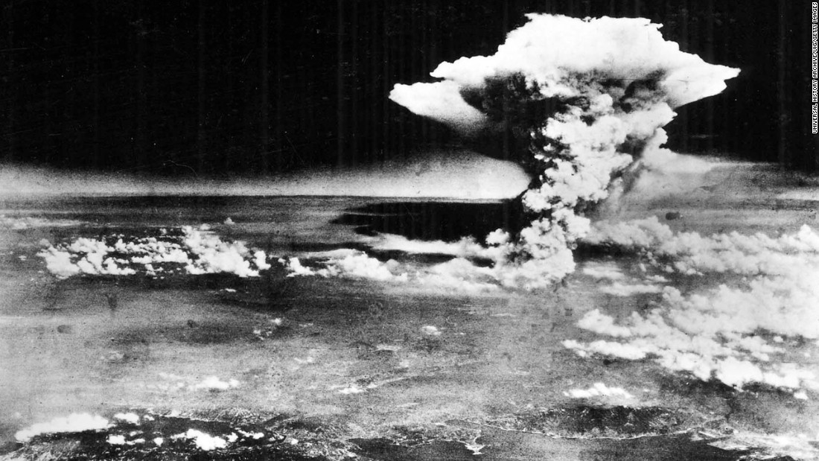
First atomic bomb: Hiroshima (USA, fission)
Hiroshima bomb: 63 Terajoules [6.3  10¹³ Joules] (15 kT)
Equivalent to about 0.7 grams of matter converted to energy

Slide 151
Largest bomb: Tsar Bomba (USSR, fusion)
Tsar Bomba: 240 Petajoules [2.4  10¹⁷ joules] (57 MT)
3800 times larger than Hiroshima bomb
Converted about 2.7 kg of matter into energy

Slide 152
Questions?

Slide 153
How do we know Special Relativity is accurate?

Slide 154
No Lorentz violations could be measured thus far, and exceptions in which positive results were reported have been refuted or lack further confirmations.

Slide 155
Everyday uses of Special Relativity
Global Positioning System (GPS)
Muon decay

Slide 156
GPS is based on very accurate clocks
GPS clock ticks must be known to an accuracy of 20-30 nanoseconds
~5 meters on the road.
GPS satellites are constantly moving relative to Earthly observers
These clocks move a little more slowly
Special Relativity predictions … next slide
GPS also gets substantial corrections from General Relativity
http://www.astronomy.ohio-state.edu/~pogge/Ast162/Unit5/gps.html

Slide 157
GPS: How big an effect is satellite motion?
Speed of a GPS satellite is 14,000 KPH (3889 m/s)
β_{satellite} = 3889 / 299,792,458
= 0.0000129633
γ_{satellite} = 1.000000000084
One day = 84600 seconds
γ_{satellite}(one day) = 84600.0000071084 seconds
7.1 microseconds off
This means that over a day, your position inaccuracy would grow from about 5 meters to about 300 meters.

Slide 158
An aside – GPS and General relativity
The satellite is in micro-gravity
The receiver is in Earth gravity
General Relativity:
Earth clock runs 38 microseconds slower per day
5.4X bigger effect than Special Relativity
About a mile of error per day

Slide 159
Muon Decay
1941 experiment
Now a common experiment in a graduate physics laboratory

Slide 160
No relativity
Distance: 10,000 meters
Time = distance / velocity
t = 110⁴ [m]/( (0.98) (3 10⁸ [m/s] ))
t = 34  10⁻⁶ [sec]
Muon lifetime = 2.2  10⁻⁶ [sec]
15.5X longer
Expect to see about 20 muons
20

Slide 161
With time dilation
Distance: 10,000 meters
Time = distance / velocity
t_{Enterprise} = t₀ / γ
t = (110⁴ [m]/( (0.98) (3 10⁸ [m/s] )))/ γ
t = (34  10⁻⁶ [sec]) / γ
t =6.8  10⁻⁶ [sec]
Muon lifetime = 2.2  10⁻⁶ [sec]
3.1X longer
Expect to see about 116,000 muons
Agrees with experiment
116,000

Slide 162
Special Relativity includes Newton and E&M
Special Relativity extends Newtonian Mechanics to close-to-c speeds, but it does not contradict it
It includes all of Newtonian Mechanics in its entirety.
Special Relativity
Newtonian Mechanics
Electro-magnetism
(Maxwell)
Questions?

Slide 163
General Relativity …
Einstein’s Relativity does not end here
General relativity combines acceleration (non-inertial reference frames) with gravity
Gravity is a result of the geometry of spacetime (!)
We are moving fast enough that you might think we have the
time to go over General Relativity in some detail.
But, alas, we do not.

Slide 164
Questions?

Slide 165
Intuition … reprise
How do we know what we know?
Intuition
Deduction
Observation
This talk:
Intuition can be incomplete
“Counter intuitive”
Deduction and observation can be amazing

Slide 166
In other words, Special Relativity is A triumph of the Scientific Method

Slide 167
Special Relativity: Conclusions
Time dilates
Length contracts
Simultaneity is relative
Matter and energy are the same thing
It agrees, impressively, with experiments
Our old intuition must change
Maxwell’s Equations are correct
And they always have been
Einstein was an insightful, hard working scientist

Slide 168
End of Relativity Lecture
Questions?

Slide 169
But Relativity does not end here
General relativity
Einstein’s life’s work
Space is warped by mass
Mass moves according to how space is warped
Mind-blowing predictions:
Precession of the orbit of Mercury
Light is bent by gravity
Black holes
Expansion of the universe
Gravity waves

Slide 170
What to cover next?
Brownian Motion
Electron Volts
Photoelectric effect
The Picard Maneuver
Next slide: Conclusions

Slide 171
Conclusions
Feedback

Slide 172
Weary, though fascinated!
Einstein was one of the greatest minds ever
1905: Four papers changed humans’ understanding of the physical world
Special Relativity: Old intuition of space and time must be adjusted
Algebra is cool

Slide 173
Feedback (One answer is correct)
I promise to fill out the feedback form
Feedback forms are silly
http://tinyurl.com/SMPFeedback-Fall17

Slide 174
That’s all, folks!
These slides:
1. https://smp.fnal.gov
2. “Session I: Fall 2017”

Slide 175
Feedback
http://tinyurl.com/SMPFeedback-Fall17

Slide 176
The other 1905 Einstein papers were also profound

Slide 177
Brownian Motion

Slide 178
“Investigations on the theory of Brownian Movement”
Brownian Motion

Slide 179
Brownian Motion
Botanist Robert Brown,
1773-1858
A tiny, visible object (suspended in water) will move about randomly.
Could the pollen grains be alive?
Nope. Shown to happen with lab-created inanimate stuff

Slide 180
Brownian Motion: Einstein
Einstein solved the problem, assuming “molecules” are what is pushing the object around.
His calculations revealed the size of these molecules
Avagadro’s Number

Slide 181
"On a Heuristic Point of View about the Creation and Conversion of Light”
Photoelectric Effect

Slide 182
The Photoelectric Effect
Covered last week by Professor Hooper
Emission of electrons when light shines onto a material … sometimes
This phenomenon was discovered by Hertz and Hallwachs in 1887.

Slide 183
Interpretation based on Maxwell’s Equations
Light is a wave
Brighter light → More energetic electrons
Brighter light → More prompt emission of electrons
Dim light: electrons would be released slowly and at low energy

Slide 184
Observations
In 1902, Lenard observed that the energy of individual emitted electrons increased with the color of the light, but not the intensity.
Furthermore, when the color was blue enough, electrons would be emitted instantly

Slide 185
Max Planck
Studied the radiation emitted from a glowing body
“Black Body Radiation”
(Radiation: energy from light)

Slide 186
How to fit this frequency curve?
Assume that electromagnetic energy could be emitted only in quantized form
He introduced a new constant, h:
E = hν
h is Planck's constant,
6.62607×10⁻³⁴ [Joules seconds]
ν (“nu”) is the frequency of the radiation.
Scientists appreciated the novelty and correctness (mathematically) of this assumption, but they did not (particularly) like what this meant!

Slide 187
Max Planck and Einstein
Einstein showed that Planck’s assertion, that light is made up of particles, would resolve the photoelectric effect
Light comes in quanta, and they behave like particles in the Photoelectric effect
These particles (now called “photons”) hit electrons in the atoms of the metal and can only kick them out if the energy of the photos is high enough

Slide 188
Wave/particle duality
The photoelectric effect helped to propel the then-emerging concept of wave–particle duality in the nature of light.
Light simultaneously possesses the characteristics of both waves and particles, each being manifested according to the circumstances.
It was soon realized that particles with mass also have a wavelength

Slide 189
Units of mass and energy
We use “Electron Volts” as an energy
1.6×10⁻¹⁹ joules
Since mass=energy, we also say that a particle has a mass in “electron volts”

Slide 190
Converting between energy and mass
When two particles collide at high energy, the result has a lot of energy
Often (usually) this energy becomes mass.

Slide 191
An anti-electron (positron) and an electron

Slide 192
An anti-electron (positron) and an electron

Slide 193
An anti-electron (positron) and an electron
Positron
Electron

Slide 194
This burst of energy turns into a particle
End lecture
End Relativity

Slide 195
Spacetime

Slide 196
I-88

Slide 197
I-88
Davenport
Chicago

Slide 198
Time
Future
600 seconds
You and me in 5 minutes
You and me now
I-88
Davenport
Fermilab
Chicago
Past

Slide 199
Time
At about 12:05 PM today
As seen from Wilson Hall
600 seconds
You on I88
Me on I88
I-88
Davenport
10 miles
15 miles
Chicago
Fermilab
What are our speeds?
You = 10 miles / (1/6 hr) = 60 MPH
Me = 15 miles / (1/6 hr) = 90 MPH

Slide 200
Time
Same thing, as seen from your car
600 seconds
You on I88
Me on I88
I-88
5 miles

Slide 201
Time
What about a pulse of laser light?
2 sec
1 sec
Laser
Mirror at
299,792,458 meters
Us
Space

Slide 202
Questions?

Slide 203
Time
1 second from now
Photon
Space
299,792,458 meters from here

Slide 204
Time
2 sec
Mirror at
-299,792,458 meters
1 sec
Mirror at
299,792,458 meters
Photon
Photon
Space
Us

Slide 205
Causality: The fastest a signal can travel is c

Slide 206
Time
Photon
Space
US

Slide 207
Time
Causal
Photon
Non-causal
Non-causal
Space

Slide 208
What is the effect of a Lorentz Transformation on Spacetime?

Slide 209
End lecture
End Relativity

Slide 210
What is Intuition?
(noun)
The ability to understand something immediately, without the need for conscious reasoning.
“We shall allow our intuition to guide us"
a thing that one knows or considers likely from instinctive feeling rather than conscious reasoning.
“Your insights and intuitions as a native speaker are positively sought“
synonyms: instinct, hunch, feeling (in one's bones), inkling,
(sneaking) suspicion, idea, sense, notion;

Slide 211
The time for the light to make one round trip as seen while sitting on the clock
t₀ : Time as seen on the clock
d₀ : Distance as seen on the clock
t : Time as seen on the Enterprise
d : Distance as seen on the Enterprise
d₀
v = ßc

Slide 212
The time for the light to go from
left to right, as seen from NCC-1701D
v = ßc
d - (a little bit)

Slide 213
The time for the light to go from
right to left, as seen from NCC-1701D
v = ßc
d + (a little extra)

Slide 214
The total time for the light to go from left to right, and back, as seen from NCC-1701D

Slide 215
We’ll use this:

Slide 217
Full equation for total energy
In other words …
Anything with energy has momentum
A photon has momentum
Return

Slide 218
An aside: The Picard Maneuver (“The Battle” – ST:TNG S1E9)
If a starship travels a short distance at very high warp (for this purpose: instantly), it will appear to be in two places at once for a brief time.
USS Stargazer, under command of J. L. Picard (SD 2365)

Slide 219
How long will it be in two places?
The view of the Stargazer will travel to the observer at the speed of light.
So the “Old” position will remain visible for the time it takes for the light to reach the observer
d
Double vision time = d/c
If d = Earth:moon distance, t ≈ 3 seconds
If d = Earth:Sun, t ≈ 499 seconds

Slide 220
Stargazer was here, several billon meters away
(way smaller than one pixel on this image)
Not quite what the ST:TNG writers had in mind

Slide 221
An aside: No new physics in 20th Century?
One school of thought:
Classical mechanics could cope with highly complex problems involving macroscopic situations
Thermodynamics and kinetic theory were well established
Geometrical and physical optics could be understood in terms of electromagnetic waves
Conservation laws for energy and momentum (and mass) were widely accepted
It was generally accepted that all the important laws of physics had been discovered
Research would be concerned with clearing up minor problems and particularly with improvements of method and measurement.
However, A. A. Michelson's in his 1899 lectures Light Waves and Their Uses:
What would be the use of extreme refinement in the science of measurement?
[…] all future discovery must lie [here].
The more important fundamental laws and facts of physical science have all been discovered, and these are now so firmly established that the possibility of their ever being supplanted in consequence of new discoveries is exceedingly remote.
Nevertheless, it has been found that there are apparent exceptions to most of these laws, and this is particularly true when the observations are pushed to a limit, i. e., whenever the circumstances of experiment are such that extreme cases can be examined. Such examination almost surely leads, not to the overthrow of the law, but to the discovery of other facts and laws whose action produces the apparent exceptions.

Slide 222
Some perspective on Annus Miralilis
Worked as an examiner at the Patent Office in Bern, Switzerland
Limited access to scientific reference materials,
Co-worker: “[Einstein] could not have found a better sounding board for his ideas in all of Europe".
Einstein tackles some of the era's most important physics questions
These papers solved the primary scientific problems of the era:
Lord Kelvin lecture titled "Nineteenth-Century Clouds over the Dynamical Theory of Heat and Light”
Michelson–Morley experiment
Black body radiation.
Coordinate transformation of Maxwell’s Equations.

Slide 223
Find x:
x
3 cm
4 cm

Slide 225
Find x:
5 cm
3 cm
4 cm
Pythagorean Theorem

