Slide 1
Physics of Particle Detectors
Mandy Rominsky
Saturday Morning Physics
08 December 2018

Slide 2
What are we trying to learn about?
How do particles interact?
What are the building blocks of nature?
Why is there more matter than antimatter?
What is dark matter?
What is dark energy?

Slide 3
How are we going to answer these questions?
This lecture!
Notes:
We will use the scientific method to figure things out -

Slide 4
So – what is our tape measure?
We want to look at something very very small and see if it is made of smaller things. We also want to see how two small particles interact.
Can we use a microscope?
Best scanning electron microscope can see something as small as 0.2 nanometers (0.0000000002 meters)
Smallest object human eye can see is a few microns (0.000001 meters)
The Bohr radius of hydrogen atom is 0.0000000000053 meters (53 picometers)
How do we look at such small objects?

Slide 5
How do we look at such small objects?
Take it apart!
Notes:
Picture of laptop components, body parts, mitochondria DNA under microscope

Slide 6
How do we take apart particles? Collisions
To break down these particles, we also need a ton of energy and shoot them at each other or targets.
Accelerator Lecture (Cindy Joe, November 17)

Slide 7
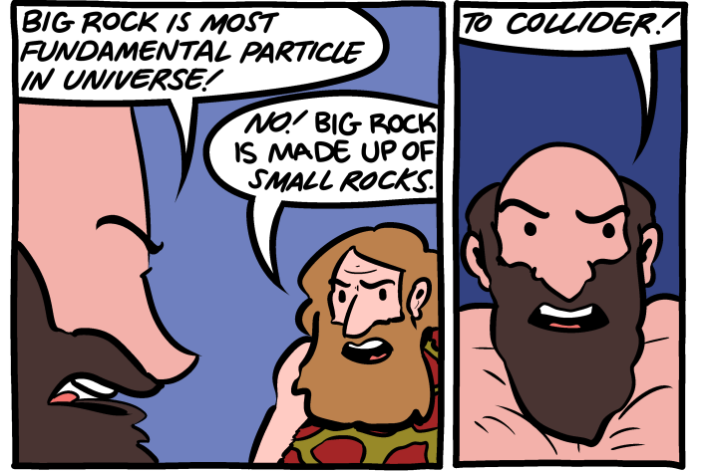
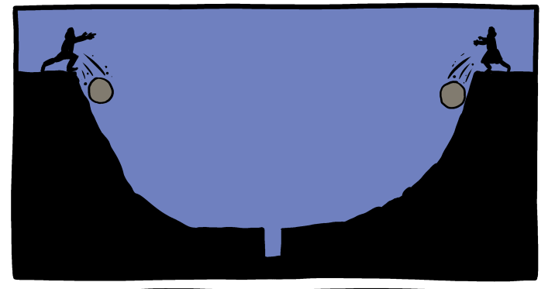
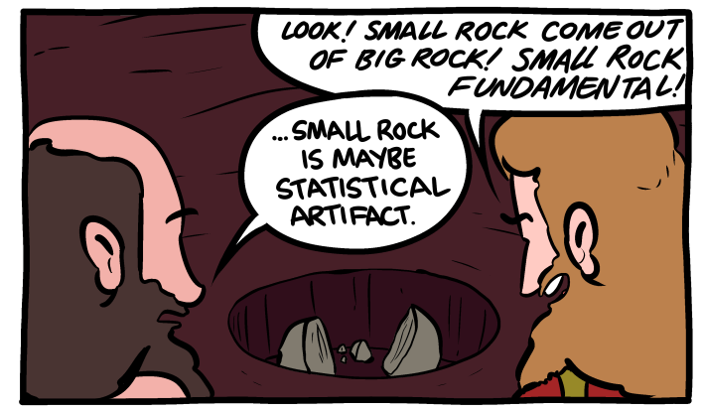
In Other Words

Slide 8
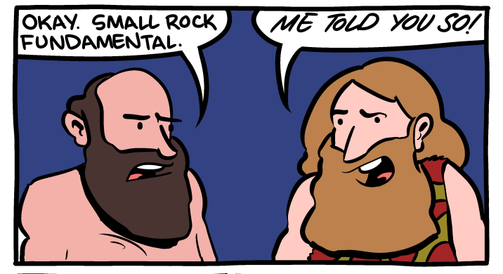
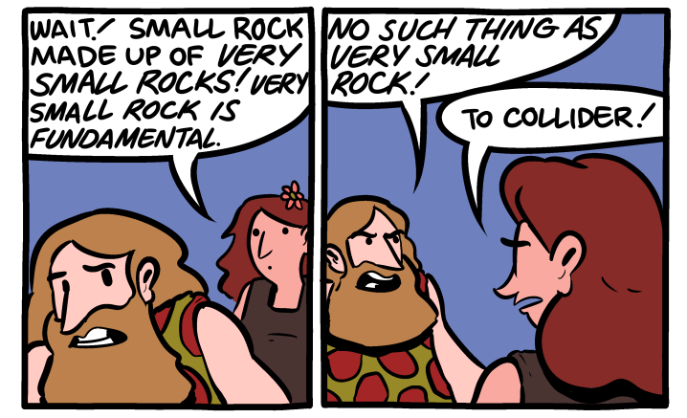
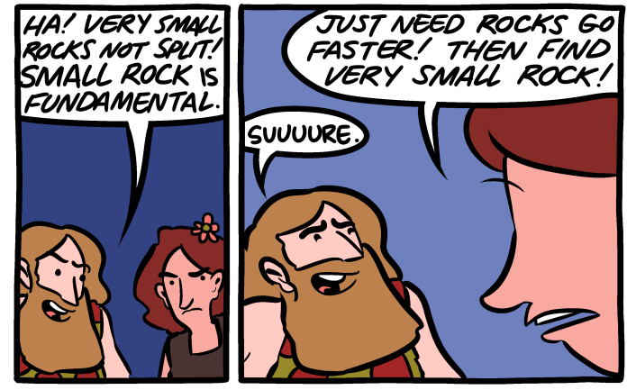
In Other Words

Slide 9
In Other Words

Slide 10
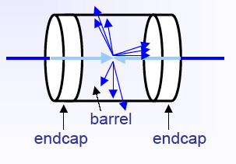
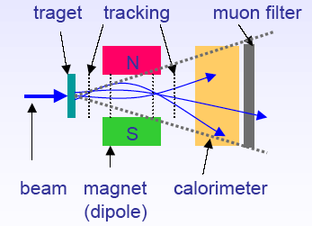
We want to see the end products of the collision
Fixed Target Geometry
Collider Geometry
Detector
Detector
Detector
Detector
Detector
Detector
Notes:
Blue boxes represent detectors

Slide 11
You’ve seen these!
Neutrino Campus
D0 Detector
LHCb @ CERN

Slide 12
What will be in those collisions?
**Full Intro Lecture on 10/27**
Standard Model
Matter is made of quarks and leptons
Particles communicate through the 4 force bosons shown
Four forces
Electromagnetic
Weak
Strong
Gravity
Notes:
We are going to use these things to help us understand the world around us

Slide 13
What theory tells us
Theory tells us that a quark and antiquark interact via a W boson and produce a set of particles.

Slide 14
A little more realistic picture
We send a proton/antiproton towards each other

Slide 15
What we actually see

Slide 16
So Many Questions
What do those lines mean?
Why are they curving?
What do the circles mean?
Why are some areas black?
How do we even know what we’re looking?

Slide 17
How do we identify particles?
In biology and chemistry, we have classification schemes

Slide 18
How can we identify particles?
We know that particles have a unique set of numbers that define them.
Mass, charge, etc.
Momentum conservation
Momentum before is the same as the momentum after a collision
Energy conservation
Same energy before and after collision
We can observe electromagnetic interactions and strong interactions
We can tell types of particles based on their lifetime
Muons, kaons, pions all decay at different times and into different things

Slide 19
Add tools to our toolbox
Motion in a magnetic field
Ionization
Scintillation
Calorimetry

Slide 20
Motion in a uniform magnetic field
Try this at home!! The tension in the string is keeping the ball moving in a circle

Slide 21
Motion in a uniform magnetic field
Remove the person, add in a magnetic field.
B Field

Slide 22
Uniform circular motion in a magnetic field
$F=\frac{mv^{2}}{r}$ : Force in a circular motion
$F=qvB:$Force on a particle in a uniform magnetic field
$$F=\frac{mv^{2}}{r}=qvB$$
$$r=\frac{mv}{qB}$$
We can measure the radius of curve particles make to learn about their momentum

Slide 23
Ionization
Definition: Ionization is the removal or addition of an electron to an atom to make it positive or negative.

Slide 24
How does this help us?
After ionization, you are left with a free electron (negative) and a positively charged atom
Add an electric field
Notes:
Simplest operation – won’t go too much farther into details at this stage. Talk through what this tells us.

Slide 25
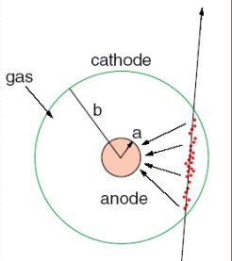
How does this help us?
After ionization, you are left with a free electron (negative) and a positively charged atom
Adding an electric field – we can separate the different types of charges.
Electrons will leave a charge on a s sensor that we can read out.
Notes:
Simplest operation – won’t go too much farther into details at this stage. Talk through what this tells us.

Slide 26
Scintillation Light
Sometimes, in some materials, a particle moving through does not knock out an electron

Slide 27
What can we do with scintillation light?
The photon emitted will have a very specific energy
We can count the number of photons that go to our readout tools

Slide 28
Fundamental Interactions
We’ll study 2 types – Electromagnetic interactions and nuclear interactions
Particles are either going to interact with detector material electrons or with it’s nucleus

Slide 29
Types of particles we can see
Electrons (charged) and photons (no charge)
Interacts with free electrons in atom
Muons (charged)
Interacts with free electrons in atom
Pions and protons (charged), kaons (charged)
Interacts with nucleus
Neutrons (no charge)
Interacts with nucleus

Slide 30
Let’s build detectors!
We have a well stocked toolbox
Theory tells us which particles we can see at the end of the collision
3 basic processes (motion in a magnetic field, ionization, scintillation)
Conservation laws (final state will tell us something about the initial state)

Slide 31
Go back to our car crashes
In order to fully understand an interaction, we should use multiple detectors. There are 2 classic geometries: fixed target and collider.
Fixed Target Geometry
Collider Geometry

Slide 32
Particle Interactions
Trackers (momentum, charge measurements)
Electromagnetic interactions
Scintillation (excitation)
Ionization
Calorimeters (energy, mass measurements)
Electromagnetic interactions
Ionization
Strong interactions
Hadronic showers
Cherenkov Detectors and Time Projection Chambers
Let’s look at these one by one

Slide 33
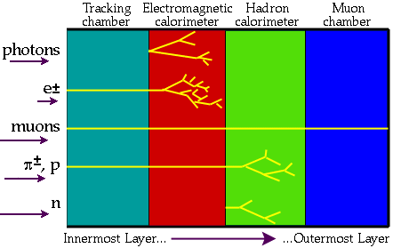
Break down into a slice
Put least amount of material and fastest detectors near the interaction point, build out from there.

Slide 34
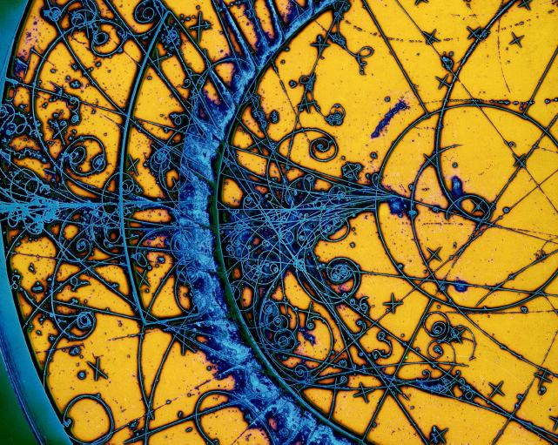
Tracking Detectors
Used for:
momentum measurements (p)
charge determination
particle production position (primary and secondary)
Main Concepts
Motion in Magnetic field
Ionization
What are trackers made out of?
Gaseous detectors
Silicon detectors
Scintillating fiber trackers
Notes:
Add more pictures of trackers

Slide 35
Tracking detectors
Measures the momentum, direction of the particle, and charge
It only sees charged particles
Usually the first detector to see the collision
Inside a magnetic field
Will show the direction of a particle without hindering it
Will also show if other particles are created after the collision
Called a ”secondary vertex”

Slide 36
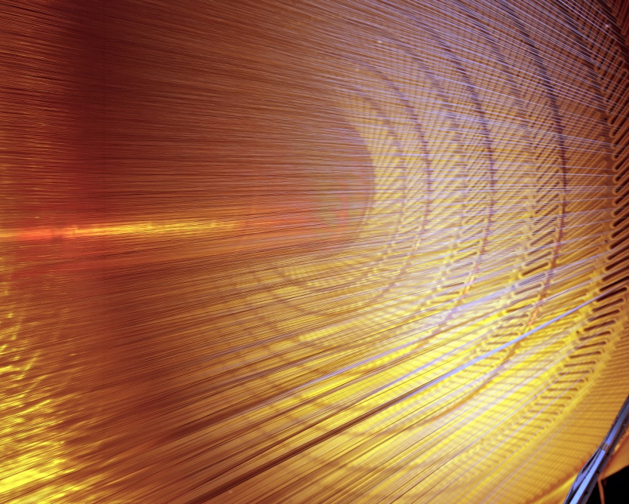
Gas based trackers
Basic construction: Gas filled region (tube, big containter) with signal wires or plans.
Low mass (gas!)
Works with ionization and electric fields

Slide 37
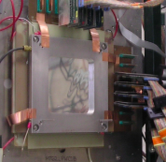
Gas Detector Types

Slide 38
Silicon trackers
Very important – radiation hard!
Can tell trajectory of particles very precisely
More material than gas trackers
Works via ionization
CMS Silicon Tracker
D0 Silicon Tracker
Notes:
Another silicion picture

Slide 39
How do Silicon trackers work?
Ionization!
Same principle as gas detectors, a electron is knocked free and we separate out the positive and negative charges.
Silicon

Slide 40
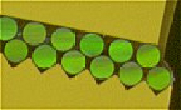
Scintillating Detectors
Can be used in a variety of situations.

Slide 41
Tracking Summary
Okay, so we’ve learned how to tell the charge, what direction it went, and it’s momentum
Three types of tracking detectors: gaseous, solid state, scintillating
Gaseous detectors rely on charge multiplication
Gas choice is a bit of “magic”
Covers large areas ”cheaply” with sensitive materials
Solid state/scintillating
Fine granularity, commercially produced
Can have problems with too much material in the beamline

Slide 42
Calorimeters
Used for:
Energy measurements
Mass measurements
Main concepts
Ionization
Nuclear interactions = “showering”
What type of calorimeters are there?
Electromagnetic calorimeters
Hadronic calorimeters
Sampling vs homogeneous
Lead Tungstate crystals

Slide 43
How does a calorimeter work?
Particles have gone through the trackers with only minimal energy loss (they haven’t really slowed down).
If they never stop- they can leave our detectors and we can’t tell the difference between them or how much energy they have.
So we stop them.
Deposit all their energy
We can tell a lot from how they stop

Slide 44
Detector slice
Calorimeters can cause particle to shower. Where this occurs tells us something about the particle there.

Slide 45
How do calorimeters stop particles?
Particles will interact with different materials in understandable ways
We put specific materials in their path
Dense layers
Ionizing medium

Slide 46
Electromagnetic Calorimetry
Electromagnetic calorimeters measure the electrons (positrons) and photons that interact with the electrons in the atoms
Used to determine photons and electrons

Slide 47
Hadronic Calorimetry
Hadronic calorimeters
Contain both an EM component driven by EM interactions and a hadronic component driven by Strong interactions
Can detector neutral particles and ”see” missing energy

Slide 48
Containing the shower
In both Electromagnetic and Hadronic calorimeters, we want all the information from a particle to stay in the detector
This drives the size of the calorimeter
More energy = harder to stop
CMS Hadronic Calorimeter

Slide 49
Calorimeter summary
Calorimeters are part of the reason detectors are so huge.
Takes a lot of material to stop and contain the traversing particles
Two main types
Electromagnetic
Hadronic
Homogeneous calorimeter
Typically crystral
The whole thing is active
Sampling calorimeter
Absorbing material + active readout layer

Slide 50
Cherenkov radiation
The fastest speed anything can go in vacuum is the speed of light
But in some materials, particles can go faster

Slide 51
Cherenkov Radiation
The velocity (u in this picture) will depend on mass of the particle
Angle will also change depending on velocity, mass, and material used for detector

Slide 52
Liquid Argon Time Projection Chambers
DUNE! Next big neutrino detector
Event display from LArIAT

Slide 53
DAQ and electronics
Okay, the particles have interacted with our detectors – now what?
Final product is
A number: mass of the Higgs = 125 GeV
A plot:
How do we get from trackers and calorimeters to this?
Notes:
Find good, public plots of various decays, higgs, etc, need a bump plot

Slide 54
Data Acquisition Process
Slow controls
Detector
Signal processing
Triggering
Storing to tape
Analysis!

Slide 55
Detector signals
Trackers, calorimeters, TPCs all have “eyes”
Photomultiplier tubes
Silicon Photomultiplier tubes
Sense wires that collect charge

Slide 56
Example – Photomultiplier Tube

Slide 57
Signal processing
Shape
Look at the shape of the signal – will tell you important information
Amplify
Make a small signal large enough to see
Discriminate
Only look at signals above a certain threshold.
Notes:
Add plots of what this looks like

Slide 58
Processing signals
We’ve turned those particle interactions into electronic signals

Slide 59
Trigger systems
Take the input from all the sub systems and detectors
Make a decision: keep or not?
Usually multi-level
Make decisions based on which detector sub systems have events.
CMS Level 1 Trigger

Slide 60
Detector Readout – Put it all together
Detectors have “eyes”
Turn the signals into something readable by electronics
We trigger on only what we want to keep
Finally – Data is stored into a system and later retrieved for analysis
Also used in data quality monitoring.

Slide 61
So Many Detectors
Particle detectors are used in many fields, not just particle physics
Medical physics, security, studying the pyramids

Slide 62
Outlook – What is up and coming
As we move ahead, things get more complicated!
High Luminosity Large Hadron Collider
lots of radiation
DUNE
Large amount of liquid argon

Slide 63
Summary
The physics of particle detectors comes down to matter interacting with matter
Could spend a lifetime studying these different effects
What I want you to remember:
Charged particle interactions are our main source of information
Ionization
Scintillation
Use energy loss to determine what type of particles you are viewing
Interact with atom’s electrons
Interact with the atom’s nucleus

