Slide 1
Main Injector/Recycler
D. Capista
Friday Operations Meeting
19 May 2017

Slide 2
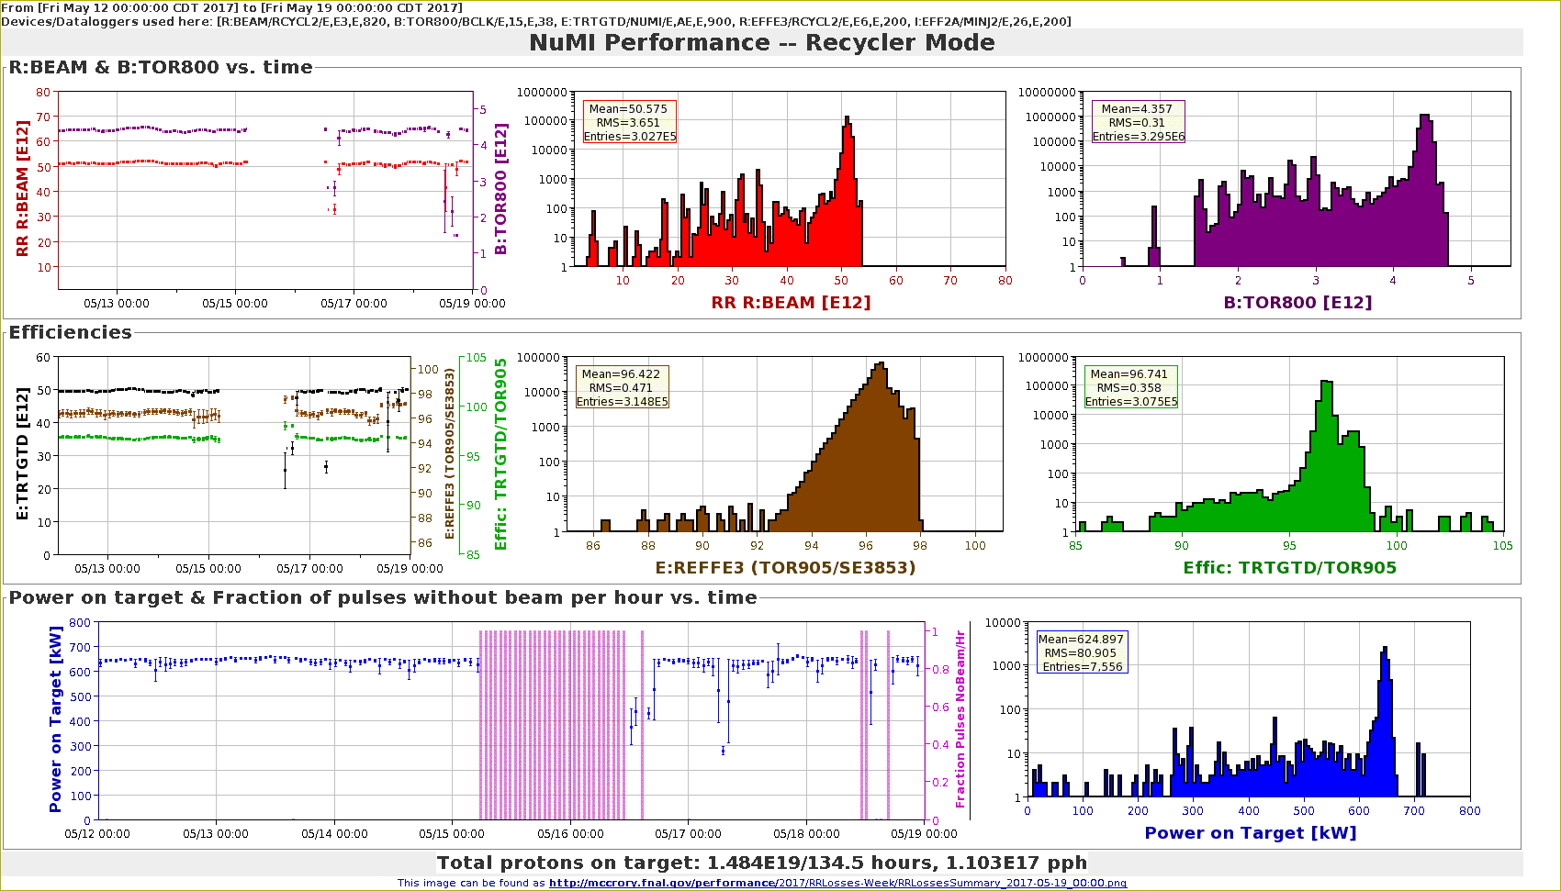
NuMI Performance RR

Slide 3
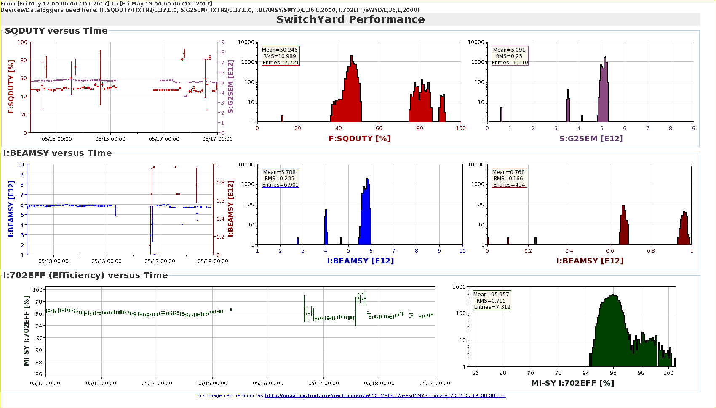
SY120 Performance

Slide 4
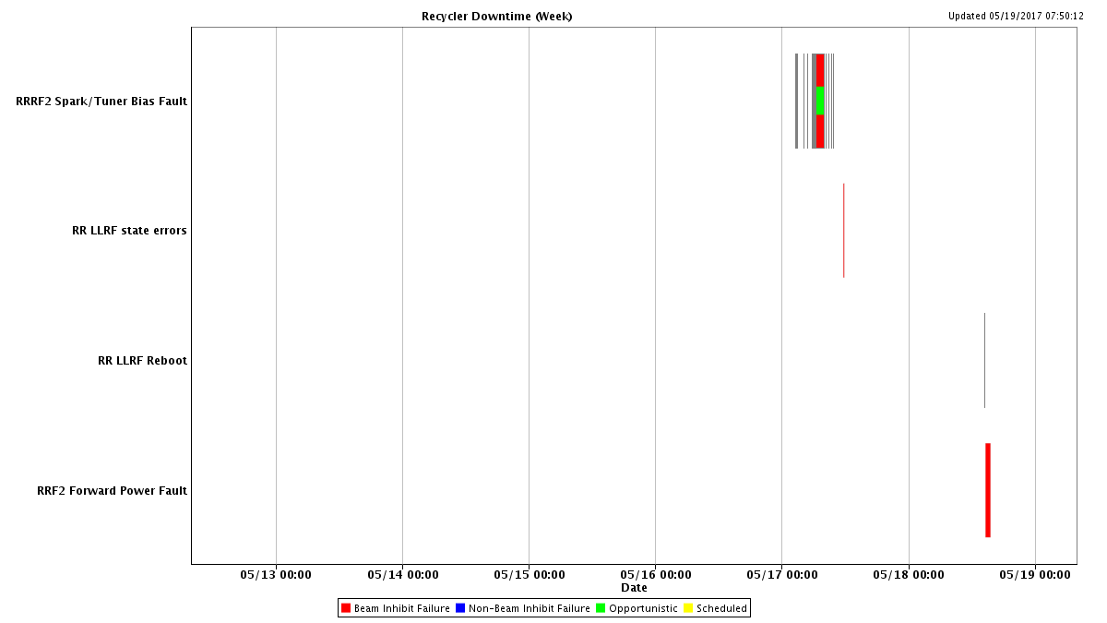
RR Downtime
No data found

Slide 5
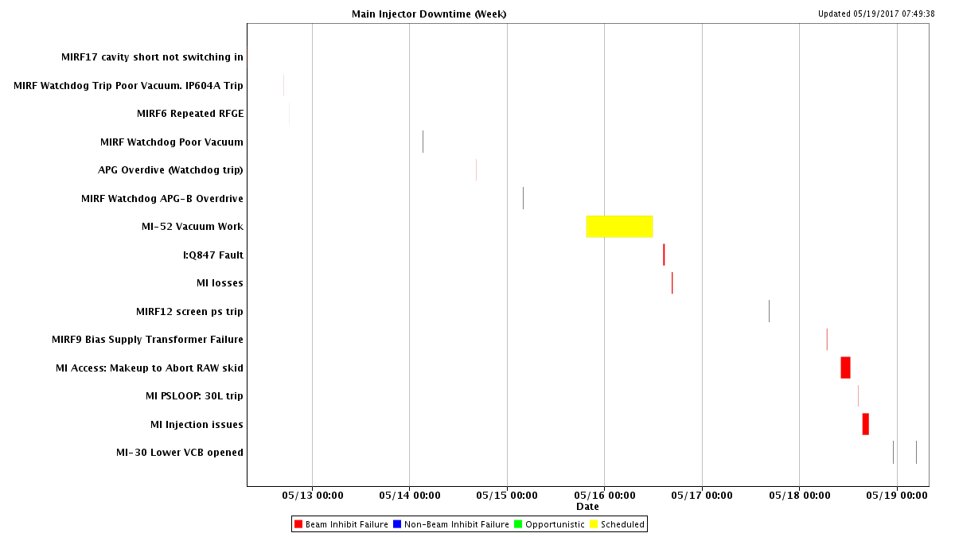
MI Downtime

Slide 6
MI52 Vacuum
RGA Scan
Leak checked vacuum valves
Leak found on Lambertson ion pump
522 Lambertson #2, 2nd ion pump
Previously VacSealed
VacSealed again
Replaced 520D ion pump with a new Triode pump
If this fails again, we would like to replace the beampipe, if possible.

Slide 7
Studies Requests
Timing Change
1.2s Ramp
TBT Lattice Measurements

