Slide 1
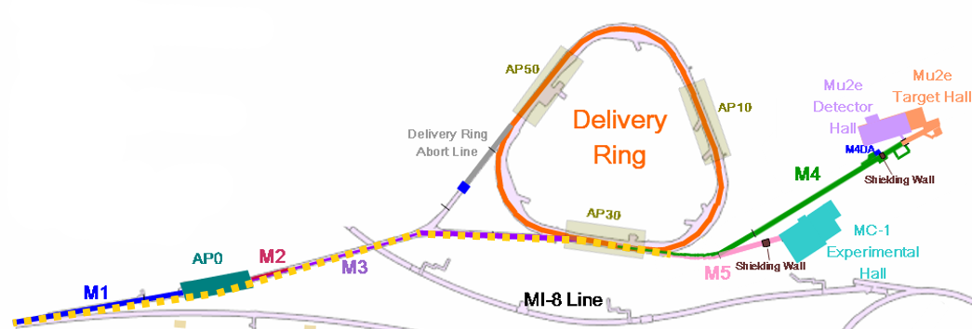
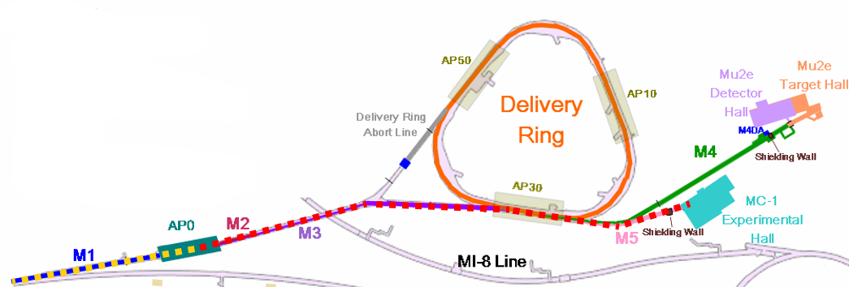
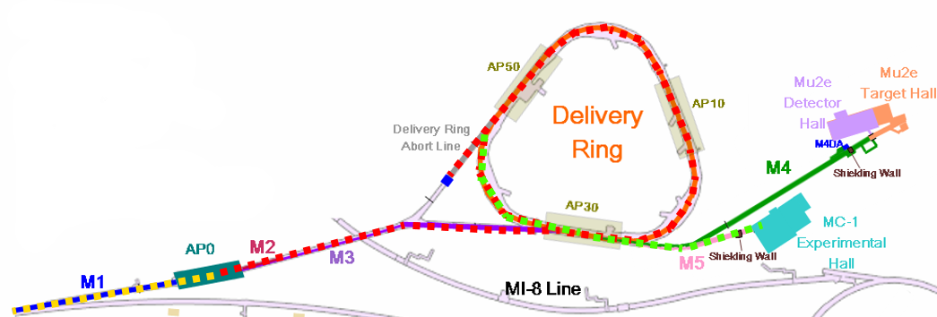
g-2 beam commissioning overview
8 GeV protons bypass target, through shared M4
If time also around Delivery Ring
8 GeV protons to target, 3.1 GeV secondaries to g-2 ring (100:1 protons to muons)
8 GeV protons to target, 3.1 GeV secondaries around Delivery Ring, proton removal, muons to g-2 ring - after shutdown
✓

Slide 2
Status and plans
Established 3 GeV secondaries to the end of the M5 line at entrance to g-2 storage ring
Coordinating with work in the experimental hall, hope to try injecting into ring soon
Have also circulated 3 GeV secondaries around Delivery Ring
Abort kicker ready; can work on proton removal
Received target station beam dump and prepping for installation
Will install at good break point in beam / experiment commissioning

Slide 3
Beam to End of M5 Line
Got all M5 line power supplies on 5/23
Beam went all the way down the line
Last 2 quads not at full voltage so beam will be narrower

