Slide 1
Follow up on Technical Design Review recommendations
31/5/2017

Slide 2
Assigments of replies discussed at last TB
Goal to endorse replies at this TB
A few items still in progress, draft replies collected for most of the recommendations
Draft replies are in the attached excel document

Slide 3
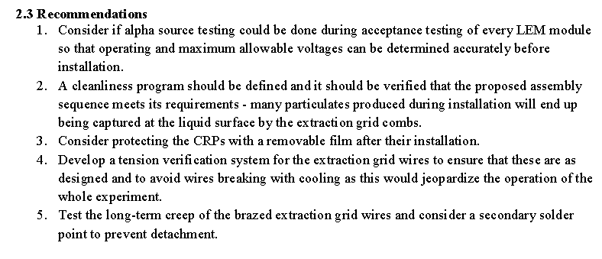
Technical Design Review committee recommendations (From last meeting on May 10th)
→ short replies to recommendations due in an excel file to Steve Kettel and Eric James in two weeks. Eric and Steve will keep track of the process, the Review Committee is over
Tentative assignment to formulate replies:
CRP, electronics, DAQ
Marco, Eddy, Sebastien
OK
OK
Adamo, Sebastien
OK
Dominique, Benjamin
OK
Dominique, Benjamin
Dominique, Benjamin
OK

Slide 4
Photon Detection System, Slow Control
OK
Adamo, Ines
Ines, Thorsten
In progress
OK
Adamo , Ines
Note: the PMT attachment with cryogenic glue was already considered in our design
OK
Laura
Laura
In progress
In progress
See Adamo’s talk
Adamo, Laura
OK
Laura, Franco
OK
Franco, Yann
(already discussed in preliminary grounding document provided to committee)

