Slide 1
Wednesday 9:00
2017-07-05

Slide 2
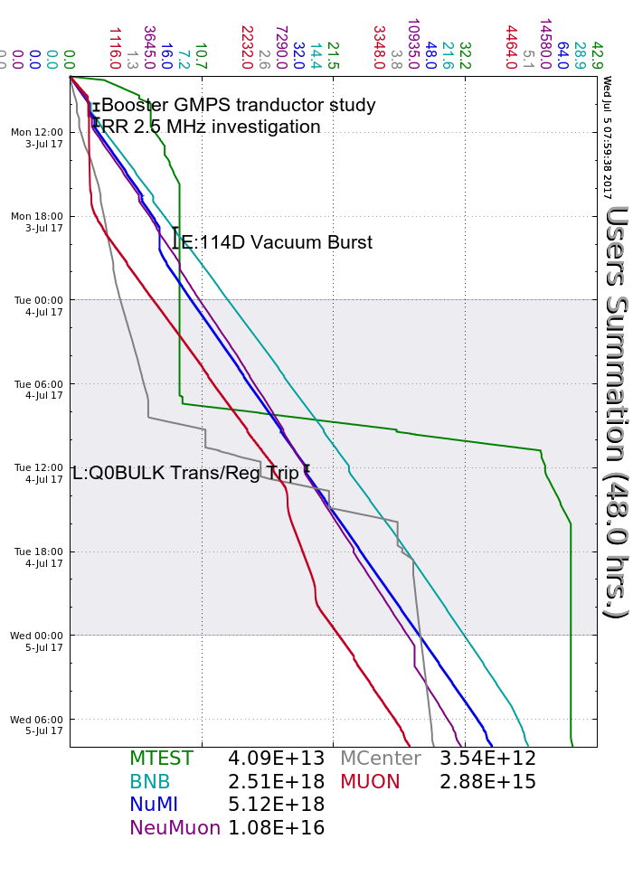
Monday
PS Techs replaced F:MC2H
GMPS Transductor studies
RR 2.5 MHz RF Studies
Studies Day
NuMI Vacuum burst, turned off E:IP114D to recover
Tuesday
L:Q0BULK temperature trips, experts added mesh front panel
Multiple KRF6 CS Faults, cycled contactor to recover
Laser Notcher issues, experts recovered
Wednesday
Delivery Ring D10 sector vacuum issues, recovered
Laser Notcher tripped off, tuned for increased losses
More KRF6 CS Faults
Current Conditions
Had beam to NuMI, BNB, Muon Campus, SeaQuest, LArIAT and MTest
Linac 400 MeV RadTrip, Experts investigating chopper

