Slide 1
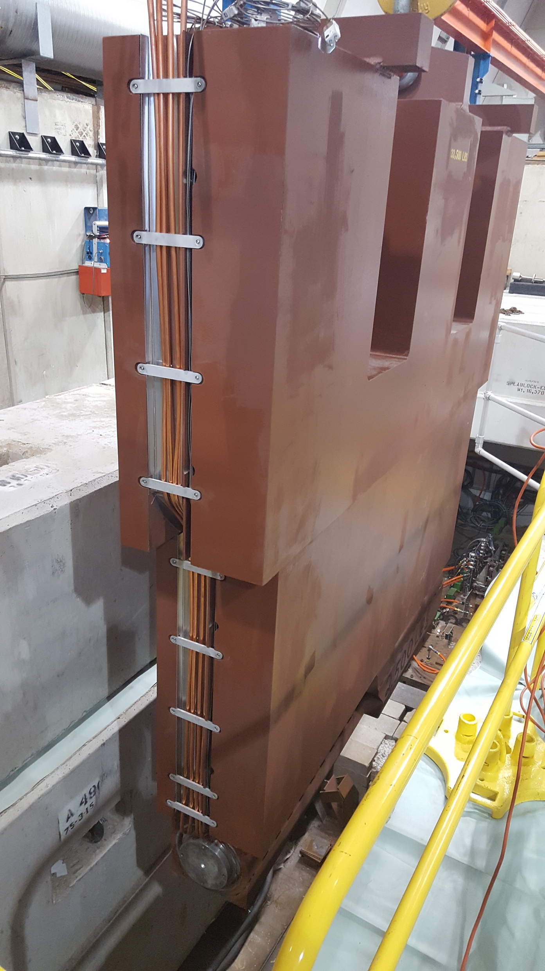
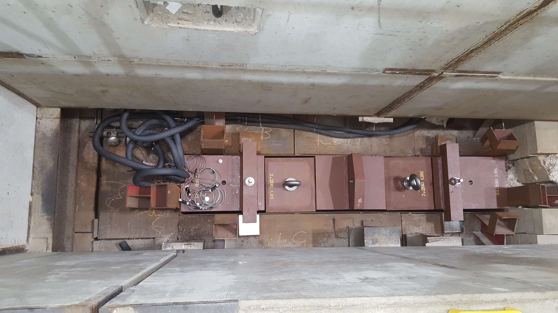
AP0 target dump
The new dump is in place with all waterlines and thermocouples are connected
Can now run at higher intensities and more pulses. Can only take 25% of a booster batch. Starting to run into booster dump limits dumping the other 75%

Slide 2
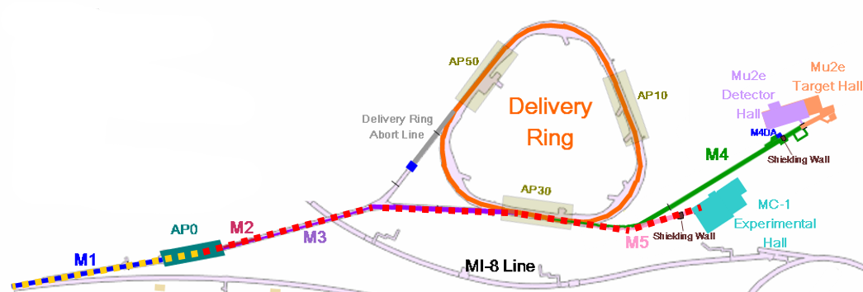
Status and plans
Replaced V742
Pulled and fixed PWC744
Deliver beam and perform beam studies over the weekend
Still have lots of work to do to improve efficiencies
Take advantage of opportunities to run 8Gev beam to fix Delivery Ring orbit. Maybe next week

Slide 3
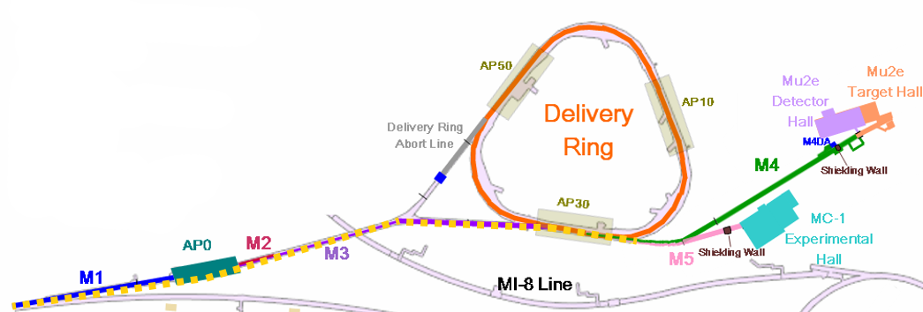
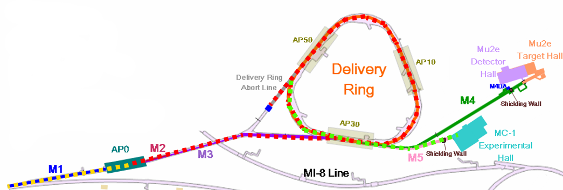
g-2 beam commissioning overview
8 GeV protons bypass target, through shared M4
If time also around Delivery Ring
8 GeV protons to target, 3.1 GeV secondaries to g-2 ring (100:1 protons to muons)
8 GeV protons to target, 3.1 GeV secondaries around Delivery Ring, proton removal, muons to g-2 ring
✓
✓

