Slide 1
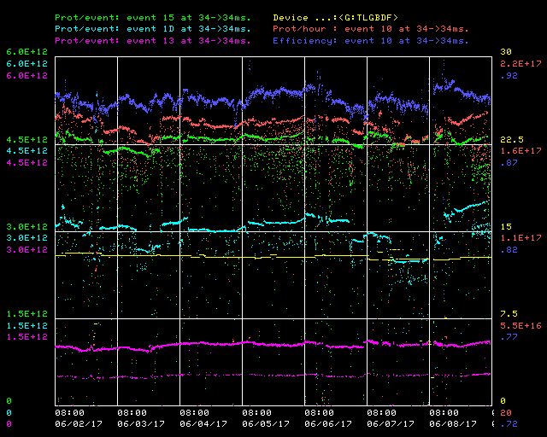
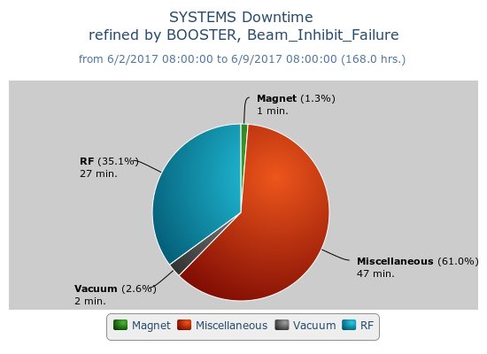
Booster Operations 06/02/17 – 06/09/17
F
T
F
F
Sa
Su
Su
M
F
F
F
W
F
Sa
W
F
Sa
F
F
F
F
F
Sa
Su
Su
M
Tu
F
F
F
M
M
F
Sa
Su
M
F
M
W
W
Sa
Tu
W
Th
F
Sa
F
F
Sa
F
F
Su
Th
F
Su
M
M
F
Sa
M
M
Th
Su
M
Tu
Su
Su
Sa
Su
F
Sa
F
F
Sa
Tu
F
W
W
Su
W
F
Su
M
W
Th
W
F
Sa
M
W
Th
F
Sa
Su
Tu
W
Th
F
F
Sa
Su
W
T
F
Sa
Su
M
Tu
Sa
M
Su
M
W
M
W
Th
F
M
F
Su
M
W
F
Sa
Su
u
F
Sa
W
Th
Sa
M
W
F
Sa
Su
W
F
Su
M
Th
F
Capture/Transition Issues
Access to replace BRF16 Cavity
BRF8 Cable Fault
DOGL3 Flow Switch
MKS06 Cable Termi
Collimator Studies
Access, BRF21 installed
Downtime:
Total 1 hour 17 minutes
Misc mostly studies related down times, cogging module code updates, etc.
Minor HLRF trips
Vacuum: BRF11&12 trips
This week:
Beam to NuMI, BnB, SY, and Muon Campus
$15 ~4.6E12 89-90%, $1D ~3.5-2.5E12 89-91%, $13 @ 1.0 E12 @ 92%
TLGBDF mostly ~ 12.56 Hz
2.66E19 Total Protons for the week
Early Capture studies
Transverse coupled bunch instability studies at injection
Laser Notching studies, syncing to Booster Notcher on $1D’s
Cogging Module code updates for notching alignment on cogged cycles
Lots of Booster tuning, injection losses have been up, limiting intensity and rep rates, but appear to be getting better
Higher extraction losses due to Muon Campus partial batching with higher intensity and more cycles
2 days of Booster studies planned before end of run

