Slide 1
Main Injector/Recycler
M-J Yang
MI Department
June 9, 2017

Slide 2
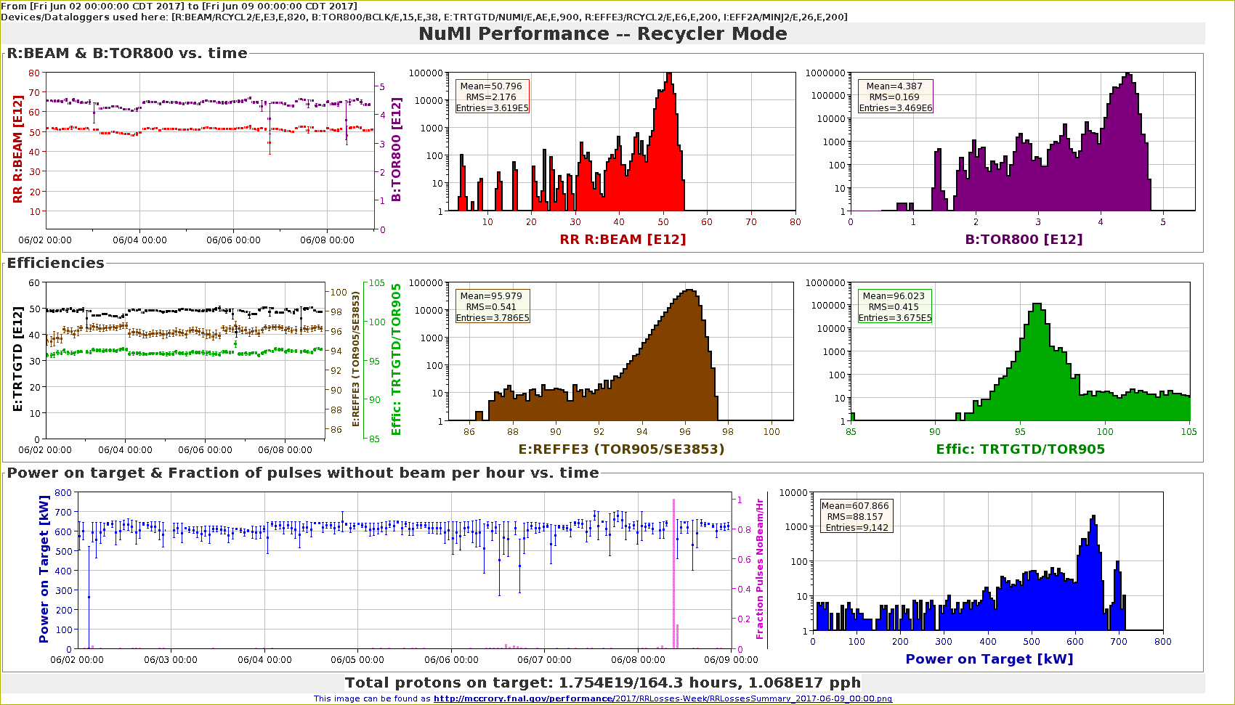
NuMI Performance RR

Slide 3
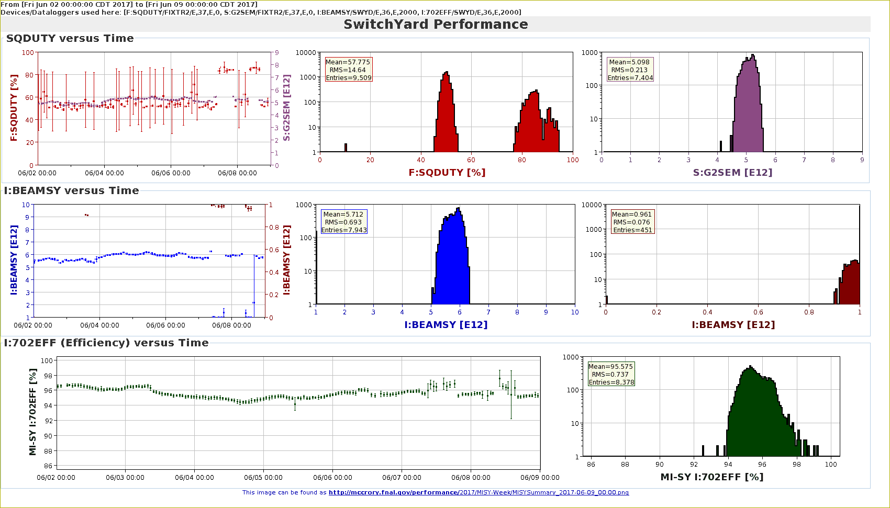
SY120 Performance

Slide 4
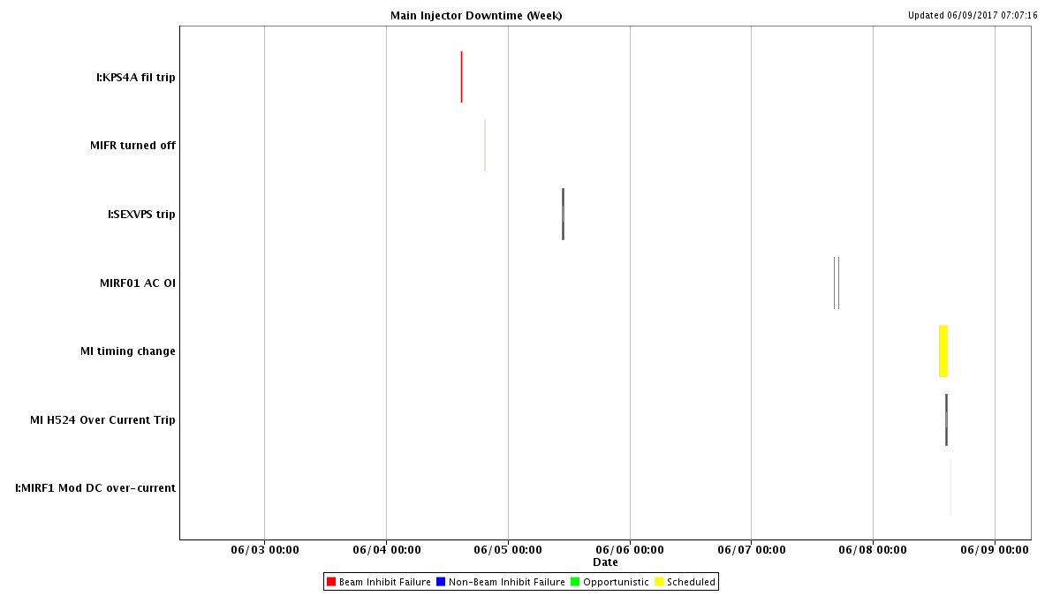
MI Downtime

Slide 5
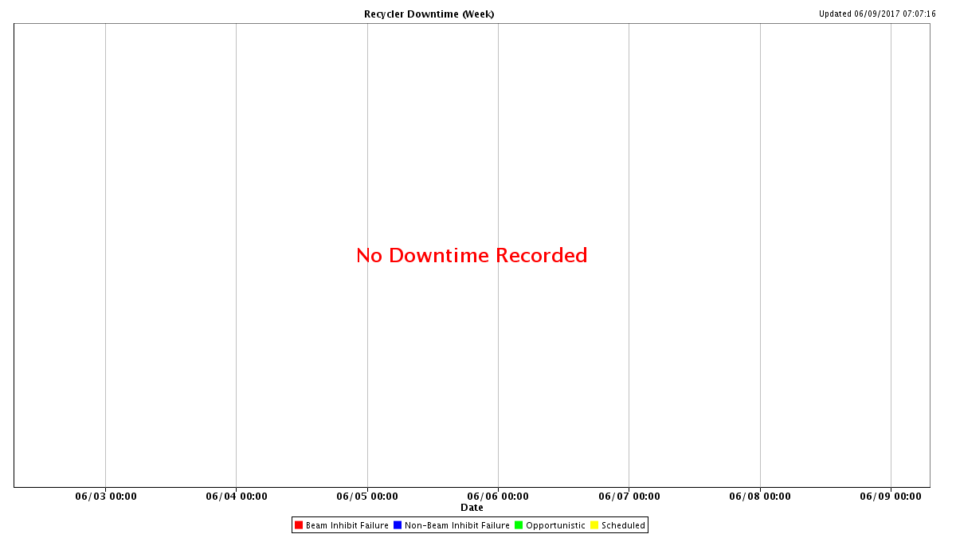
RR Downtime

Slide 6
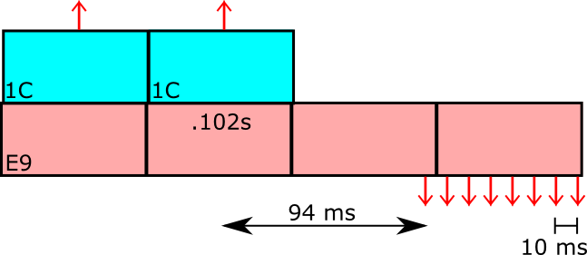
Injection timing change
$1C is moved by 15 msec.
New injection times at 36 and 102 msec
enough time, 94 msec, to make 8 2.5-MHz bunches.
previously at 51 and 117 msec
leaves less than 80ms for re-bunching.

Slide 7
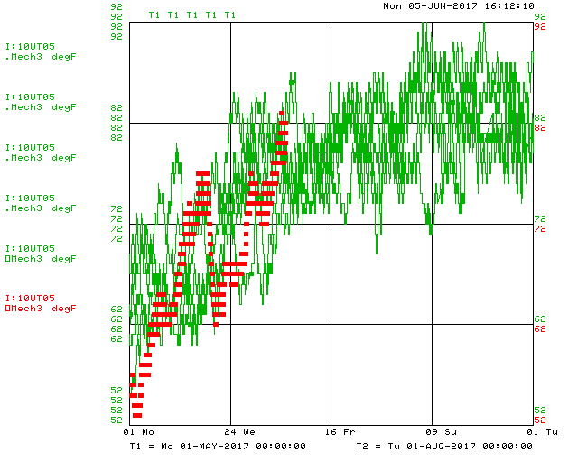
LCW water temperature watch
Alarm is setup
for both supply and return temperature
If alarm goes off
Contact MI person.
Slow down rep-rate.
Or, halt the ramp.

Slide 8
Plan for MI52 Vacuum problem
Leak checked vacuum valves.
Check ion pump magnets.
Replace beam pipe for E-cloud.
Inspect both ends of both septum.
Replace with spare septum if found necessary.
Replacing ion pumps IP521B.
Check MIRF04 cavity for water leak.

Slide 9
Studies Requests
Timing Change
Shorten injection time delay by 15 msec.
Done.
1.2s Ramp
Ramp waveform change.
One study cycle per super cycle.
RR TBT study
0.8 second $E0 cycle
AT time of $20 flat-top.

