Slide 1
Monday 9:00
2017-06-12

Slide 2
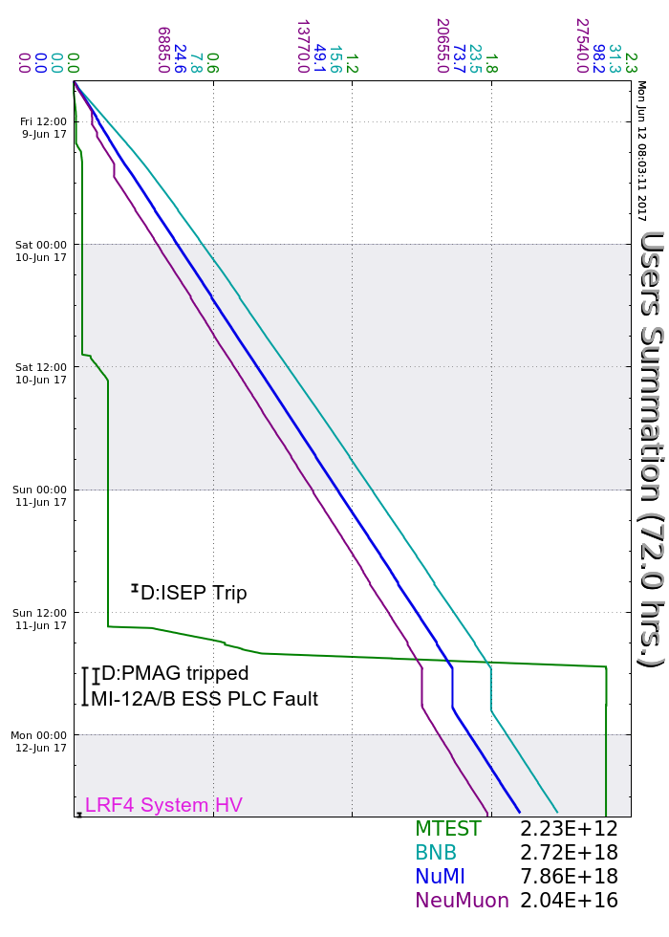
Friday
MS2 cooling tower repaired
Saturday
F0 false fire alarm
LRF1 Overcurrent trips required local attention
M:BV900 closed several times, jumpered open
Sunday
D:Q812 regulation issues, rebooted PRAC multiple times
MI-62 expansion tank low, filled
Muon Campus g-2 Ring Center radtrips beginning at 07:30
D:ISEP tripped without alarm, reset and added monitoring
MC-1 surveyed and went open access, secured in evening
D:PMAG tripped, experts needed to adjust trip limit
MI12 A&B went unsecured due to PLC Fault, experts recovered
Monday
Two F0 false fire alarms
LRF4 HV trip, experts recovered
Current Conditions
Beam to NuMI, BNB, Muon Campus and SeaQuest

