Slide 1
9 O’Clock Meeting
Wednesday June 14, 2017

Slide 2
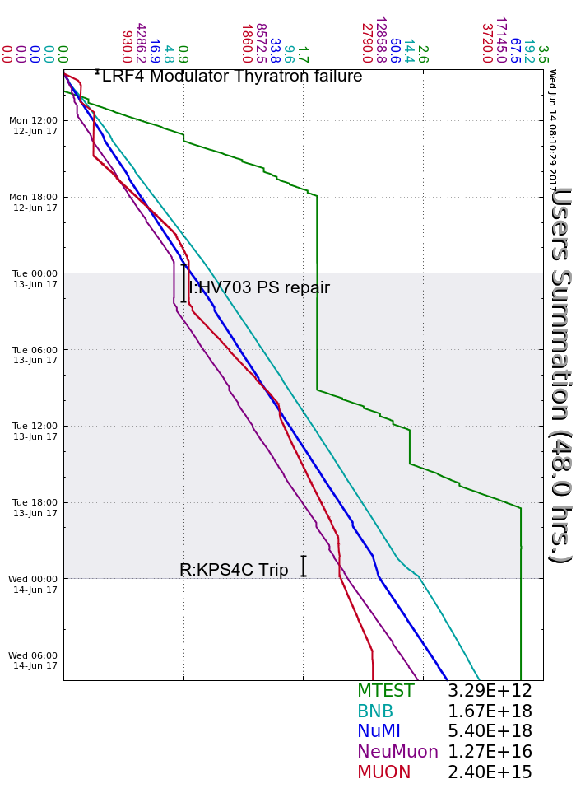
Monday:
LRF4 HV thyratron failure; Experts recovered
I:HV703 fault took down P1 beam for a few hours (no SY or g-2)
Tuesday:
Poor vacuum in Muon closed BVs
Wednesday:
R:KPS4C panel meter failure; went MI-only for 1.5 hours
Rad Safety performing shielding study at AP0 (no keys until they’re finished)
Controlled access in Delivery Rings
MT6 Open Access to swap experiments
Beam to NuMI, BNB, SeaQuest

