Slide 1
Radiation Shields in the penetrations of NP-02
David Montanari
Wed Jun 14, 2017

Slide 2
Motivation
To reduce the radiation heat leak (to the LAr) coming from the spare penetrations, and other penetrations, if any:
Spare Detector Penetrations.
Spare Cryo Penetrations.
Manhole.
Maybe other Detector penetrations not fully utilized?

Slide 3
Not to scale

Slide 4
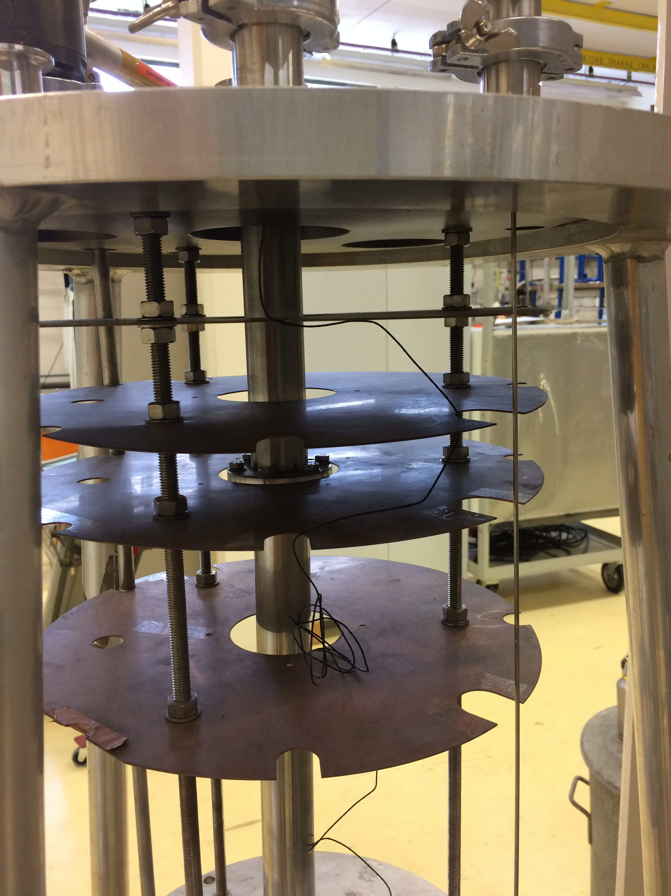
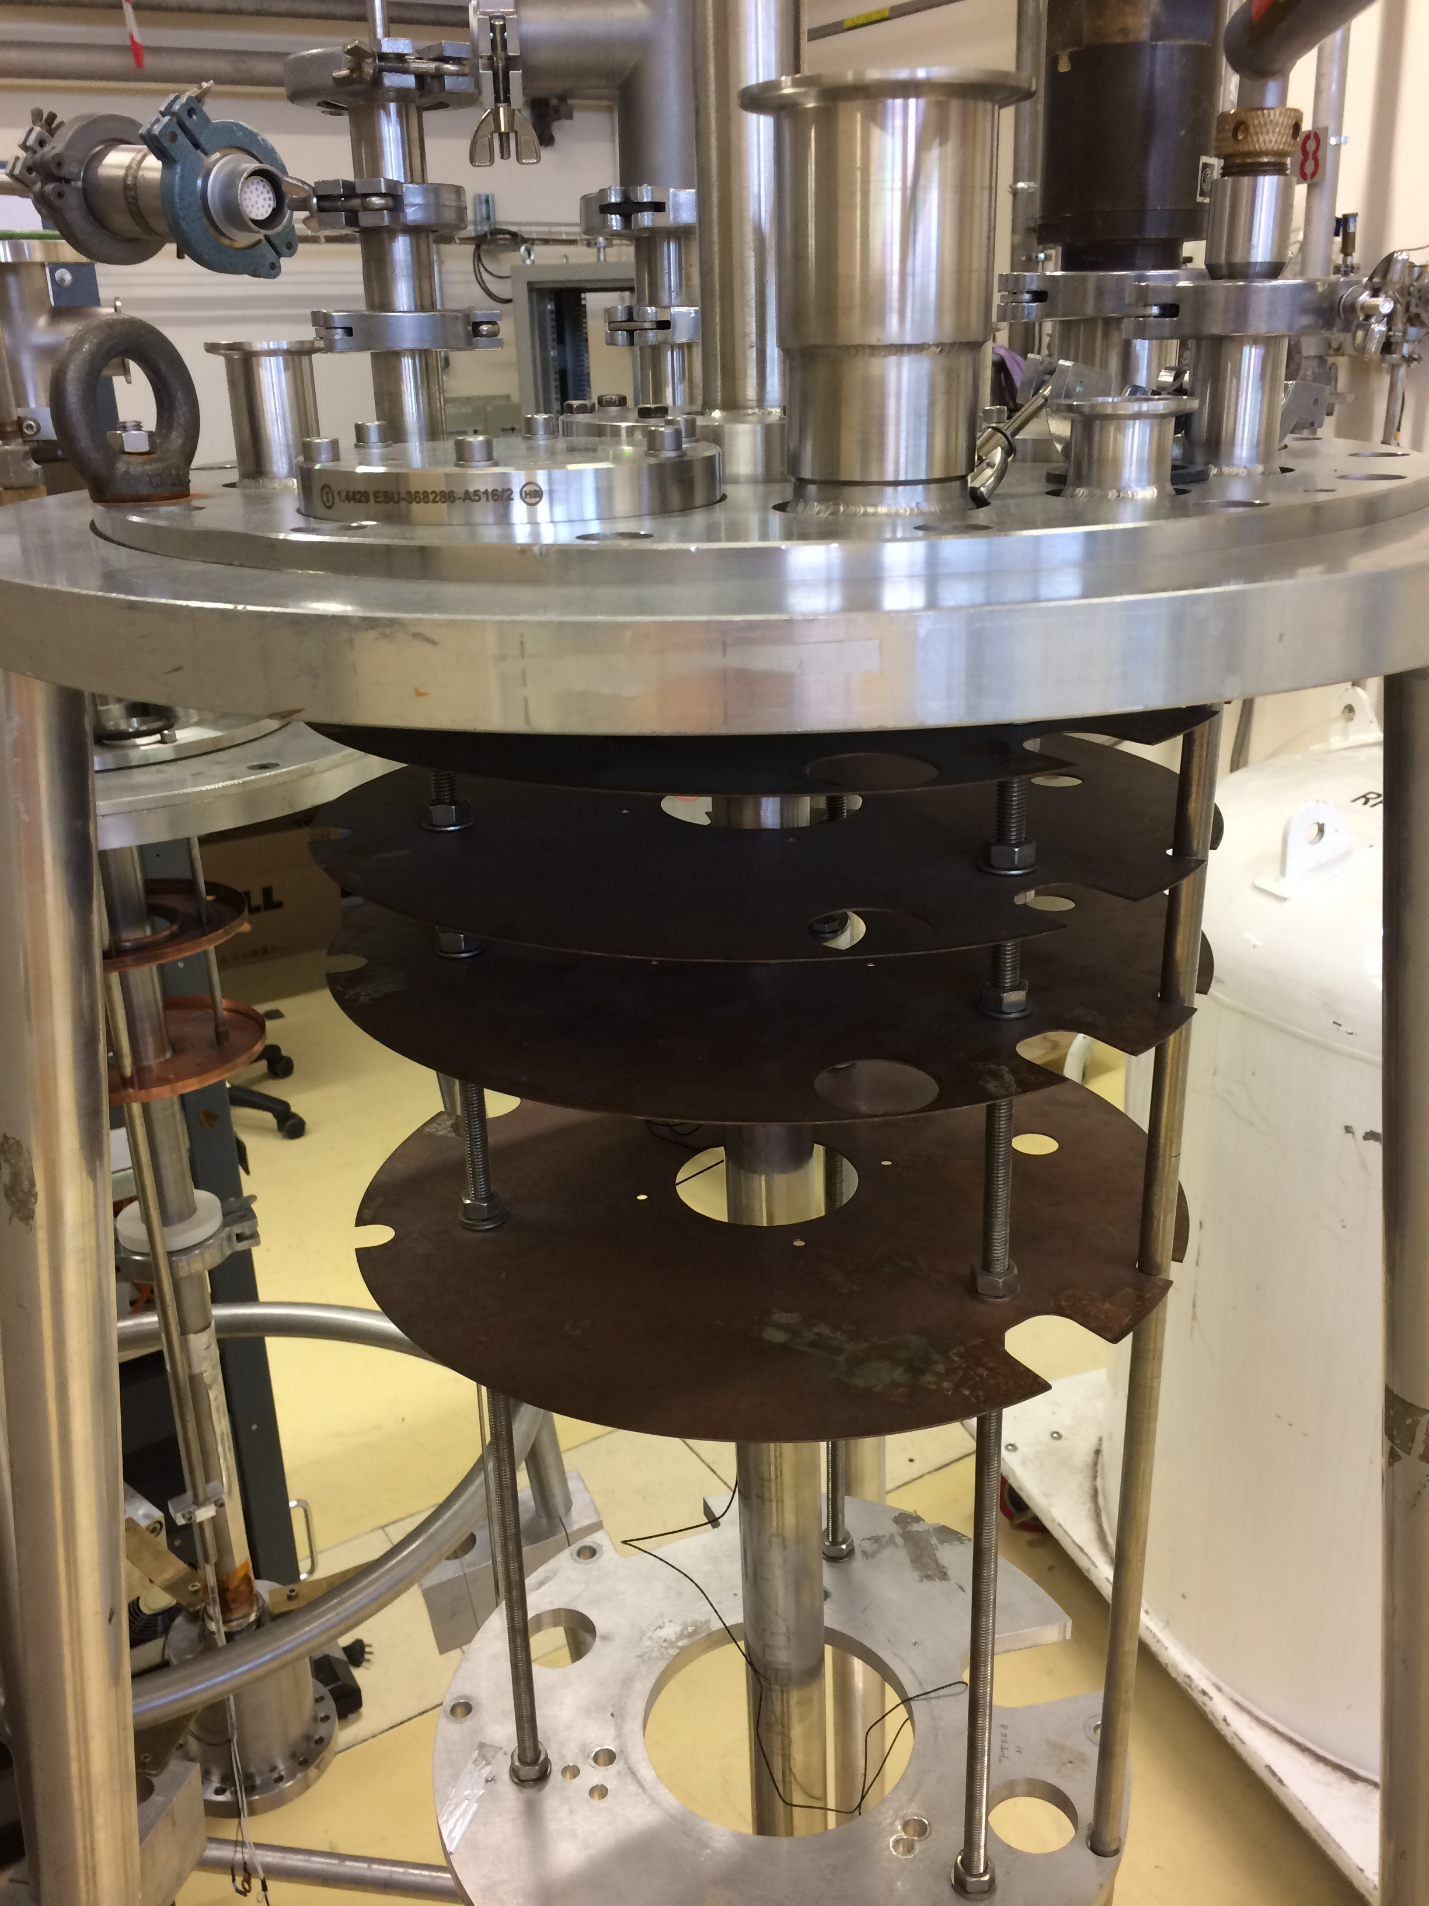

Slide 5
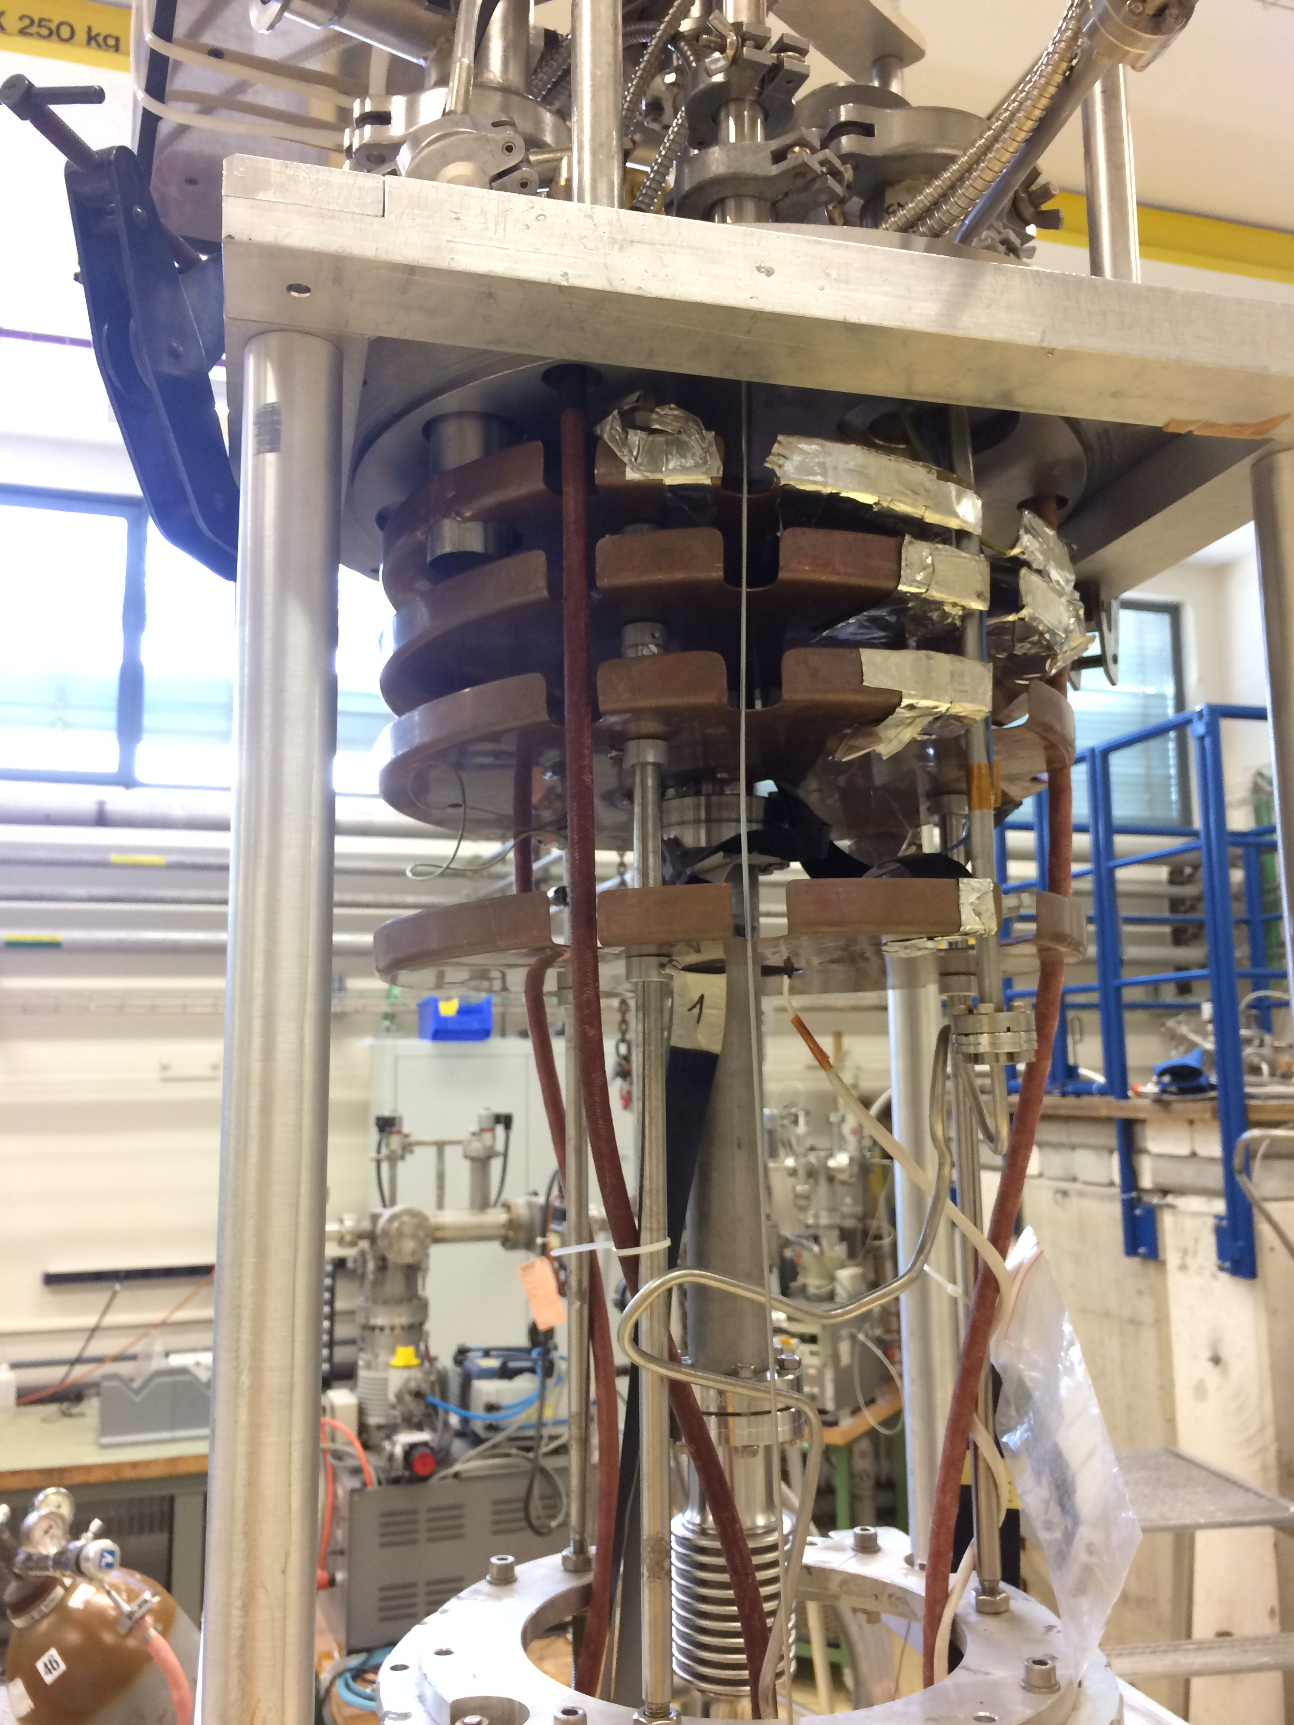

Slide 10
What/When is needed?
Confirmation of size and location of the Detector Spare penetrations and size of the Flange sealing them.
Size and location of other penetrations potentially available (and the available footprint) and size of the Flange sealing them. In general, this would predominantly cables/wires/etc. that may be easy to bundle altogether and run through an (or multiple) opening(s) in the radiation shields.
When: by end of this week.
Between NP-02 and NP-04, Detector and Cryo there are quite some penetrations to fit (~20).
We need to order the flanges, start preparing the shields, etc.
There is available manpower now for this work, we should take advantage of it.

