Slide 1
PIP-II Project Manager’s Report
Steve Holmes
PIP-II Project Management Group
28 June 2017

Slide 2
Outline
Goals
Financials
ES&H/NEPA
Technical/R&D
India Collaboration
Project Management
CD-1 Status

Slide 3
Project Goals
Milestone | Planned | Actual or Forecast
CD-0 | Q1 FY2016 | November 12, 2015 (A)
CD-1 | FY2017 | Q2FY2018
CD-2/3a | FY2019 | FY2019
CD-3 | FY2020 | FY2020
CD-4 | FY2026 | FY2026
Profile unlikely to survive the summer
PBR is for $14.0M in FY18
Balance of years due from OHEP by August 31

Slide 4
Goals for FY17
New goal is to achieve CD-1 in early CY2018
RLS
ICR
Documentation
Financial Goals
Live within the provided budget: $21.03M (includes FY16 carryover)
Cross the FY17/18 border with ~$2.0M unobligated (carryover)
ES&H Goals
Be prepared to initiate Environmental Assessment on 10/1/17
R&D Goals
Release CDR
Complete PIP2IT MEBT
Keep HWR and SSR1 on track for CY2018/19 delivery
India Collaboration Goals
Meet 2017 deliverable milestones
Establish confidence between the partners
Management Goals
Complete all CD-1 documentation and successfully navigate required reviews
Fill missing positions on organization chart

Slide 5
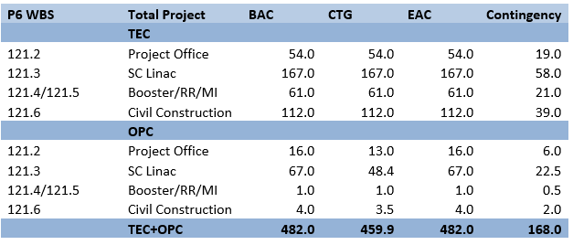
Financials (inception through 4-30-17)
Spending since CD-0
OPC/Project Office, Civil Const, and SC Linac are only areas of activity to date
4.6% complete

Slide 6
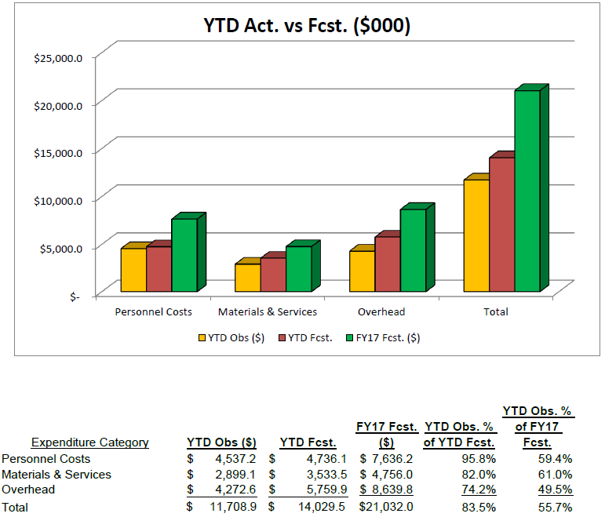
FY17 Financials (through 5-31-17)
RIPs: $138K
Current Management Reserve: ($75K)
Demands against Management Reserve: $679K

Slide 7
FY17 Financials/Management Reserve
Budgets adjusted following FY17 forecast-to-complete in April
Several funding change requests were approved, most notably
HB650 cavity dressing + contract designer (shared with SSR)
RFQ new couplers/tuners
SSR1 CM parts
Current Management Reserve: ($75K)
Includes $130K of uncosted obligation on Pavac contract that DOE has agreed to move from GARD to PIP-II (in June)
Note: We have not seen funds yet, although we have obligated the work. Potential issue with recoloring or money?
Unfunded Requests: $679K
Lab 2 Improvements $338K
PIP2IT RFPI $15K
LLRF $56K
Partially funded
CF subsurface documentation $20K
Environmental Assessment $250K
Not shown in MR: Anticipate SWF underrun of up to $2M

Slide 8
FY18 Strategy @ $14.0M
Currently projecting FY17 underrun of $1.8M
Budget FY18 for $15.8M
Support 40 FTE
Standing army (20) + priority activities (20)
Compare to 54 FTE budgeted in FY17
SWF+OHD $10.7M
M&S + OHD $5.1M
Schedule ~$1M of M&S in Q4 FY18 = virtual reserve
Priorities
CD-1
CDS install at PIP2IT
MEBT absorber at PIP2IT
HWR (pCM)
SSR1 (pCM)
HB650
CF design start (site prep and buildings)
EA
Issues
Essential that we get operations support for Lab2 ($338K w/ovhd)
We need this for SSR1 assembly
We have requested from Laboratory Reserve
Booster injection design

Slide 9
ES&H/NEPA
Wetlands Jurisdictional Determination
FSO has submitted the application package to USACE (Apr 27)
Fermilab personnel met with USACE representative to provide overview (May 12)
If accepted, the wetlands located in the PIP-II footprint would be designated non-jurisdictional
Process should take ~ 1 year
If denied, a new wetlands permit application would be submitted in FY2018 to allow USACE the 1 year review period in order to meet a PIP-II start work date of late FY2019/early FY2020.
Environmental Evaluation Notification Form (EENF) ready for submission to DOE/FSO
Expect to forward to FSO this summer and initiate selection of PIP-II NEPA/EA contractor before the end of FY17

Slide 10
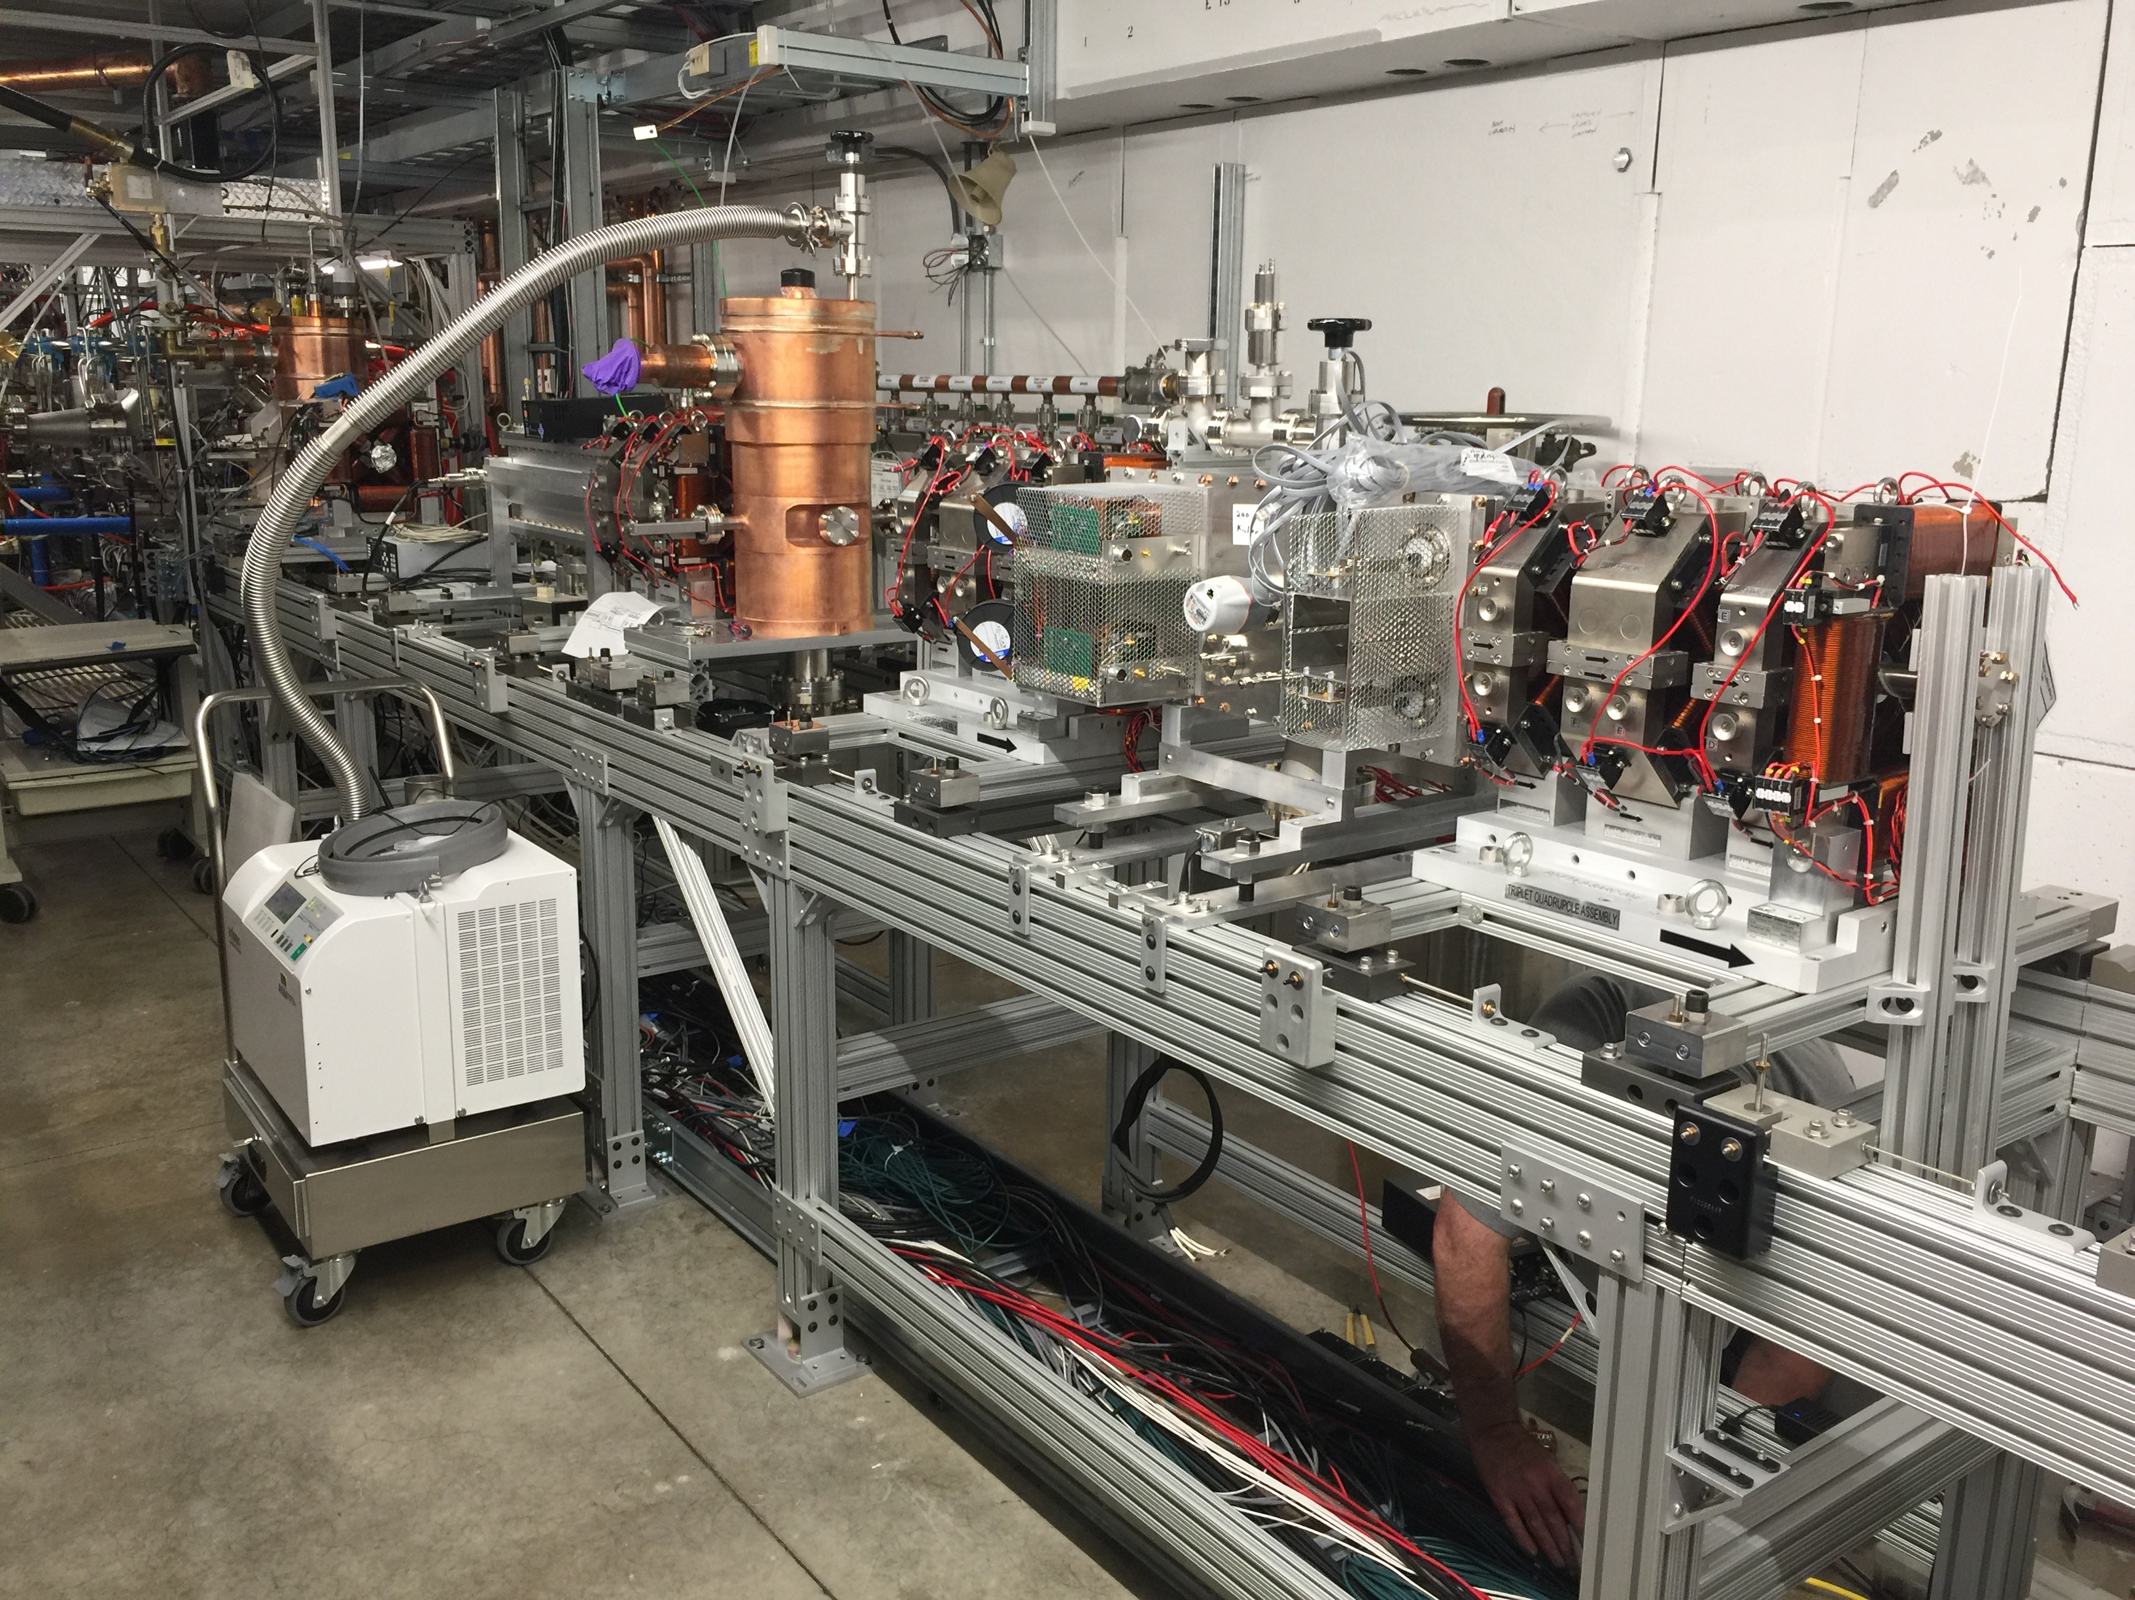
Technical/R&D Status
PIP2IT
2017 goal to complete MEBT and commission with beam
5 mA × 1 ms × 20 Hz to dump
Measure kickers’ effects on the beam
Completed installation of MEBT-2. Operations have resumed with 4 MEBT triplets, additional buncher cavity. Transmission to dump at ~99%, starting commissioning of chopper kickers
Final 3 triplets to complete
MEBT arrived @FNAL,
2 now at CMTF,
1 being measured in TD.

Slide 11
Technical/SRF R&D Status
HB650
Goal is to qualify and dress four cavities in FY17
Two cavities are qualified
Third near spec
Going through “nitrogen infusion” processing
Fourth went through second vertical test last month
High FE; will require reprocess
SSR1
Dressed cavities are showing FE in full power tests (at STC)
This is delaying the SSR1 schedule
Investigating
Couplers
New RFQ coupler design has been completed and reviewed
Procurement initiated
HB650 couplers RFP has been released
Best value procurement with pre-qualified vendors

Slide 12
India Collaboration
Joint R&D Project Document
Addendum II: Documentation of Fermilab engineering deliverables.
Close to convergence – shooting for end of June
Addendum I: Modification to DAE deliverable dates to reflect delays in R&D program to FY2020
DAE to make Addendum I consistent with Addendum II
Visitors
We have been authorized by DAE Secretary to restart the long- and short-term visitors programs
Can accommodate 36 months LT, and 12 months of ST in FY18 budget
Wish list for second round has been developed by DAE
Exports
Procurement of MOSFETs for SSR1 RF sources is becoming critical
No distributor willing to sell if BARC is end user (business decisions)
Options:
Convince distributors it is in their interest to apply for the require export license
Convince Department of Commerce to remove BARC from entities list for Annex I activities
Upcoming Visits
Leonardo Ristori et al will be visiting BARC in August for:
Witnessing of SSR1 He vessel welding
Review of SSR2 cavity design
IIFC Meeting
Preparations initiated for a meeting at BARC in October
Schedule in doubt.
These cavities must be on-site 12/31 to end up in SSR1 pCM

Slide 13
Project Management/CD-1
Assumptions Document approved (Mar 9)
Functional Requirements Specification approved (Mar 17)
Lab MOU draft under internal (project) review
Critical path is:
RLS (see L. Lari presentation)
BOEs (see P. Derwent presentation)
Risk Registry
140 approved risks
Undertaking initial calculation of associated contingency
Agreement with AD on division of scope between PIP-I+ and PIP-II
Associate cost impact/savings is:
Point estimate: $17M
Upper cost range: $21M

Slide 14
Project Management/CD-1 Strategy
We are currently developing a “technically limited” RLS, with a goal of PIP-II completion coincident with completion of the LBNF shutdown (Q2FY26).
RLS includes DOE funded activities only
Earliest finish date appears to be ~Q1FY27; limited by SRF assembly and testing facilities
We are concentrating on eight level-3 sub-projects, representing ~70% of the project cost.
These have all been through internal review and are frozen for the moment.
All are showing increases of several x 10% as compared with the CD-0 estimate
Some (currently) show a reduced scope of DAE deliverables as compared to CD-0 estimate
Need to normalize this
We have committed to sharing with DOE the funding profile associated with these eight level 3 sub-projects at the IPT meeting on June 29 (tomorrow)
See Luisella’s presentation
DOE/HEP has informed us that they will be able to provide the funding profile to be utilized for CD-1 at the end of August.
Upon receipt we will iterate the RLS to match the CD-1 profile
Dates
Director’s Review November
DOE IPR/ICR January/February 2018
ESAAB (CD-1) March/April 2018

Slide 15
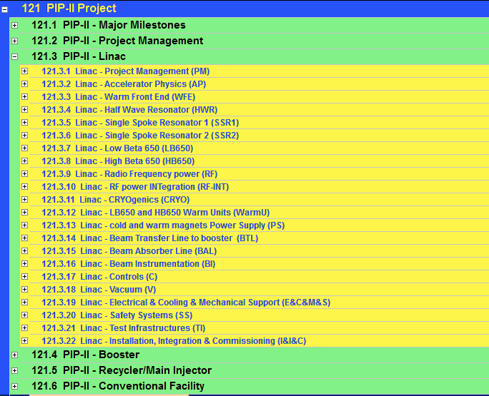
RLS status
Close to be ready/ready
Advanced
Preliminary
Internal Review
In P6
Detailed Plan
WBS for BOE
~70% of Total PIP-II Project costs

Slide 16
Project Management
Personnel
Allan Rowe has succeeded Don Mitchell as Project Engineer
Assisted by Jim Steimel as Project Engineer for Electrical Systems
Issues that are impeding progress
Lab2 cleanroom not complete – requires substantial further investment to make usable
Engineering support for SRF
Tom N (Mu2e) and Chuck G (LCLS-II) have very minimal availability
Much of the slack is being taken up by Vikas Jain (RRCAT visitor)
He returns to India in October → need to identify a replacement
Six DAE long-term visitors will be returning India over Sep-Nov
Replacements TBD: Budgeting four people arriving Jan 1.

Slide 17
Summary
Moving toward CD-1, with a newly-modified plan
Delaying by ~4 months to allow alignment of schedule and funding profile.
India collaboration is taking a lot of attention
Improving interactions and information exchange
Need to add more staff prior to CD-1
Essentially there

