Slide 1
Resource Loaded Schedule Status
Luisella Lari
PIP-II PMG meeting
28 June 2017
Thanks to L3/L2 managers
and PIP-II Project Management Team

Slide 2
Outline
PIP-II RLS news
PIP-II RLS draft cost profile
PIP-II RLS FY18 obligations
PIP-II RLS next steps

Slide 3
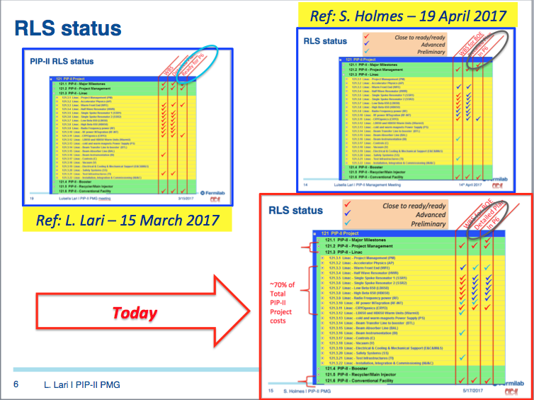
PIP-II RLS news
The PIP-II Project requires a complex RLS: a reminder from May PMG

Slide 4
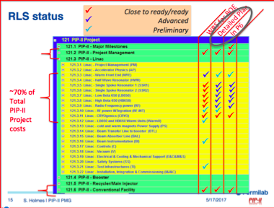
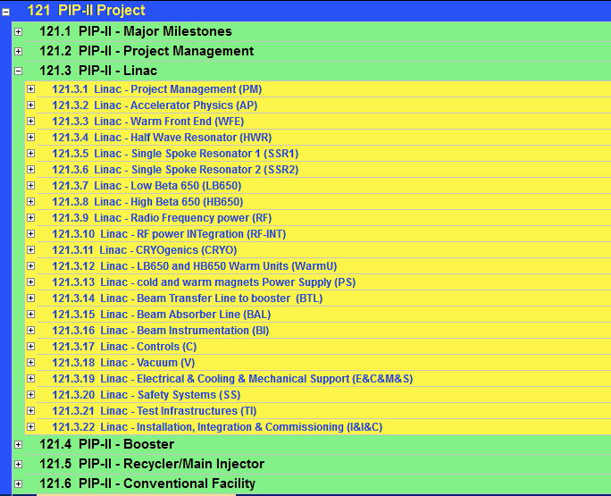
PIP-II
RLS news
Close to be ready/ready
Advanced
Preliminary
Internal
Reviewed
In P6
Detailed Plan
WBS for BOE
~70% of Total PIP-II Project costs

Slide 5
PIP-II RLS news: major changes with respect CD-0
CF cost profile updated in P6, following the new estimations (May 2017) for construction phase (about 40 M$ on top of CD-0 estimation).
CMs (but HWR) technical driven RLS updated:
  With the availability of Test Facilities → i.e. All the Dressed cavities will be tested in VTS and about 30% in STC/HTS-2, including samples test for IIFC dressed cavities (@ CD-0 it was foreseen not to test any IIFC dressed cavities and to test 50% of FNAL cavities).
  Including RF tests for each CM in PIP2IT or CMTS before final installation in PIP-II tunnel (not foreseen @ CD-0).
RF Power RLS includes the circulators as part of the FNAL scope (about 3 M$ cost identified as in-kind contribution @ CD-0)
Cryogenics RLS includes the CM bayonet boxes as part of FNAL scope (about 4 M$ cost identified as in-kind contribution @ CD-0) .

Slide 6
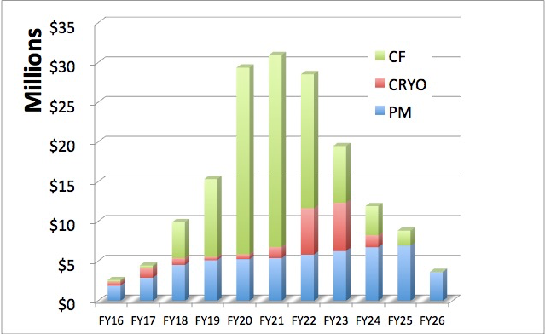
PIP-II RLS draft cost profile in P6
Please note that P6 is not yet including the SWF costs for CMs and RF Power and Contingency
In P6 in May
Now in P6: including escalation and overhead

Slide 7
PIP-II RLS draft cost profile in P6
In P6 now

Slide 8

PIP-II RLS with respect to Early CD-4
Early dates for CD-4 presented at the November Review 2016
End on March 2026 → end of RF test in PIP2IT for the last SSR2 CM.

Slide 9
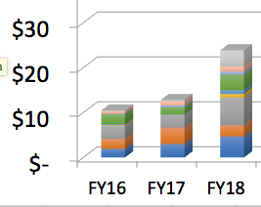
PIP-II RLS obligations for FY18
Technical driven schedule in P6, including the SWF costs for CMs and RF Power is over budget for FY18
About 3 M$ in obligations for FY18, mainly for SSR2 Nb and LB/HB650 Prototype Cavities and HWR SSAs
NB: FY18 Budget foreseen is 14+1.8 M$

Slide 10
PIP-II RLS draft cost profile in P6
Total P6+SWF costs
= 381 M$
i.e. 70% of the Total Budget

Slide 11
PIP-II RLS next steps
Include SWF costs in P6 for CMs and RF Power;
Checking/Review the RLS Critical Path (meeting on July the 10th);
Review the RLS (70% in cost) - on the point of view of planning - at the end of July by the OPSS office;
Continue the RLS internal Reviews;
Include the missing plans and checking possible discrepancies with CD-0 data;
Produce the obligations profile for all FYs;
Align to FY18 budget?
Thanks to L3/L2 managers
and PIP-II Project Management Team

