Slide 1
Main Injector/Recycler
Friday 9AM meeting
M-J Yang, MI Department
June 16, 2017

Slide 2
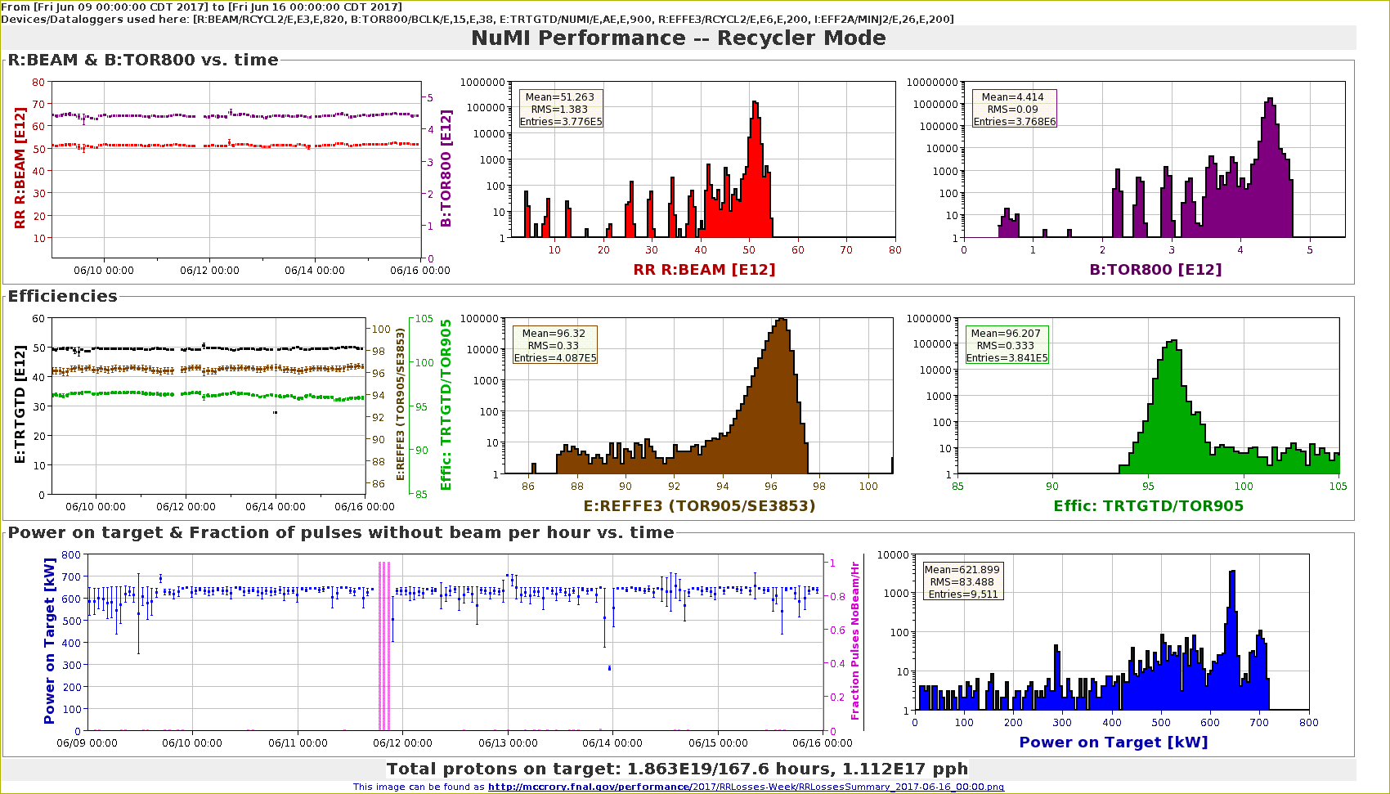
NuMI Performance RR

Slide 3
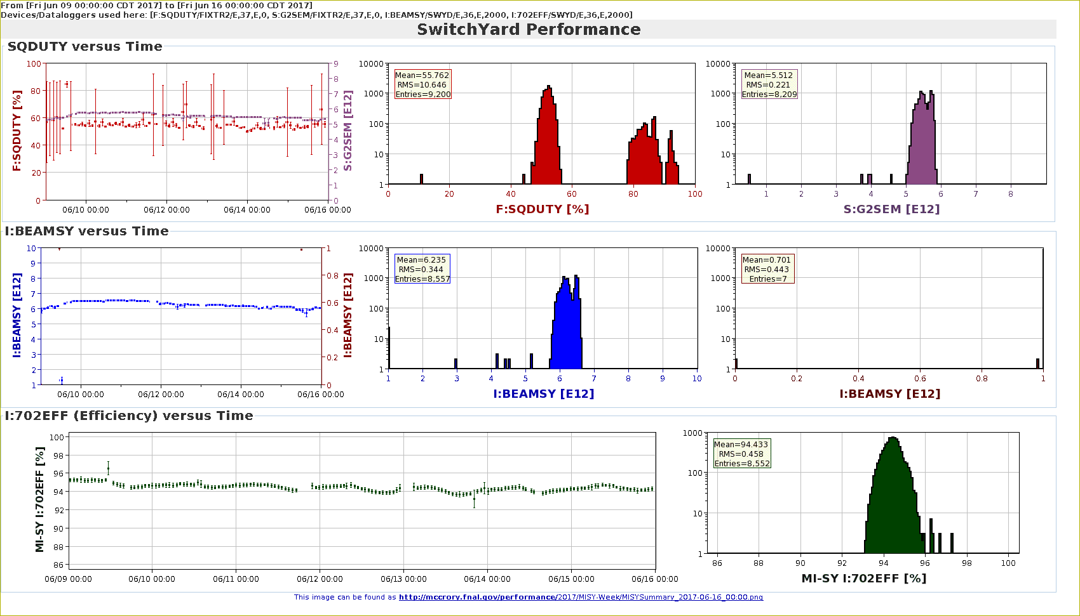
SY120 Performance

Slide 4
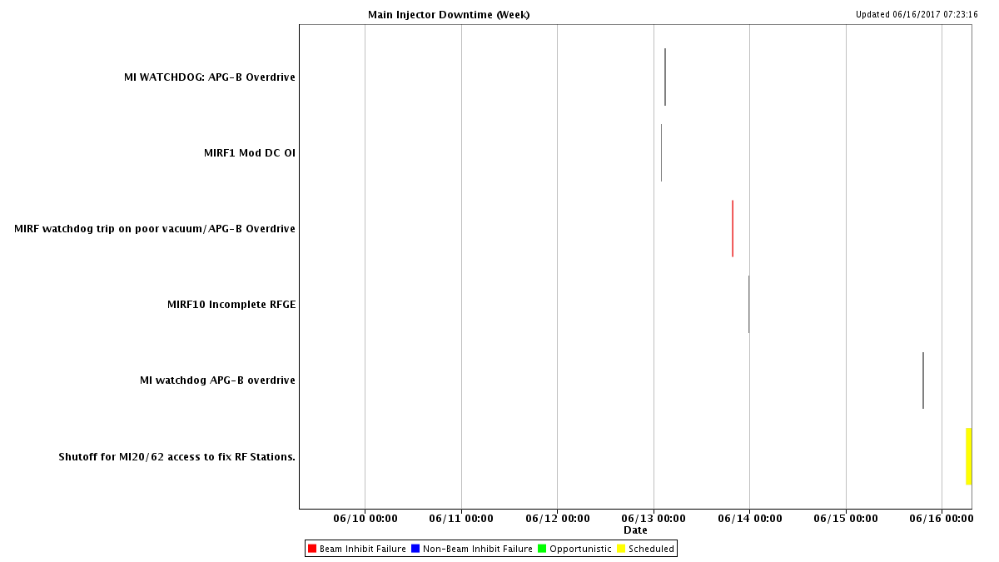
MI Downtime

Slide 5
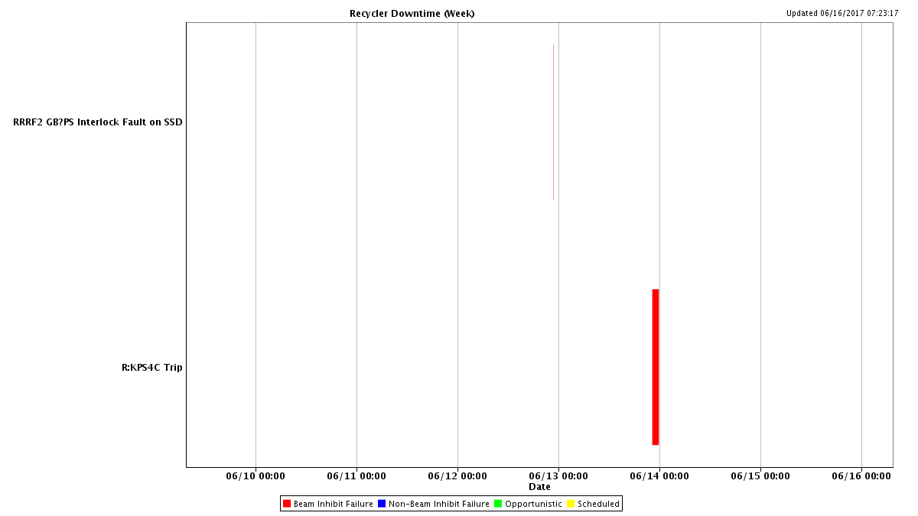
RR Downtime

Slide 6
Plan for MI52 Vacuum problem
Leak checked vacuum valves.
Check ion pump magnets.
Replace beam pipe for E-cloud.
Inspect both ends of both septum.
Replace with spare septum if found necessary.
Replace ion pumps IP520B.

Slide 7
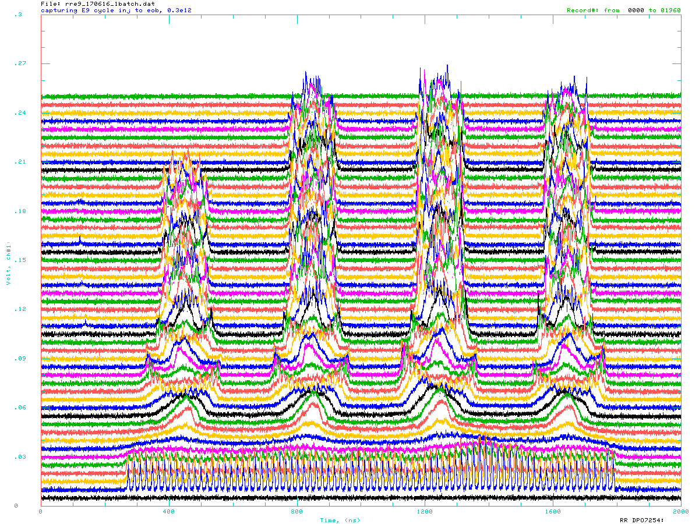
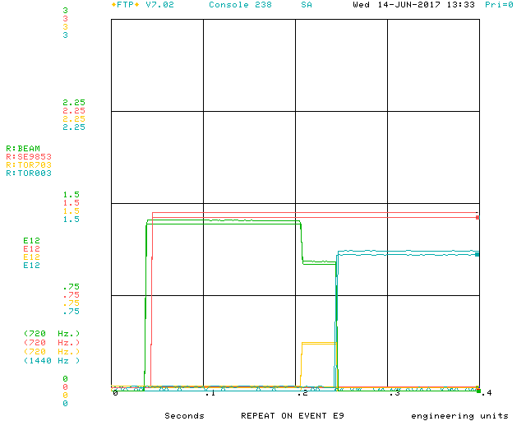
RR E9, G-2 cycle
One Booster batch
Coalesce to 4 2.5 MHz bunch
Extract one to muon campus
Three to the dump

Slide 8
Downtime request
Look for MI RF cavity water leak
RF station 04 and 10.
Radiation survey
Ring-wide survey of barcode locations.
A DALE run around the ring.
Detailed survey of 40 straight, from 340 to 404
In preparation of 402 Lambertson magnet replacement.

Slide 9
End of run studies Requests
MI power supply study (EE support).
RR 1.2s Ramp
Ramp waveform change.
One study cycle per super cycle.
RR TBT study
0.8 second $E0 cycle.
AT time of $20 flat-top.
RR injection loss study.

