Slide 1
9 O’Clock Meeting
Kelli Rubrecht
6/16/2017

Slide 2
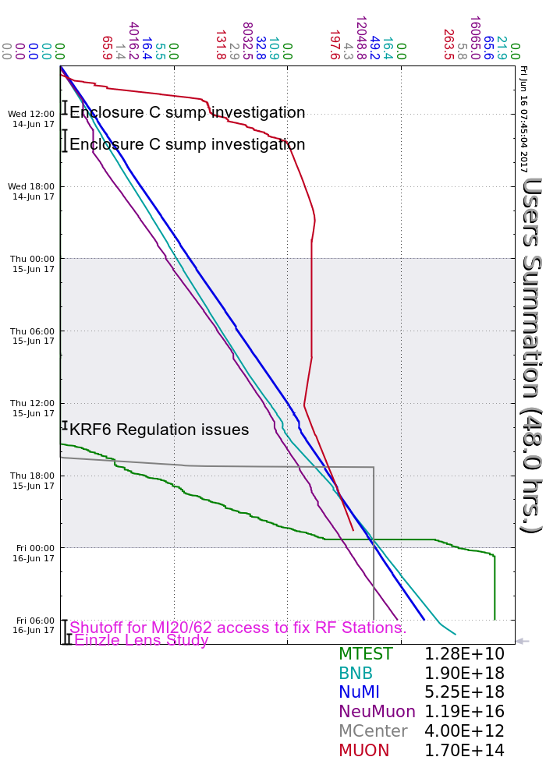
Wednesday
Access into Encl CDE to troubleshoot slow sump pumps
FSEP motor control failure; experts recovered
Many studies
Thursday
MIRF10 cavity water leak indication (MIRF4 and MIRF10 down)
MTest ORC and took beam
KRF distribution skid controller issue held off beam
Friday
Access Friday™ to fix MIRF, various other jobs
Approx. 4 hours of downtime (recovery around/after lunch)

