Slide 1
DUNE Near Detector Systems
Near Neutrino Detector Team
Near Neutrino Detector Technical Review
May 29, 2015

Slide 2
1. Straws
Based on the literature review summarize what longitudinal precision along the wire could be obtained by reading at both ends: using timing and/or charge division information.
The longitudinal coordinate measurement from direct time measurement (DTM) was studied in [1] for straws with 9.5mm diameter and length of 2 m with Ar/CO2 80%/20% and 30 micron wires. The resolution achieved varied from 1.4 cm to 2.6 cm depending upon the hit position with Fe55 source. The ultimate resolution quoted due the intrinsic limitations of the method is between 1.3 cm and 1.5 cm.
[1] V. Peshekhonov, Physics of Particles and Nuclei, 2015, Vol. 46, No. 1, pp. 94 – 122

Slide 3
2. Determination of the Neutrino Flux
Have you (Sanjib) tried the low Enu in NOMAD and what is precision as a function of the energy?
Answer

Slide 4
2. Determination of the Neutrino Flux

Slide 5
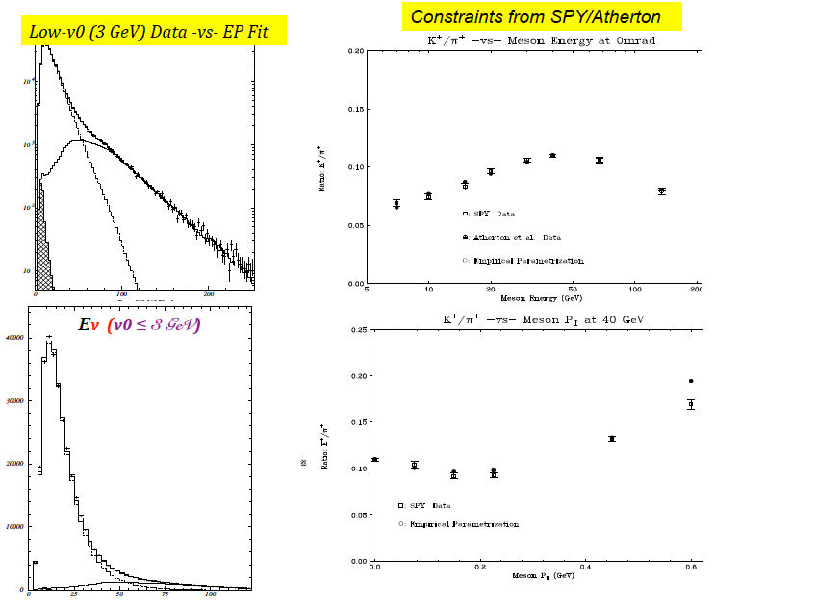
2. Determination of the Neutrino Flux

Slide 6
2. Determination of the Neutrino Flux

Slide 7
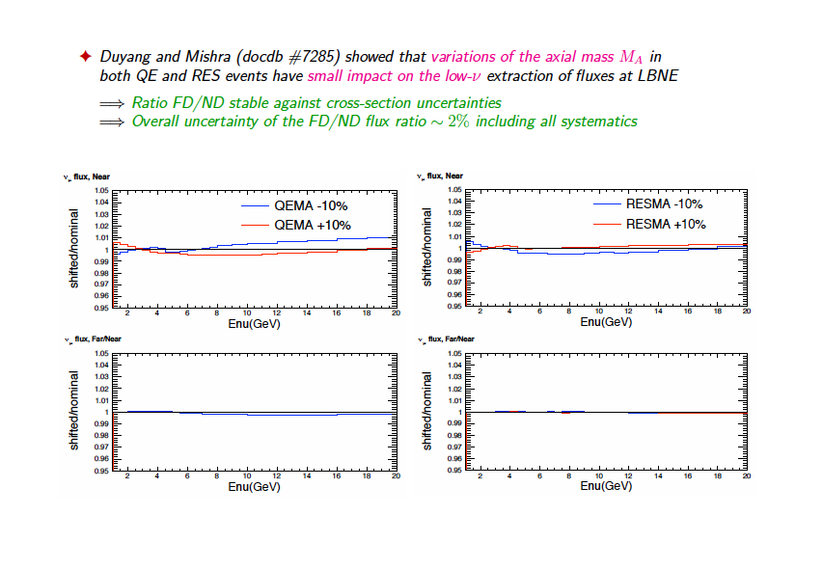
2. Determination of the Neutrino Flux

Slide 8
2. Determination of the Neutrino Flux

Slide 9
2. Determination of the Neutrino Flux

Slide 10
2. Determination of the Neutrino Flux

Slide 11
3. Calorimeter
In Chapter 7 (Near Det. ref. Design) it is written that the lead and scintillator will be glued together. Why to glue them? Could this process damage the scintillator?
Gluing of scintillator with Lead should not damage the
Scintillator. This operation was carried out on T2K with no negative impact. Similar operations were carried out in MINOS. Testing these procedures is part of the R&D plan.

Slide 12
4. Calorimeter
Describe why such large number of separate readout samples (58 in the forward region) is required.
The reference (default) segmentation is conservative. One could argue that by ganging together the downstream scintillator-planes, neither the energy resolution nor the e-vs-gamma-vs-pi separation would be adversely affected. This will be one of the (important) optimization studies that we will undertake.
The benchmarks are: (a) good energy resolution, (b) good EM-vs-Had shower separation, (c) energy and direction of neutral hadrons (n, K0).

Slide 13
5. Calorimeter
How well the position of a photon along the strips using time difference or charge ratio of the two ends could be determined?
Answer

Slide 14
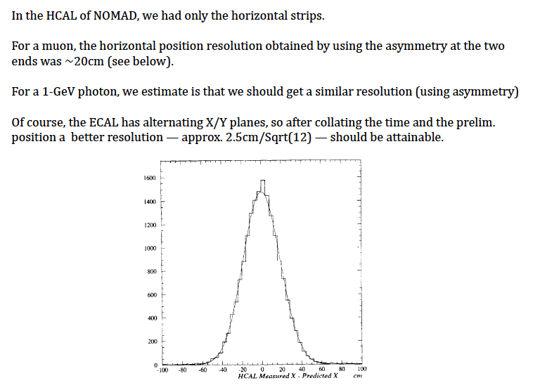
5. Calorimeter

Slide 15
6. Requirements
Could you present how main DUNE physics requirement are propagated to the specifications for the near detector. This might be available in already existing documents not presented to the review committee today.

Slide 16
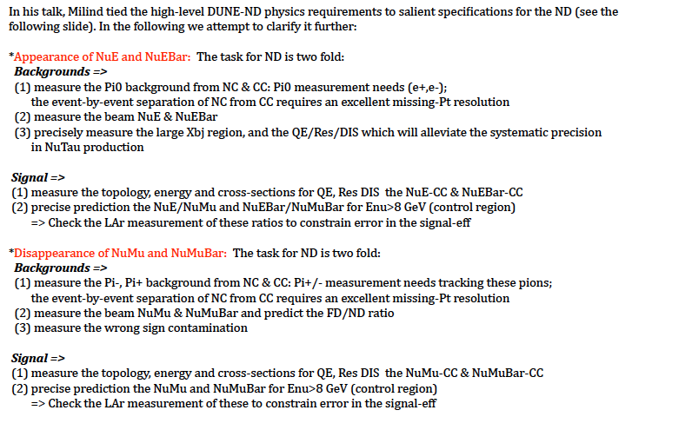
6. Requirements

Slide 17
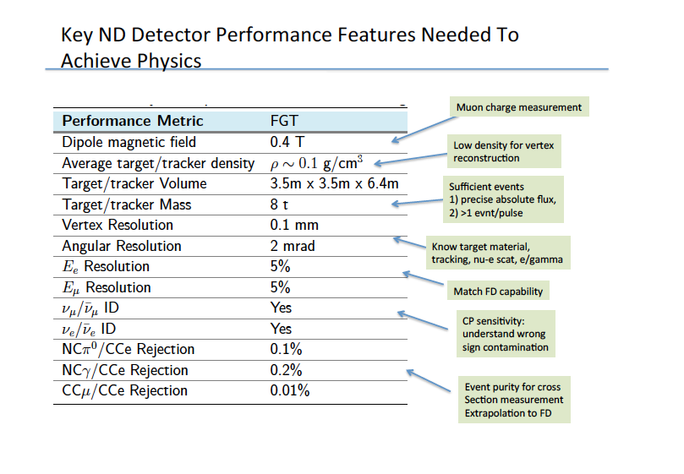
6. Requirements

Slide 18
6. Requirements (continued)
Could you present how main DUNE physics requirement are propagated to the specifications for the near detector. This might be available in already existing documents not presented to the review committee today.
The requirement to measure the relative neutrino fluxes => use of low-nu dominated by the muon energy scale uncertainty (e.g. a scale uncertainty of 0.2% on the muon translates into more than 0.5% on the FD/ND) => low density and momentum resolution (multiple scattering ~5%)
The requirement to measure the absolute fluxes => use of nu-e NC elastic scattering requiring e+/e- separation (low density) and good angular resolution ~2 mrad
Measurement of pi0 content down to ~300 MeV => e+/e- down to 80 MeV => B=0.4 T
NOMAD experiment => density 0.1 g/cm^3 combined with B=0.4 T
Systematic error in FD less than statistical error + absolute flux nu-e NC => mass of ND 5-10 tons => tracking volume
Efficiency for pi0 detection ~50% => fiducial transverse size of ND ~ 3 m

Slide 19
7. Magnet
Did you consider option to have superconducting coils? What is electricity cost of the normal conducting magnet operation per year? This parameter could be an important part of the value engineering.
The usage of superconducting magnets has number of issues as mentioned below.
Using a superconducting magnet entails building a very large-sized vacuum insulated cryostat for the S.C. Coils. Available detector volume will be compromised due to the large-sized vacuum vessel. Building a cryogen-free conduction-cooled superconducting magnet can be explored.
Although High temperature superconductors are now available for the small surface magnetic fields in question, they do have safety related issues due to N₂ gas accumulating in the cavern.
The electricity bill for the joule losses in the electromagnetic coils runs into 1.6 Million USD/year.
Requirements of additional sub-systems like vacuum, helium return line etc will need space.
Permanent magnet based system was best to reduce running cost of the project, but the requirement to ‘open’ the magnet rules out this option

Slide 20
8. Straws
How operation of the tubes is affected by the magnetic field?
The straws can operate without problem in the modest magnetic field B=0.4 T, once the Lorentz correction is applied. It must be noted that the straw tubes used in the ATLAS TRT (4 mm diameter with TR radiators) operate in a large solenoidal magnetic field of B=2 T.

Slide 21
9. Magnet
There are high current power cables needed to provide power to the front-end electronics. How these sources of current affect magnetic field in the tracker volume? Do you plan to have Hall probes mounted inside operating detector to monitor value of the field?
Current of 1 A will produce 2 Gauss of magnetic field at radial distance of 1 mm from the current varying wire.
40 gauss is 1% of the total field (This much perturbation may be allowed, this suggest that 20 A of current shall not be a problem)
This value of magnetic field is linearly proportional to value of current and inversely proportional to the radial distance.

Slide 22
10. Straws
Why are you so concerned about water in the air affecting tubes walls? Did you consider other tubes materials, like mylar?
The effect of water is not a major concern, but could potentially deform the thin plastic walls. The use of mylar was considered but we favored a full kapton fabrication for both the inner and the outer walls of the straws for the mechanical properties. We plan to flush CO₂ in the volume around the straws to reduce potential water content. This will also have the benefit of avoiding the presence of Xe gas (from leakage) in the volume around the straws, where the TR absorbed would not be detected.

Slide 23
11. Integration
There are multiple services required for the detectors from power lines to cooling and signal cables. How the process of the integration of different systems is planned to be organized?
This is conducted under systems engineering. We have significant systems engineering in the schedule as well as time for both electrical/electronics and mechanical engineering teams for each subsystem to interact on interface issues. This has already begun where personnel are available and is understood as necessary when the groups in India are funded and staffed.
Between CD-1 and CD-2, change-control will be implemented to further formalize the process.

Slide 24
12. Integration
How alignment and survey of the different elements of the detectors are planned to be performed?
We will have position markers and an initial survey of the longitudinal position of each STT module. The final alignment will be performed with the large number of passing through muons expected from interactions in the surrounding rocks and detector elements, which should cross a large number of STT modules. These muons will be also used to monitor the detector over time.

Slide 25
13. Integration
Provide time structure of the beam on the detector(proton beam). This question is (partly) related to the determination of the t0 time for each specific event.
Answer

Slide 26
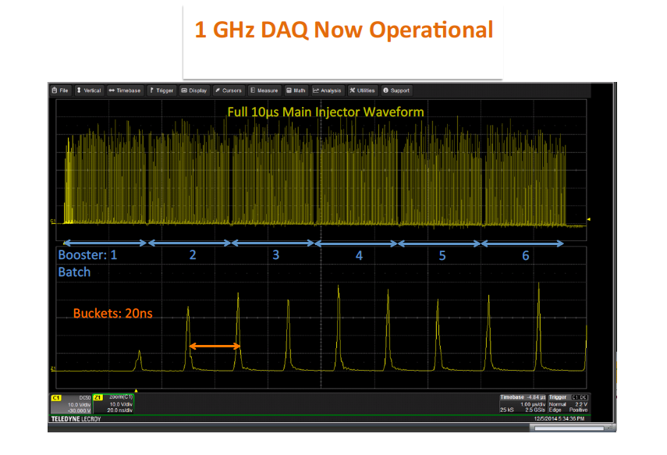
13. Integration

Slide 27
13. Integration

