Slide 1
DUNE
Sanjib Mishra, USC
Independent Technical Design Review
DUNE-ND
May 28-29, 2015

Slide 2
DUNE-ND Magnet Internal Technical Design Review DUNE-ND May 28-29, 2015
Electromagnetic Applications Section
Control Instrumentation Division
Bhabha Atomic Research Centre, Trombay, Mumbai

Slide 3
Dipole Magnet- Requirements
Tracking detectors and ECAL Modules will reside in 0.4T dipole magnetic field volume with inner dimensions 4.5m*4.5m*8.1m.The magnet needs to support and anchor the detectors
Dipole magnet should be open–close C-type structure
Field uniformity in 3.5 m*3.5 m*7 m volume better than 2%
Field uniformity in 1m*1m*2m better than 1%
Detector Fiducial volume mass ~8 tonnes

Slide 4
XII Plan layout
Particulars of work plan | Cost in Millions of INR
LBNE Dipole magnet Design Report Thermal, Electrical, Hydraulic, Structural and Magnetic | 11
Prototype magnet and Power supply Development | 25
Prototype movable assembly Development | 12
Magnetic measurement | 5
Magnet Simulations | 2
Magnet Design, structural ,thermal design software | 25
Infrastructure development | 20

Slide 5
Magnet Layout

Slide 6
Magnet Assembly in closed condition

Slide 7
Magnet assembly in open condition

Slide 8
Perspective views of the Magnet
Magnet with top and bottom
plates hidden
Magnet with top and bottom plates

Slide 9
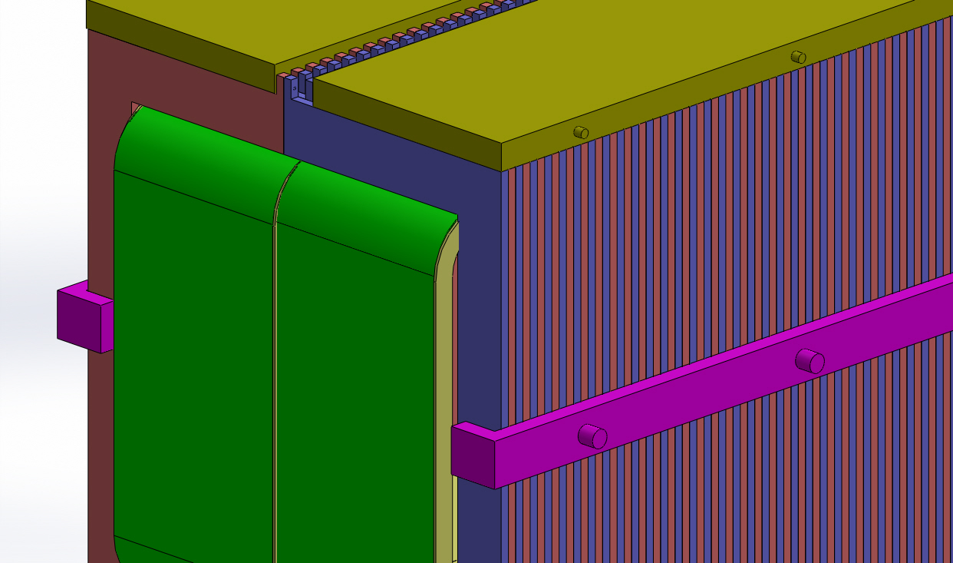
Zoomed view of ‘C’ core assembly, coil and supporting plates

Slide 10
Magnetic Design

Slide 11
Coil-Bobbin Design: salient features
100 mm gap between the two bobbins
The half cores will move with the coils
The detectors will be accommodated in the space inside the two bobbins
Water-cooled hollow copper conductors have been used
Detachable type cooling tube attachments to chiller
The Design can support upto 10 Tonnes of detector weight

Slide 12
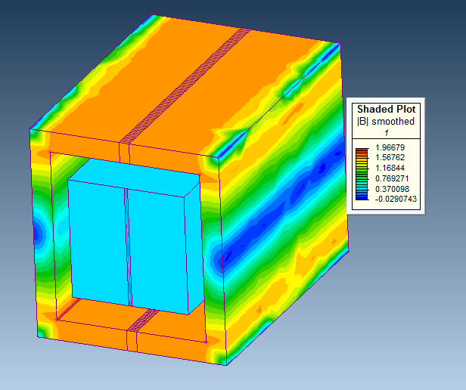
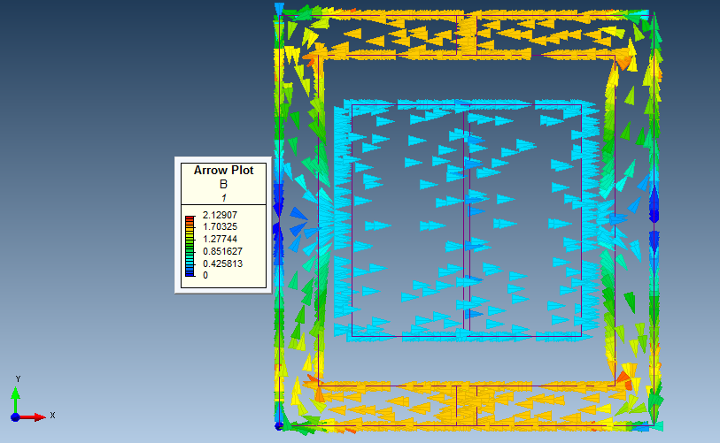
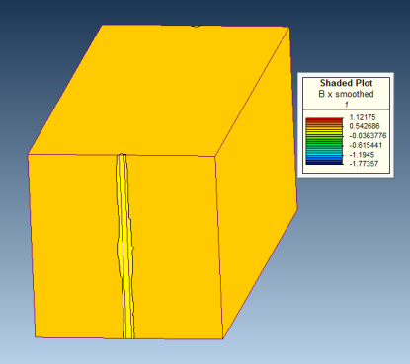
Magnetic simulation Results
1.6T
Beam direction
B plot
Volumetric Magnet field plot
Arrow plot of Magnetic field (x direction)
Volumetric Magnet field plot of Good field region (3.5 m X 3.5 m X 7.1 m)
Opening of core and coil bobbin

Slide 13
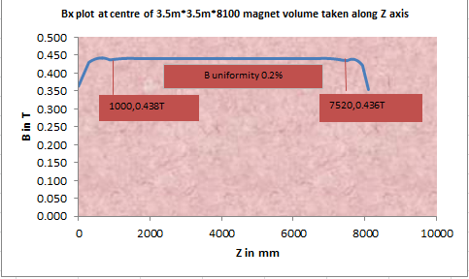
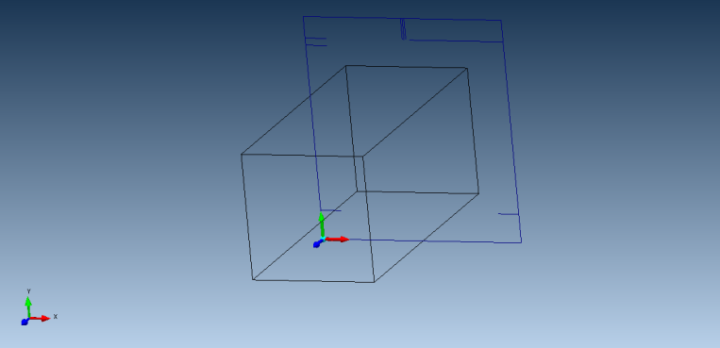
Bx plot at Centre of 3.5m*3.5m*8.1 magnet volume taken along z axis
z
y
x

Slide 14
Electrical and Thermal design parameters
Particulars | Units | 23/13/2R (Hollow conductor)
8 layer Double pan cake Coil | - | 8+8
MMF | Ampere Turns | 1600000
Electrical turns | - | 1376
Current in conductor | Ampere | 1163
Current Density | A/mm² | 2.96
Copper Cross-sectional Area | mm² | 393
Water flow area | mm² | 133
Total Resistance | Ω | 1.80
Total Inductance | Henry | 11.7
Total weight of Copper | MT(Metric Tonnes) | 150
Time to settle of current | Seconds | 32
Total length of Copper conductor in one hydraulic circuit | m | 480 ( available 520 m)
Total Power Loss (MW) | MW | 2.43

Slide 15
Hydraulic design Parameters
Particulars | Units | Value
Single hydraulic circuit (Turns, length) | meter | 16 ,480
Total number of hydraulic circuits in parallel | - | 86
Power Loss per hydraulic circuit | kW | 28.25
Cooling Flow rate | LPM | 8.968
Pressure drop in single hydraulic circuit | bar | 8.58
Water velocity | m/s | 1.15
Temperature difference between inlet and outlet header for single hydraulic circuit | ºK | 45
Cooling Surface area | m² | 19.59
Reynolds Number | - | 21900
Prandtl number | - | 4.536
Nusselt Number | - | 112.93
Heat Flux | kW/m² | 1.44
Temperature difference between Copper surface and Bulk water temperature | ºK | 0.26
Bulk water temperature (taken ref inlet water temperature as 20) | ºC | 42.5
Heat Transfer Coefficient | W/m²/ºK | 5458

Slide 16
Magnetic Measurements

Slide 17
Magnetic Measurement methods
Hall probe and search coil based magnetic measurement system has been envisaged for magnetic qualification of LBNE Dipole Magnet.
The parameters to be measured are (a) Magnetic field density, and (b) Magnetic field uniformity in the GFR.
Modular Magnetometer PCBs housing Hall probes and PCB based search coils/air core inductors shall be fabricated and magnetic field mapped using multichannel Data Acquisition system having Lab VIEW GUI for instant data interpretation.
The large Good Field Region poses challenges for Magnetic field measurement, for which moving SS frame movable on linear bearings shall be designed. Modular PCB Magnetometers shall be mounted on this frame and measurements shall be carried out at discrete longitudinal locations in one plane.
Possibility of using Magneto-Optical (MO) sensors for Magnetic field measurement using shall be explored.
In-Out Connector
Hall Probe
Air core inductor
Temperature
sensor
Mounting Hole

Slide 18
Magnetic Measurements System
In-Out Connector
X
X
X
X
X
X
X
Hall Probe
X
X
X
Air core inductor
3500 mm
Mounting Hole
X
X
X
X
X
X
X
Temperature
sensor
X
X
X
X
X
X
X
X
X
X
X
Location of Modular PCB
7500 mm
Linear Bearings
Linear Bearings
Moving frame
The sensor configuration is tentative and more number of sensors can be accommodated; 80 channel DAS is planned for the system.
Same system shall be used for Magneto-Optical based measurement systems. The MO sensor shall be placed on moving frame while optical Polarizer and optical analysers shall be placed on fixed supports at both ends.
Fixed supports

Slide 19
Structural Design

Slide 20
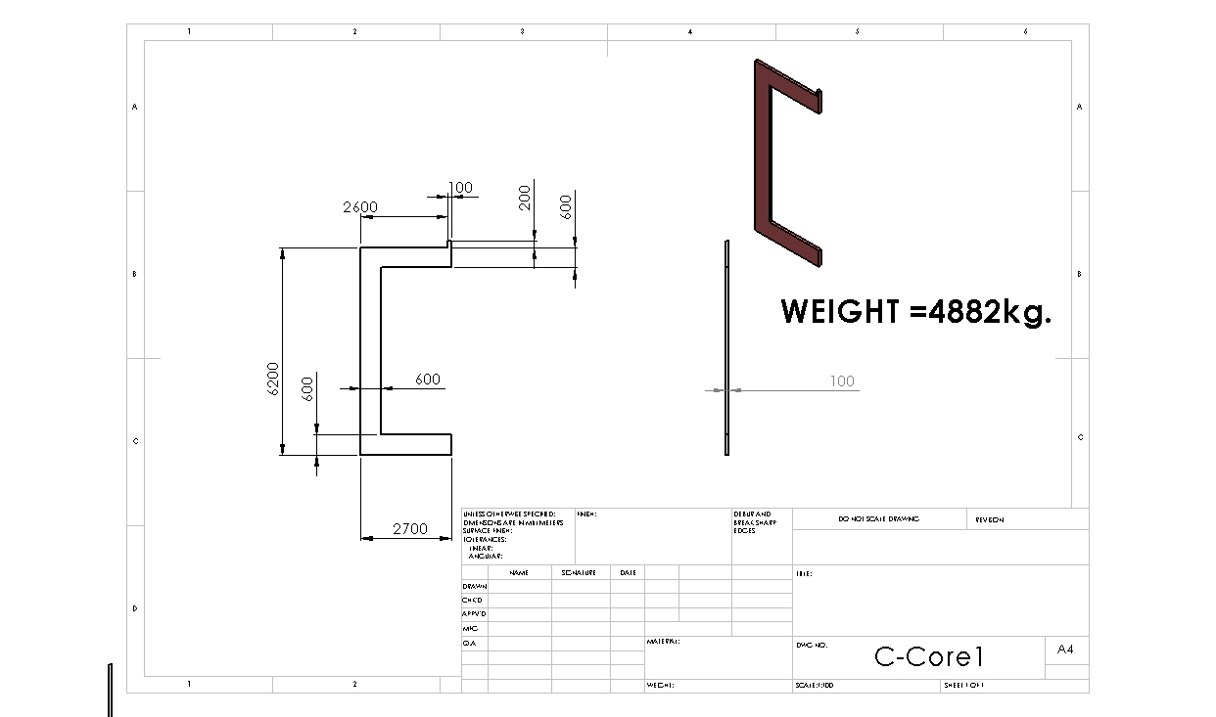
‘C’ Core Type I

Slide 21
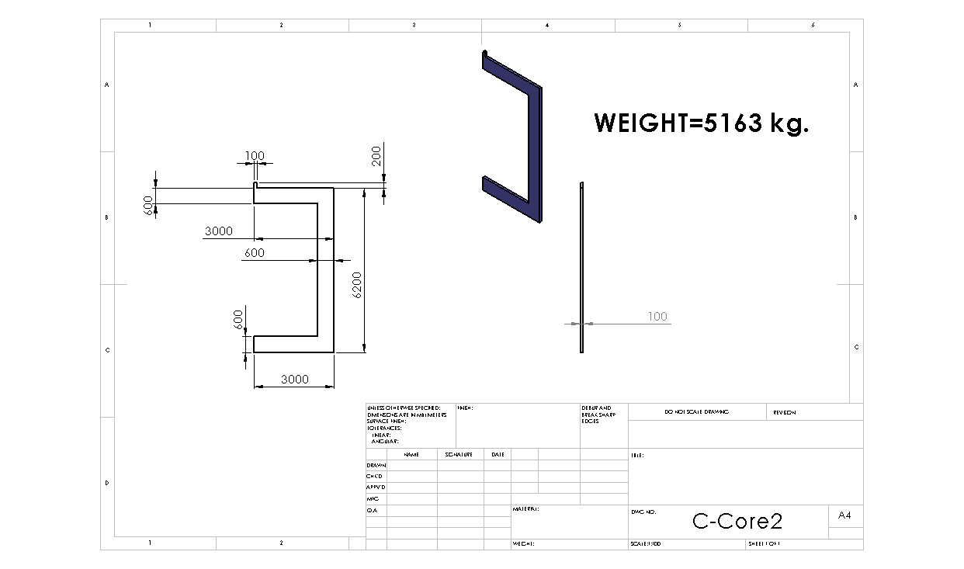
‘C’ Core Type II

Slide 22
Coil Bobbin

Slide 23
COIL

Slide 24
Max. Deformation of bobbin = 28.6 mm

Slide 25
Maximum Von Mises Stress = 190 MPa

Slide 26
Max. deformation (buckling)=1 mm

Slide 27
Max. Von Mises Stress (buckling) =5.20 MPa

Slide 28
Max. Deformation of C-Segment = 1.16 mm

Slide 29
Max. Von Mises Stress =3.5 MPa

Slide 30
Max. Deformation (buckling)=1.00 mm

Slide 31
Max . Von Mises Stress(buckling) =0.664 MPa

Slide 32
Max . Deformation of single roller = 0.013 mm

Slide 33
Max. Von- Mises Stress of roller =11.9 MPa

Slide 34
Bill of Material
PART | Quantity | Material | Weight per unit (Tonnes) | Total weight (Tonnes)
Bobbin | 2 | Austenitic SS | 25.7 | 52
C-Segment Type I | 81 | Soft Magnetic Steel | 4.9 | 396
C-Segment Type II | 81 | Soft Magnetic Steel | 5.2 | 421
Coil | 2 | OFE Copper | 75 | 150
Anchor Plates (Top) | 2 | Austenitic SS | 32.5 | 65
Anchor Plates (Bottom) | 2 | Austenitic SS | 54 | 108
Total Weight of the assembled magnet (except detectors and fasteners) |  |  |  | 1192
Conclusion: The Max. Von Mises Stress in the critical parts are within acceptable limits ( Yield Stress = 230 MPa)

Slide 35
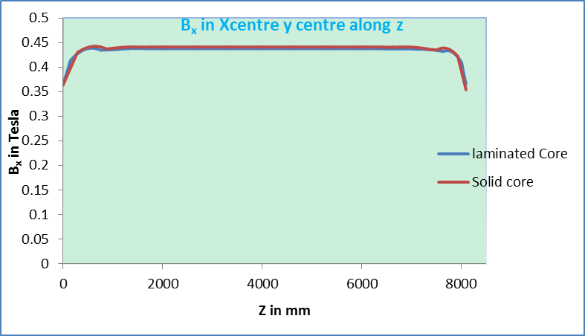
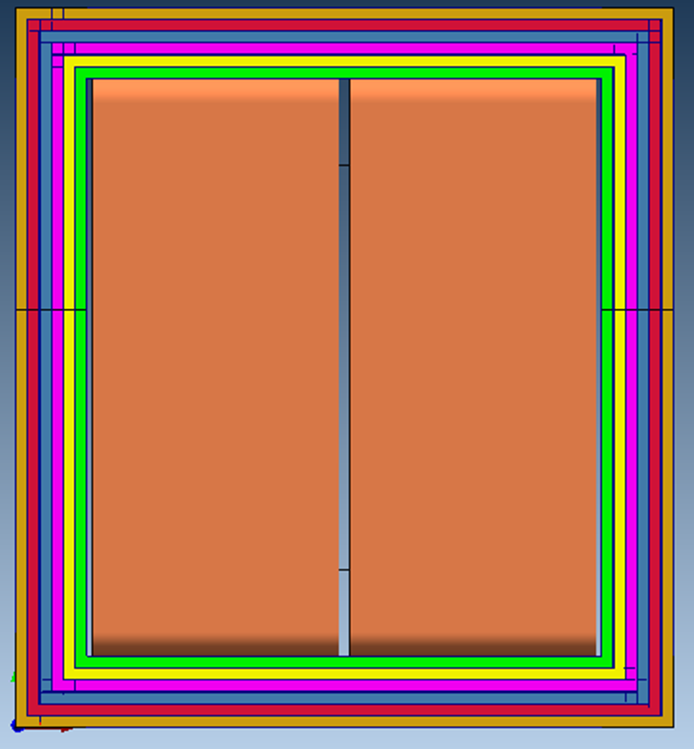
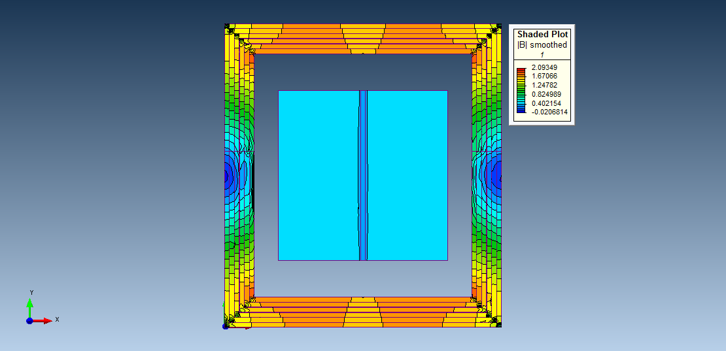
Alternate core design :
Laminated Core structure
600mm six laminate core made by each laminate core structure 100mm with 4 mm gap between each core
4 mm gap between core
Magnetic field distribution in the core and Good Field Region

Slide 36
Discussions
Field uniformity, magnitude of magnetic field and the desired good field region(GFR) : Present design has magnetic field uniformity better than 2% in a GFR of 3.5m*3.5m*7.0 m.
What is the operational life of Magnet?
Detector lay-out : Weight/Volume, location and drawings of individual detectors
Permissible temperature in detector vicinity and dependence of detector performance on temperature
Permissible pressure of cooling water in magnet facilities (safety issues)
Limitation on LPM (if any)
Dipole magnet inclination
Limitation on longitudinal and transverse size and how to retrofit the magnet on beam line
Drawings of accelerator Lay-out
Are magnetic field measurements required during experiments?
Limitation on power availability (V, I, MW)
Is there any possibility of charged heavy particle interaction with magnet/sub-systems (Concerns of Nuclear irradiations)

Slide 37
Thanks

