Slide 1
OSG Networking Area Planning and Discussion
Shawn McKee/University of Michigan
OSG Retreat / Madison
July 26th 2016

Slide 2
Goal: Networks Supporting Science
While some of us are interested in (or worried about!) networks it is fair to say most scientists would rather not have to think about them.
Ideally networks are “transparent” and always do the right thing, allowing data to move as fast as possible, from anywhere to anywhere at anytime ☺
The challenge is twofold:
Networks underlie all our distributed infrastructures and must work well for us to use our grids, clouds and HPC resources.
Problems in the network can be very hard to identify, isolate and fix
OSG is working to better monitor, manage and diagnose our networks for all our benefit.

Slide 3
OSG Networking Components
Network Monitoring via perfSONAR
Having perfSONAR fully deployed with a global dashboard is giving us powerful options for better management and use of our network
A network datastore host all network metrics
Tools to manage and maintain our infrastructure
A Modular dashboard (MaDDash); critical for “visibility” into networks. We can’t manage/fix/respond-to problems if we can’t “see” them.
OMD/Check_mk (used to monitor and verify the state of many globally distributed perfSONAR services); required to maintain the overall proper functioning of the monitoring infrastructure.
The development of the “mesh-configuration” and corresponding GUI interface; critical to creating a scalable, manageable deployment for WLCG/OSG
Documentation --- Installation, debugging, How-tos
Outreach and Support
With the network R&E community, VOs, software developers
OSG Support provides network ticket triage and routing

Slide 4
Year-5 Work Summary
New perfSONAR v4.0 released and deployed
New MCA (OSG product) into production; given to pS Team
Deployed site count steady; site/service monitoring deployed and maintained
Network support: triage and problem resolution (~15 incidents)
Network analytics pipeline deployed (beta)
Opt-in network problem alerting enabled (beta)
Documentation and web page updates ongoing
Outreach and community building ongoing
Community White Paper inputs provided
Close cooperation with WLCG (GGUS, monitoring config, etc)
LHCONE/LHCOPN network testbed on SDN and point-to-point work

Slide 5
Networking Documentation
Quick view of networking is available from the main web page: https://www.opensciencegrid.org/open-science-grid-networking/
Our existing detailed documentation at https://twiki.opensciencegrid.org/bin/view/Documentation/NetworkingInOSG needs:
Streamlining
Migration to GitHub? (What is the new location?)
The perfSONAR developers provide excellent documentation on installation and configuration of perfSONAR
We point to that and provide details on the few specific things we need to worry about for OSG/WLCG installations
Firewalls configured allowing our access to the data
Configuration for auto-mesh and information about MCA
Information about OSG network services
Information about OSG and WLCG support

Slide 6
OSG Networking Year 6 Plans
Continue to do what we do now, and:
Simplify number and complexity of components
Develop more usable and effective Alarming and Alerting
Improve the ability to manage and use network topology and network metrics via an Analytics Platform
Goal is to gain insight from the set of network and transfer related information we have
Standardize on dashboards for problem identification and historical views of the network metrics

Slide 7
Schematic of OSG Net Services
perfSONAR Toolkits

Slide 8
OSG Network Work Plan
Effort to-date in OSG networking a combination of me, Operations ,Technology and Software/Release
As we add sites or update technologies there will be a support load (me+Operations)
Exploring new capabilities will require help from Technology
Producing new packages may require Software/Release help
We leverage other efforts (WLCG, perfSONAR developers, ESnet/MaDDash, satellite proposals)
We must ensure we continue to reliably gather and provide network metrics moving forward.
Year 6 needs to work on simplifying what we have

Slide 9
Network Issues
Just last week we had a meeting to discuss two items that Frank brought up:
Are we ready to abandon the ESNet owned network performance measurement data store in favor of a different solution, e.g. elastic search?
What do we want to do about the network performance information we can get from our regular operations of glideinWMS and StashCache ?
In light on the focus on simplifying for year 6 these are interesting questions.

Slide 10
ESmond Information
ESmond (ESnet Monitoring Daemon) is the system perfSONAR uses to collect and store network metrics
It is a combination of Postgresql and Cassandra
Part of every perfSONAR toolkit deployment
It has a number of issues
No easy way to analyze data stored in ESmond
It lacks data lifecycle management tools
At larger scales it has been fragile
It is now orphaned in that the original developers are no longer supporting it

Slide 11
OSG Network Service
We choose to leverage ESmond when we created the OSG network service
Primary advantage was that it was part of perfSONAR and fully supported all the data types we would collect
Using ESmond allows us to directly “see” the data via MaDDash (Monitoring and Debugging Dashboard) and other perfSONAR tools.
We bought dedicated hardware to run ESmond and our associated OSG network services
ESmond has been a bit complex for operations and we have lost data stored in it already.

Slide 12
Schematic of Net Metrics Flow
perfSONAR
Toolkits
perfSONAR RSV
(gathers net metrics)
ESmond Measurement Archive
CERN Message Bus
(stomp protocol)
GOC Message Bus
(RabbitMQ protocol)
MaDDash
(+data access)
UC ElasticSearch
(for analytics)
FNAL
(data to tape)

Slide 13
What do we need?
A data repository for historical data access
A way to see results in MaDDash
A way to analyze the data easily
Customized dashboards for “insight”
NOTE: We shouldn’t expect one technology to be the best choice for ALL our needs!

Slide 14
Esmond Part 2
perfSONAR developers are looking for a replacement.
Prototype will likely be deployed with v4.1 in early 2018
Transition to new tech in v4.2 in late 2018?
ESmond works fine for a Toolkit measurement archive, e.g., couldn’t use ES
Built in to perfSONAR; interfaces with MaDDash
ElasticSearch is great for on-demand analytics and custom dashboards (Kibana)
What is the long-term archive solution?

Slide 15
Considerations
Don’t wait for perfSONAR developers
Leverage the hardware we have
Reconfigure/optimize/simplify our data flow
Data usability should be paramount

Slide 16
Proposal for Discussion
Use of message queueing technologies insulates us from details of data storage choices
Once data is on the bus, clients can grab it and stuff it into whatever we want
Provide “short” (~1-2 months) data storage into ESmond fronted by MaDDash in OSG or reconfigure to use toolkits as data source
Reconfigure OSG hardware; enforce data cleaning
Add ElasticSearch to OSG hardware for long-term access to data (not fast, not diagnosis/analysis system)
Should allow us to keep ~2-4 years of data for researchers
Send data for analysis and custom dashboards to UC instance. Set medium (6-12 months) data lifetime
Send data to FNAL for long-term tape storage
What storage format? How to retrieve? How to use?

Slide 17
Schematic of Net Metrics Flow
perfSONAR
Toolkits
perfSONAR RSV
(gathers net metrics)
ESmond Measurement Archive (1 month)
CERN Message Bus
(stomp protocol)
GOC Message Bus
(RabbitMQ protocol)
MaDDash
(+data access)
CERN clients
UC ES
(analytics)
NL ES
(diagram)
FNAL
(tape)

Slide 18
Pipeline Changes
The data pipeline will be modified to have use the GOC RabbitMQ message bus.
Raw JSON data will go to tape at FNAL for long term storage
Network metrics will be sent to ElasticSearch at Nebraska for use in non-interactive exploration and display of data, e.g., 1 year graphs of quantities of interested updated daily
Network metrics currently be read from CERN’s bus and sent to UC will be reconfigured to use the OSG message bus as a source
Data cleaning and transformation is currently done by Ilija using a VM at CERN. This will be migrated to the US and will use the GOC bus
The STOMP protocol will be enabled on the GOC bus
We will continue to send data to CERN for their use
We will reconfigure ESmond on OSG to only host a few weeks of data to support our MaDDash instance (to quickly view net status)

Slide 19
Results of Changes
While it may some more complex, the pipeline changes result in simplifications in use and operations
All critical data stays within OSG controlled resources allowing easier debugging and management
One primary bus setup at GOC that we need to worry about
Data endpoints have very specific tasks allowing simpler configuration and better resource use
The Esmond instance can be very much scaled down. No need to address data lifecycle management via Esmond!
Enables a future improvement: perfSONAR 4.1 should support central configuration to send data from our toolkit instances directly to a RabbitMQ bus like the one at GOC

Slide 20
How to incorporate existing other network data sources?
We discussed how we gather and enable the use of other network datasources like:
HTCondor
StashCache
Brian already mentioned centrally using the Condor history access to gather information centrally. We can do this for XferStats as well
UC will explore enable the appropriate transfer logs on the Schedd
In conjunction with Technology, a pipeline to get that data into ElasticSearch will be setup and tested
Longer term we want to send all such metrics to the GOC bus

Slide 21
Continuing to Do What We Do…
Basic things still need to happen year 6:
Supporting users, VOs for net problem identification and repair
Upgrades and bug-fixes to tools that gather, display and provide network metrics
Tuning and optimizing existing testing
Maintenance and creation of documentation
Support for new ideas and feature requests.
Exploring needs for new metrics to better meet researcher needs.
Also on the To-Do list: restoring the OSG network “production” services to production status. Simplifications in our architecture should make this straightforward

Slide 22
Questions / Discussion?
Thanks!

Slide 23
Additional SLIDES

Slide 24
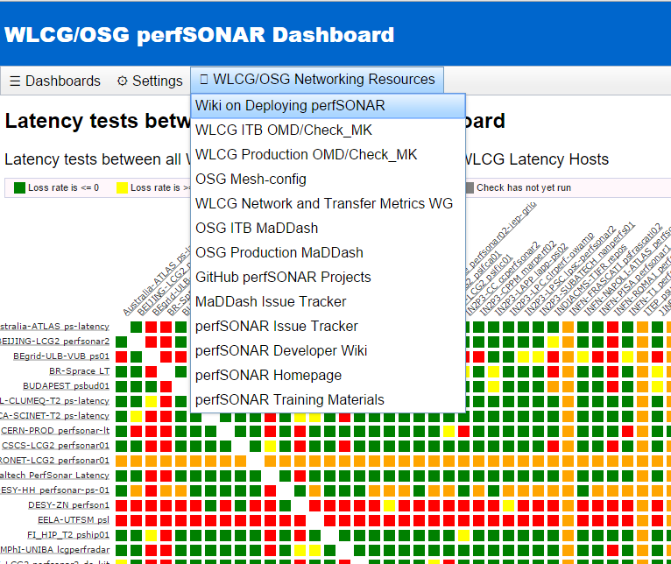
Monitoring Metrics
Use MaDDash to view metric summaries
Provide quick view about how networks are working
OSG hosts a production instance at: http://psmad.grid.iu.edu/maddash-webui/
Metrics are displayed via source-destination matrix
Multiple dashboards (meshes) can be selected
Custom menus link to relevant resources
New release (2.0) incorporates MadAlert
http://maddash.aglt2.org/madalert.html

Slide 25
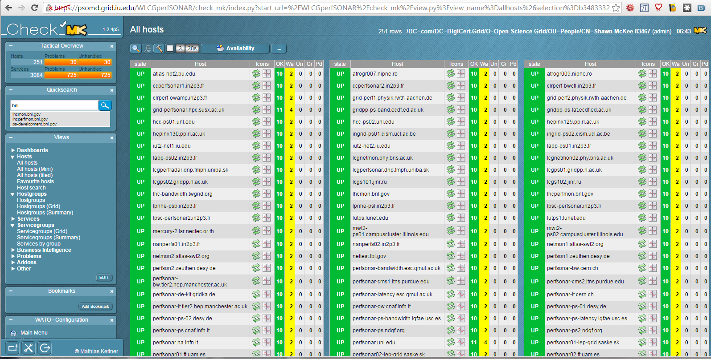
OMD/Check_MK Service Monitoring
We are using OMD & Check_MK to monitor our perfSONAR hosts and services. Provides useful overview of status/problems
https://psomd.grid.iu.edu/WLCGperfSONAR/check_mk/
[Requires x509 in your browser; update for InCommon authentication planned]

Slide 26
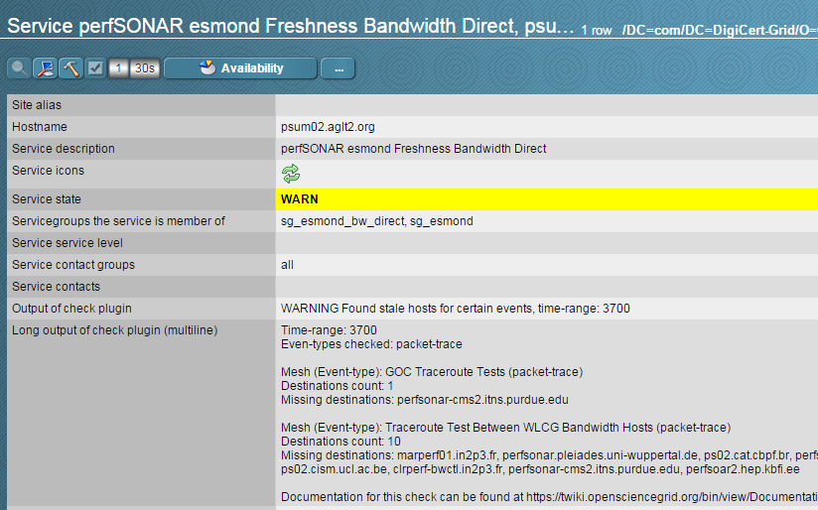
Detailed Service Checks

Slide 27
Managing perfSONAR Deployments
OSG originally developed a “mesh-config” GUI built within the OIM/MyOSG framework
We provided a GUI to define and organize the regularly scheduled tests between specific sets of perfSONAR instances.
The mesh-config was a huge benefit; no longer need to use email to hundreds of system admins to make changes to network tests and their organization. The GUI made changes easy and consistent.
Problem: not able to be made easily available to others within or outside OSG.
Campuses deploying many perfSONARS
Science VOs wanting to organize/customize their perfSONARs
Solution: Soichi Hayashi produced a draft of a standalone package which provides an even more feature-rich mesh-configuration GUI
However Soichi left OSG
Draft (beta) version had need of a number of fixes and enhancements to meet our needs

Slide 28
Standalone Mesh-config (MCA)
Soichi was pulled back into efforts to finish up the MCA (Mesh-Configuration Admin) GUI
20% effort from December-March, 10% April-May funded by perfSONAR/IU
Documentation at http://docs.perfsonar.net/mca and at https://github.com/soichih/meshconfig-admin
Issues tracked at https://github.com/soichih/meshconfig-admin/issues (14 open, 8 closed)
OSG instance running at https://meshconfig-itb.grid.iu.edu/ (create an account to play with this)
Now 258 hosts imported from OIM/GOCDB
New API available https://meshconfig-itb.grid.iu.edu/apidoc/
Close to being ready to use for production

Slide 29
MCA Screenshot

Slide 30
Primary Features of MCA
Gathers and organizes information on hosts from a combination of sources
Can import perfSONAR global lookup service entries
Able to gather information from registration databases like GOCDB and OIM
Auto-completion / entry of values
Context dependent user interface (see Testspecs)
Can be easily installed outside of OSG
Provides a RESTful interface to allow easy monitoring and software-controlled config
https://meshconfig-itb.grid.iu.edu/apidoc/
Supports filtering and dynamic host groups
Can now build dynamic meshes, e.g., all CentOS6 hosts who are members of the ATLAS community
Able to support both perfSONAR 3.x and 4.x

Slide 31
Standalone Mesh-config (MCA)
We (OSG networking/Soichi) have finally finished the standalone mesh config administrator (GUI)!
As of May 31, 2017 the code and responsibility for maintenance and future upgrades was give to the perfSONAR developers team.
Documentation at http://docs.perfsonar.net/mca and at https://github.com/soichih/meshconfig-admin
Issues tracked at https://github.com/soichih/meshconfig-admin/issues (14 open, 17 closed)
OSG ITB instance running at https://meshconfig-itb.grid.iu.edu/ (create an account to play with this)
Production instance is operational https://meshconfig.grid.iu.edu/
Old URLs are remapped to use the new one.
Some small issues (see issue tracker) but it is working well

Slide 32
Enabling Alarming
We have a longer term goal of alerting and alarming on network issues.
Milestone completed: technical design of a suitable analysis system based upon existing time-series technologies
Current operating implementation gathers all perfSONAR data OSG sends to CERN and puts it in ElasticSearch.
Jupyter instance regularly runs cron tasks to analyze data
Near-term goal: anyone can subscribe to simple alert-emails.
Not “production” yet; needs further interface tweaking to make it easy for users to use

Slide 33
Prototype Alarm/Alert System

Slide 34
Current Example Alerting Email
Last time I showed an text example email
We updated the format:
Working to customize by alert type

Slide 35
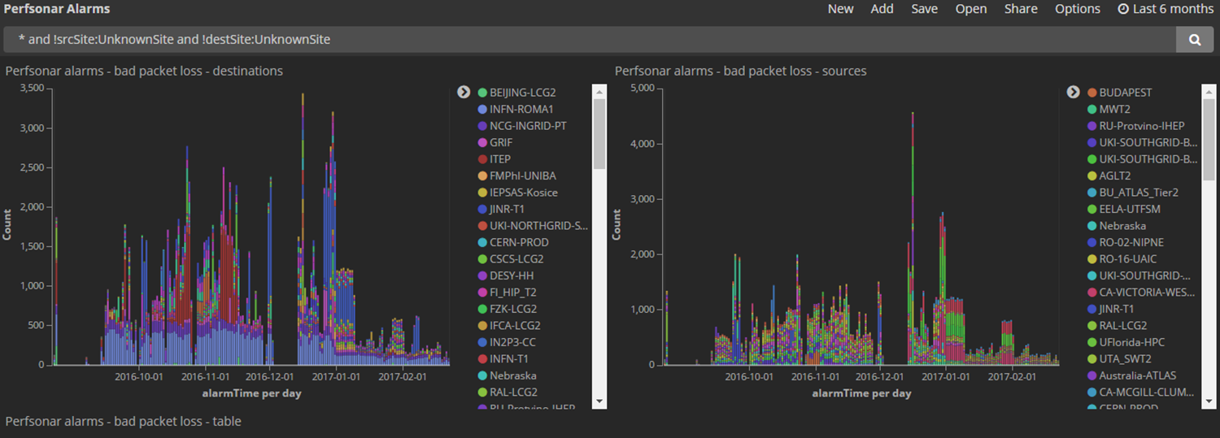
Examples of Network Analytics
Using the ELK setup from Ilija Vukotic/UC we can look at some of the network data results
This link shows the last 6 months of significant packet loss results by source/destination: http://tiny.cc/PktLossNoUnknown

Slide 36
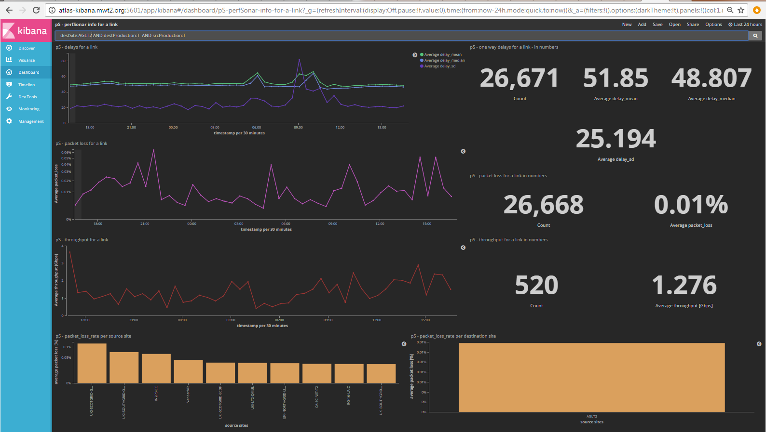
We can analyze in the context of a specific site or link. Example http://tiny.cc/pSLink

Slide 37
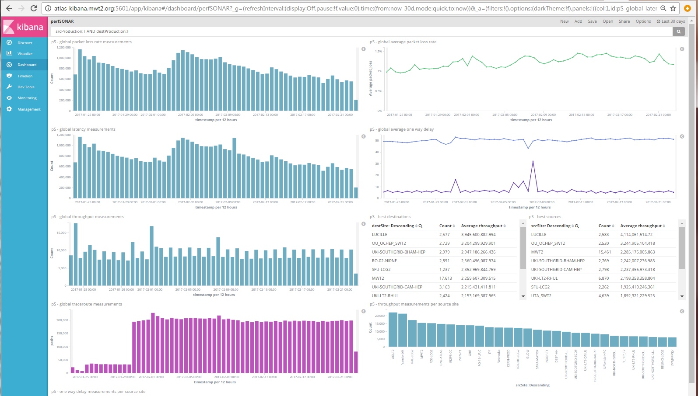
This example shows measurements being made and captured by OSG http://tiny.cc/pSDash

Slide 38
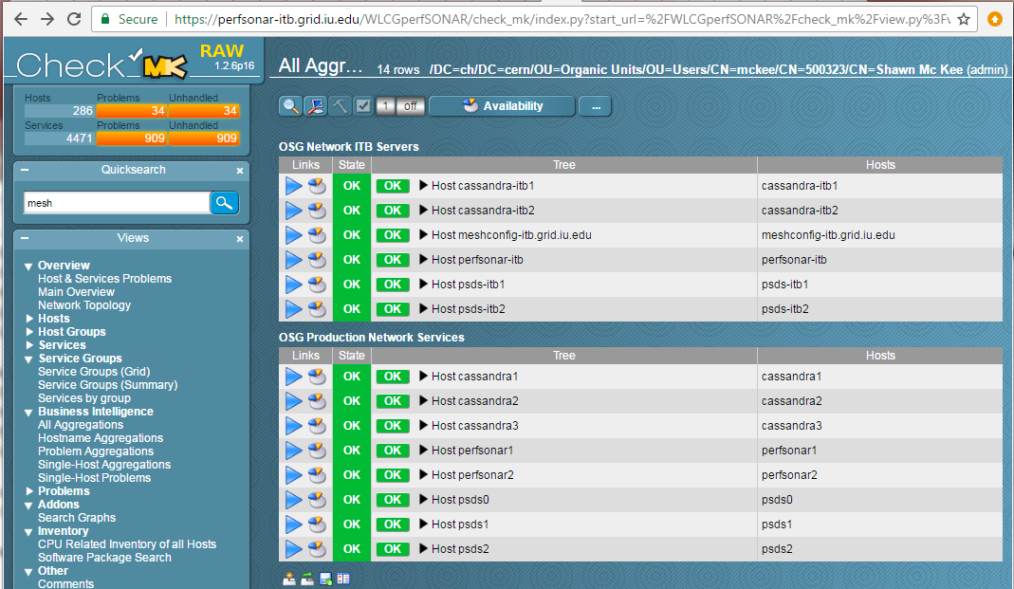
Status of OSG Net Services
Config Changes

Slide 39
Understanding Network Topology
One thing that may not be obvious is that all the network measurements are only really useful if we know the path being measured…topology is very important to find/fix problems.
OSG measures topology via traceroute and tracepath
Can we create tools to manipulate, visualize, compare and analyze network topologies from the OSG network datastore contents?
Can we build upon these tools to create a set of next-generation network diagnostic tools to make debugging network problems easier, quicker and more accurate?
Even without requiring the ability to perform complicated data analysis and correlation, basic tools developed in the area of network topology-based metric visualization would be very helpful in letting users and network engineers better understand what is happening in our networks.
This area is under active investigation in various projects. Lots of work to do here.

Slide 40
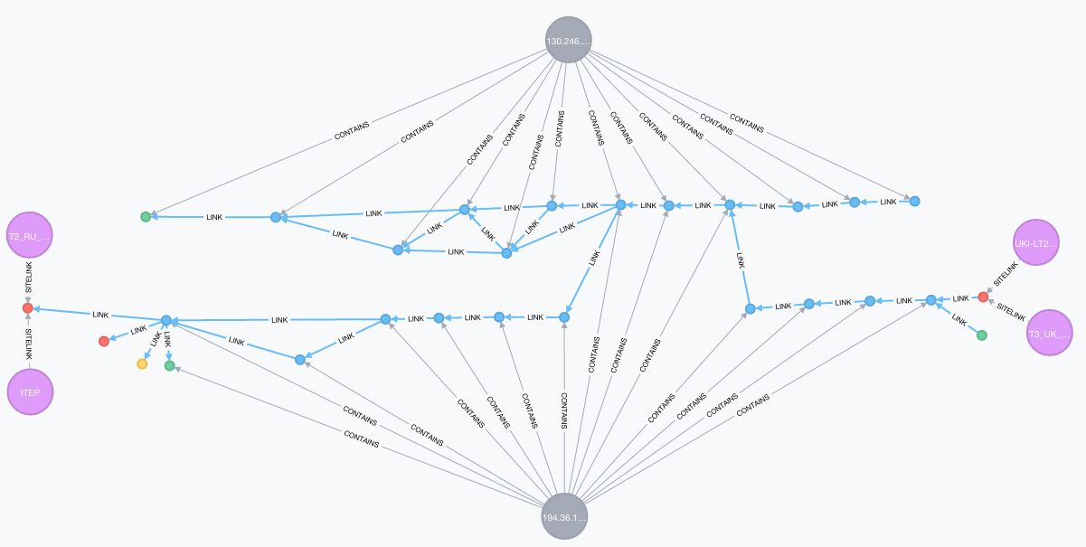
Exploring Path Analysis
We can simplify the graph by aggregating nodes that belong to same NREN
(visual debugging)
We can correlate paths with packet-loss/latency information (PuNDIT)
GEANT
Aachen
DFN
RAL
JANET
ITEP
QMUL
latency, packet-loss,
throughput all available

Slide 41
Network Performance Issues
We have been using our OSG infrastructure and data to identify and fix numerous network issues.
The table on the right shows the recent (since Feb 2016) WLCG support unit issues. Using OSG perfSONAR data we even know the root cause of the current open issues.
Within OSG we have additionally found and fixed issues involving Caltech, Boston University, BNL, FNAL, OU, Michigan, Michigan State, Langston, Indiana, University of Chicago, Unversity of Illinois, Nebraska and Georgia Tech
The bad news is that most of these cases were not initiated proactively but rather in response to data transfer issues
Incident | Ticket | Comments
BNLRALCERN |  | Still open
BNL SARA CERN | https://ggus.eu/index.php?mode=ticket_info&ticket_id=120957 | Resolved, issue with ESNet router at CERN
ASGC CERN IJS | https://ggus.eu/index.php?mode=ticket_info&ticket_id=119820 | Still open
CBPF | https://ggus.eu/index.php?mode=ticket_info&ticket_id=120081 | Resolved by RNP stopped publishing to ESNet CBPF IPs
FNAL CERN | https://ggus.eu/ws/ticket_info.php?ticket=119551 | Didn't reach WLCG throughput SU, was assigned directly to CERN LHCOPN, was fixed by Esnet - faulty router interface in New York
PIC inbound | via mailing listhttps://twiki.cern.ch/twiki/bin/view/LCG/NetworkTransferMetrics#Network_Throughput_Support_Unit | 10 Gbps link WAN at PIC sharing LHCOPN,LHCONE was completely saturated causing input discards
BNL to PIC | via mailing list | LHCOPN link CERN-PIC was flapping a lot due to an issue with the Geant fibre to Spain
MAINZ CA | via mailing list | MAINZ uses a "commercial" network provider and Canadian sites only peer with R&E networks
OU inbound | via mailing list | Narrowed down to a faulty switch on site
CA EU | https://ggus.eu/index.php?mode=ticket_info&ticket_id=118748,https://ggus.eu/index.php?mode=ticket_info&ticket_id=118730 | Trans-atlantic channel instability, resolved by Canarie by re-routing

Slide 42
Overview of perfSONAR Pipeline
The diagram on the right provides a high-level view of how OSG is managing perfSONAR deployments, gathering metrics and making them available for use.

Slide 43
Analytics Platform
Ilija Vukotic/U Chicago has been leading an effort to get network metrics into an analytics platform
This analytics service indexes historical network related data while providing predictive capabilities for near term network throughput performance.
Primary functions:
Aggregate, and index, network related data associated with WLCG “links”
Serve derived network analytics to ATLAS production, DDM & analysis clients
Provide a generalized network analytics platform for other communities in the OSG
Part of ATLAS Analytics platform
https://cds.cern.ch/record/2056257/files/ATL-SOFT-SLIDE-2015-752.pdf

Slide 44
WLCG Network and Transfer Metrics Working Group
https://twiki.cern.ch/twiki/bin/view/LCG/NetworkTransferMetrics
The WLCG efforts at CERN are being reorganized; this is an opportunity to chart future directions for the working group
There was a review of the working group April 28th during the WLCG Operations Coordination meeting.
https://indico.cern.ch/event/514078/
We have a number of areas (projects; see next slide) we are considering and we need to understand where these efforts should be housed (Stay in WG, move to GDB, to LHCONE)
OSG will continue to rely upon the WG to help organize global perfSONAR maintenance and support

Slide 45
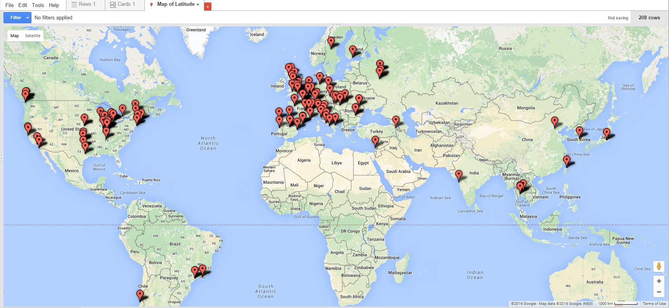
A Global Monitoring Infrastructure
We enabled a global deployment of perfSONAR to instrument our networks (both IPv4 & IPv6)
278 perfSONAR instances registered in GOCDB/OIM
248 Active perfSONAR instances
208 Running latest version (3.5+)
http://grid-monitoring.cern.ch/perfsonar_report.txt for stats (updated daily)

Slide 46
Alarming and Alerting on the Network
Being able to "alarm" on real network problems is a good target: indicate (via monitoring) there is a network problem
The next step is to actually "alert" on network problems.
The difference between an alarm and an alert is the target. An alarm can appear in some monitoring system for an operator to respond to while an alert is targeted at a person or list of persons (email, page, etc.).
To effectively alert requires that we first have a valid 'network' alarm AND that we be able to localize the problem more specifically than "along the end-to-end path". Alerts should be only sent to those able to fix the problem.

Slide 47
Example: BNL-SARA Issues
What happened?
No one noticed…for ~2 weeks!

Slide 48
Higher Level Service Support
OSG needs to be able to support "higher-level services" that require network metrics to make decisions regarding data transfers and higher-level workflow optimizations involving the network.
Proximity service prototyped identify “close” SEs and perfSONARs e.g: http://proximity.cern.ch/api/0.1/trace/tracepath?src=atlas-npt2.bu.edu&dst=heplnx130.pp.rl.ac.uk
What metrics and with what timeliness are best for meeting this need?
This can be very complicated to answer in practice.
We will need to work closely with the developers of such services and iteratively adapt what is provided to make this as effective as possible.
First need is a network “cost-matrix” of source-destination pairs
Interaction with users will point the way to missing components

Slide 49
Understanding Network Topology
Can we create tools to manipulate, visualize, compare and analyze network topologies from the OSG network datastore contents?
Can we build upon these tools to create a set of next-generation network diagnostic tools to make debugging network problems easier, quicker and more accurate?
Even without requiring the ability to perform complicated data analysis and correlation, basic tools developed in the area of network topology-based metric visualization would be very helpful in letting users and network engineers better understand what is happening in our networks.

Slide 50
Graph Databases: Neo4j

Slide 51
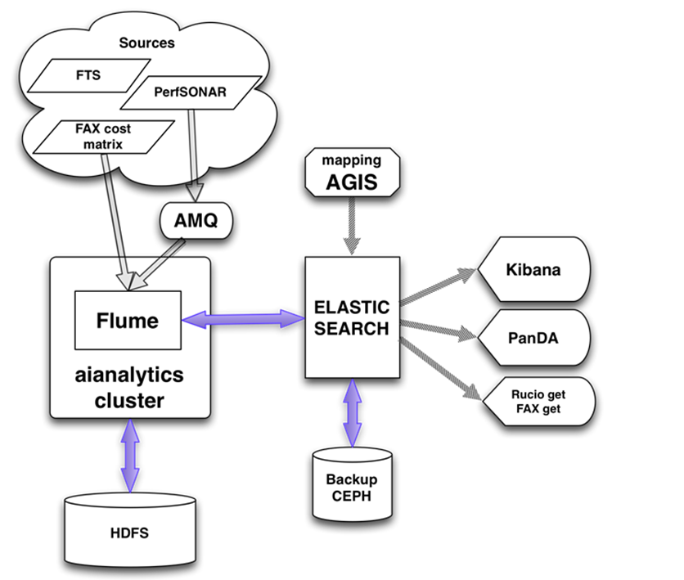
ATLAS Network Analytics
Diagram shows the flow
End-to-end+perfSONAR
data both available to
jointly analyze
Kibana can be used to get
customized views
http://cl-analytics.mwt2.org:5601
More details at: http://tinyurl.com/gt92zwb

Slide 52
Using Our Data
Host A is getting poor performance to Host B and seeing 3% packet loss
Normally we would start to investigate partial paths to isolate the problem
However we also see Host D to Host C is having problems and 2% packet loss:
And there is a third pair (Hosts E and F) having 1% packet loss:
Let’s correlate these paths
Host A
128
613
481
772
016
835
Host B
Host D
340
907
613
481
746
592
Host C
Host E
419
481
772
109
079
Host F

Slide 53
Topology View
Host C
Host E
592
419
746
Host A
128
613
481
772
016
835
Host B
907
109
Solution:
2% loss from 613-481
1% loss from 481-772
Contact these link owners!
340
079
Host D
Host F

Slide 54
OSG Network Services Update
Since the last meeting ALL VMs running OSG network services have been updated to use the most recent perfSONAR v4 RPMs
The postgresql DB (part of ESmond) was also updated to use 9.6 instead of 9.4
No significant issues discovered and all services are running well after the update.

Slide 55
Virtualization Resource Balancing
Once all VMs were update in terms of software we let them run for a few days to get a baseline of resource use
We had a number of cases where we had mismatches in CPU or RAM for VMs.
Fortunately it was roughly balanced so that systems need more CPUs could use the ones released from others and similarly for memory.
The check_mk monitoring was really important for identifying the right resource requirements
One small tweak (adding back some “stolen” memory) was needed on a couple VMs
System now seems balanced for the current workload
Have to watch over time and adjust as required.

Slide 56
Hardware Update / Data loss
Since the beginning of the year we have been waiting to update the storage (disks) in use for the network datastore
8TB replacements for 4TB disks have been on-hand for months
At the end of April we attempted to do incremental updates to RAID-10 (4-disk) sections of the hardware
PROBLEM: VMs running Postgresql and Cassandra were not shutdown while the storage was changed and we lost/corrupted the postgres DB
Attempted recovery (3 days of work) only recovered 5-7% of the Postgres metadata.
Consulted experts but nothing to be done
Cassandra retained all the data but “index” for it missing in postgres
Two changes: Postgresql DB should now have daily backups (need to confirm this is in place with Scott) and future procedures will shutdown VMs if their storage is modified

Slide 57
Updated Net Service Monitoring
We have been using OMD/Check_mk to monitor both perfSONAR services and host status.
WLCG has built an improved system (ETF=Experiments Testing Framework) which we have leveraged to create a perfSONAR specific implementation of.
It is distributed as a Docker image and requires a CentOS 7.x base OS with Docker to use.
We requested a new VM (psetf.grid.iu.edu) and ‘root’ access for Marian and I
We deployed Marian’s etf_ps docker instance and tested and tweaked
Once working we requested the psomd.grid.iu.edu DNS alias be switched to psetf.grid.iu.edu from perfsonar1.grid.iu.edu
We then had Tom shutdown perfsonar1.grid.iu.edu (we want to keep the VM image for 6 months in case we need any data off from it)
Have a look https://psomd.grid.iu.edu/etf/check_mk/
NOTE: Apache redirect requested for (ticket #34087) https://psomd.grid.iu.edu/WLCGperfSONAR/check_mk but not yet in place
Docs and details at: https://gitlab.cern.ch/etf/docker/blob/master/README.md

Slide 58
Network Alerting Reminder
We have a longer term goal of alerting and alarming on network issues.
Milestone completed: technical design of a suitable analysis system based upon existing time-series technologies
Current operating implementation gathers all perfSONAR data OSG sends to CERN and puts it in ElasticSearch.
Jupyter instance regularly runs cron tasks to analyze data
Anyone can subscribe to simple alert-emails.
http://tiny.cc/RegATLASAlarm
Needs “tuning” of text and user-interface for end-user use.

Slide 59
Kibana perfSONAR Infrastructure

Slide 60
Grafana Dashboard (ESnet sites)

Slide 61
Grafana (Site to 2 Destinations) (CERN to BNL and TRIUMF)

Slide 62
URLs for Reference
OSG Network Datastore Documents
Operations https://docs.google.com/document/d/1l144BSo-88M0cLMMjKcKMIE-Q5s21X-w3lYl-0Pn_08/edit#
SLA https://twiki.grid.iu.edu/bin/view/Operations/PSServiceLevelAgreement
Data lifecycle https://docs.google.com/document/d/1mJ1kf43nZf6gvKoNtiTOc0g0MYDv_wSfSm7YdiMs3Lo/edit#
Current OSG network documentation https://www.opensciencegrid.org/bin/view/Documentation/NetworkingInOSG
OSG networking year-5 goals and milestones: https://docs.google.com/document/d/1FzmXZinO4Pb8NAfd5SWUzaAFYOL23dt66hQsDmaP-WI/edit
perfSONAR adoption tracking: http://grid-monitoring.cern.ch/perfsonar_coverage.txt
Deployment documentation for both OSG and WLCG hosted in OSG (migrated from CERN)
https://twiki.opensciencegrid.org/bin/view/Documentation/DeployperfSONAR
ATLAS Analytics:
Packet-loss: http://tiny.cc/PktLossNoUnknown (6 month view)
perfSONAR dashboard: http://tiny.cc/pSDash
perfSONAR link details: http://tiny.cc/pSLink
Mesh-config in OSG https://meshconfig.grid.iu.edu/
Pre-Production Meshconfig https://meshconfig-itb.grid.iu.edu/
perfSONAR homepage: http://www.perfsonar.net/

