Slide 1
Cosmic Frontier DAQ needs
Paul O’Connor
BNL Instrumentation Division
DAQ R&D workshop
Albequerque NM 20171011

Slide 2
Disclaimer and prejudices
My background is not in DAQ…
1990 – 2000
RHIC and ATLAS ASIC-based FEE
1995 – 2005
ASIC FEE for medical, photon science, DHS WFO
2003 – present
LSST CCDs & readout
2016 – present
LDRD on 21cm

Slide 3
CF Landscape
OHEP experimental programs
Energy Frontier
Cosmic Frontier
Intensity Frontier
Dark Matter
Cosmic Acceleration
Cosmic- and Gamma-ray
Massive galaxy spectroscopic survey
Stage IV CMB
21cm intensity mapping
Color-sensitive sensors
Low-resolution spectroscopy
Fiber-fed spectrographs

Slide 4
CF Landscape
OHEP experimental programs
Energy Frontier
Cosmic Frontier
Intensity Frontier
Dark Matter
Cosmic Acceleration
Cosmic- and Gamma-ray
Massive galaxy spectroscopic survey
Stage IV CMB
21cm intensity mapping
Color-sensitive sensors
Low-resolution spectroscopy
Fiber-fed spectrographs

Slide 5
CF Landscape
OHEP experimental programs
Energy Frontier
Cosmic Frontier
Intensity Frontier
Dark Matter
Cosmic Acceleration
Cosmic- and Gamma-ray
Massive galaxy spectroscopic survey
Stage IV CMB
21cm intensity mapping
Color-sensitive sensors
Low-resolution spectroscopy
Fiber-fed spectrographs

Slide 6
CF Landscape
OHEP experimental programs
Energy Frontier
Cosmic Frontier
Intensity Frontier
Dark Matter
Cosmic Acceleration
Cosmic- and Gamma-ray
Massive galaxy spectroscopic survey
Stage IV CMB
21cm intensity mapping
Color-sensitive sensors
Low-resolution spectroscopy
Fiber-fed spectrographs

Slide 7
OHEP experimental programs
Energy Frontier
Cosmic Frontier
Intensity Frontier
Dark Matter
Cosmic Acceleration
Cosmic- and Gamma-ray
Massive galaxy spectroscopic survey
Stage IV CMB
21cm intensity mapping
Color-sensitive sensors
Low-resolution spectroscopy
Fiber-fed spectrographs

Slide 8
Next-generation galaxy spectroscopic surveys
Extend to higher redshift
Extend to higher sky coverage
To achieve survey speed, require collecting spectra of 10⁴ – 10⁵ targets simultaneously
Can trade off resolution, field of view, limiting magnitude
2 basic strategies:
Low-resolution spectra with color-sensitive detectors or low-dispersion prism
Massively parallel fiber-fed spectrographs

Slide 9
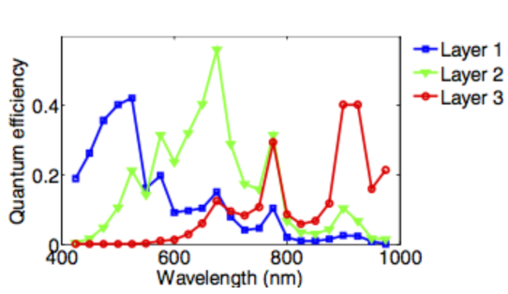
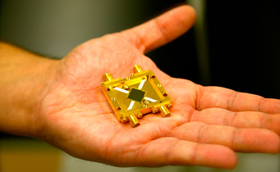
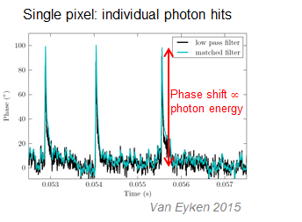
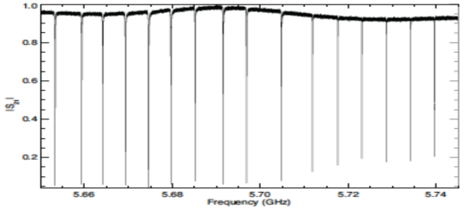
Color-sensitive detectors for low-resolution redshift survey
Muti-color CCD (simulation)
Improve photo-z over broadband filters while preserving throughput
Filterless, dispersionless spectroscopic imaging
Semiconductor and superconductor options
Multicolor CCDs
MKIDs: single-photon sensitive with R~30
Photon absorption breaks Cooper pairs, changes inductance, measure phase and amplitude change
Each resonator (pixel) has a unique resonant frequency in the GHz range
A comb of sine waves is generated and sent through the device
Thousands of resonators can be read out on a single microwave transmission line (FDM)
Microwave Kinetic Inductance Detector (MKID)
B. Mazin

Slide 10
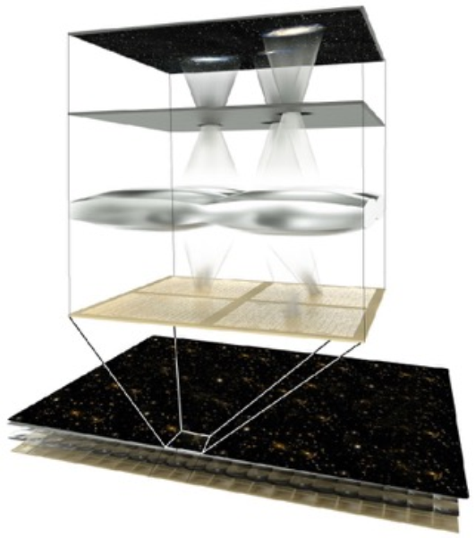
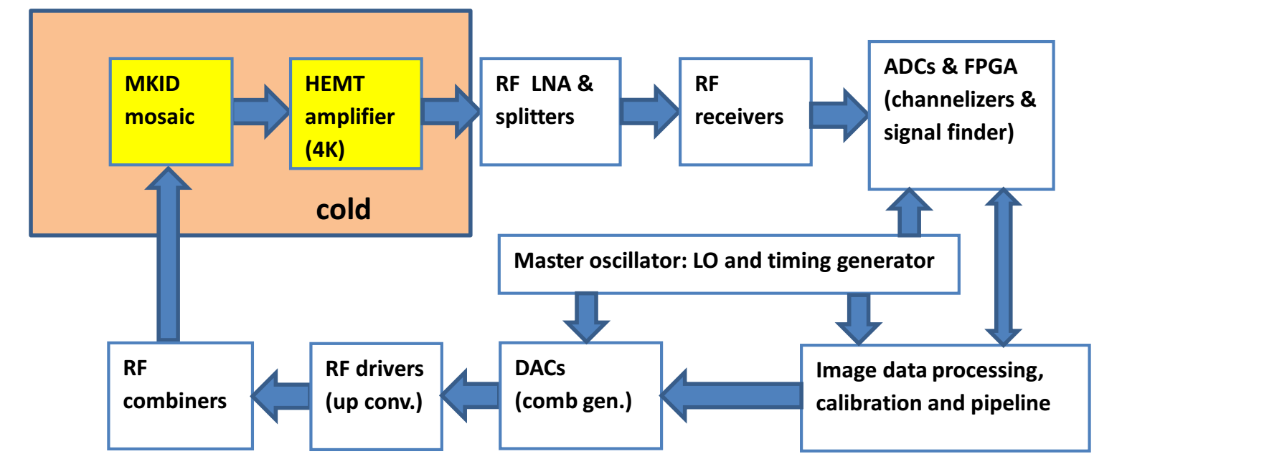
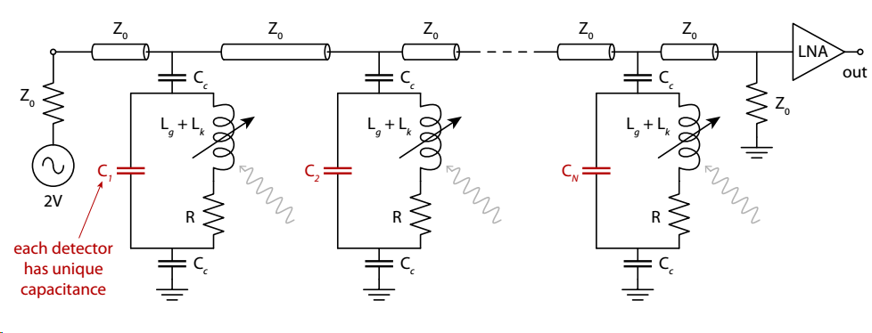
Example: 100,000-element MKIDs array
Giga-z concept (Marsden 2013)
Possible readout/DAQ architecture (FNAL)
DAQ challenges:
Scale-up:
2K camera demonstrated (ARCONS, arXiv:1306.4674)
30K camera in development (KRAKENS, arXiv:1506.03458)
Multi-GHz RF data transport in/out of sub-1K cryostat
Warm electronics: “software-defined radio” technique, massive GSa/s rate, need for real-time pipeline
Calibration (laser scan?)
Multiplexed MKID string

Slide 11
Data rates and volumes for 100,000 element MKIDs low-resolution spectroscopic survey
Input to DAQ:
GHz-rate FDM on 50 feedlines (2000 MKIDS each) digitized at ~4GSa/a, 12b ➔ 300GB/s
Intermediate output:
Each photon arrival tagged with position (17 bits), energy (7 bits), time (5μs/15s = 22bits) = 46 bits → 6 Bytes
Broadband sky signal ~ 300photons/macropixel/s; 80% of pixels have galaxy sources ~ 10X sky rate
2700ph/pix/s × 105 pix × 6Bytes/pix = 1.6GB/s (200X reduction from raw rate)
Data volume if intermediate output is stored:
Assume 1000 hours/yr on-sky time for 5 years ➔ 29PB

Slide 12
OHEP experimental programs
Energy Frontier
Cosmic Frontier
Intensity Frontier
Dark Matter
Cosmic Acceleration
Cosmic- and Gamma-ray
Massive galaxy spectroscopic survey
Stage IV CMB
21cm intensity mapping
Color-sensitive sensors
Low-resolution spectroscopy
Fiber-fed spectrographs

Slide 13
Fiber-fed spectrographs beyond DESI
Existing surveys (DESI) still not statistics limited
Extend to 100M galaxies, z > 1.5
4-arm spectrographs including λ > 1000nm channel
Leverage LSST imaging
Existing or new large S. hemisphere telescope
DAQ/control issues:
Leverages DESI experience
Control/alignment of dense (30X DESI) fiber positioner array
Dawson
Future Cosmic Surveys 2016

Slide 14
Fiber-fed spectrographs
Assumptions:
100k fibers
1 hour/exposure, 1 min./readout
10000 hours open-shutter time over 10 years
200 4-arm spectrographs, 500 fibers/spectrograph, 4K² pixels/detector, 16bit resolution
➔ 26GB raw data per exposure
➔ 430MB/s rate
➔ 260TB total
Incremental advance over present CCD readout
Schlegel
Future Cosmic Surveys 2016

Slide 15
OHEP experimental programs
Energy Frontier
Cosmic Frontier
Intensity Frontier
Dark Matter
Cosmic Acceleration
Cosmic- and Gamma-ray
Massive galaxy spectroscopic survey
Stage IV CMB
21cm intensity mapping
Color-sensitive sensors
Low-resolution spectroscopy
Fiber-fed spectrographs

Slide 16
Stage IV CMB
A Conceptual Design Team with representatives fro 4 labs has been working to define the science case and technology implementation for a ground-based CMB survey:
Array of mm-wave telescopes, 4 bands, measure r, Neff
Cryogenic focal plane, <<1K
2 sites: S. Pole, Chile
500K detector elements (10X Stg.3, higher sensitivity), up to 50K/telescope
In-cryostat frequency-domain multiplexing with MHz or GHz carrier (time- and code-division mux also considered, or hybrid approach)
Backend electronics similar to MKID and a universal platform is considered.

Slide 17
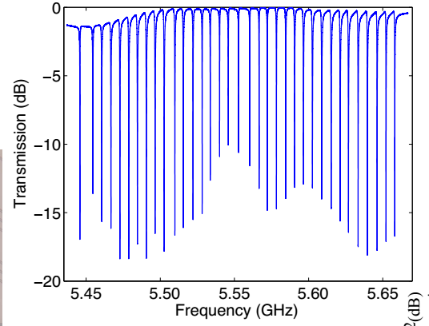
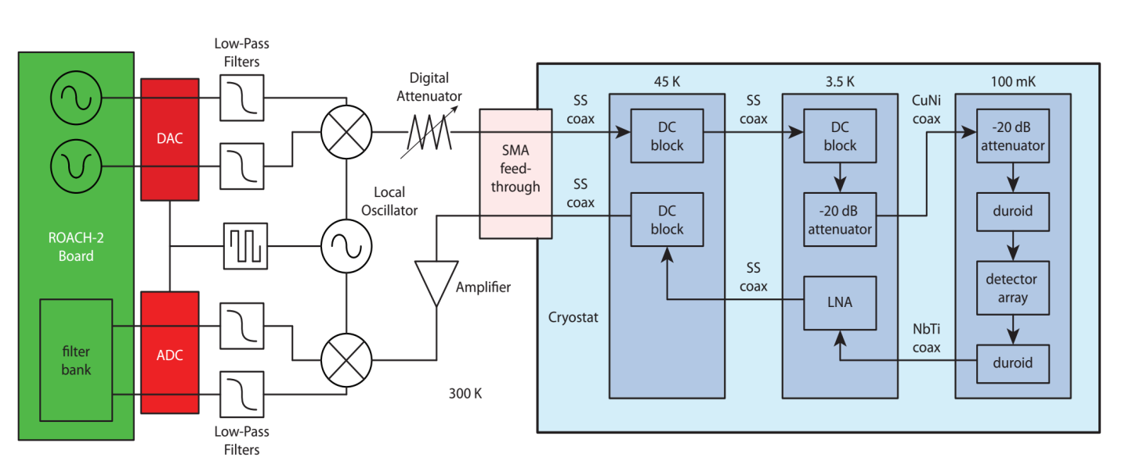
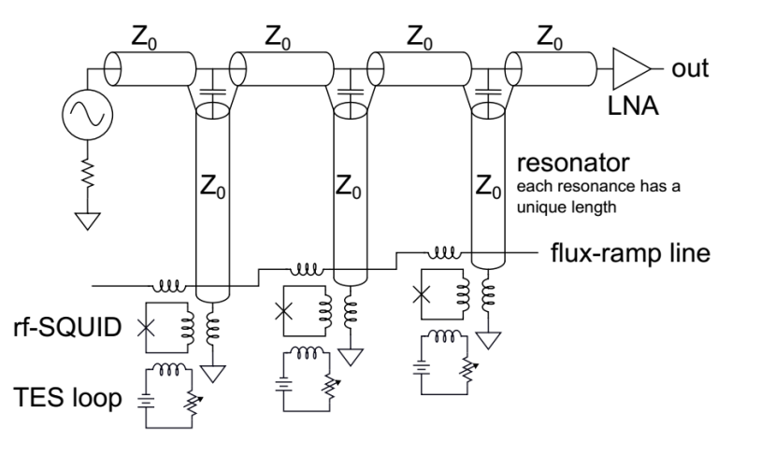
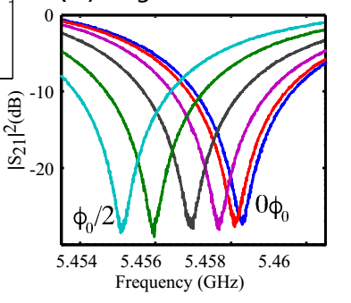
CMB-S4 readout architecture (GHz FDM)
Frequency comb in
Encodes element position along string
Flux-coupled TES resonators
Backend digital: probe comb generation, transmitted wave sampling and demux
Incident radiation shifts phase of resonance

Slide 18
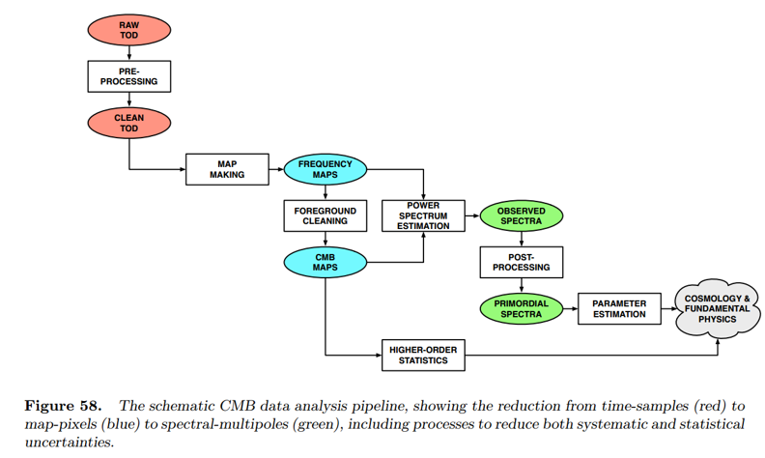
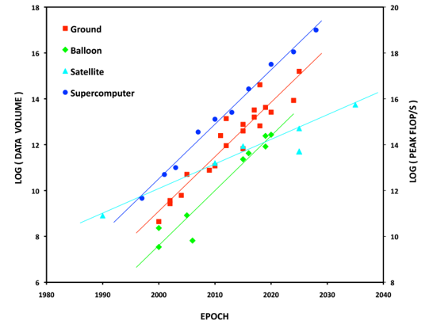
DAQ R&D issues for CMB-S4
Investigate alternative ways to reach higher multiplexing ratios:
High-bandwidth FDM
MKIDs vs TES
Higher sampling rates in warm backend
Packaging approaches to reduce wire count between thermal stages in cryo
Clock distribution stability
Algorithms to go from sampled FDM domain → Time-Ordered-Data domain → cleaned TOD → Map domain: what should be part of DAQ? Couple with simulation effort
Final data volumes: increased over S3 but not challenging
CMB S4 data pipeline
Growth of data volume (and computing)

Slide 19
OHEP experimental programs
Energy Frontier
Cosmic Frontier
Intensity Frontier
Dark Matter
Cosmic Acceleration
Cosmic- and Gamma-ray
Massive galaxy spectroscopic survey
Stage IV CMB
21cm intensity mapping
Color-sensitive sensors
Low-resolution spectroscopy
Fiber-fed spectrographs

Slide 20
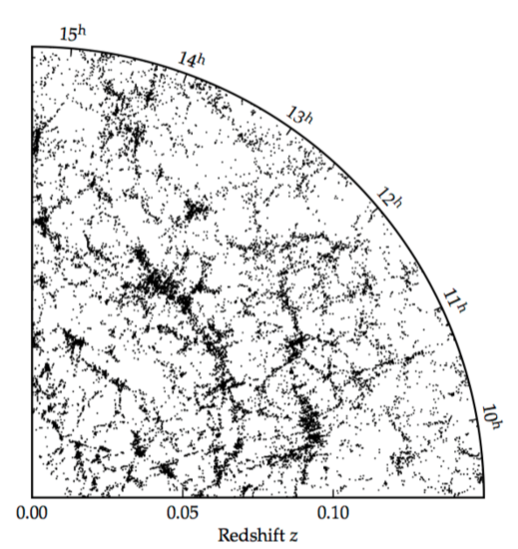
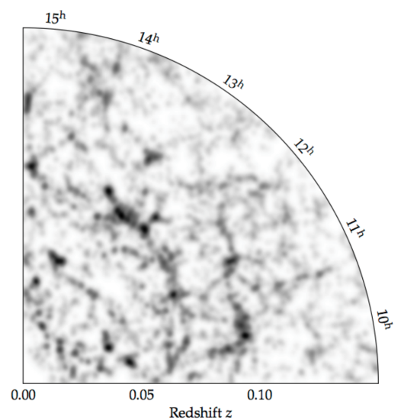
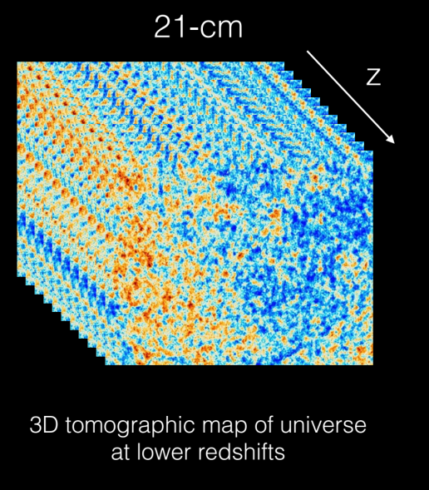
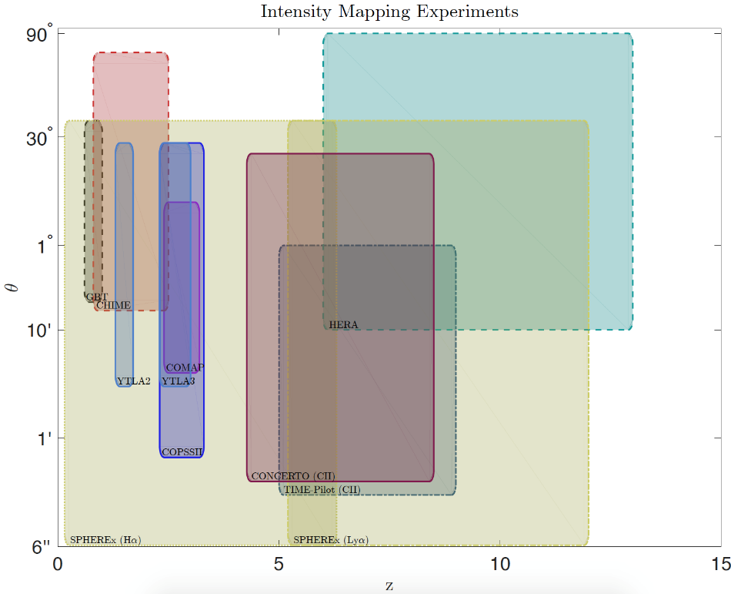
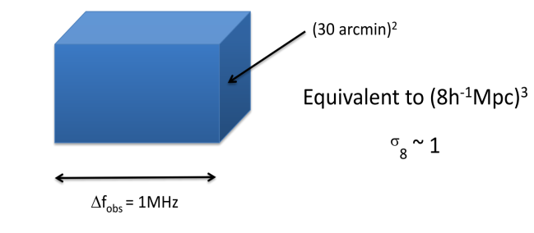
21cm intensity mapping
Detect redshifted 21cm emission from neutral hydrogen (or CO)
Design telescope with beams to make maps (like CMB) with just enough angular resolution to detect Large Scale Structure – no need to resolve individual galaxies
Narrow 1.420GHz emission line gives precise redshift automatically

Slide 21
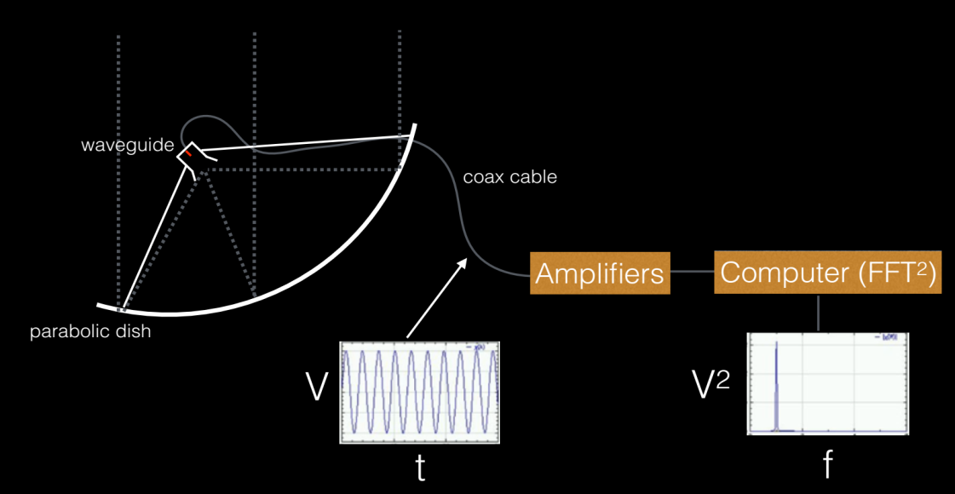
21cm readout
At frequencies < 1GHz, one can just directly sample the electric field (after amplification and bandpass filtering), Fourier transform and square to get intensity as a function of frequency.
Multiple antennas can be operated as an interferometer, increasing collecting area and allowing higher angular resolution
Interferometer of N antennas requires N²/2 cross-correlators at RF
Single-dish (imager) configuration
Single-dish correlation receiver
LNA
Browne 2012
Consider digitizing from here and performing subsequent processing in FPGA or GPU

Slide 22
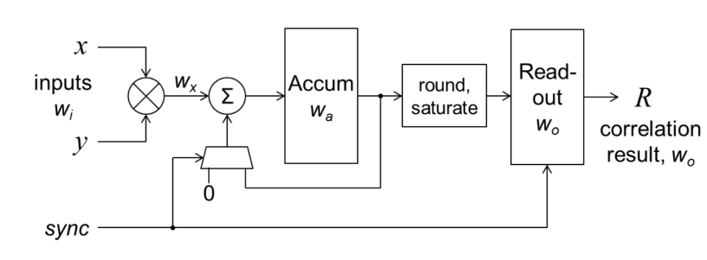
Example 21cm signal chain (single dish)
Antenna
Pulsed calibration injection
[cooled] amplifiers + filters
Digitizer
RFI identification and excision
|Fourier transform|²
Accumulate
Waterfall chart
Offline processing: calibration, foreground removal, map-making
Calibration signal processing
For interferometer of N antennas, a set of N²/2 correlators is required.

Slide 23
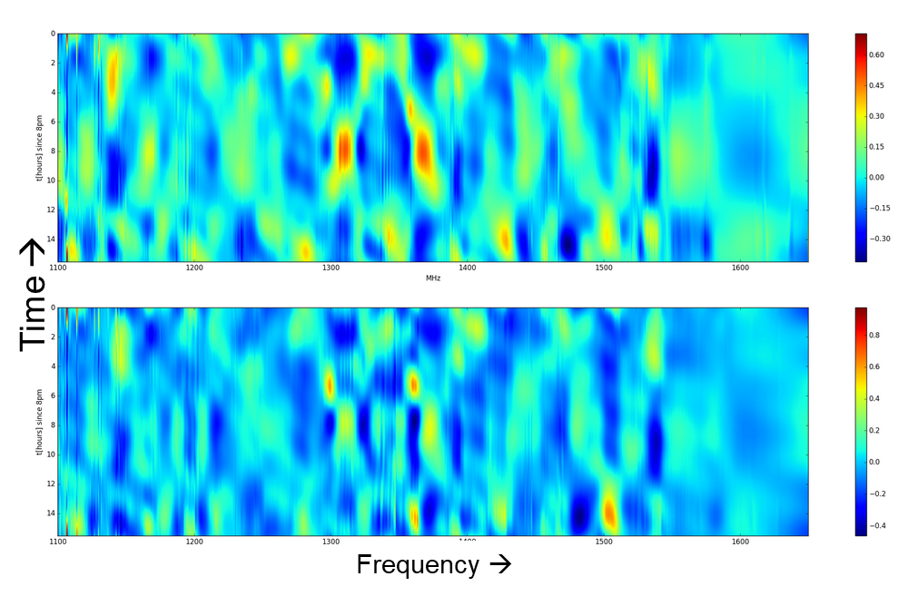
DAQ R&D issues for 21cm IM
Take maximum advantage of high speed digital sampling and processing hardware (ADCs, FPGAs, GPUs) as they will exist in 2025
Leverage digital RF and high-speed DAQ expertise within Labs
RFI mitigation (neural networks?)
Ensuring receiver gain and phase stability
Waterfall chart (BNL)
For interferometers:
Correlator architecture study using proper FoM to optimize system-level cost and power consumption
Stable distribution of signals (RF over fiber?)

Slide 24
Lessons learned from LSST
Importance of early integration (vertical slice tests)
Expose system-level problems not seen in component-level tests
Ensure test stand DAQ is ready for production tests
Decide if science DAQ will be used for test stands
Test stand DAQ needs to be ready earlier, and with possibly more features/functionality than science DAQ
Importance of a good detector emulator
Importance of DAQ for diagnostics and hazard mitigation
Especially important for detectors in cryo

Slide 25
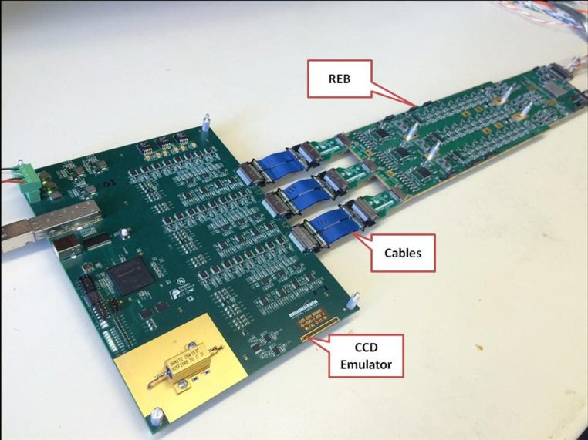
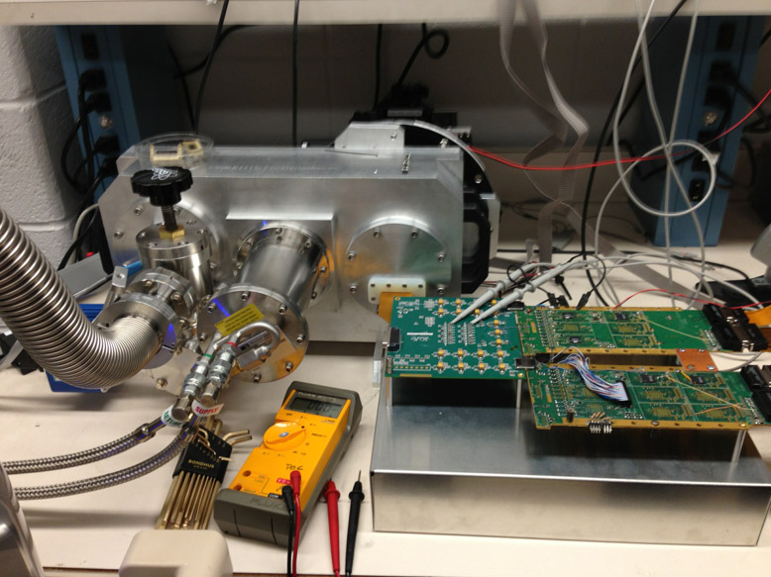
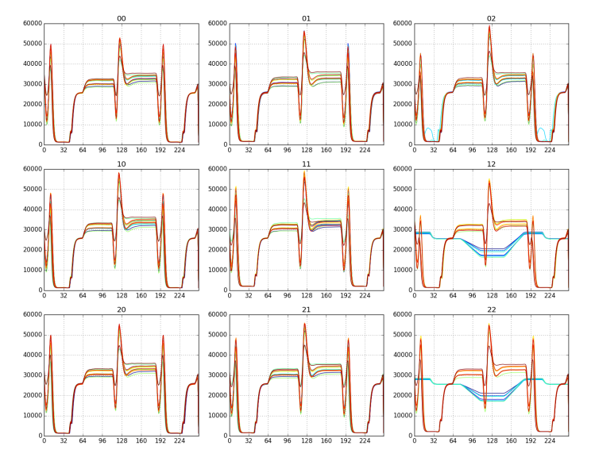
LSST DAQ lessons learned
Triple CCD emulator
Vertical Slice Test
Scan mode diagnostics

Slide 26
Summary
Next-generation large-scale cosmic acceleration experiments in planning stages
Several areas of common R&D interest:
Digital RF signal generation and processing
Algorithms for on-the-fly calibration and data cleaning
Analog data transport into/out of cryostats
Test stands and calibration
For galaxy spectroscopic survey:
Viability of MKIDs at 10⁵-pixel scale
Control and alignment of 10⁵ fiber positioners
For CMB:
Choice of detector and multiplexing method
For 21cm:
Leveraging high-speed digital sampling and processing to minimize cost and power

