Slide 1
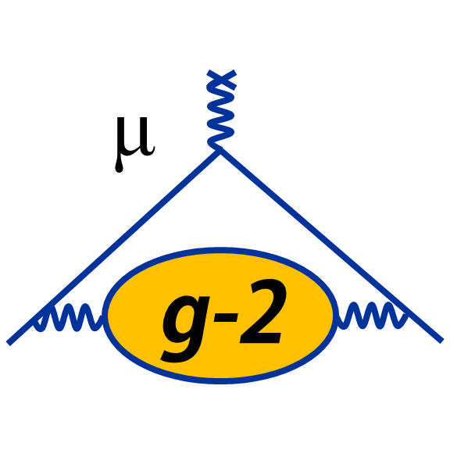
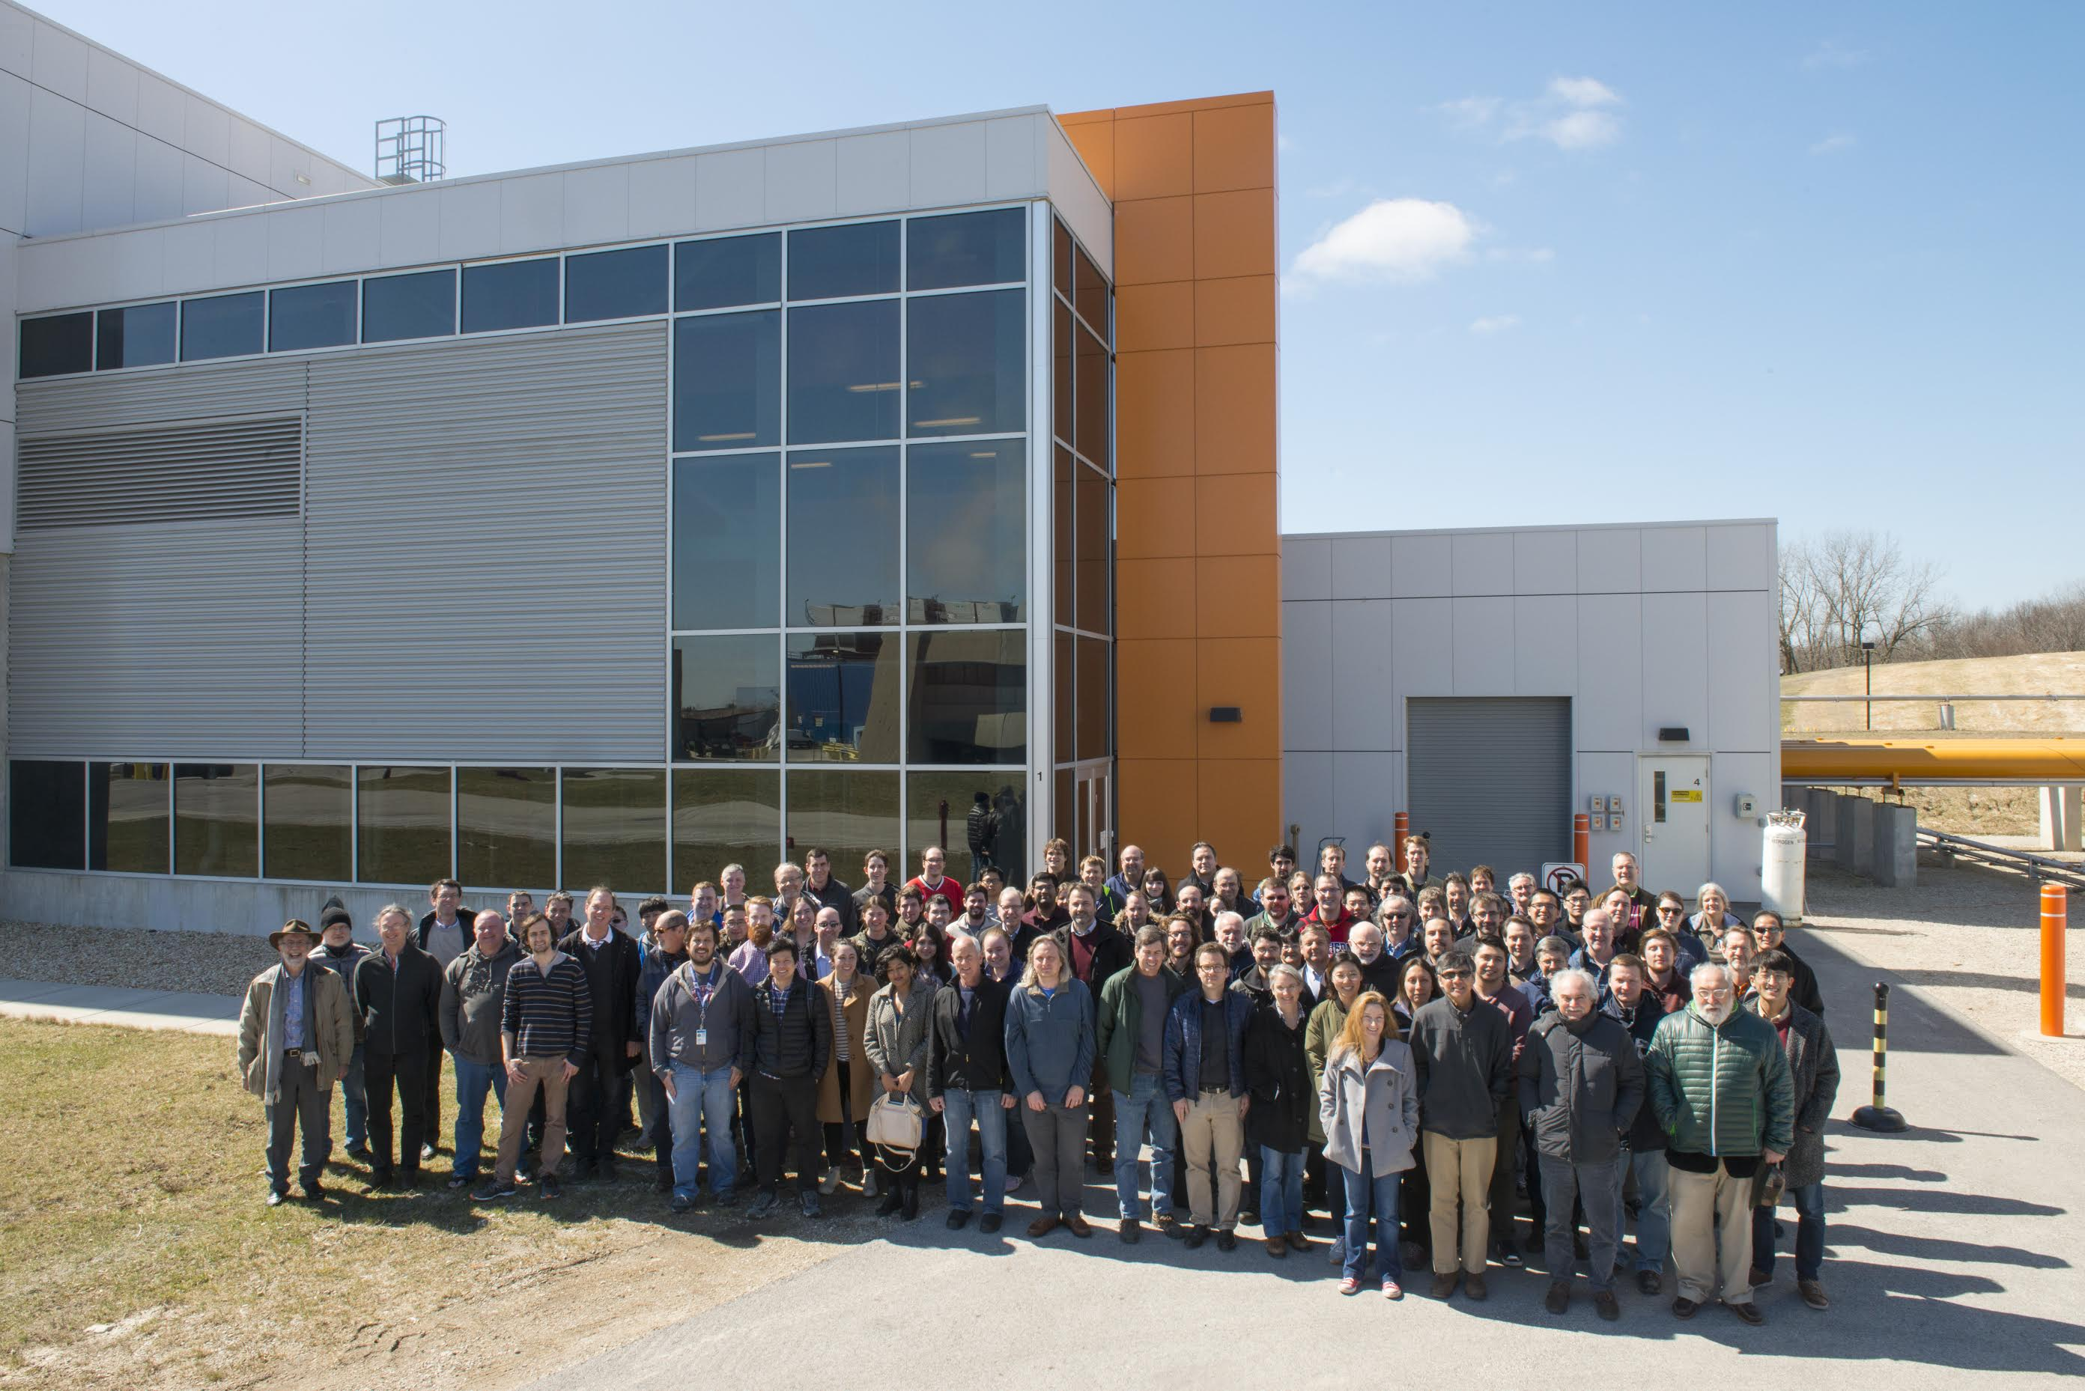
Muon (g-2) to ≤ 140 ppb
State of the Experiment
“Right now we have a symphony of issues … “
From a C. Polly email
And we are having FUN solving them and realizing first beam after 9+ years of planning
David Hertzog (Washington) and Lee Roberts (Boston)
for the E989 Muon (g−2) Collaboration

Slide 2
g-2 Theory Community very active
Strong support from DOE and Fermilab

Slide 3
“What the PAC would like to hear …” Steve Geer
What would you do if FY18 run is ~3 months only
What would you do if there is no FY18 run
Run Plan for a FY18 full-year run
I have added to that charge:
  Status of commissioning run
  Health Test of Subsystems
  Flash plots of performance to date
… which I will present first
- p. 3

Slide 4
Goals of Commissioning run
Test / exercise all experimental equipment with beam
Establish muon storage rates to check TDR estimates
Acquire enough statistics for meaningful offline analysis development
and, we should not forget
Train the crew and be ready for Physics Runs in early FY18
Nominal commissioning schedule:
May 23rd: 1 fill / minute*
June: 6-8 fills / minute
July 7th: Shutdown
*720 fills / minute when running fully
- p. 4

Slide 5
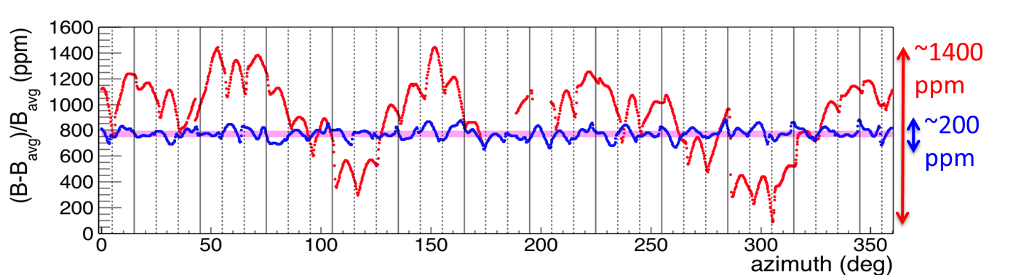
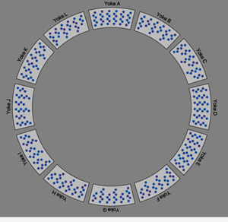
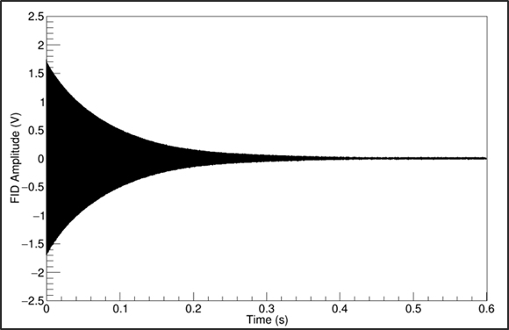
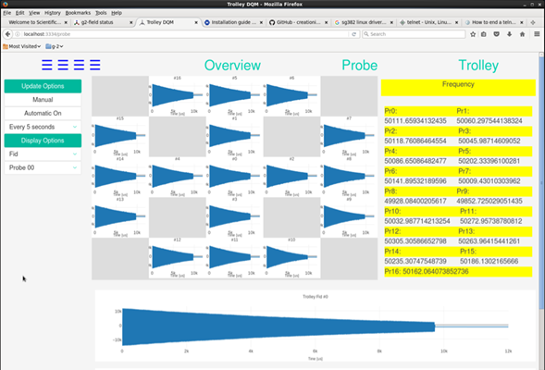
Test / exercise all experimental equipment:
The ω_{p} Measuring Systems
✔
Precision shimmed Field
Fixed NMR probes
NMR Trolley system
NMR Plunging probe (just installed)
Online monitoring
Field DAQ
✔
All working
~✔
~✔
FID
✔
✔
✔= almost perfect; ~✔= not yet optimized, fully tested, or complete

Slide 6
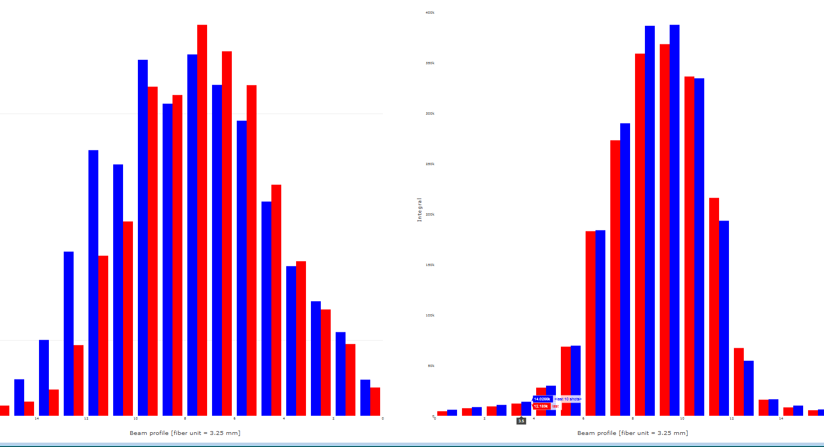
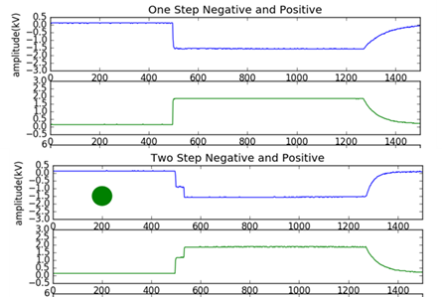
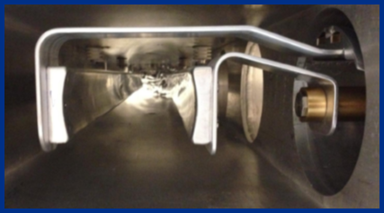
Test / exercise all experimental equipment:
The Muon Storage Optimization Systems
~✔
T0 start counter
IBMS imaging system
Inflector
Pulsed Electric Quadrupoles
Fast magnetic Kicker
Fiber Harp x/y planes in vacuum
~✔
✔
~✔
~✔
B
x
μ+
✔
μ coming at you
✔= almost perfect; ~✔= not yet optimized, fully tested, or complete

Slide 7
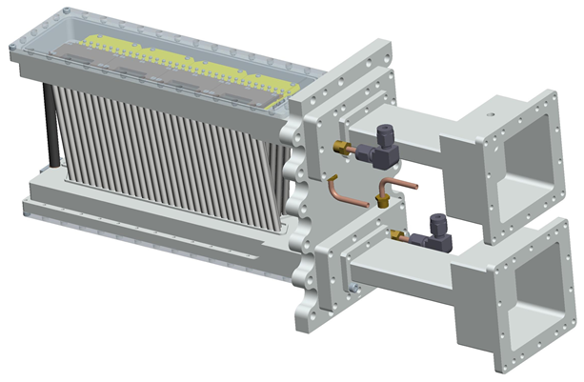
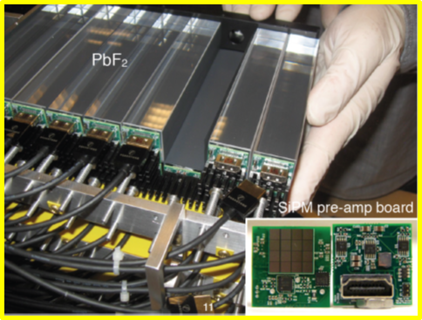
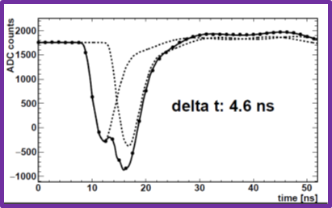
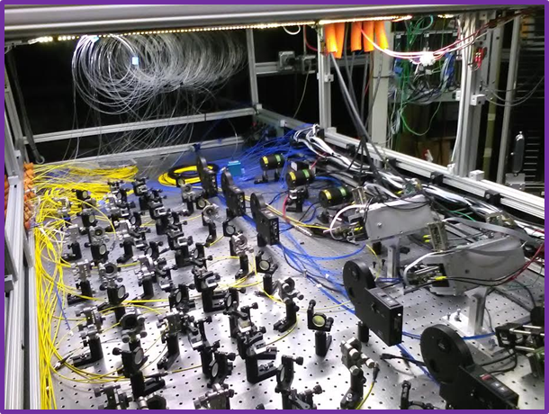
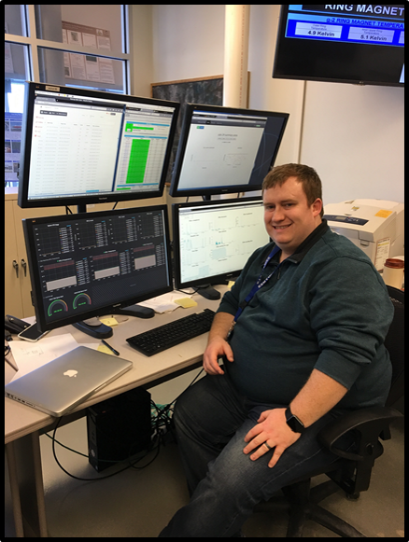
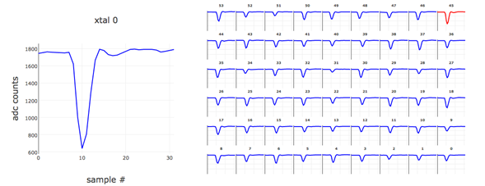
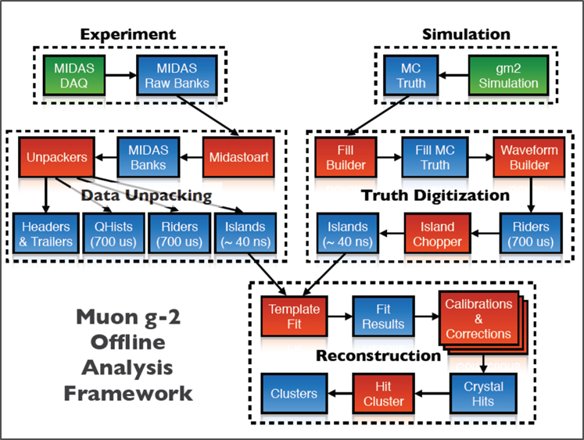
Test / exercise all experimental equipment:
The ω_{a} Measuring Systems: General conclusion “working very well”
~✔
In vacuum straw trackers
PbF₂ calorimeter arrays
800 MSPS digitizers
6-laser, distributed calibration system
Real-time GPU processing
MIDAS DAQ
Online Data Quality Monitors
Nearline / Offline processing
Slow Controls
✔
✔
✔
✔
~✔
✔
~✔
~✔
✔= almost perfect; ~✔= not yet optimized, fully tested, or complete

Slide 8
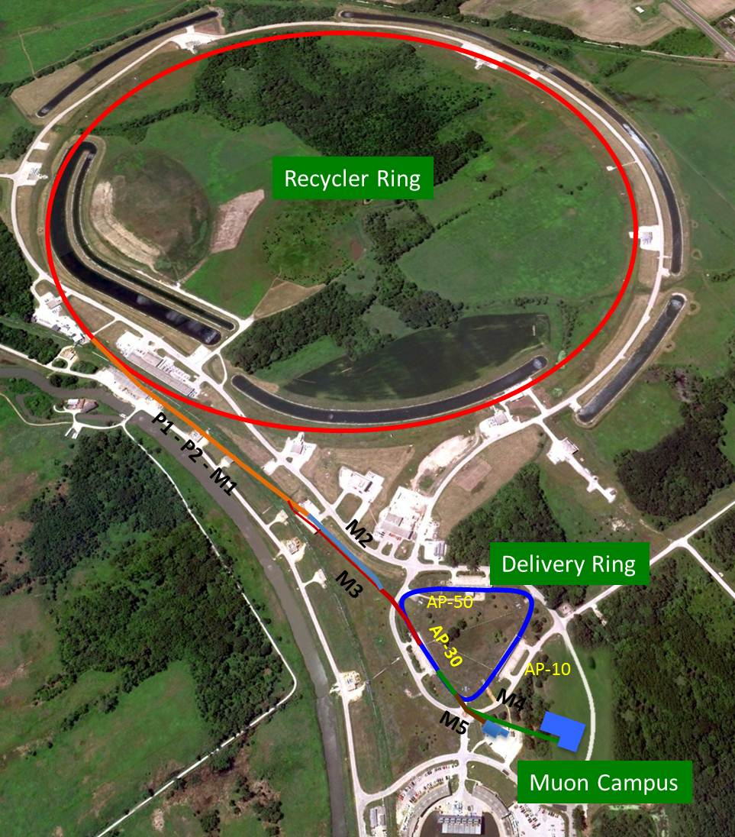
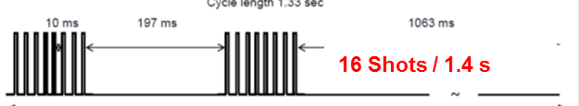
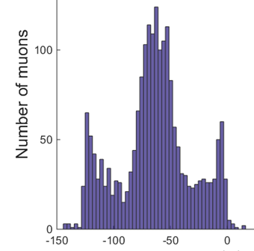
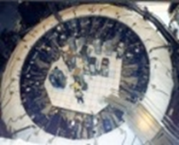
Creating the Muon Beam for g-2
8 GeV p batch into Recycler
Split into 4 bunches
Extract 1 by 1 to strike target
Long FODO channel to collect π ◊ μν
p/π/μ beam enters DR; protons kicked out; π decay away
μ enter storage ring
Intensity profile is 120 ns wide with “W” shape

Slide 9
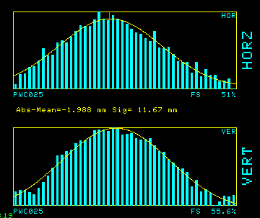
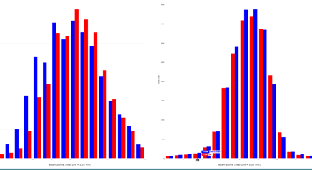
This year we are bypassing the DR
Protons: 60
Pions: 4
Muons: 1
At Storage Ring Entrance
And in front of Inflector with our IBMS detector
X
Y
X Y

Slide 10
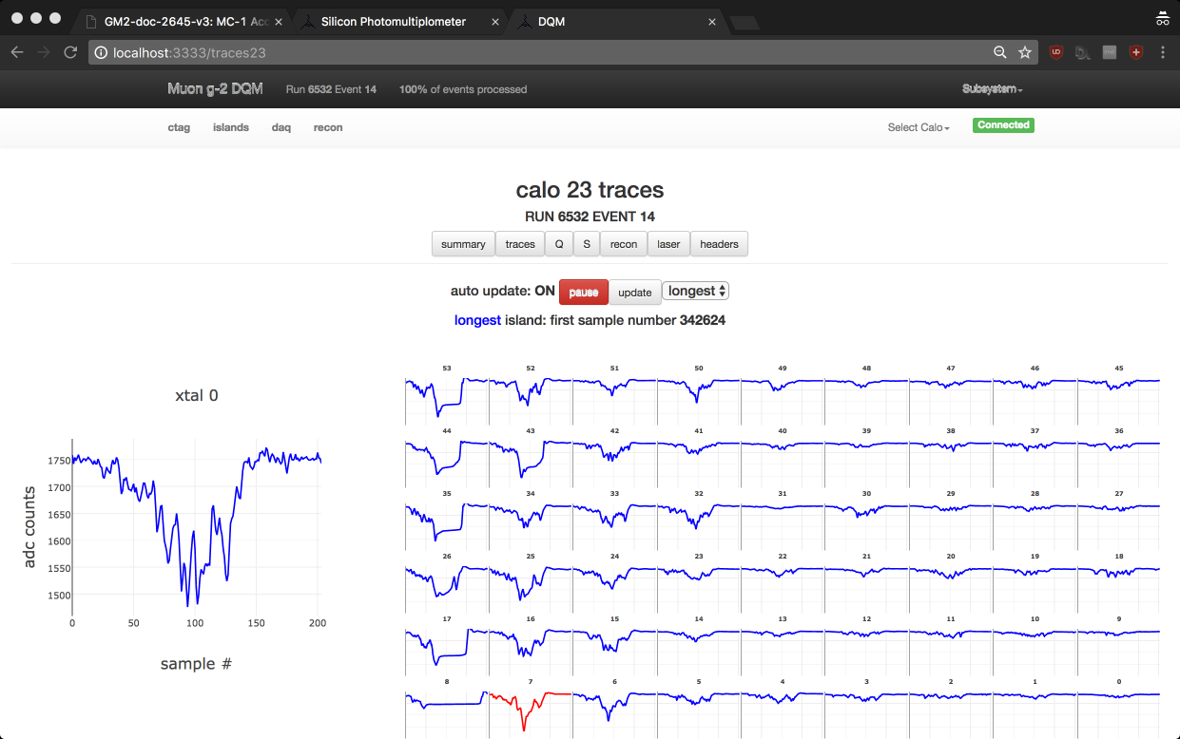
Recent success: May 23rd
First Beam Crashes into Calorimeters

Slide 11
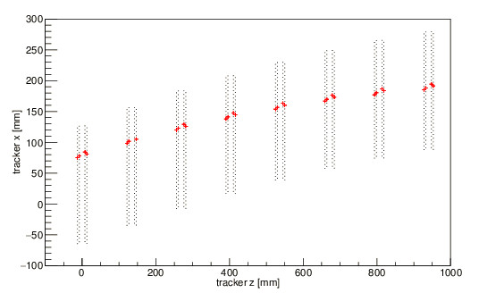
Recent success: June 5
First evidence of stored protons from some hand-selected events
Image from Tracker of escaping proton at late times

Slide 12
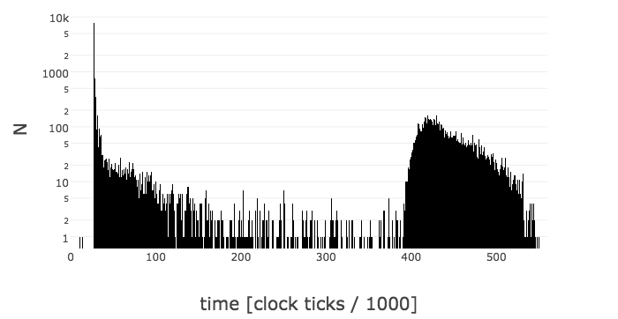
How do we tune in real time? (this is online displays)
Sweep the following to optimize Storage of Protons (muons)
  Kicker timing
  Quad strength
  Inflector current
  Incoming beam x,x’, y,y’
  Incoming beam focus parameters
We have online monitors of:
  Stored protons
  Stored muons
  Incoming beam composite intensity
Now dumped out and integrated as proxy for storage.
Protons scraped out
← Now stored →
500 μs

Slide 13
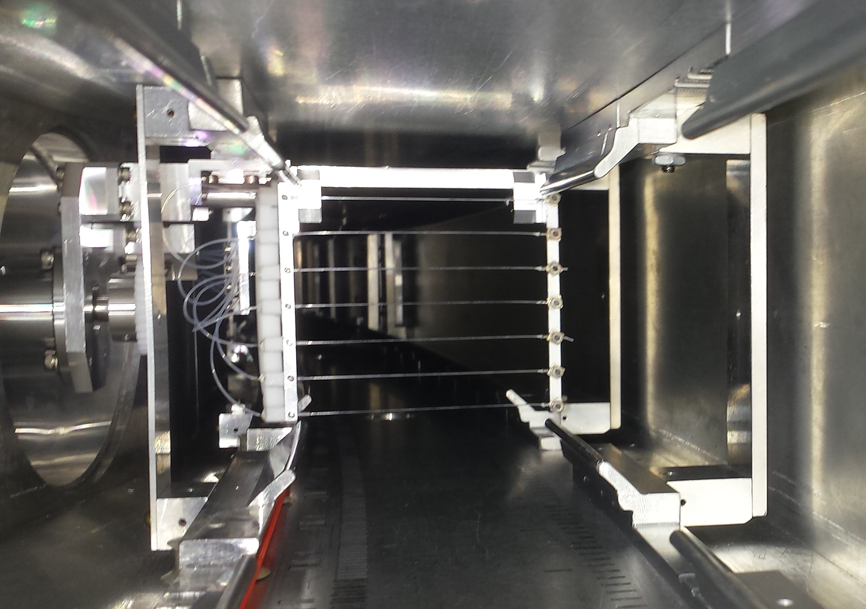
Rich information on stored beam from in-vacuum Fiber Harps arrays
Looking downstream as a Muon or Proton would

Slide 14
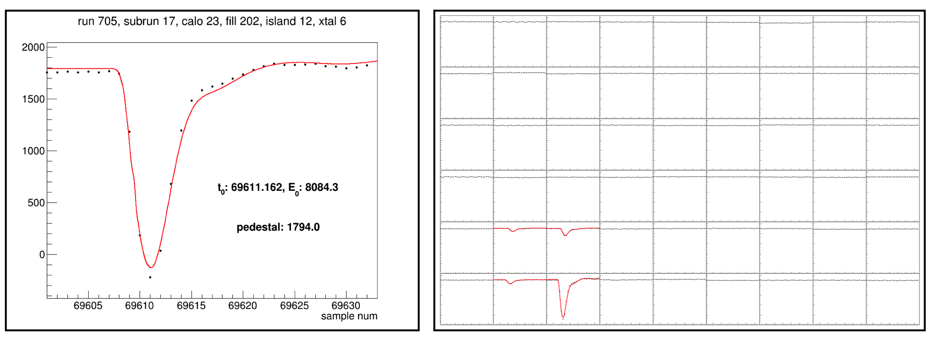
What a high-energy positron looks like in our calorimeter
~3 GeV
Online pre-calibration gain of 1294 crystals using Laser system for absolute PE / pulse integral

Slide 15
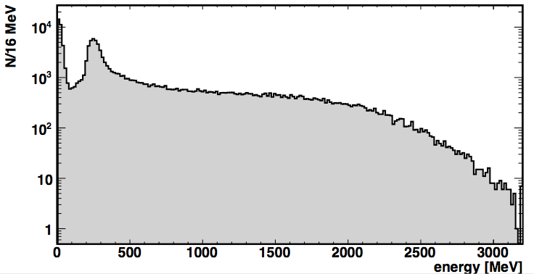
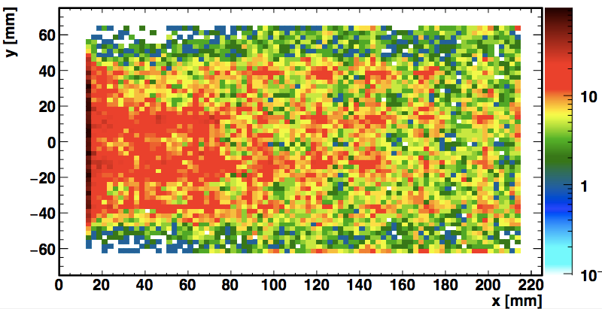
1294*/1296 crystals working and calibrated in Calorimeter
Spectrum “as expected”
Escaping protons
Muon Decay Positrons
Muons Here
Hit positions “as expected”
*easy to fix after run ends and we have access

Slide 16
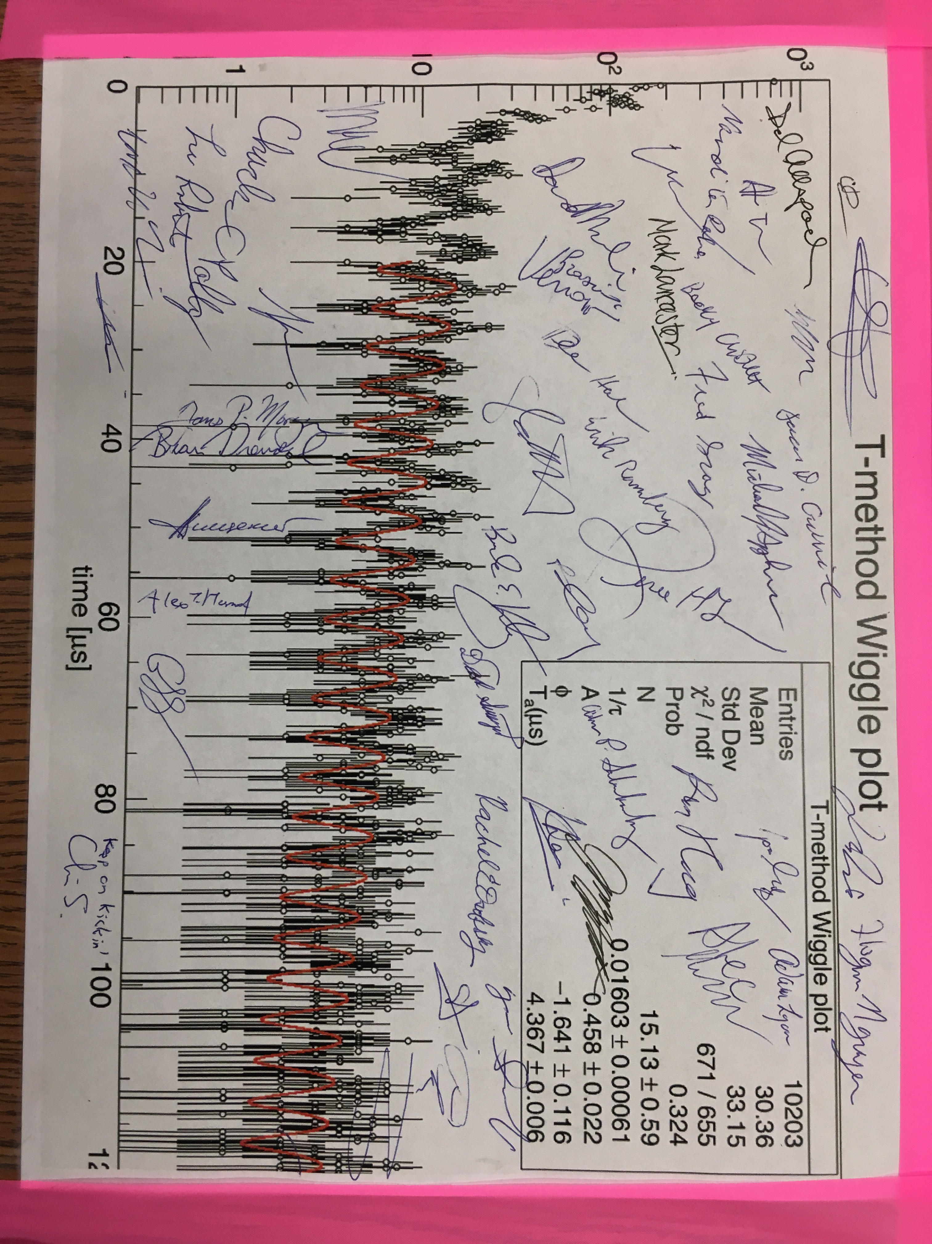
Recent success: June 11
First evidence of stored muon precession

Slide 17
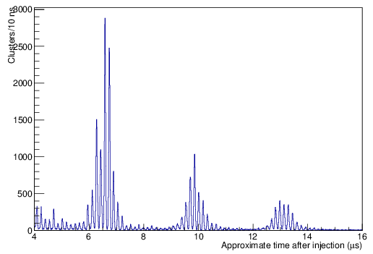
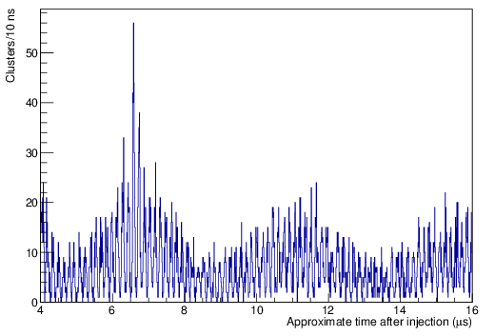
Proton and Muon Fast Rotation in calorimeters
(could not see this at BNL so easily)
Protons only
CBO
Muons only
g-2 precession

Slide 18
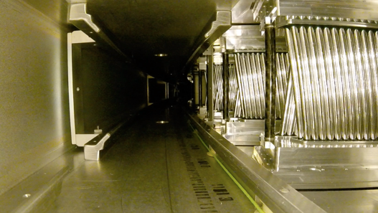
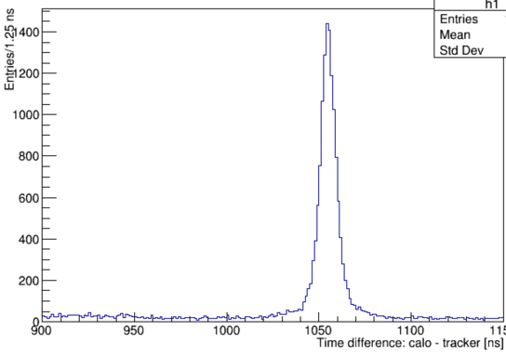
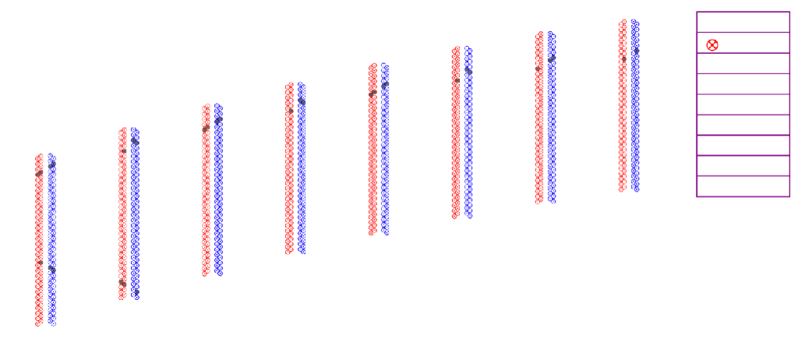
Tracker & Calorimeter working together
ΔT = Calo(t) – Tracker(t)
X

Slide 19
Getting better … : June 25

Slide 20
Transmission and Storage so far …
Ion Chamber readbacks versus simulation
(normalized to protons on target)
 | Diktys simulation 1E12 POT | June 18 1.3E11 POT | Normalized to POT (*)
Into M2 Line (IC804) | 6.77E8 | 6.60E7 | 80%
In downstream M3 Line (IC740) | 2.12E8 | 1.86E7 | 81%
In M4 Line (IC902) | 1.16E8 | 0.60E7 | 47%
End of M5 Line (IC025) | 1.00E8 | 0.27E7 | 29%
Transmission and Muon Storage Fraction ~ 1/6 of expectation at this time:
  Not yet optimized:
    Inflector transmission (possibly significant)
    Quad HV (limited by present vacuum)
    Kicker strength (1/3 needs repair)

Slide 21
2015 Schedule overview (PAC talk 6/15)
Construction (Project & Muon Campus):
MC-1 (GPP)
In 2 years, schedule slipped only 3 months
Nice job by all
g-2 Cryo Plant (AIP)
Ring Assembly
Ring cold ready for operations
Shim Field
Prep Chambers/Install
Construct/Install Sub-systems
Experiment ready for operations
Accelerator Modifications
Accelerator ready for operations
Operations (Laboratory):
Ring Cold
Detector/DAQ Commission
Beam
Tune-up
Full Running Intensity
Physics Production Running
Analysis (Collaboration):
Analysis Tools Development
Mock Data
1-2 x BNL statistics
1st Results
~5-10 x BNL
2nd Results
21 x BNL
Final Results

Slide 22
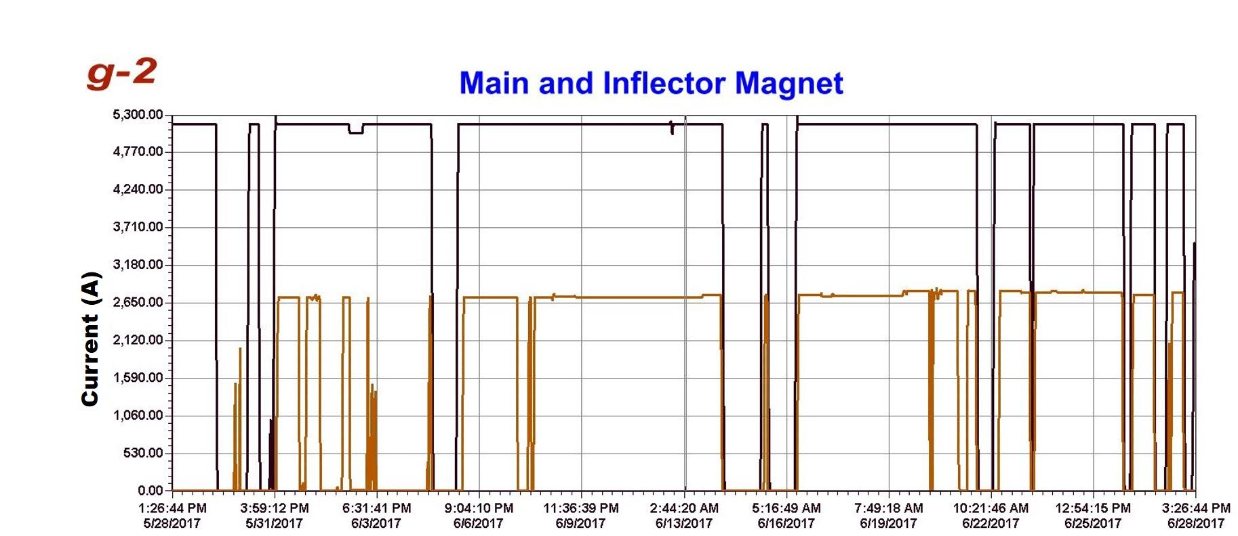
2017 PLANNING
Mar/Apr 17
May/Jun 17
Jul/Aug 2017
Sep/Oct 17
Nov/Dec 17
Jan/Feb 18
Mar/Apr 18
May/Jun 18
Jul/Aug 18
Finish proj. scope
Accelerator commissioning
Shutdown
DR comm. + intensity ramp up
Physics production running + continued intensity tune-up
Shutdown
p
p
μ
First beam available
to ring w/ protons
Additional ring/detector
commissioning
Superconducting Main Magnet and Inflector Up Reliably

Slide 23
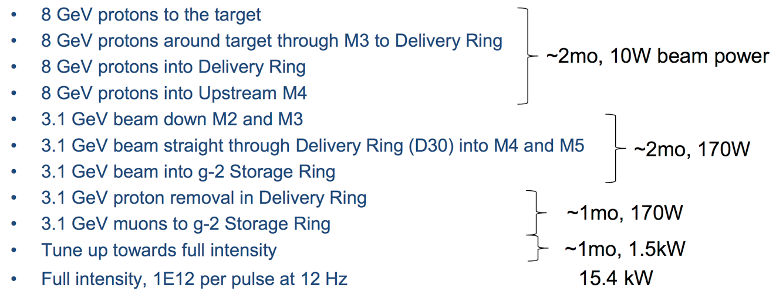
If FY18 Run is 3 months long: (factual statements)
AD estimated 6 months to achieve full intensity and rep rate:
  10¹² POT/fill, 90% transmission, 12 Hz operation (as expected in our TDR)
This year, 3 months well used to bring beam to ring, even with known rep-rate and flux limitations:
  Muons to ring entrance ~10⁻³ / hour compared to when fully operational
Completion of tuning & commissioning in FY18 will require 3 months
  Install new pulsed septa magnets
  Commission all pulsed power supplies for 12 Hz avg / 100 Hz bursts
    Target station lens and pulsed magnet
    Delivery Ring injection and abort septa
    Delivery Ring injection, extraction, and abort kickers
The Storage Ring transmission and muon capture efficiency low
AD Plan

Slide 24
If FY18 Run is 3 months long: (impact statements)
Nearly the entire period will be a dynamic tuning / optimization exercise to achieve the required running conditions.
Non-optimized beam will provide opportunity to further commission experiment and muon storage parameters
Precession data obtained should compare to BNL E821 statistics
BUT! Depending on the quality, it may not provide a “physics” quality data set unless we get at least 1 month of good and stable conditions with all systems functioning well
THE IMPACT
  Lose a full year on our Physics Production calendar
  Highly inefficient use of time and resources
  Likely lose critical (young) people who have brought the experiment up to a running condition. These are the experts. Many are on fixed-term contracts and thesis calendars.
    Run restart 9 months later will be at risk if some experts depart
    Could also lose critical Fermilab technical support
  Impact to Mu2e is likely if g-2 is slowed significantly

Slide 25
If there is NO FY18 Running at all…
A Doomsday Scenario for g-2
The Experiment is built and ready after 9+ years of planning, design, construction
The Experiment has largely been commissioned.
It’s too delicate to simply stand down for 15 months and be expected to come back alive without serious problems
International partners will be dumbstruck
University grants devastated and groups diminished
Trust destroyed

Slide 26
Summary
Our Run Plan for (full) FY18 cycle
  Use Shutdown to address known issues
    Vacuum improvement → kicker and quad increased HV expected
    Small noise issues on some signals; new T0, additional IBMS planes
    Integrate final aux systems into DAQ
  Tune our systems using parasitic beam during AD muon campus development
  Take high-quality data aggressively until 2018 summer shutdown
What happens if it’s only 3 months …
  Mostly commissioning
  Setback of 1 year on physics calendar
  Delayed “discovery” window for new physics
  Mu2e likely impacted
And worse? No running?
  Honestly?
The Collaboration continues to thank the Lab for strong support
- p. 26

Slide 27
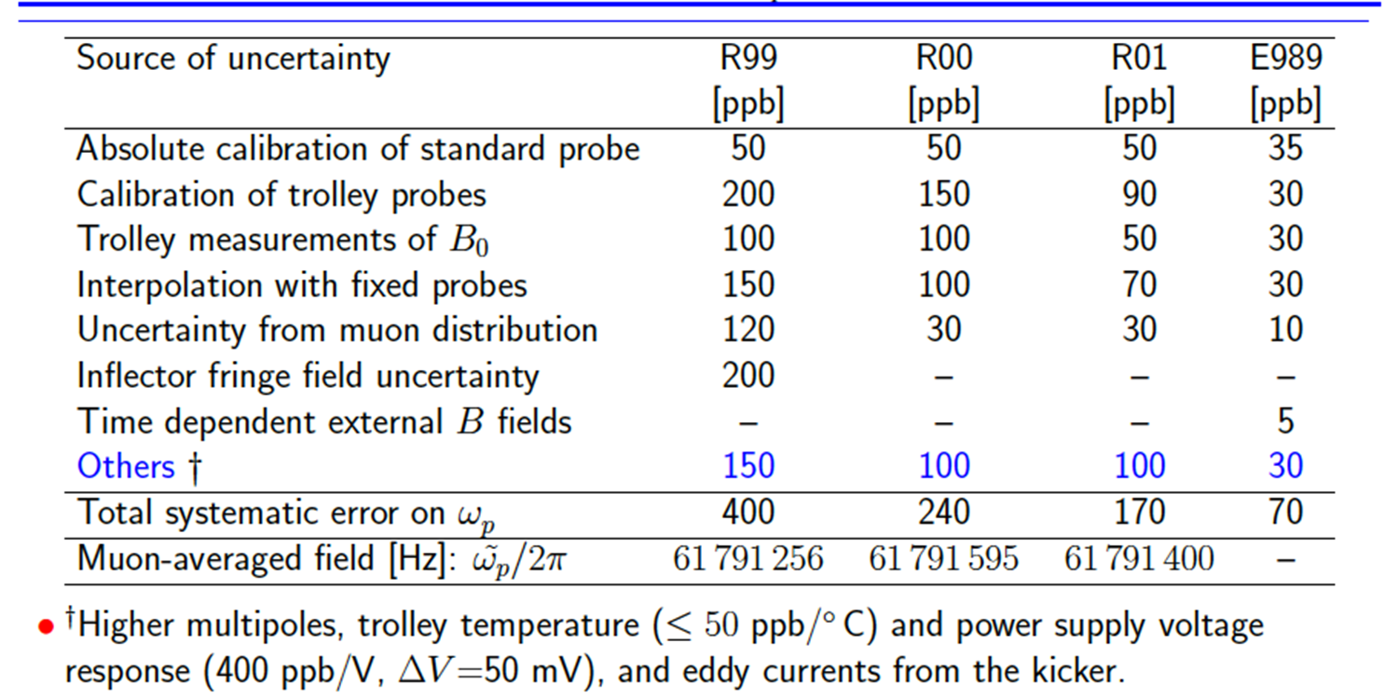
Systematic Errors on ω_{p} (ppb)
Brookhaven E821
FNAL
The Muon (g-2) Collaboration, Fermilab PAC – 24 - June – 2015
- p. 27

Slide 28
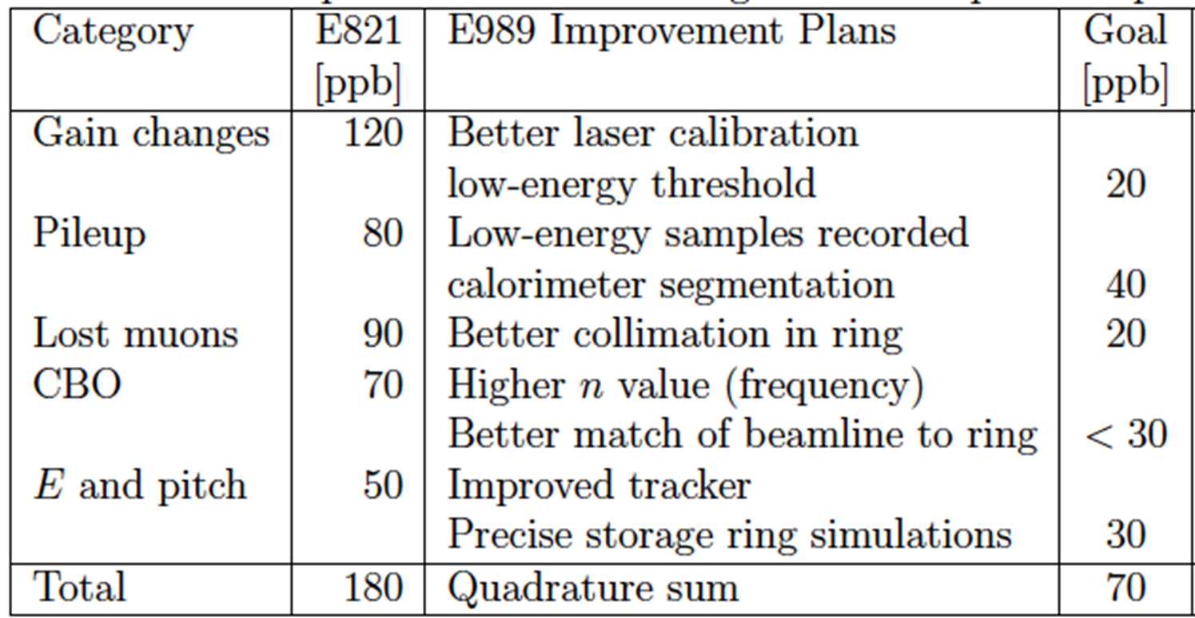
Systematic Errors on ω_{a} (ppb)
Detector Team
Ring Team
Detector Team
The Muon (g-2) Collaboration, Fermilab PAC – 24 - June – 2015
- p. 28

Slide 29
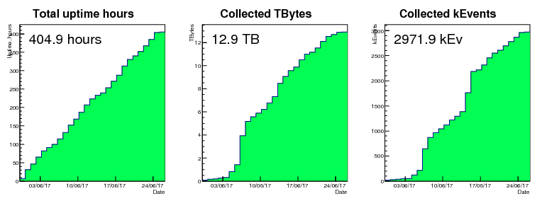
DAQ Performance
MIDAS DAQ is reading data from all 24 calorimeters, Laser system, tracker, fiber harps, Quads and IBMS, as well as 33 slow controls.
Total uptime after first 25.5 days is 66% with almost 3M fills collected.

Slide 30
The Laser Calibration System is fully installed and operational

Slide 31
Measuring ω_{a} [ from BNL realized → FNAL goals ]
Statistical error: [ 460 ppb → 100 ppb ]
  x21 in statistics, ~1.8 x 10¹¹ events
Producing and storing 21x more muons than BNL requires a new beam development concept
AND: Understanding at a deep level, the beam production, polarization, phase space properties.

Slide 32
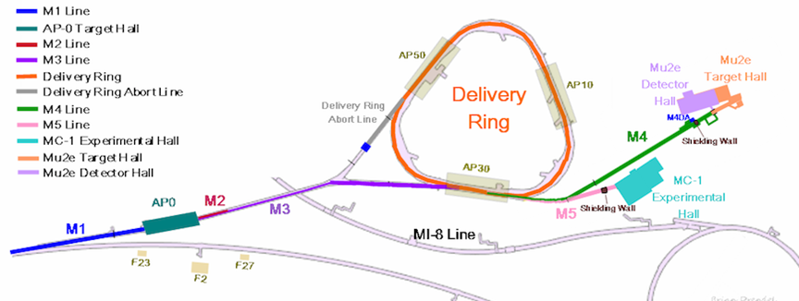
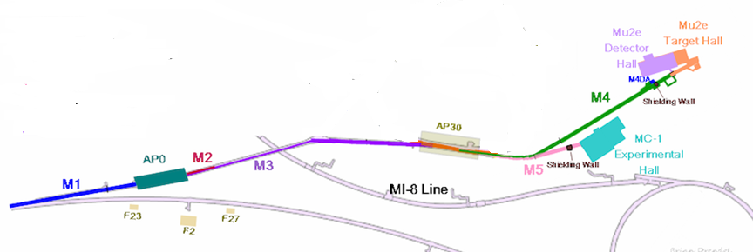
Commissioning beam will have a large proton and pion background.
Muon Campus
Muon Campus without DR (g-2 commissioning)
D. Stratakis, GM2-doc-5664

Slide 33
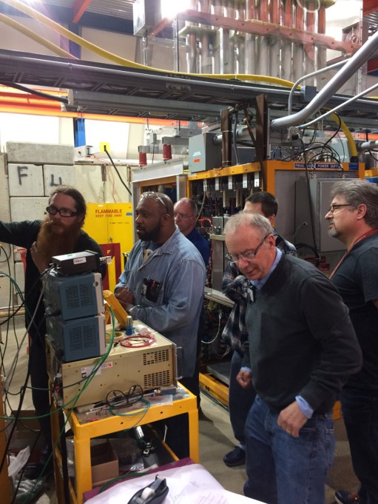
g-2 beamline work during shutdown
Install new pulsed septa magnets
  Commissioned using old Pbar septa which does not have cooling to run at full g-2 repetition rate
Commission all pulsed power supplies for 12 Hz avg / 100 Hz bursts
  Target station lens and pulsed magnet
  Delivery Ring injection and abort septa
  Delivery Ring injection, extraction, and abort kickers

