Slide 1
SBN Program Status
Peter Wilson
Fermilab PAC – July 2017
6 July 2017

Slide 2
Outline
Scope and organization of the SBN program
Infrastructure Progress
ICARUS Progress
SBND Progress
Program cost and budget
Summary

Slide 3
SBN Program Scope and Organization

Slide 4
SBN Program Scope
Construction and installation (aka Phase 1):
Design and construct two buildings: GPPs
Design, construct, and install the SBND detector
Refurbish and install ICARUS T600 detector
Design, construct, and install infrastructure (eg cryogenics)
Operations (aka Phase 2):
Operate MicroBooNE detector – FY15 on
Cold commission and operate ICARUS detector - start FY18
Cold commission and operate SBND detector – start FY19
Primary DOE contributions: infrastructure, assembly and installation

Slide 5
SBN Work Breakdown for Construction

Slide 6
SBN Work Breakdown for Construction
WBS 1
WBS 2
WBS 3
WBS 4
Program
Coordinator:
Peter Wilson
Deputy:
Cat James
Technical
Coordinator:
Brian Rebel
Technical
Coordinator:
Claudio
Montanari
(CERN-INFN)
Deputy:
Andrea Zani (CERN)
Technical
Coordinator:
Cat James
Definitions:
L1 Manager = TC
L2 Manager is next level below
MS Project File covers WBS 1-4

Slide 7
SBN Work Breakdown – Funding Sources
DOE
DOE
LANL LDRD
DOE-CERN-INFN
STFC-NSF
Swiss
DOE
DOE-CERN-INFN
DOE-NSF
CERN-INFN
WA104
DOE
DOE
NSF: two separate NSF MRIs
CERN-DOE-INFN
DOE: funds through Fermilab

Slide 8
Infrastructure Progress

Slide 9

SBN FD Building - Done
Completed on schedule and budget – working on post construction outfitting

Slide 10
SBN ND Building - Done
Completed on schedule and budget – working on post construction outfitting

Slide 11
Cryogenics – WBS 4.3
Overview and Scope - four parts, divided between institutions
  Internal – CERN/INFN for ICARUS, FNAL for SBND
    Portions of the cryogenics which are inside the cryostats
  Proximity – CERN for both detectors
    Bulk of the Ar system: circulation, re-condensing, filtration
    CERN contract with DEMACO for SBN and ProtoDUNEs
  External - FNAL for both detector
    LN2 circulation to condensers and heat exchangers
    Filling and storage for all cryogens
  Controls – FNAL for both detectors
    Readback of all devices; programming of feedback loops; monitoring and logging
All systems go through Fermilab Operational Readiness Clearance (ORC) review process. This starts during the design process.

Slide 12
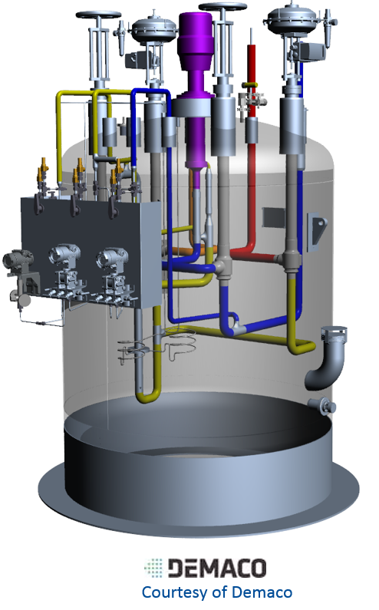
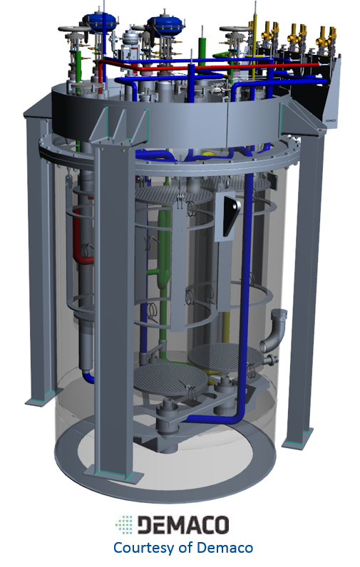
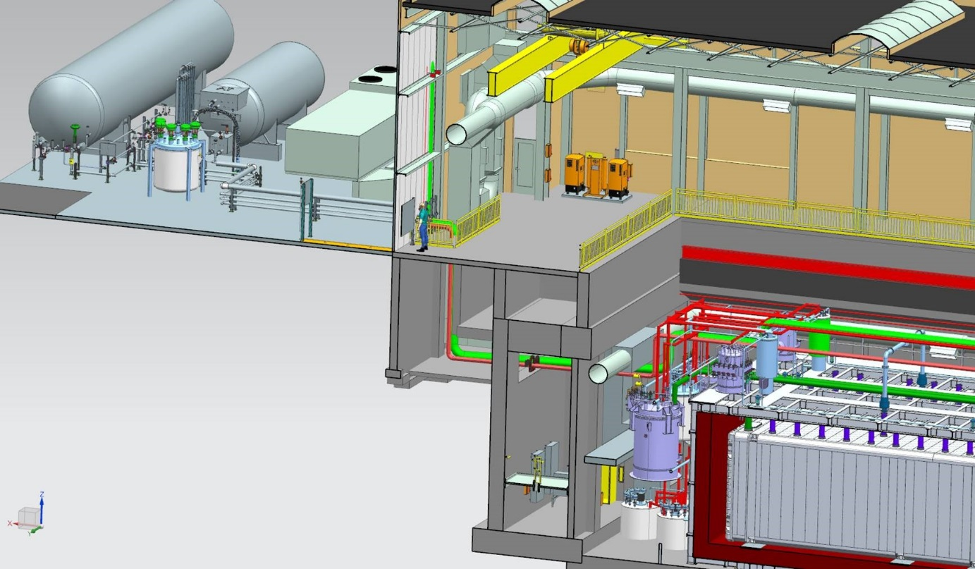
Far Detector Cryogenics
Current Status
  All proximity valve boxes are designed and fabrication has started at DEMACO
  Procurement of parts for External and Controls portions is nearly complete
  Pre-assembly of the FD External piping has begun
Integration via:
Physical interfaces
Management of space
Installation
Validation for safe operations

Slide 13
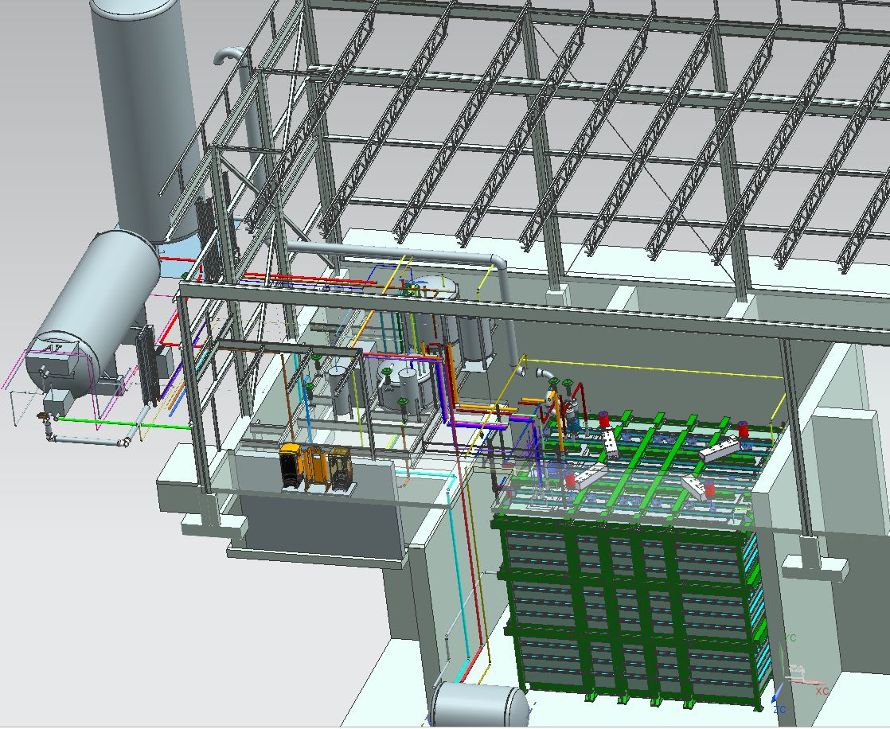
Near Detector Cryogenics
Current Status
  Final design for Near Detector is expected to begin in early 2018

Slide 14
Overburden - WBS 4.7
Design, procure and install 3m of reinforced concrete shielding over both detectors
  Detectors both sit just below grade - building designs provide concrete/dirt around the sides and the ability to support blocks above the detector pits
  1st layer are engineered “bridge” blocks, made to span the open space over the detectors and support the total overburden weight
    These must be purchased; design is complete – part of GPP
  2nd and 3rd layers are shield blocks of various sizes obtained from around the Fermilab site
    All are identified but remain in their current location; retrieval when needed
Installation occurs after a detector is filled with liquid argon, and its systems are commissioned and verified as operational
    Don’t bury a detector until we know it is working
    Anticipate that the Far Detector overburden will be in place 1-2 years before Near

Slide 15
ICARUS Progress

Slide 16
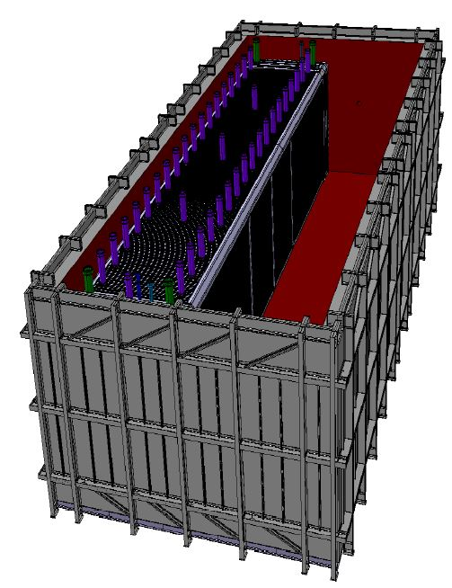
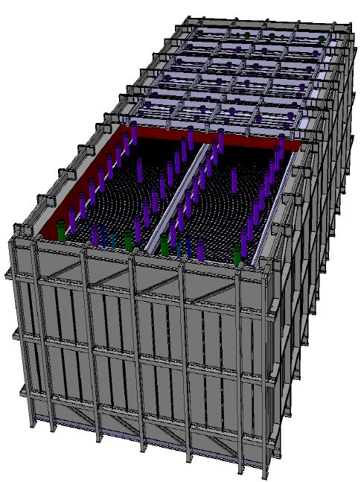
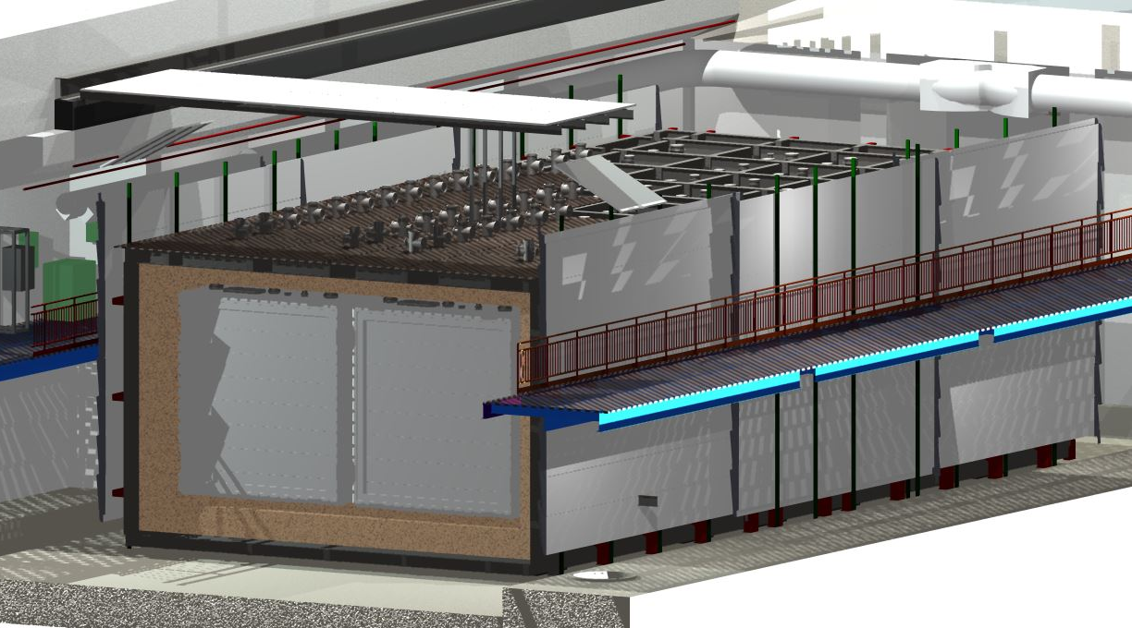
ICARUS Overview : Parts
ICARUS cryostat design
  Updated design from Gran Sasso operation
  Each T300 TPC (two T300s = one T600) sits inside a Cold Vessel which is the cryostat to contain the LAr
  The two cold vessels are placed inside a steel box, Warm Vessel, which is lined with foam insulation

Slide 17
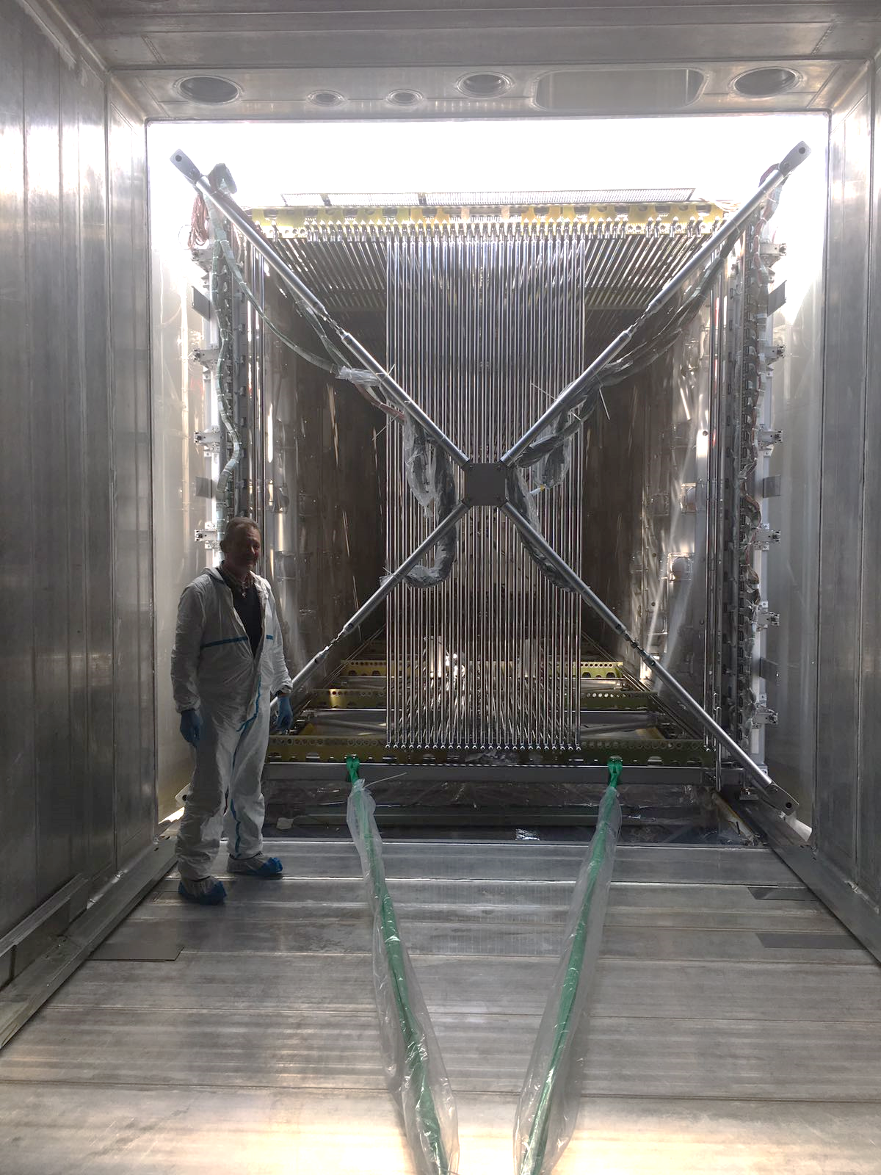
ICARUS TPCs – WA104
Refurbishment of the TPC and fabrication of the cryostat cold vessels completed w/2nd TPC pulled into the cryostat March 29
Remaining milestones:
  Arrival of T600 at Fermilab (July 2017)
  Delivery of warm vessel insulated roof (August 2017)
  Delivery of internal cryogenics, including cold shields (September 2017)
  Delivery of chimneys, feed-throughs, and detector readout systems (Late 2017 – early 2018)
  Top CRT modules (2018)
Focus is moving to installation activities at Fermilab with the TPC/vessels in transit
Pulling the 2nd T300 into its cryostat – March 29

Slide 18
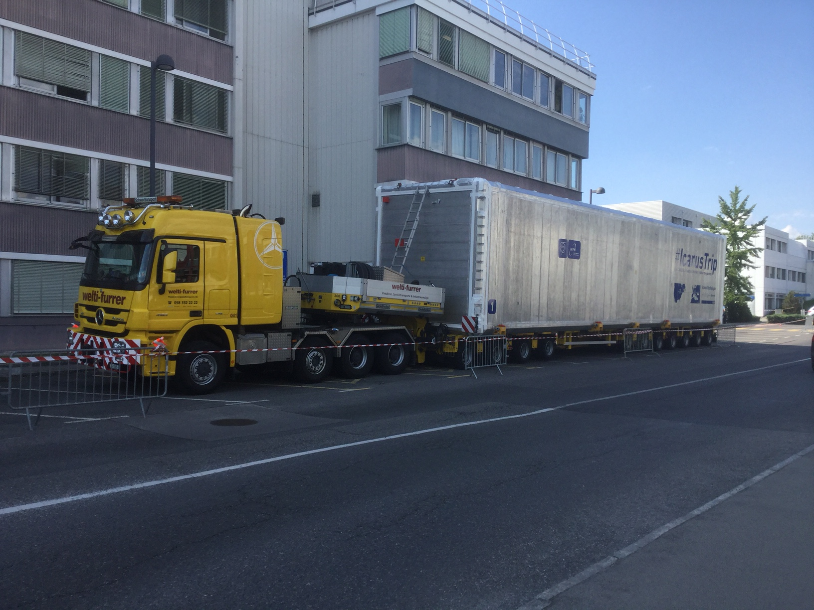
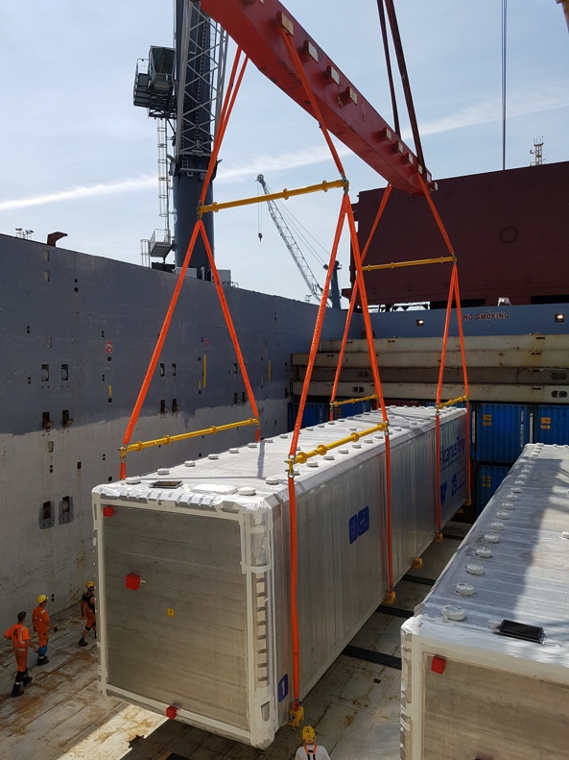
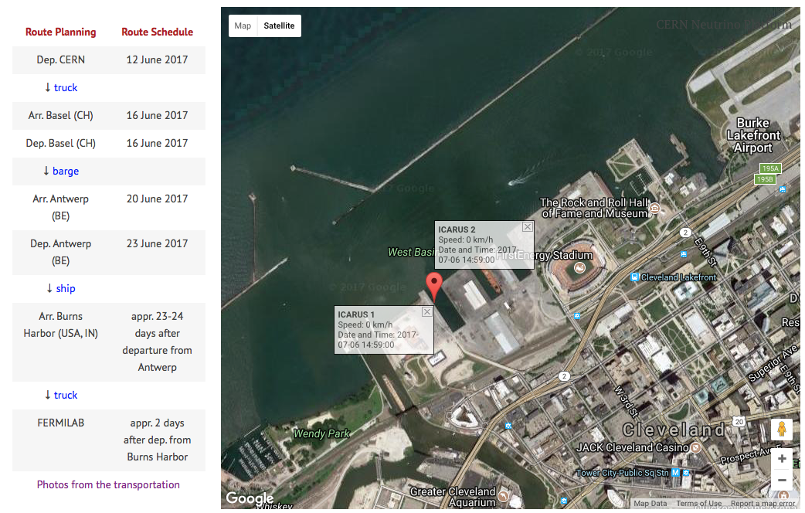
ICARUS Transport
Cold vessels w/TPCs departed CERN June 12 - arrival at Fermilab in late July.
Follow at:
  #ICARUSTrip
  http://icarustrip.fnal.gov
  http://cenf-wa104.web.cern.ch/wa104org/icarus-transportation-cern-fnal
Ready to leave CERN on June 12
Loading at Antwerp on June 23
Stop at Port of Cleveland on July 6

Slide 19
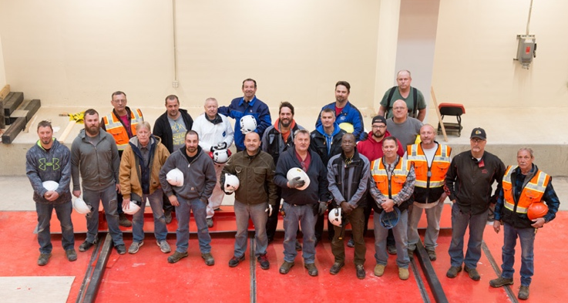
ICARUS Installation – WBS 4.4
Joint effort of Fermilab, INFN, CERN and collaboration
  CERN : insulated warm vessel and cold vessels (w/eng. documents). Transport of detectors to Fermilab. Technical labor for specific installations.
  INFN & ICARUS collaboration : detector readout systems, internal cryogenics piping and instrumentation etc. Technical labor for installation and collaborators with historical knowledge.
  Fermilab : personnel in support of installation, including engineering; specific support hardware; provides guidance through ORC and personnel to develop review material.
New ground for Fermilab : vendors performing work on-site who are not hired by us – they work for CERN
  first instance in progress now : insulation contractor
CERN – FNAL – INFN Warm Vessel Team

Slide 20
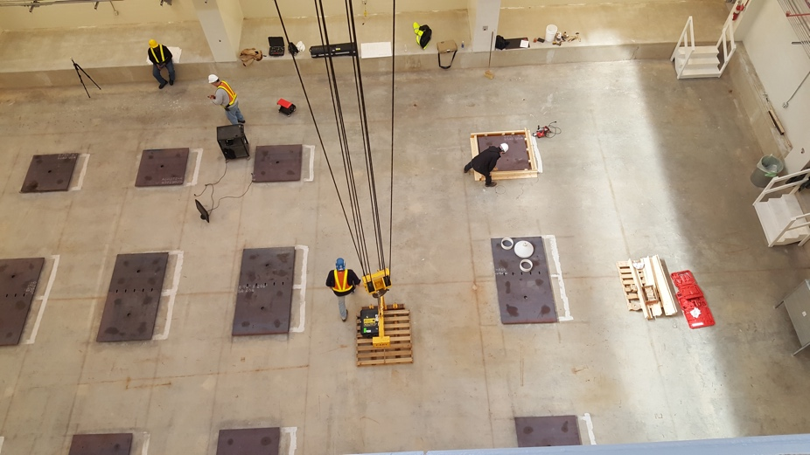
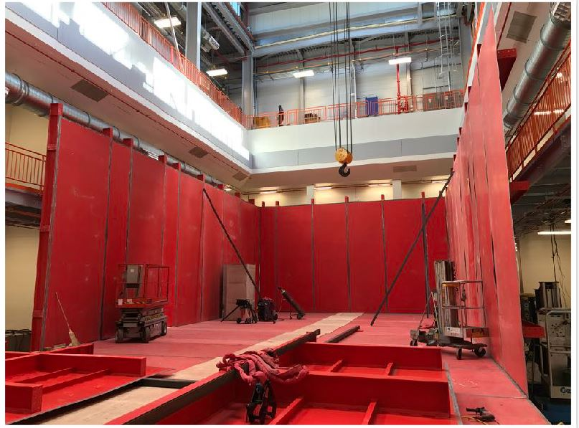
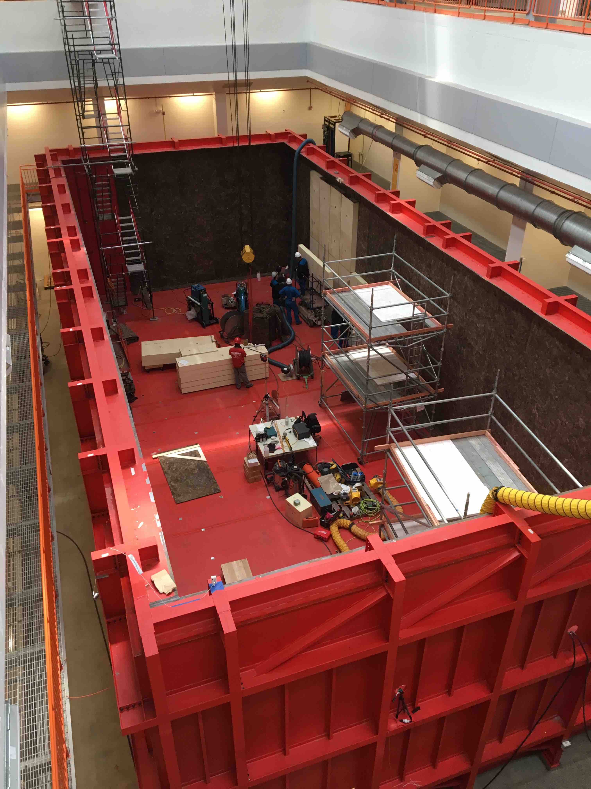
ICARUS Installation Progress
Floor Footers
Installation began in February
  Load-bearing pads on the building floor
    Provided by Fermilab, following guidelines from CERN engineers who designed the warm vessel
  Received the warm vessel parts provided by CERN
May
  Assembly of warm vessel steel box
    CERN and INFN technical crew with CERN supervision
    Fermilab provided logistics, crane ops, welding
June/July
  Insulate the warm vessel : CERN contractor
Planning
  Installation rigging contract
  Cryogenics and readout installation
Erecting walls
Insulation Installation

Slide 21
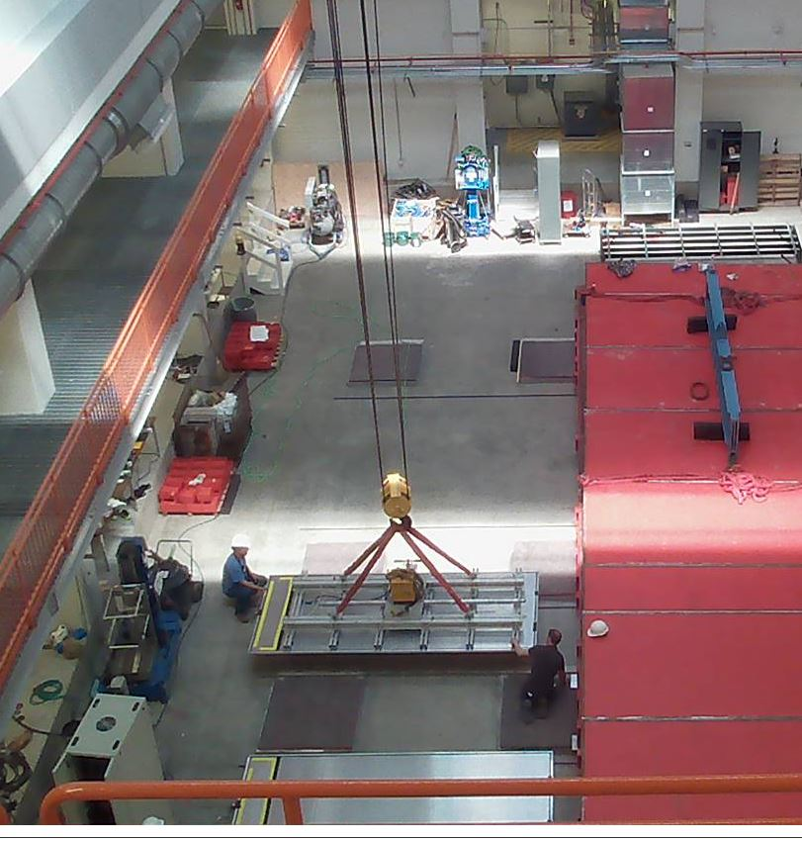
ICARUS CRT – WBS 4.6
CERN / INFN
  Top CRT : New scintillator panels, SiPM output, CAEN readout (same as MicroBooNE and SBND)
    Components being procured, final designs and prototypes
FNAL: Sides, Bottom, mechanical support
  Side scintillator : MINOS w/new SiPM output, CAEN readout.
    Checkout of modules this summer
    Testing prototype readout
  Bottom Scintillator : Double-Chooz scintillator from UChicago/VATech.
    4 of 14 install, remainder ready to install
  All mechanical support, design and fabrication : Top, Sides, Bottom
    Design in progress
Installing Bottom CRT Panels

Slide 22
Far Detector Timeline (Technically Driven)
TPC 1 & Cold Vessels
TPC 2
T600Ship
Readout Electronics
Warm Vessel
Ship
Refurbish, Design and Fabricate
CRT Top Design & Fabrication
Cryogenics Design, Fabrication, Delivery
Building Construction
Install and Commission
Warm Vessel Installation
Top
T600 Install
Readout Electronics
Side CRT
Top CRT
OB
Not all activities shown
Cryogenics
Lar Fill Commission
Operate
3Q 2016
4Q 2016
1Q 2017
2Q 2017
3Q 2017
4Q 2017
1Q 2018
2Q 2018
3Q 2018
4Q 2018
1Q 2019
2Q 2019
3Q 2019
July 2017
Feb.2019
Timeline – Calendar year

Slide 23
SBND Progress

Slide 24
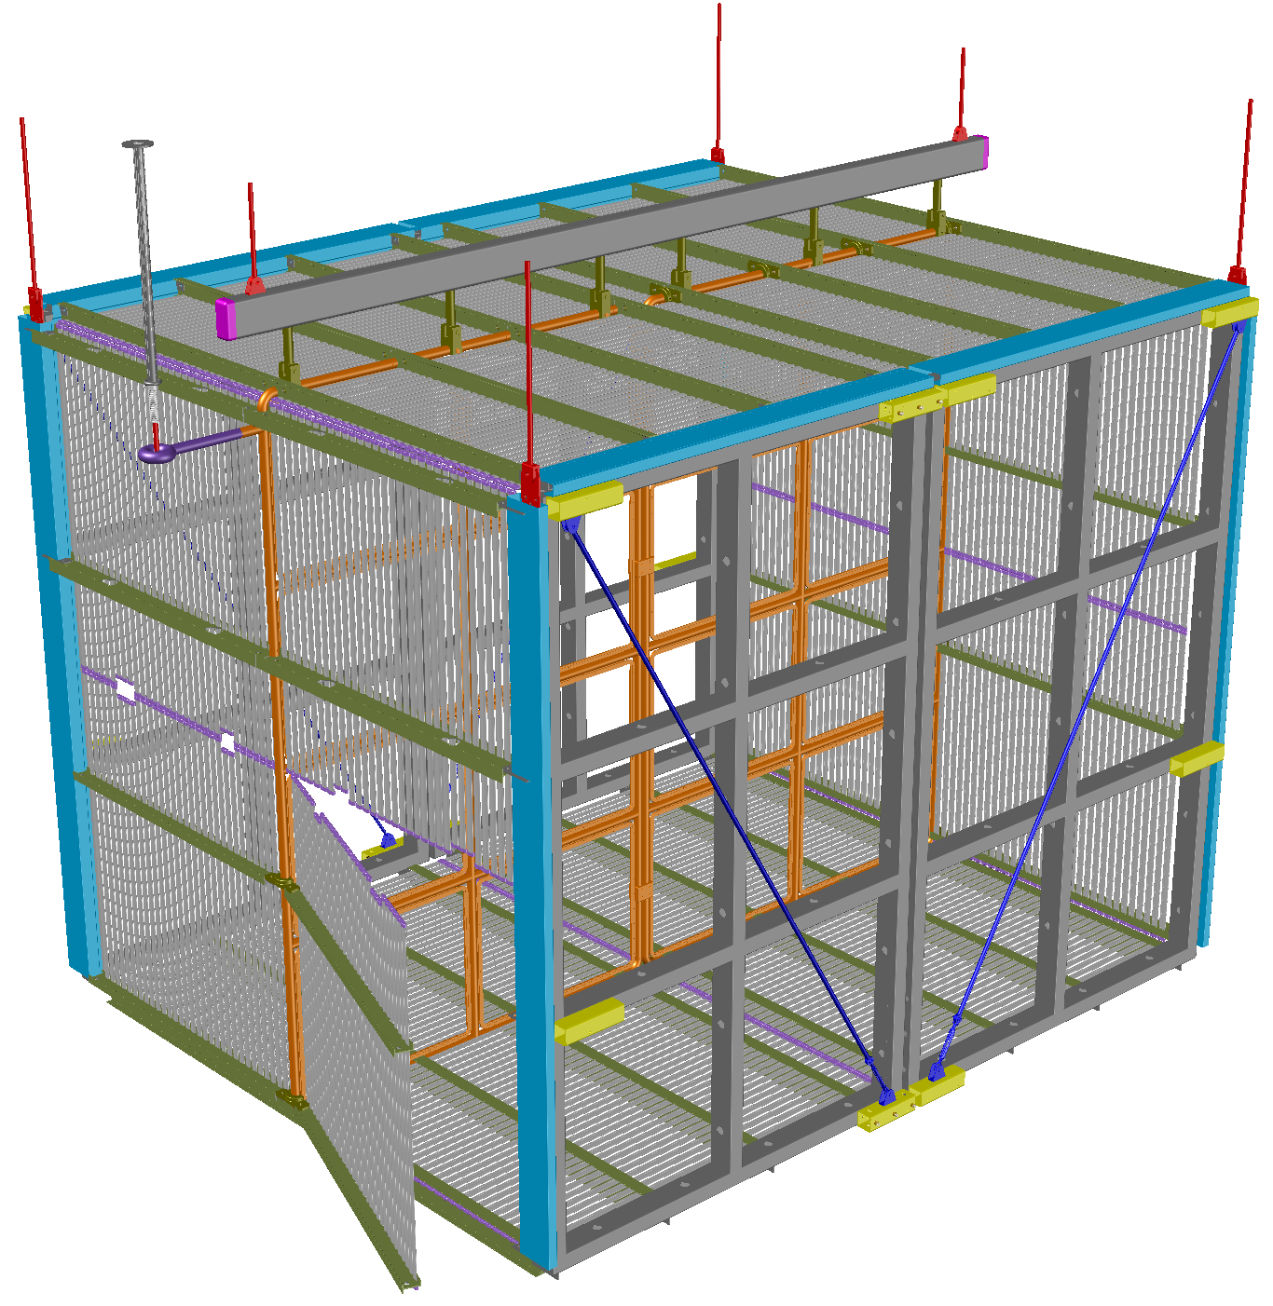
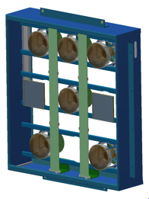
TPC – WBS 2.3
Field Cage Panels (x16)
HV Feed-through
Connections to cryostat top (x6)
WBS 2.4
PMT Module (x24)
Cathode Plane
Assembly (x2)
Anode Plane Assemblies (x4)
Access Field Cage Panel

Slide 25
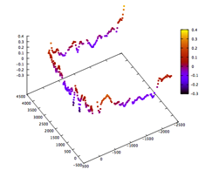
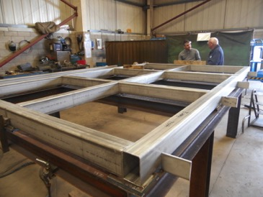
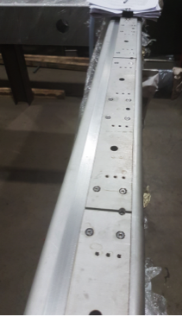
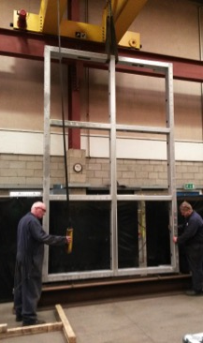
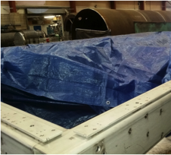
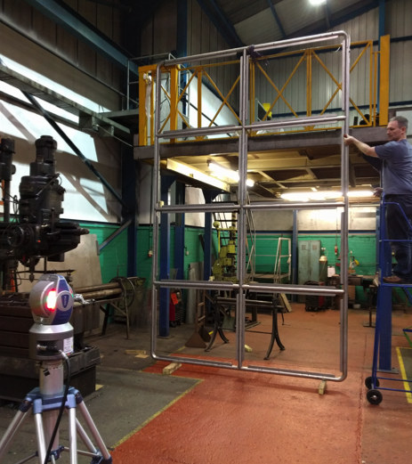
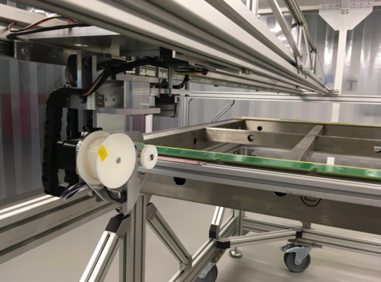
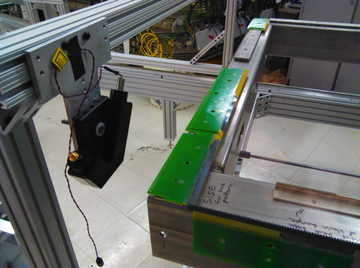
TPC Construction Progress
First 3 of 4 APA frames complete and ready to ship
Prototype wiring activities in the UK and US.
Production Readiness Reviews scheduled for July (UK) and September (US).
Wired and tested APAs to be delivered to Fermilab in Spring 2018.
CPA production

Slide 26
APA QC: Cold Test
Insulated, actively cooled and monitored boxes for APA Quality Control at wiring sites
  Large enough for both SBND and ProtoDUNE APAs
Initial cool down tests with UK system successful
US system under development between SBND groups and PSL Wisconsin (ProtoDUNE)
Full scale APA cold testing setup at Daresbury

Slide 27

HV System – Feed-through and Field Cage
FT: contract sent out by Yale in March to produce two SBND feed-through assemblies.
  Expecting to receive prototype FT in July
  Getting ready for cold test at Yale campus
Field Cage: SBND uses very similar design to ProtoDUNE-SP.
  Order for extruded aluminum profiles for both ProtoDUNE and SBND placed last month through CERN
  High Voltage Divider Board cold tests are on-going at Yale.

Slide 28
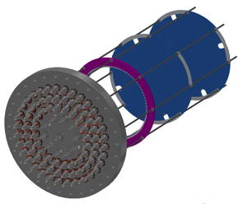
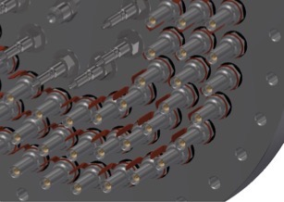
PMT Photon Detection - WBS 2.4
High performance system with 144 8” PMTs and CAEN fast digitizing readout electronics
  Hardware purchased and in hand
  System fully funded through LANL LDRD Award
x24
TPB coating (wavelength shifter) of PMTs at INTLVAC in Canada
Mounting box and integration design
Feed-through design

Slide 29
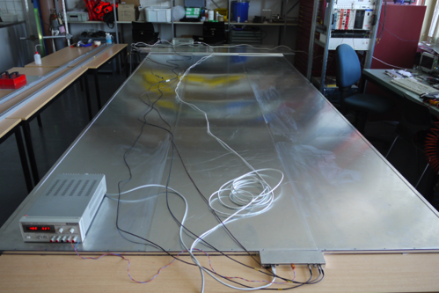
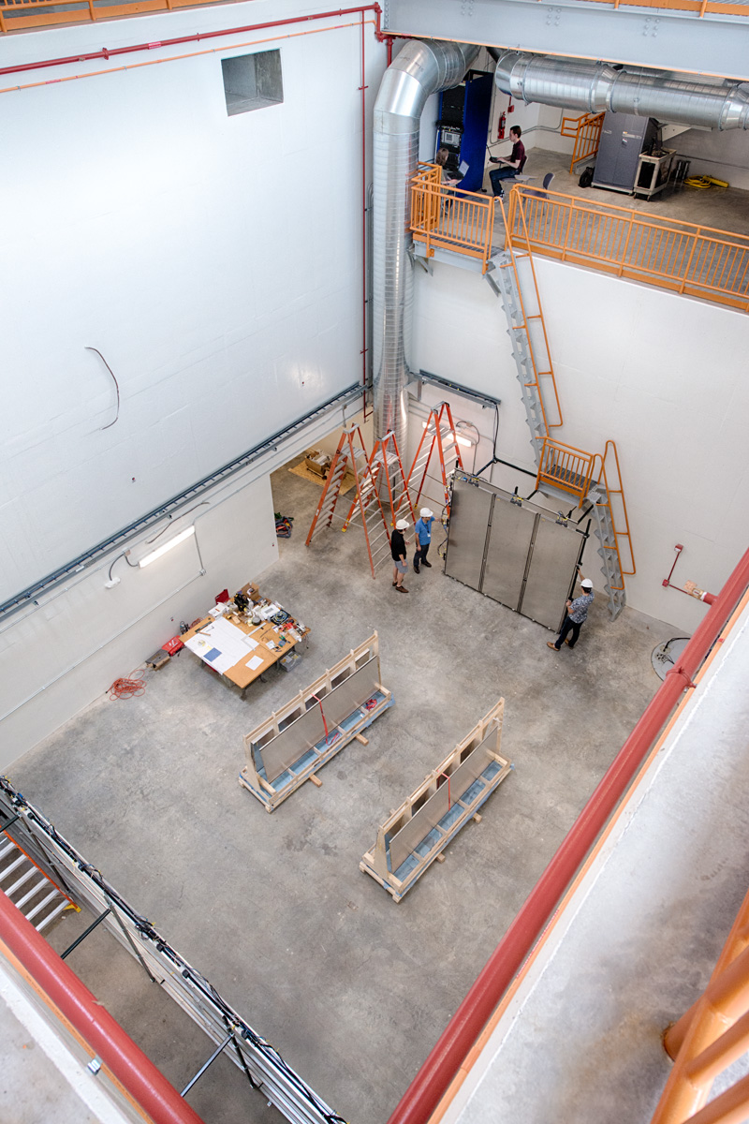
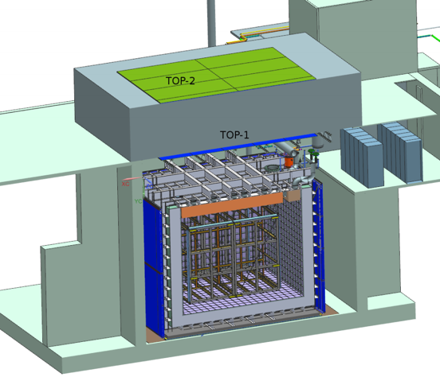
Cosmic Ray Tagger and Laser Calibration
CRT & Laser systems provided by University of Bern (Swiss NSF funded)
CRT in production at Bern, bottom panels all at Fermilab and test underway in the SBND pit
DAQ Rack
CRT Panels
SBND Detector Hall

Slide 30
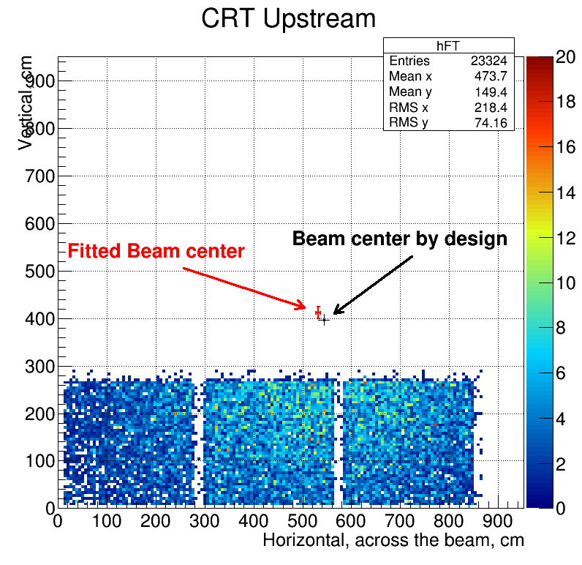
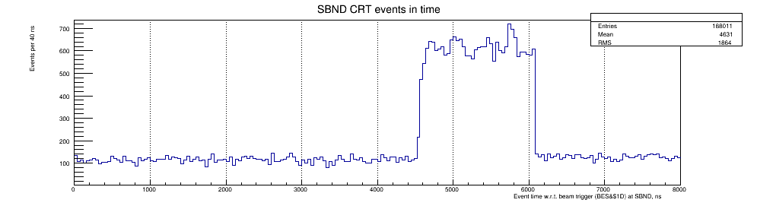
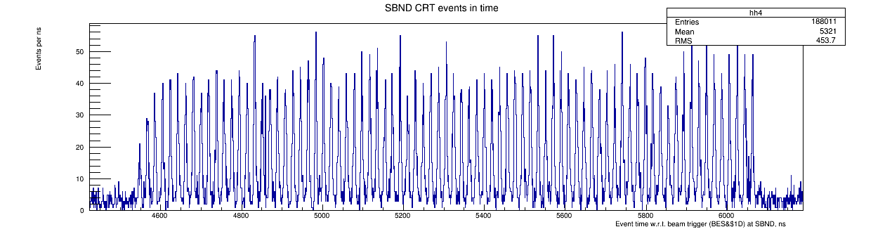
SBND CRT sees BNB!

Slide 31
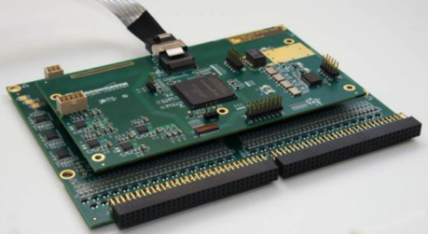
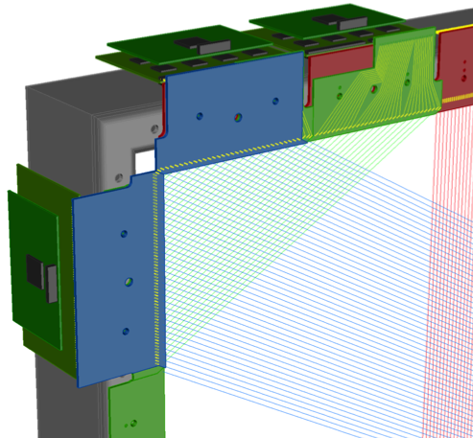
TPC Electronics
128-channel FEMB with 8 Amplifier and 8 ADC ASICs
FPGA mezzanine for multiplexing and data readout.
SBND and ProtoDUNE-SP began strongly aligned in plans for front-end TPC electronics with only minor differences for APA layouts.
  FEMB (front-end mother board) and WIB (warm interface board) developed for SBND and later modified for ProtoDUNE implementation.
An Independent Technical Review of the electronics system in October 2016 revealed performance issues with the ADC ASIC (version P1) and was deemed not suitable for SBND
  SBND now carefully considering ADC options to satisfy technical requirements for the SBND physics program while keeping cost impacts minimized

Slide 32
TPC Electronics ADC Options
  Commercial off the shelf (COTS) ADC operated in LAr temp
    Requires qualification for cold operation; promising tests of three models at LN2 temps demonstrate excellent yield (all) and linearity (2 of 3)
    Next step: stress tests of 1 or 2 models at BNL/FNAL to qualify for long term operation
  Warm ADC system
    Several examples of working systems in MicroBooNE, ICARUS, LArIAT
    Has significant integration implications due to larger cable count
  Multiple P1 ADC ASICs per channel
    Dual-gain: a high gain path to provide improved resolution on signals up to mip-scale
    Requires qualification of a commercial op-amp for cold operation
    Detailed simulation studies to understand realistic performance of such a system are required
Cold ADC Steering Committee (Chair: Mike Shaevitz) has been working since February to evaluate cold ADC options and steer the work needed to inform a decision.
Just launched: Warm ADC Working Group (Chair: Georgia Karagiorgi) to provide detailed schedule and cost estimates for this option.

Slide 33
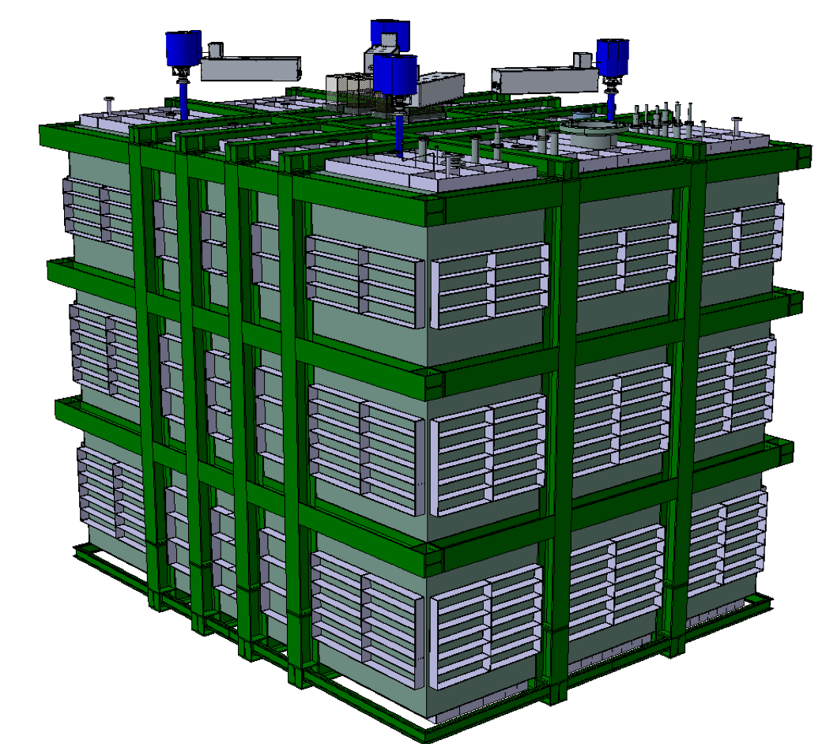
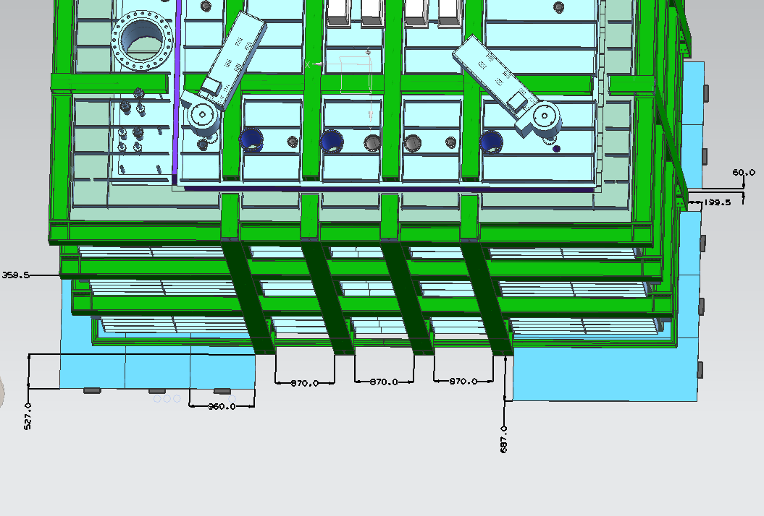
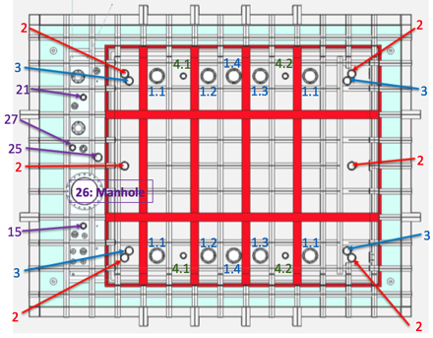
Cryostat
Design from CERN: SBND a 3rd generation prototype for DUNE
  Based on lessons being learned now from 1x1x3 m³ and ProtoDUNEs
Cryostat interfaces with CRT panels
bottom CRT
panels
Cryostat lid a key integration element for TPC

Slide 34
Near Detector Timeline (Technically Driven)
TPC / PMT Design and Fabrication
TPC Electronics Design, Prototyping
TPC Electronics Production
Cryostat Design, Procurement
Ship
Design Fabricate
Cryogenics Final Design
Cryogenics Delivery
Top
CE
Install and Commission
Building Construction
TPC Assembly
Cryostat Installation
Detector Installation
Readout
Not all activities shown
Cryogenics Installation
LAr Filling & Commissioning
Top CRT and Overburden
4Q 2016
1Q 2017
2Q 2017
3Q 2017
4Q 2017
1Q 2018
2Q 2018
3Q 2018
4Q 2018
1Q 2019
2Q 2019
3Q 2019
4Q 2019
June 2017
Jan.2020
Timeline – Calendar year

Slide 35
Management, Budget and Costs
The following is a condensed version of slides shown at DOE-OHEP briefing on SBN on June 21

Slide 36
Program Management
SBN program conceived during the P5 process as a campaign not a 413b project
Manage the construction and installation tasks using standard project management tools
  Resource Loaded Schedule (RLS)
  Design, construction and installation readiness reviews
  PMGs including lab and agency representatives (Mar ’16 on)
  Report at Fermilab Project Oversight Group (POG)
  Fermilab Director’s reviews of SBN Program: Dec 2015, Dec 2016 and planned Sept 2017
Differences from a 413b project:
  No CD process setting a TPC, KPPs, and completion date
  Funding as available – contingency through scope or timeline

Slide 37
DOE Funding
SBN program is funded from two sources within the Fermilab budget:
  Dedicated ”R&D” funds at level of $10.5M over FY15-FY18
  Detector and Computing Operations funds (Detector OPS) within the Neutrino Division
The SBN buildings were constructed as General Plant Projects and are not included in the following discussion
Funding and obligation (cost) summaries to follow show whole program starting in FY15 including construction and operations phases of each detector
  Include MicroBooNE operations funding and obligations
  This is a change from previous presentations (e.g. Director’s Reviews)
  Allows more complete analysis of the effect of delays and tradeoff’s of options

Slide 38
Current Funding Assumptions (pre-PBR)
Flat-flat budget for all FNAL Neutrino Division operations funds in FY18 and beyond
So called “R&D” funds capped at $10.5M over FY15-18
  Impact of other scenarios will be analyzed later this summer

Slide 39
Program obligations
Construction and installation
  From resource loaded schedule for WBS 1-4
  Schedule is technically driven and aspirational
  Not resource leveled or matched to a funding profile
Commissioning and operation assumptions
  Steady state MicroBooNE operations
  For ICARUS and SBND, use MicroBooNE experience as model for commissioning year and steady state
  Includes LAr fill (first year), LN2 (every year), misc M&S and technical labor

Slide 40
SBN Budget and Obligations – Technically Driven
Construction from current technically driven RLS file
Operations turn-on assumes technically driven construction
Carryover (FY X) = Funding (FY X) + Carryover (FY X-1) – Obligations (FY X)

Slide 41
SBN Budget and Obligations – Resource Limited
Operations turn-on likely to occur later as construction schedules shift

Slide 42
Next steps for planning SBN program
In process of adapting the plan to address changing technical schedules and funding limited effort
  Move from technically driven to funding limited schedule (e.g. FY18)
  Examine staging and possible de-scoping options
  Reminder: detectors are primarily in-kind contributions: CERN, INFN, NSF, Swiss, UK-STFC
Tools now in place to model scenarios for funding, construction scope and schedule, and operations timelines
The Technical Coordinators and L2s already charged with examining alternate plans to reduce DOE costs.
  Use of more student and postdoc labor
  Value engineering: reuse of equipment and alternate technical solutions
  Seek additional support from collaborating institutions.
Engaging with collaborations:
  SBND Institutional Board and Collaboration meetings
  ICARUS PIs meeting

Slide 43
Staging – de-scoping challenge
Most simple changes have significant impact:
  Concrete overburden for ICARUS and SBND are already planned for purchase and installation after the LAr fill of each detector
  Readout electronics for ICARUS side CRT modules could be purchased/installed later but would not want to delay much past LAr fill
  SBND TPC size and channel count already set by completed APA frames
Examples:
  FNAL Cryogenics team looking at M&S reductions through reuse of equipment such as controls hardware. Working with CERN and DEMACO for past year on value engineering of systems including optimizations with ProtoDUNEs
  Look hard at costs of the SBND TPC electronics options

Slide 44
Priorities for FY18
ICARUS
  Support installation activities for vessels, cryogenics and electronics with CERN, INFN and collaboration
  Complete installation of cryogenics in collaboration with CERN
  Cool down and fill detector (if ready)
SBND
  Support the decision on TPC electronics by early FY18
  Support assembly of the TPC at FNAL (engineering, fixtures and technicians)
  Support installation of cryostat (if ready)
  Support completion of cryogenics design in collaboration with CERN
  If funds available start preproduction of TPC electronics

Slide 45
Selected Upcoming Milestones
July:
  Create schedule baseline, start change control and status tracking
  ICARUS T600 arrives at Fermilab
  SBND APA wire winding review (UK)
August:
  Re-planning of FY18-on to match funding profile(s)
  ICARUS T600 vessels inspection, sealing and vacuum test
September:
  Director’s Review (Sept 26-27)
  ICARUS cold shields delivered; rigging contract placed
  SBND APA wire winding review (US); warm electronics report
October
  Adjust plan based on Director’s review input
  ICARUS T600 cold vessels installed
November
  ICARUS install readout chimneys and warm vessel top
  SBND Cold ADC committee report
December
  ICARUS begin cryogenics installation
  SBND decision on TPC electronics

Slide 46
Summary
The International participation in the SBN program helps to build/maintain the neutrino physics community at Fermilab.
The construction, operation, and analysis of data from SBN will undoubtedly provide significant new knowledge and important lessons to the LAr community working toward DUNE.
The SBN program is piloting many areas interaction with CERN and other international collaborators for DUNE/LBNF (e.g.):
  Equivalency of European and American engineering codes and standards
  Duty free import of scientific equipment
Tremendous progress in the development of the program
  The ICARUS detector is on its way to Fermilab and will arrive soon.
  Installation for ICARUS is already underway
  SBND is making excellent technical progress toward construction of the detector.
  Re-planning is in progress to match more realistic technical and funding scenarios.

Slide 47
Backup Slides

Slide 48
SBN Scientific Goals

Slide 49

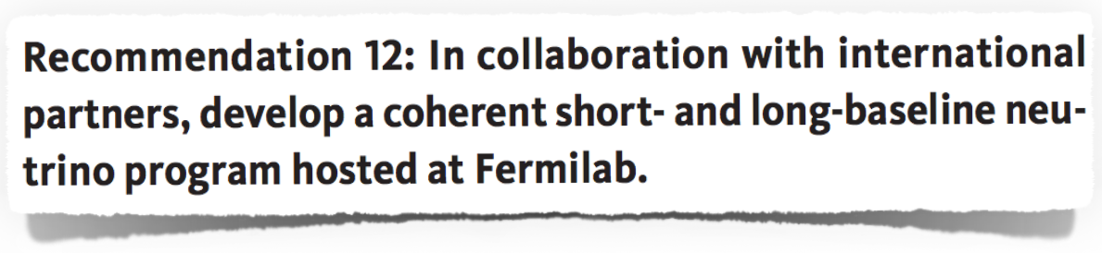
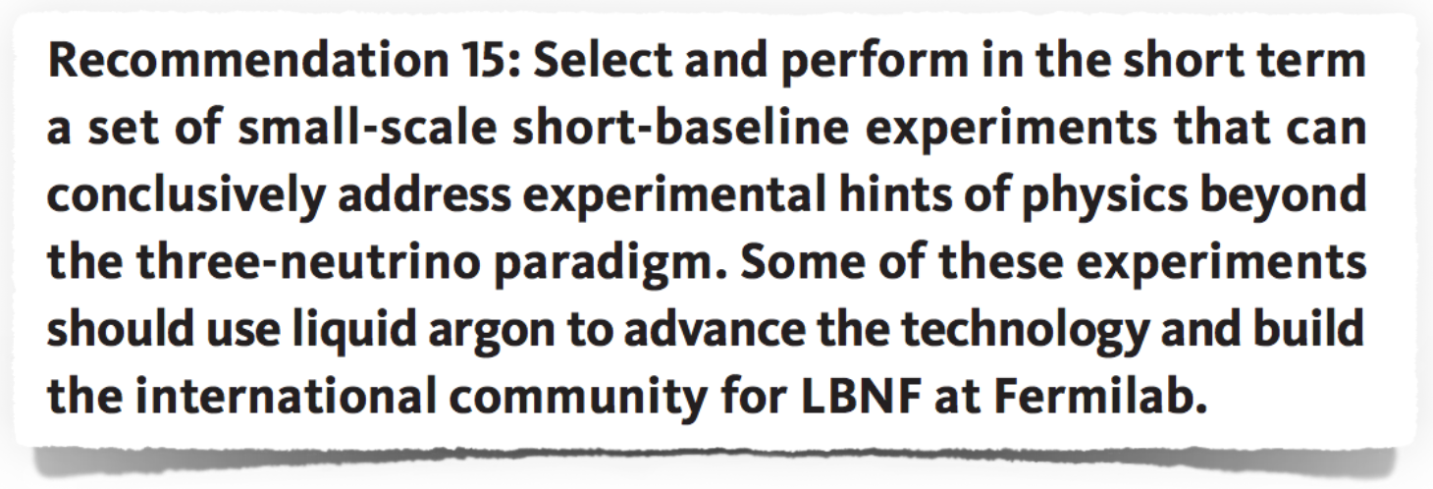
US Particle Physics Prioritization Report
P5 Report, May 2014

Slide 50
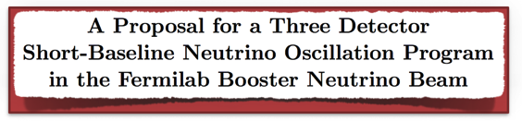
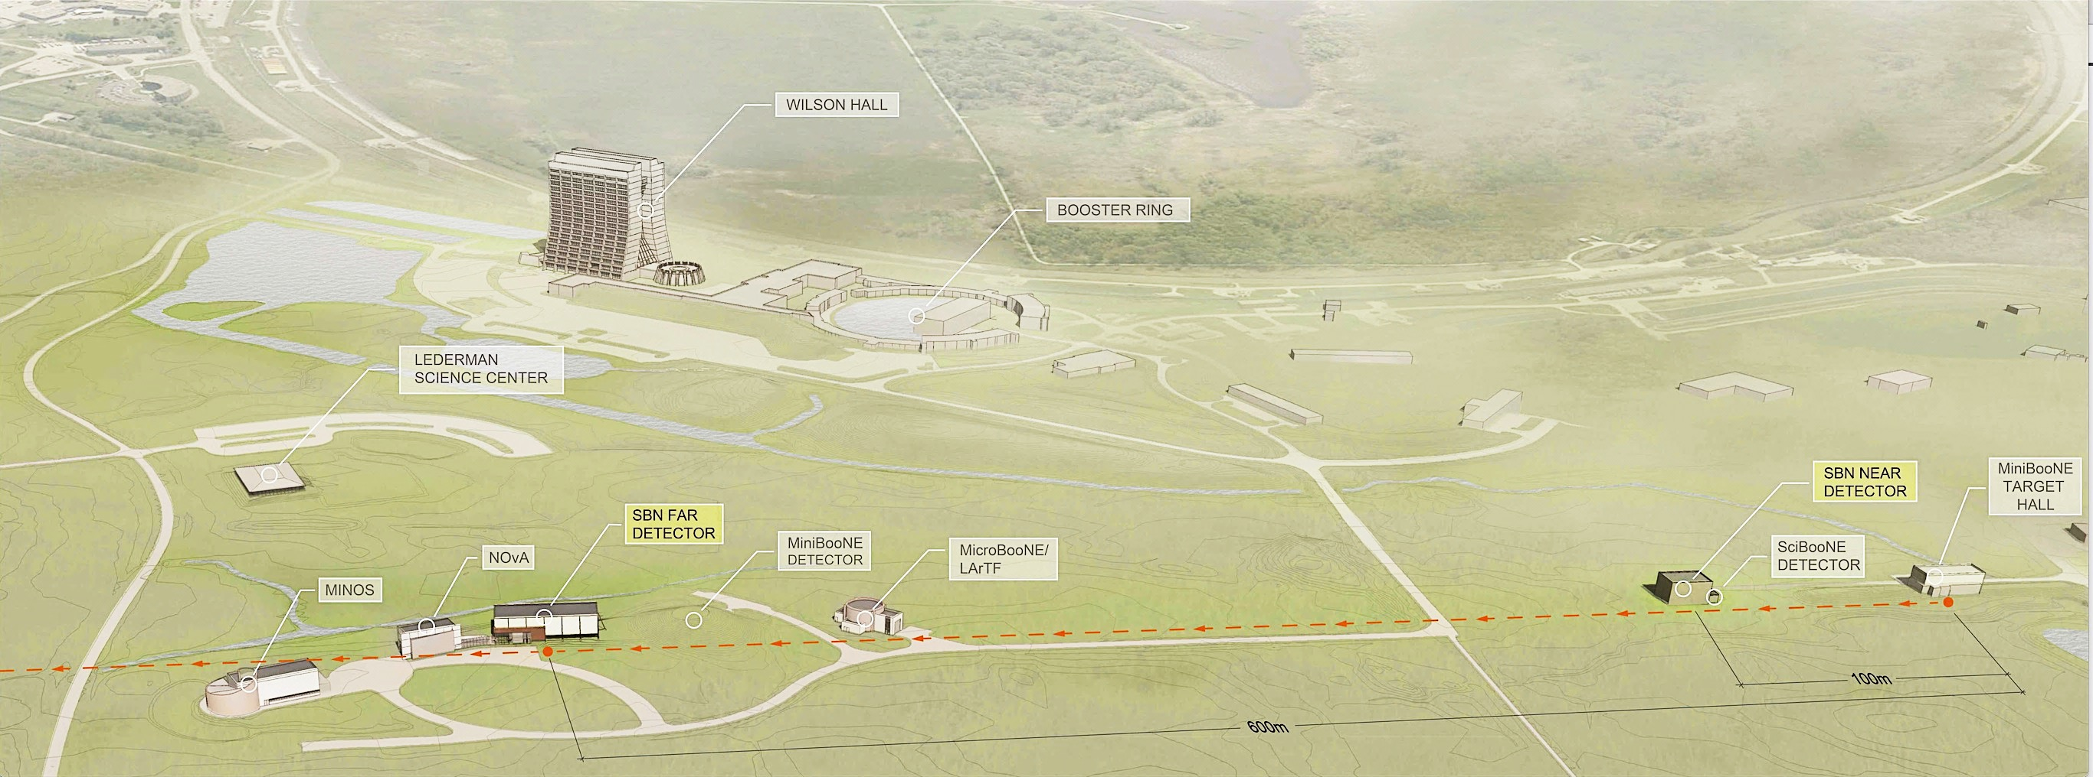
The Three Detector SBN Program
Three LAr TPC detectors located along the Booster Neutrino Beam (BNB)
  Same beam, same neutrino target, same detector technology → minimize systematics
MicroBooNE has been operational with beam since 2015
  MicroBooNE designed very specifically to be sensitive to the MiniBooNE observed anomaly
Full SBN Program approved in Feb 2015
  Addition of ICARUS and SBND extends science reach from a specific anomaly to the world-leading neutrino oscillation search experiment at Δm² ~ 1 eV²
  Up-to-date global analysis of experimental data indicate this as the region where light sterile neutrino states could still be hiding!
arXiv:1503.01520
SBND
110m
112 tons
ICARUS
600m
476 tons
MicroBooNE
470m
89 tons
Booster Neutrino Beam

Slide 51
The Three Detector SBN Program
control systematics
with near detector
before oscillations
increase statistics of oscillation signal by adding far detector mass
oscillation probability vs. distance
oscillation shape at far detector
vs. energy
arXiv:1503.01520
SBND
110m
112 tons
ICARUS
600m
476 tons
MicroBooNE
470m
89 tons
Booster Neutrino Beam

Slide 52
The SBN Oscillation Program
Sensitivities to oscillations ONLY enabled with near and far detectors
ν_{μ} → ν_{e} appearance
ν_{μ} disappearance
5σ
5σ
~3 years
~3 years
Combination of the SBN detectors enables 5σ coverage of the 99% C.L. allowed region of the original LSND signal and the global best fit values.
ν_{e} appearance cannot occur without ν_{μ} disappearance.
This is a critical aspect of verifying an oscillation hypothesis.

Slide 53
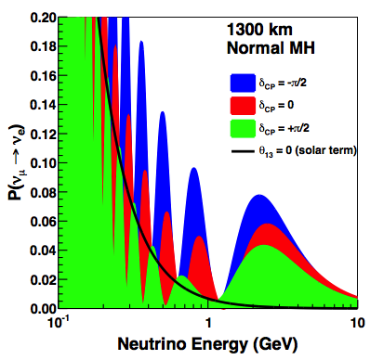

Not only oscillation physics: 𝜈-argon interactions at SBN
SBN will have by far the largest data set of neutrino-argon interactions in the world for the foreseeable future.
2nd
A broad program of 𝜈-argon cross-section measurements at SBN will have direct impact for controlling the largest systematic uncertainties in oscillation measurements at DUNE
  Large statistics at both the 1st and 2nd DUNE oscillation peaks
  MicroBooNE is blazing this trail, but SBND will record the full 3 years of MicroBooNE stats every 2 months of running!
1st
SBN Fluxes
2nd
Some SBND stats (BNB):
1.5M ν_{μ} CC/year
12k ν_{e} CC/year
also rare channels, like:
  coherent (10⁴/yr)
  strange prod (10³/yr)
  neutrino-electron (10²/yr)
+ 100K events per year (NUMI off-axis) in ICARUS, many at the DUNE 1st osc. max
1st
Dozens of potential scientific results and PhDs!

Slide 54
Other Physics Outputs of the SBN Program
Transferable analysis development, SBN enables/requires:
  Development and validation of LAr calibration and reconstruction techniques.
  Precision testing of event reconstruction and identification with large neutrino data sets.
  Detailed systematics evaluation for sensitive oscillation measurements in appearance and disappearance channels.
Collaboration, community, and building a knowledge base in LAr
  SBN provides direct experimental activity with LAr technology for the global neutrino community working toward DUNE.
  An active SBN program with International participation helps to build/maintain the neutrino physics community at Fermilab that will be centered around DUNE in the future.
  The students, postdocs, faculty and scientists working on SBN are also working on DUNE, and will go on to lead physics analysis on DUNE in the future.
  In the mean time, people want to confront data, do physics! SBN is an ideal opportunity.

Slide 55
ICARUS Contributions Matrix
WBS | System | DOE | NSF | CERN | INFN | Work Package
3.1, 3.2 & 3.4 | T600 Refurbishing including new PMTs, Cryostats |  |  | 50% | 50% | WA104
3.3 | TPC Electronics |  |  |  | 100% | WA104
3.3, 4.5 | DAQ | tbd |  | tbd | >50% | Not started
3.5 | T600 Transport to FNAL |  |  | 100% |  | WA104
4.2 | Civil Construction | 100% |  |  |  | N/A
4.3 | Cryogenics | 45% |  | 45% | 10% | Signed
4.4 | Integration and Installation | 33% |  | 33% | 33% | Draft
4.6, 3 | Cosmic Ray Tagger | tbd* |  | 50% | 50% | WA101
4.7 | Overburden | 100% |  |  |  | N/A
All fractions are approximate (5-10% level)
tbd – expect contribution but fraction not determined
CRT: 1.2MCHF in WA104 agreement for top
$400k committed by DOE, overall plan in development

Slide 56
SBND Contributions Matrix
WBS | System | DOE | NSF | CERN | INFN | UK STFC | CH | LANL LDRD | Work package
2.3 | TPC Design and Fabrication |  | 50% |  |  | 50% |  |  | Final
2.4 | PMT System |  |  |  |  |  |  | 100% | Final
2.5 | Calibration Laser |  |  |  |  |  | 100% |  | Signed
2.5 | Cosmic Ray Tagger |  |  |  |  |  | 100% |  | Signed
2.6 | TPC Electronics | 85% | 15% |  |  |  |  |  | Signed
2.7 | DAQ | 100% |  |  |  |  |  |  | N/A
2.2 & 2.8 | Integration and Installation | 100% |  |  |  |  |  |  | N/A
2.9 | Cryostat | 10% |  | 70% | 20% |  |  |  | Draft
4.1 | Civil Construction | 100% |  |  |  |  |  |  | N/A
4.3 | Cryogenics | 50% |  | 50% |  |  |  |  | Signed
4.7 | Overburden | 100% |  |  |  |  |  |  | N/A
All fractions are approximate (5-10% level)
tbd – expect contribution but fraction not yet determined

