Slide 1
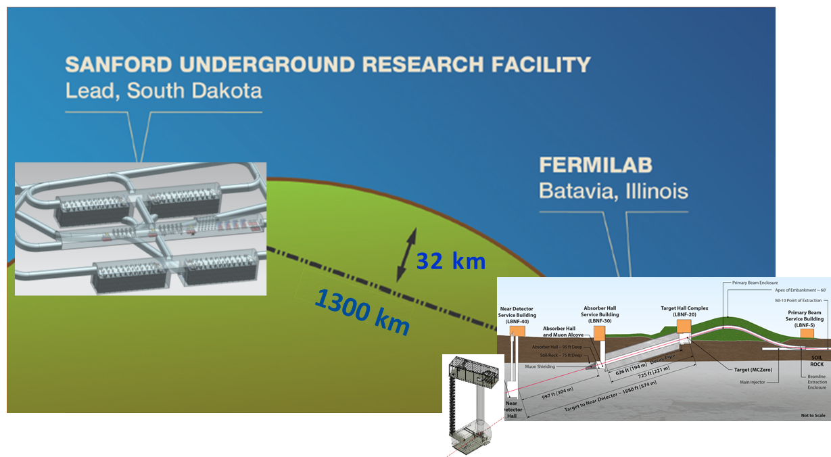
LBNC Report to the PAC
David MacFarlane,
LBNC Chair
July 7, 2017

Slide 2
Genesis, scope and membership
Recommended by Fermilab PAC in January as a new advisory committee focused specifically on LBNF/DUNE
  Modeled after the successful LHCC at CERN
Scope includes scientific, technical and managerial decisions/preparations of the experiment & facility
Provides continuous oversight, reports to Fermilab Director
Chair, David MacFarlane (SLAC)
Sampa Bhadra (York)
Amber Boehnlein (Jlab)
Joel Fuerst (ANL)
Beate Heinemann (DESY)
Patrick Huber (Virginia Tech)
Peter Jenni (CERN)
Arkadiy Klebaner (FNAL)
Bob Laxdal (TRIUMF)
Mike Lindgren (FNAL)
Ted Lui (FNAL)
Naba Mondal (TIFR)
Jocelyn Monroe (Royal Holloway)
Marco Pallavicini (Genova)
Kevin Pitts (UIUC)
Jimmy Proudfoot (ANL)
Kem Robinson (LBNL)
Nigel Smith (SNOLAB)

Slide 3
Intended outcomes: Fermilab Director
Advise the Fermilab Director
  First line of defense: warning on issues before DOE or other agencies discover them, early enough so that the Director and Fermilab can intervene and help resolve the issue
  Preserve credibility for host lab: only move forward with solid proposals (no surprises!), so internal review is tougher than subsequent external reviews: reputation is an asset to be carefully guarded!
  Important that there be a trust relationship between Fermilab and LBNC: confidence that early, insightful and accurate advice is being provided

Slide 4
Intended outcomes: RRB and INC
Provide credible validation for INC, RRB, and sponsoring agencies
  Gateway for international agencies to move forward with their funding decisions with confidence that the whole project has a valid and credible plan: all partners have confidence that they are contributing to what will be a successful outcome & the other partners will deliver on their parts as well
  Difficult to achieve with very different project and review models in each country, and relatively loose project controls for international project: will need to stand up a “DUNE Cost Group”
  Important that there be a trust relationship between LBNC and INC/RRB: confidence that insightful and accurate assessment is being provided

Slide 5
Direction from recent RRB meeting (5/11/2017)
Discussed formation of a DUNE cost group: RRB endorsed creation of DCG as a new subgroup of the LBNC
  Allows integrated and coordinated technical and cost reviews
  Nigel now working on ideas for the subcommittee chair
  Need to identify an approach and required documentation that allows authoritative evaluation of project planning, while recognizing the broad range of norms (not just DOE!) for project planning by the international agencies
  Will then lay out a detailed timeline, together with LBNF and DUNE, for consideration by the RRB

Slide 6
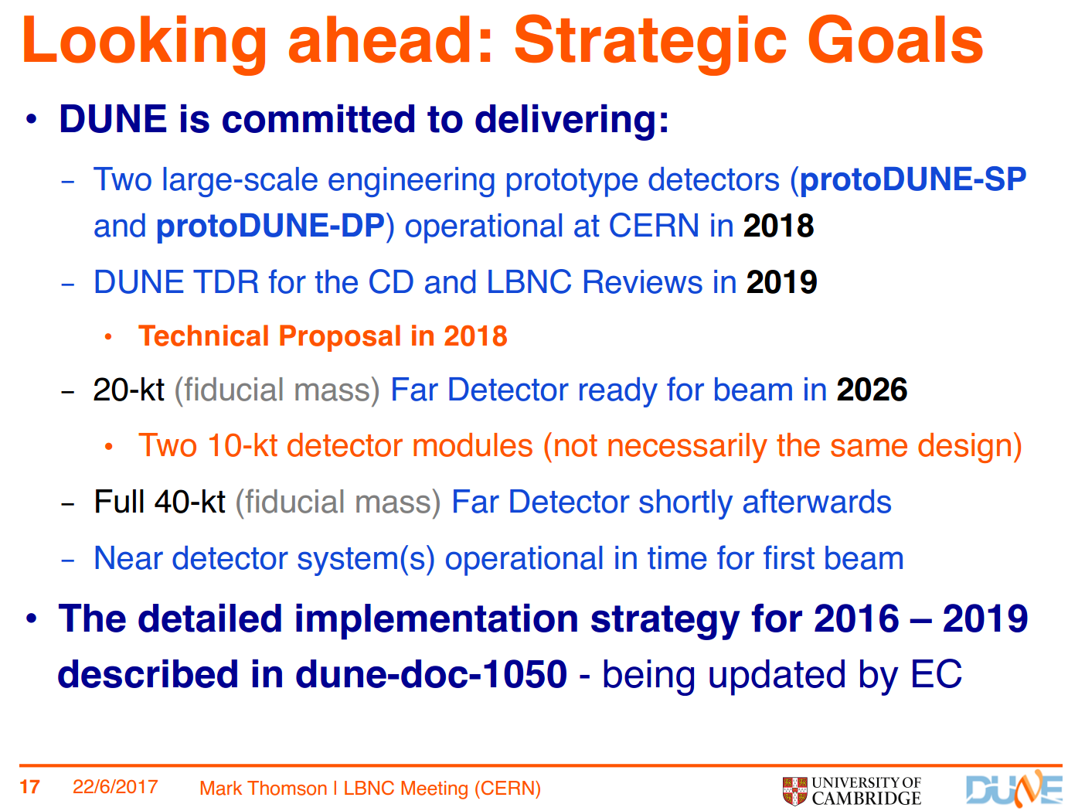
DUNE Strategic Goals
From the June LBNC review

Slide 7
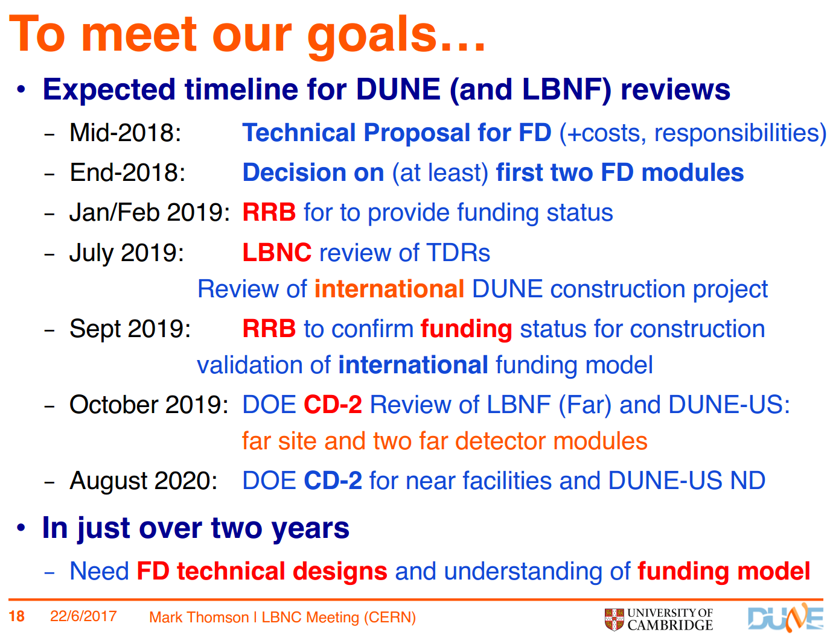
Timeline and milestones

Slide 8
4.1 Role of protoDUNEs
Large-scale prototyping/calibration
  Production (delivery of the detector components to CERN):
    stress testing of the production and quality assurance processes of detector components
    mitigate the associated risks for the far detector.
  Installation:
    test of the interfaces between the detector elements
    mitigate the associated risks for the far detector.
  Operation (cosmic-ray data):
    validation of the detector designs and performance
  Test beam (data analysis):
    essential measurements of physics response of detector
    not necessary for the finalization of the FD design
Risk mitigation and understanding of costs for CD-2
    ProtoDUNE construction validates detector design and informs the DUNE FD cost model
Detector validation for LBNC & CD-2
Physics calibration for oscillation analyses

Slide 9

DOE CD-2 Milestone Approval – Current Plan
Relationship and Timing of Reviews and Meetings
INC
Purpose: Facilitate global coordination and provide input to DOE and FNAL directorate
RRB
Purpose:
Confirm or acknowledge country by country funding status
Note: provides status input for LBNC
RRB
Purpose:
Confirm or acknowledge country by country funding status
Approve DUNE experiment
Note: provides status input for DOE IPR
Abbreviations:
INC: International Neutrino Council
RRB: Resources Review Board
LBNC: Long-Baseline Neutrino Committee
DOE IPR: Dept of Energy Independent Project Review
CD: Critical Decision
Jan/Feb 2019
Sept 2019
input
LBNC
Purpose:
Overall assessment of project (U.S. and Int’l)
July 2019
Focus:
Technical Design reports
Science reach
Global schedule assessment
Broad (vs deep) approach, similar to LHCC
input
input
Director’s Review CD-2/3b
Purpose:
Final preparation for for DOE IPR
DOE IPR CD-2/3b
Purpose:
Assess readiness to baseline DOE project (CD-2 milestone)
Focus:
U.S. components of project and experiment
Detailed look at project management, technical maturity, more.
DOE CD-2/3b Milestone
August 2019
October 2019
Focus:
Focus on U.S. portions of project and experiment
Detailed look at project management, technical maturity, more.
May seek to understand non-DOE milestones and relationships
Internal DUNE Reviews
~April 2019
Dec 2019
Internal LBNF Reviews
Formalize and finalize Int’l Participation
Note: Non-DOE funding agency reviews not shown

Slide 10
Intended outcomes: DUNE and LBNF
Advise LBNF and DUNE management:
  Arms length but “friendly” review, meant to help the project and collaboration achieve its goals by providing candid assessments
  Desire that reviewers remain in close contact with LBNF and DUNE so that they are up-to-date and informed: makes for better informed assessments and more useful recommendations
  Important to establish a “trust” relationship between LBNF, DUNE and LBNC:
    Project and collaboration is open with information and candid about status and plans
    Reviewers do not come “cold” to each face-to-face meeting, but are following closely with interest: therefore make better and better-informed recommendations

Slide 11
Intended outcomes: DUNE and LBNF
    LBNC and POCs aim for efficient and open dialog and transfer of information, while being reasonably cognizent of burden on LBNF/DUNE
    Recommendations should be discussed with LBNF/DUNE POCs so that they are fair, and maximally useful and impactful: “do no harm” but be “tough and honest” in assessment
  Important to balance “burden” on project and collaboration, but not at the expense of the trust relationships with Fermilab, INC/RRB, and LBNF/DUNE

Slide 12
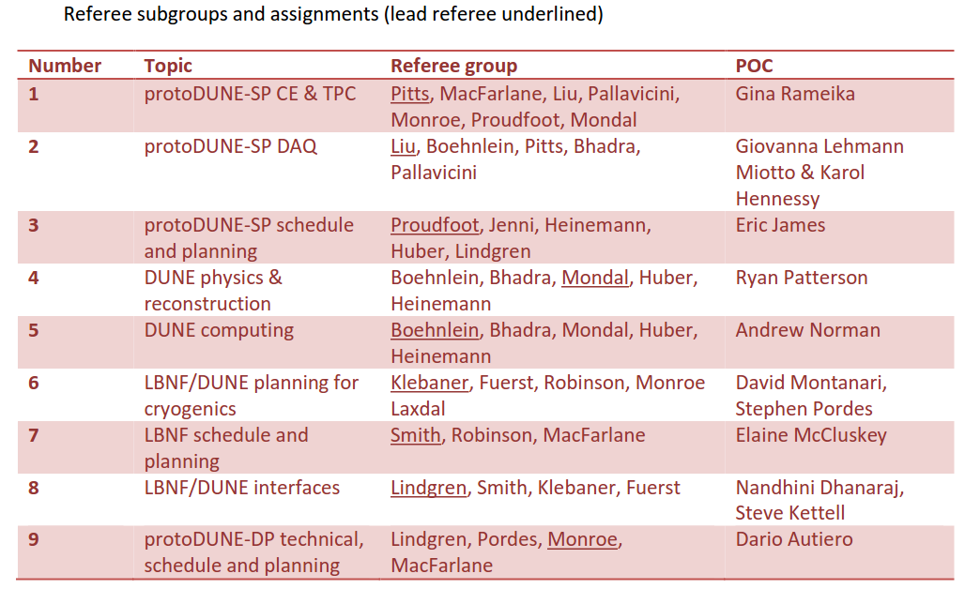
New modality from Oct 2016: referee subgroups

Slide 13
New modality from Oct 2016: referee subgroups
Move to 3 face-to-face meetings per year:
  March 23-25, 2017 at Fermilab
  June 22-24, 2017 at CERN
  Oct 26-28, 2017 at SURF
Between meetings, intention is that referee groups keep up-to-date through regular contact with LBNF/DUNE POCs
  Develop and sustain a high level of referee familiarity and understanding of the assigned systems(s)
  Provide follow-up and/or progress reports on intermediate time scales for issues identified during regular LBNC reviews
  Facilitate preparation for regular LBNC reviews, such as advance discussion of draft documents and development of agendas and focal topics

Slide 14
New modality from Oct 2016: referee subgroups
Trigger events
  Update on items for issues list developed as part of the closeout from the previous LBNC review, most often on pre-specified timescales
  New issues which, in the judgment of the POC, have significant impact on previous planning, schedules or goals for the system(s)
Modalities
  Ad hoc phone calls with the lead referee to review developments and/or identify topics of interest to the full LBNC subgroup
  Ad hoc phone calls with the full LBNC subgroup organized by referees or assigned POC
  Email updates based on trigger events

Slide 15
Agenda: June 22-24, 2017 at CERN
Postponed
to later

Slide 16
Agenda: June 22-24, 2017 at CERN
https://indico.fnal.gov/conferenceDisplay.py?confId=14195

Slide 17
Feedback and highlights:
March 22-25 meeting at Fermilab:
  Produced a 92-slide closeout deck, final version provided to PAC and reported to INC and RRB
  Organized around referee groups with findings, comments, and recommendations
June 21-24 meeting at CERN:
  Produced a 30-page written report, final version provided to PAC
  Organized around referee groups with findings, comments, and recommendations
  Executive provides a broad overview and highlights main comments and recommendations

Slide 18
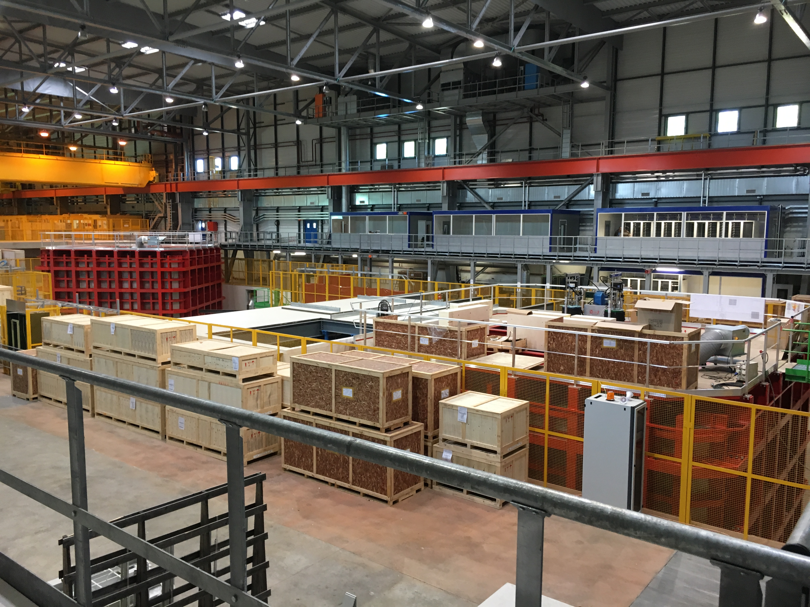
Highlight from June: Tour of Neutrino Platform
Very impressive progress by CERN, GTT in preparation for protoDUNE:
Cryostat engineering challenges being addressed efficiently and effectively
View of cryostats for protoDUNE-DP (right) and proto-DUNE-SP (left)

Slide 19
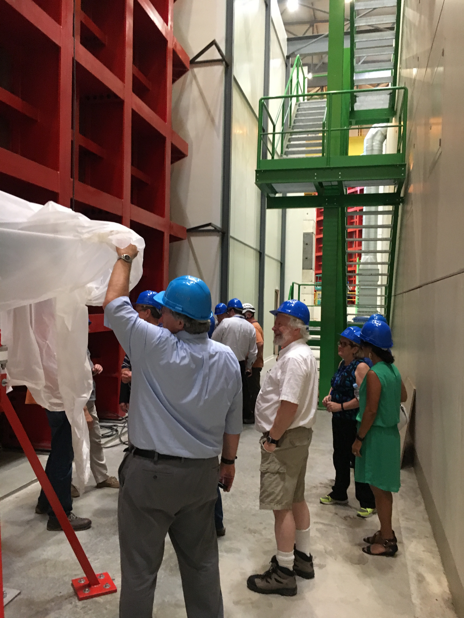
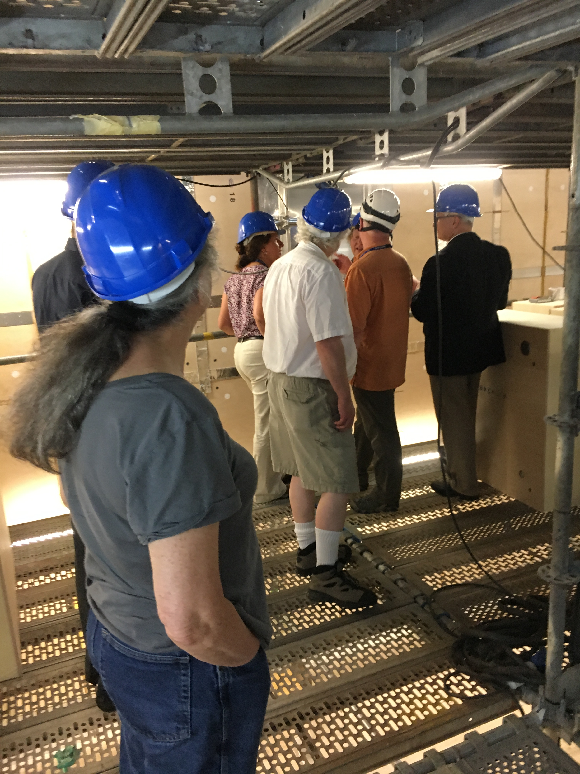
Highlight from June: Tour of Neutrino Platform
Exterior (left) and interior (right) views of proto-DUNE-SP cryostat

Slide 20
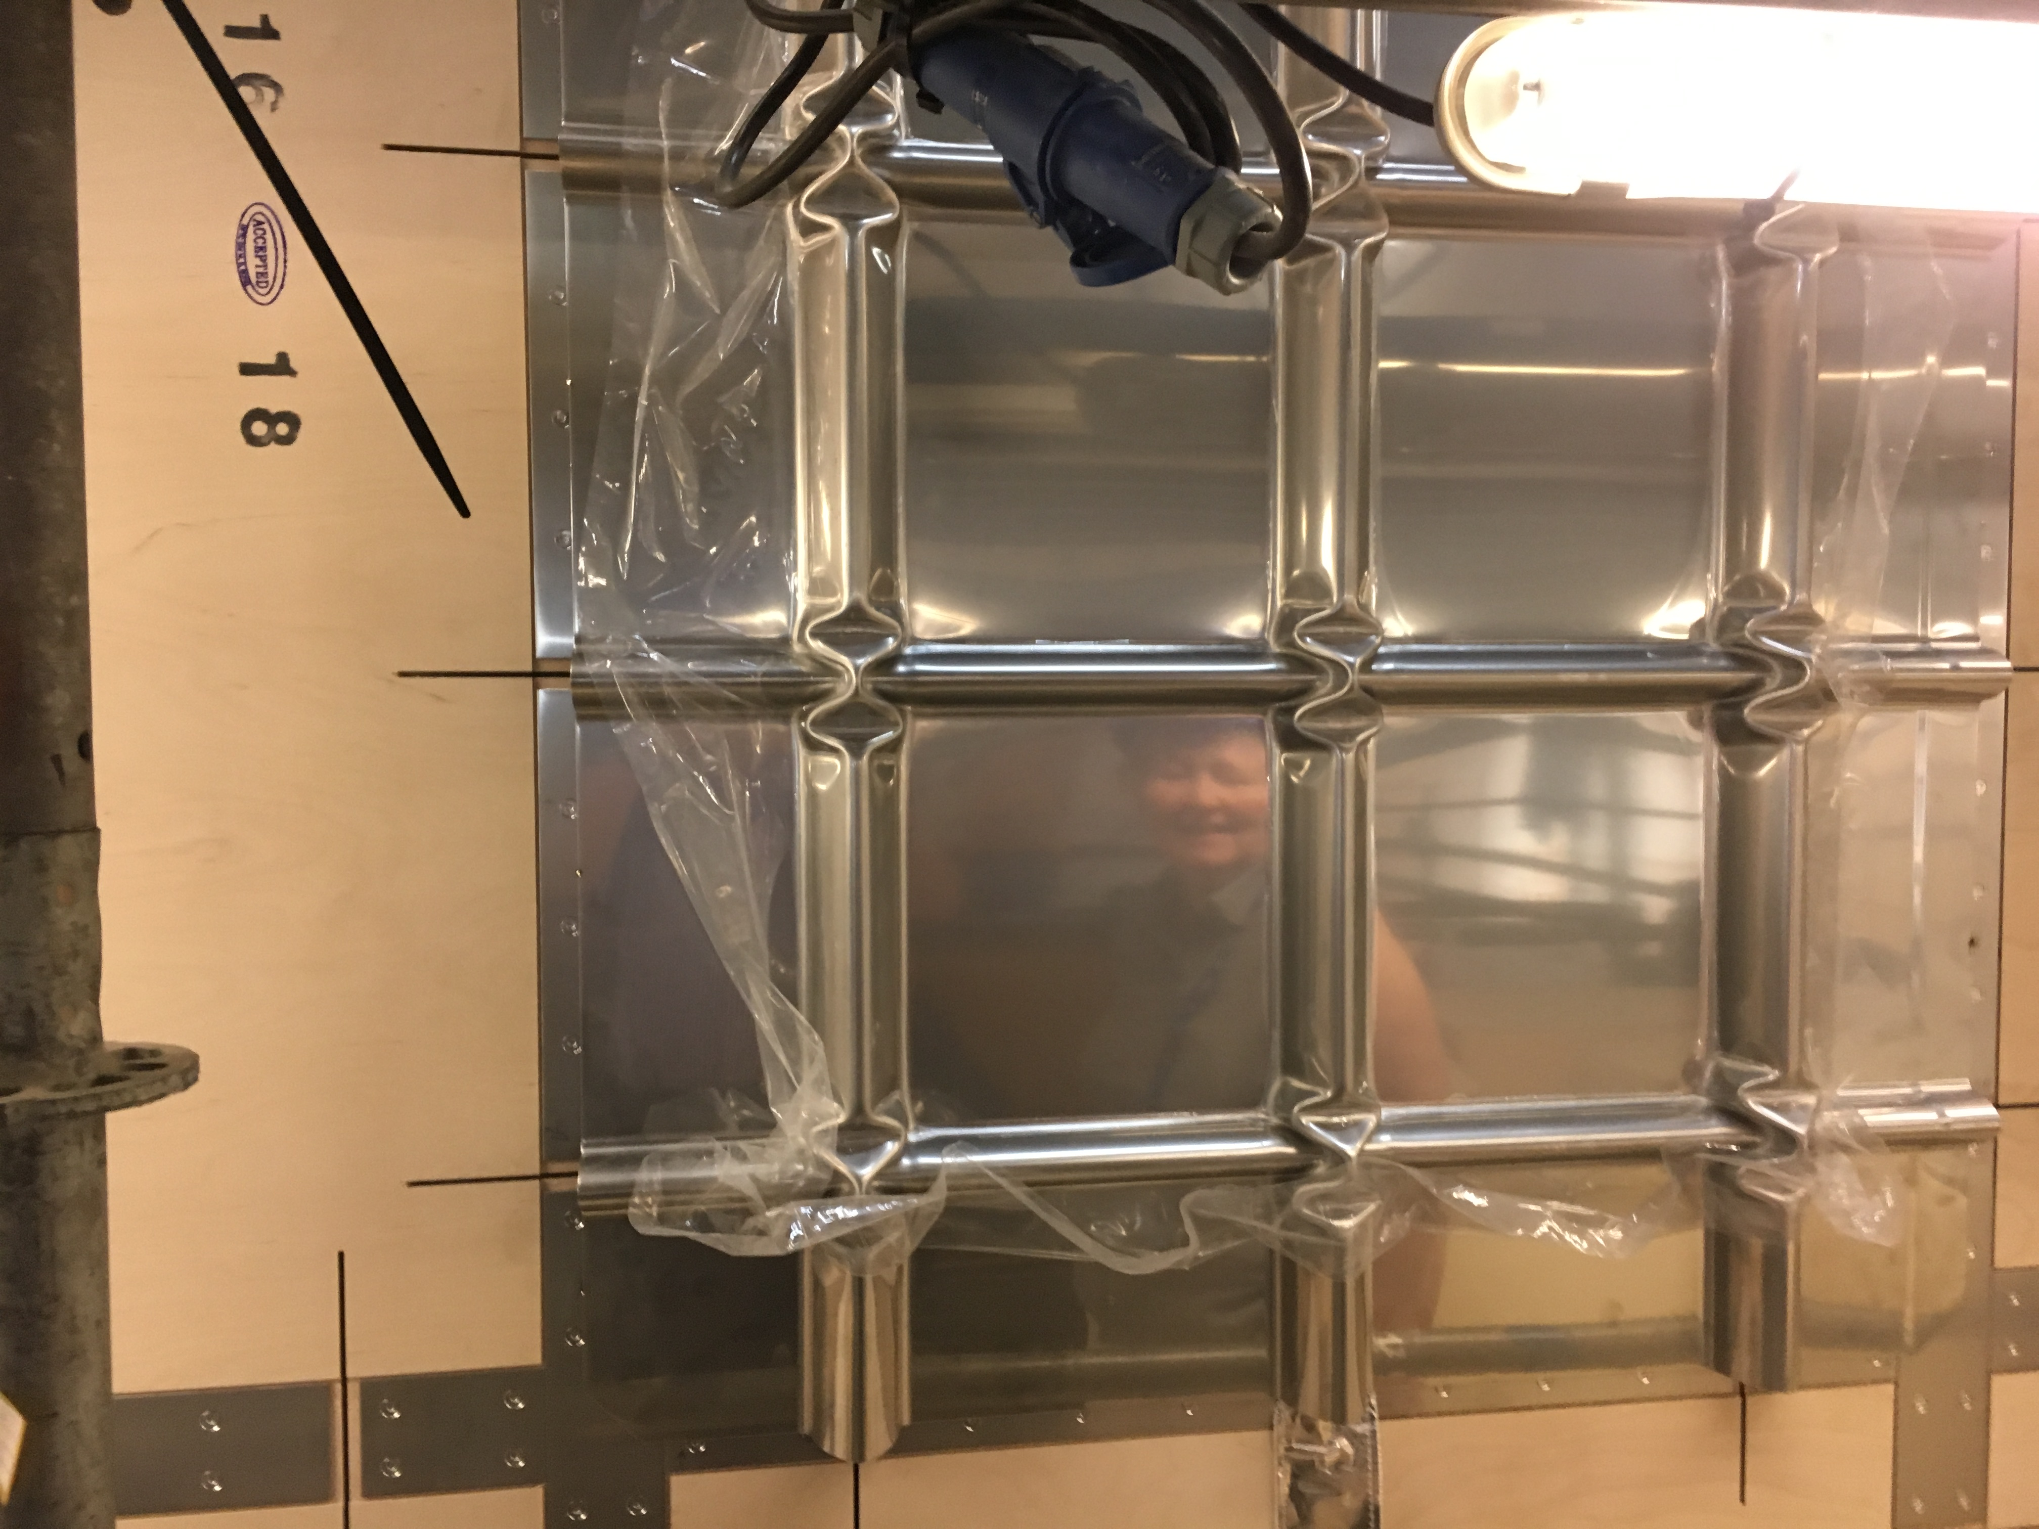
Highlight from June: Tour of Neutrino Platform
Installed portion of membrane on top of insulating panels

Slide 21
Overarching impressions
LBNF and DUNE are both making excellent progress
  However, DUNE, as a recently formed major new scientific collaboration, still shows signs of its constituent parts:
    Would benefit from efforts to establish mechanisms to ensure stronger collaboration-wide consensus
    Clearer lines of authority for management and decision making.
Primary recommendations address:
  Need to better understand the overall strategy for the first two far detector modules
  Enhance coordination between protoDUNE-SP and protoDUNE-DP
  Launch the DUNE consortia with an eye to the long-term need to maximize efficiency in overlapping areas of detector design

Slide 22
Overarching impressions
  Enhance the role of the Executive Committee and Collaboration leadership.
We also noted that, while it is still early, the demonstration of a working dual phase prototype with WA105, potentially warrants revisiting some aspects of the overall strategy for the DUNE far detector.
CERN and GTT continue to make progress with demonstrating the membrane cryostat design for DUNE, but experience from the WA105 cryostat points to the protoDUNE cryostats as the critical next engineering step.
Likewise the electronics system design for the single-phase DUNE design, including the cold electronics components, remains a significant overall concern.

Slide 23
Update on LBNF to
Long-Baseline Neutrino Committee
From the June LBNC review
C. J. Mossey, Deputy Director/Project Director, LBNF
23 June 2017

Slide 24
DOE Funding Status for LBNF/DUNE-US – 1 of 2
FY17 Funding Status
  FY17 omnibus appropriation signed into law 5 May 2017. LBNF/DUNE-US funded at $50M, $5M above LBNF/DUNE plan and President’s Budget Request (PBR).
  Allows project to move forward with CD-3a equipment purchase and construction work as well as FSCF final design, when funds fully arrive and contracts are ready.
  Also allows for modest carryover to FY18 (will be needed…)
  Funding still arriving in monthly (1/12 annual appropriation) amounts. Will potentially cause challenge to award contracts until full funding arrives (possibly mid-July).

Slide 25
DOE Funding Status for LBNF/DUNE-US – 2 of 2
FY18 Funding Status
  Good news: PBR is $55M; above FY17 PBR and final appropriated amount
  Not as good news: PBR is $55M, $40M below planned level of $95M
  While we expect Congress to enact a higher funding level than the PBR, we are uncertain about timing and amount of increase
    We are implementing the PBR amount into project DOE resource-loaded schedule.
    We are in a new phase of the project – execution of work; awarding of contracts
  LBNF and DUNE leadership consensus is to prioritize Far Site work over Near Site work
    Constrained and sequential nature of far site work
    Support collaboration objectives for detector install and detector commission schedule
  Funding at PBR level will delay start of near site conventional facilities and beamline preliminary design

Slide 26
Status of LBNC Milestones
Updates since Mar 2017 LBNC review:
  CM/GC contract
    Source evaluation best value selection and report completed
    Terms and conditions negotiated
    Consent package forwarded to DOE in early May
    Goal to award June (assuming available funding)
  Ross Shaft: proceeding - was funding constrained during April due to CR.
  Main excavation final design:
    Subcontract is being reassigned from SDSTA to FRA.
    Design work will begin when funding is available (hopefully July…)

Slide 27
Status of Responses to LBNC Review Recommendations
 | ALL LBNF RECOMMENDATIONS
REVIEW | TOTAL | CLOSED | IN-PROGRESS
SEP 2015 | 7 | 5 | 2
JAN 2016 | 1 | 0 | 1
OCT 2016 | 4 | 3 | 1
MAR 2017 | 1 | 1 | 0
Recommendations closed since last review:
From Mar 2017 Review:
  Rec #1: “Cryogenics: LBNF should present a prioritized action plan to address urgent interface, risk, and design issues due to unassigned non-DOE cryogenics scope by the next LBNC meeting.”
    The Project has advanced LAr cryogenic design sufficiently to fit within the CF envelope and to inform cryostat penetration design. We recognize the need for this design to proceed, but are balancing this with higher priorities during this timeframe. LBNF PM milestones have been added into the schedule to trigger decisions about proceeding with design related to non-DOE LAr cryogenic items 24 months before design start is required.

Slide 28
Risk Update
LBNF is actively managing 96 risks in project Risk Register, focusing on the 12 high-ranked and 25 medium-ranked risks. Risks reviewed monthly at LBNF Risk Management Board.
Risk updates related to change to N2 in target chase:
  Retired: Beam-081 Coolant of the decay pipe must be nitrogen or helium instead of air
  Retired: Beam-093 Change in Target Chase gas medium from air to inert gas
  New: Beam-095 Radiation influenced corrosion study
Schedule risk initiative: Performed preliminary Monte Carlo analysis on duration estimate uncertainty to evaluate overall schedule float to CD-4, based on recommendation from Feb 2017 DOE IPR
  Schedule impact of 1.5 years is still being reviewed, including associated costs
  Analysis is still in progress, including related Monte Carlo analysis on cost estimate uncertainty

Slide 29
Ross Shaft Rehab progress
Pause in set installation in April due to cash flow and CR
SDSTA evaluating non-conforming wood guides for cage
Processing change to add mods to very bottom for spilled rock handling
Completion Jan 2018

Slide 30
Ross Shaft Rehab photos
Steel set 280 staged & ready to be installed
Removing old set

Slide 31
Summary
Project is at inflection point, and transitioning from planning to execution
Continue to actively manage risk, organizational staffing, and project management systems
Significant procurement planning underway and aligned with execution schedule
Project continually reviewing strategy to optimize “stake in the ground milestones” and support of DUNE collaboration in dynamic funding environment

Slide 32
LBNF management, schedule and planning: Subgroup #7 (Smith, Robinson, MacFarlane)
March
Comments:
  LBNF is well placed to execute the far site project once funding becomes available, and are a well organized team with strong risk and project management
  LBNF spearheading safety code equivalency development for an international project, while making good progress on a host of legal issues (realty and improvements to non-Federal facilities, tax, insurance, liability, etc)
Recommendations:
  None

Slide 33
LBNF management, schedule and planning: Subgroup #7 (Smith, Robinson, MacFarlane)
Comments:
  Recognizing that the DUNE-single phase cryostat design is well advanced at this stage, the LBNC strongly encourages DUNE working with LBNF to re-evaluate whether a common cryostat structure design is possible for both SP and DP detectors, to provide greater understanding of the design and construction risks, deployment options, sequencing and construction efficiency.
  If this is not possible, LBNF and DUNE should assess implications on cost and schedule of any change in detector sequencing strategy, and whether a separate DP Cryostat design should be started in order to mitigate any associated risk.
Recommendations:
  None

Slide 34
LBNF/DUNE interfaces: subgroup #8 (Lindgren, Smith, Klebaner, Fuerst)
March
Comments:
  In general the interfaces are well understood, and a workable system in in place that the project can effectively use going forward
  The teams working on DUNE installation, CF, and Cryogenic systems have good communications, and an appropriate level of interaction and coordination
Recommendations:
  None

Slide 35
LBNF/DUNE planning for cryogenics: subgroup #6 (Fuerst, Klebaner, Laxdal, and Robinson)
Comments
  The tour clearly showed the impressive level of effort that is on-going to prepare the ProtoDUNE cryostats. The CERN/GTT teams were engaged with significant personnel in and around both cryostats.
  Need to guard against the schedule pressure impacting key ProtoDUNE technical and quality steps and tests.
    Important goals for demonstrating performance, reliability, and scientific calibration, but the ProtoDUNEs should be primarily viewed as engineering prototypes.
    Time pressure from meeting the LS2 schedule remains an important constraint, but achieving this goal should not compromise the need to realize engineering prototypes, particularly for the critical membrane cryostat demonstration.

Slide 36
LBNF/DUNE planning for cryogenics: subgroup #6 (Fuerst, Klebaner, Laxdal, and Robinson)
Comments:
    Negative experience of the 1x1x3 cryostat membrane is being mitigated in ProtoDUNE by choosing a different membrane and insulating foam design and defining tighter quality control on installation.
    Revised design looks like a substantial improvement on the 1x1x3 and is the standard design employed by GTT in LNG ships
    Nevertheless it is the first time this type of design will be used for a cryogenic LAr detector in a 1/20th-scale prototype for the DUNE cryostat.
    ProtoDUNE thus is critical demonstration at scale of a working engineering design.
    Sufficient time must be kept in the schedule for adequate testing and confirmation of the cryogenic performance and modeling.

Slide 37
LBNF/DUNE planning for cryogenics: subgroup #6 (Fuerst, Klebaner, Laxdal, and Robinson)
Recommendations:
  The LBNC recommends the documentation of a cryogenic testing plan for ProtoDUNE cryogenics including required diagnostics, testing steps and required schedule.

Slide 38
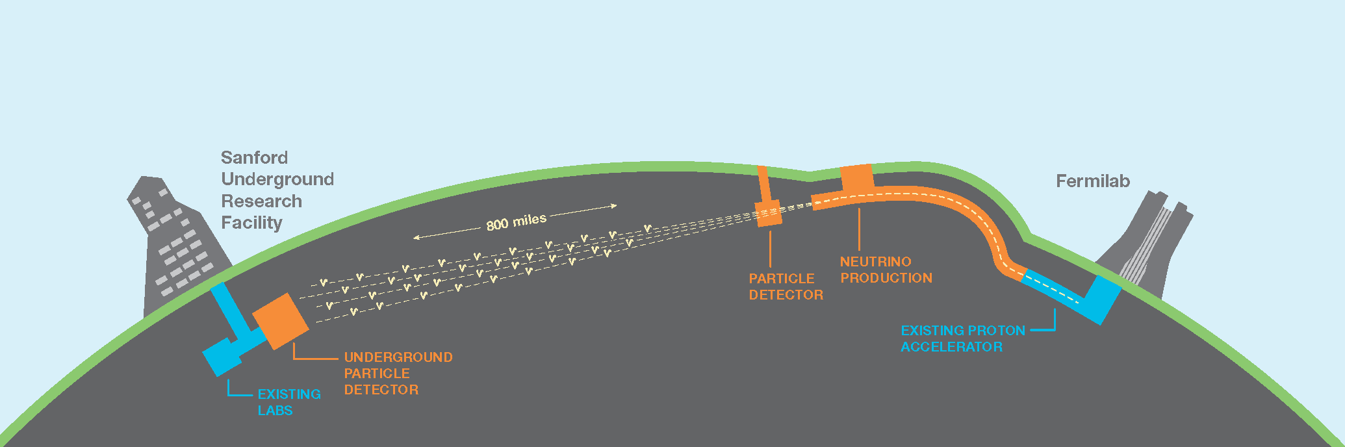
State of DUNE and Update to DUNE CD-2 Strategy
From the June LBNC review
Mark Thomson
LBNC Meeting
CERN, 22nd June 2017

Slide 39
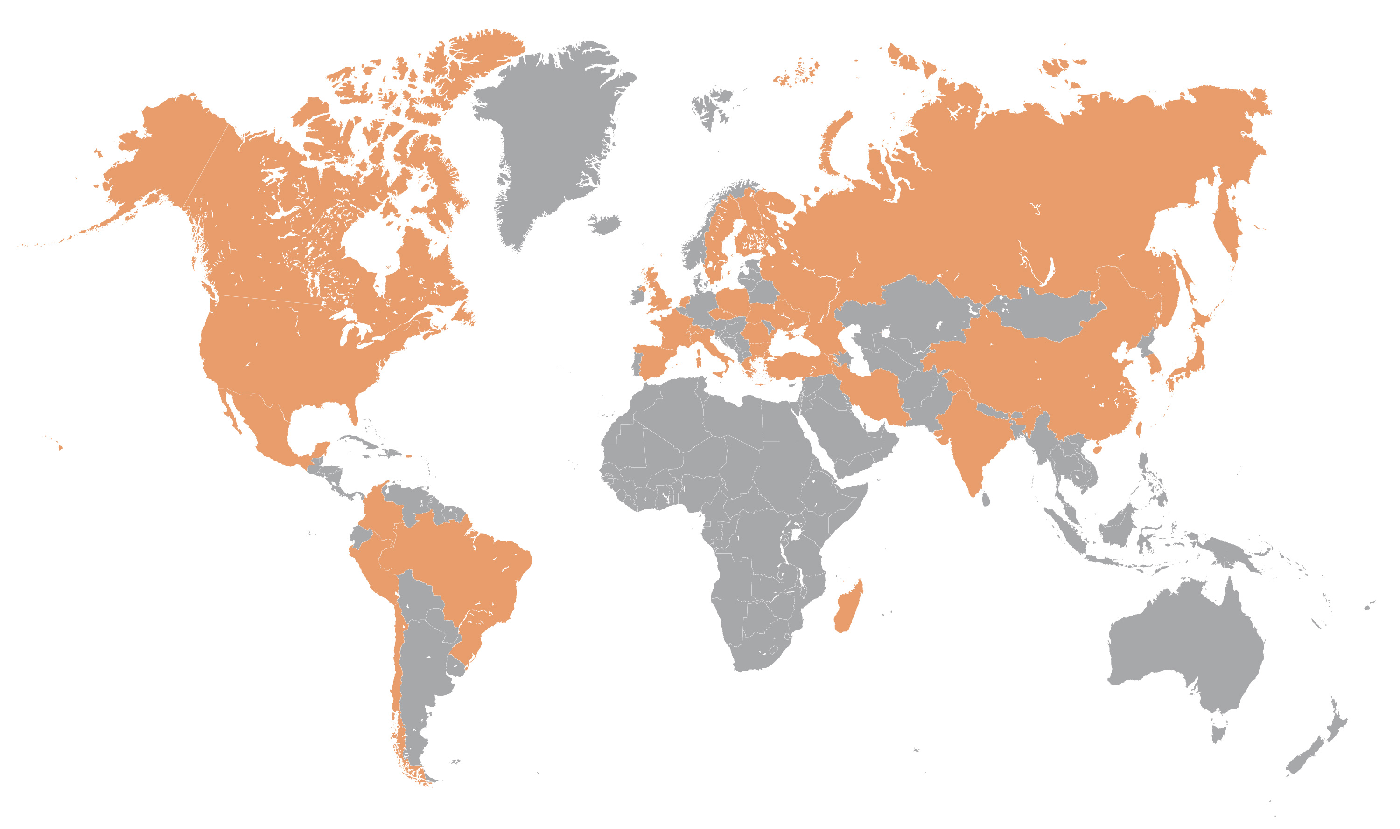
The DUNE Collaboration
  As of today:
  970 collaborators from 164 institutions in 30 nations
60 % non-US
Armenia, Brazil, Bulgaria, Canada, CERN, Chile, China, Colombia, Czech Republic, Finland, France, Greece, India, Iran, Italy, Japan, Madagascar, Mexico, Netherlands, Peru, Poland, Romania, Russia, South Korea, Spain, Sweden, Switzerland, Turkey, UK, Ukraine, USA
DUNE is still growing – anticipate next growth spurt soon

Slide 40
The DUNE Collaboration
  As of today:
  970 collaborators from 164 institutions in 30 nations
60 % non-US
Armenia, Brazil, Bulgaria, Canada, CERN, Chile, China, Colombia, Czech Republic, Finland, France, Greece, India, Iran, Italy, Japan, Madagascar, Mexico, Netherlands, Peru, Poland, Romania, Russia, South Korea, Spain, Sweden, Switzerland, Turkey, UK, Ukraine, USA
Increasing levels of engagement
  Last Collaboration Meeting
    201+ in person attendees
    >190 presentations!
DUNE is still growing – anticipate next growth spurt soon

Slide 41
Management Structure: Aug 2017
Moving to modified DUNE organizational structure to implement our strategy for CD-2: FD WGs ➝ Construction Consortia
  in addition, removed a layer of management to clarify reporting lines
  executive levels unchanged
  oversight unchanged
Project coordination
Project management
  Shift towards distributed project organization, coordinated by IPO
  Deliverables managed by international contributors within consortia

Slide 42
DUNE in 2017
Major (non-protoDUNE) milestones in 2017
  Jan Launch EoI process for FD-SP ✔
  March First ND Concept Study workshop ✔
  April Physics TDR editors appointed ✔
  May Task force reports finalized/reviewed ✔
  May FD_SP consortia discussions at collab. mtg. ✔
  June Second ND Concept Study workshop ✔
  June FD-DP consortia discussions: CERN 26/27 June
  June FD “proto-consortia” defined
  July Consortia leadership elected
  Aug First formal meetings of FD construction consortia
  Sept Rotation of coordinator/convener roles
  Nov Consortia plans presented to RRB
  Dec Far Detector TDR editors appointed
  Dec Decision-making process for first two FD modules agreed
  Dec(ish) Concept for DUNE ND agreed (Jan collab mtg.)
Focus: FD construction consortia and ND Concept

Slide 43
DUNE management, schedule & planning: MacFarlane, Jenni, Proudfoot
Comments:
  The LBNC appreciates the plans towards a more global and integrated project organization with the planned evolution of the Executive Committee (EC) becoming more explicitly the decision body steering the project. The EC must bring together the leadership of the consortia being formed, the main activity coordinators, and the DUNE management to take the major decisions carried and supported by the full collaboration.
  The LBNC sees an urgency (before the Technical Proposal) in taking these steps as a way to foster a true “collaborative working spirit” within DUNE, that will enable the collaboration to make reasoned decisions for cost-efficient common solutions and unique technology choices wherever applicable. Such decisions should take into account considerations about efficient operation and maintenance in the future.

Slide 44
DUNE management, schedule & planning: MacFarlane, Jenni, Proudfoot
Comments:
  With the recent demonstration from the WA105 prototype, the LBNC sees an opportunity to attract funding to the dual phase design and to aim for deployment of both single-phase and dual-phase detector technologies, rather than just one. However, in this scenario, there is a need to better understand the real risks, schedule implications, and practical engineering implications of deploying both technologies.
Recommendation:
  The LBNC looks forward to a report at its next meeting on steps taken towards forming a global collaboration.

Slide 45
Physics, Reconstruction, FD TF & ND TF: Subgroup #4 (Boehnlein, Bhadra, Mondal, Huber, Heinemann)
March
Comments:
  The committee is pleased to see that the reconstruction tools appear to be reaching the necessary level of maturity to support the majority of physics studies
  The TDR preparation appears to be on track but continued attention to available FTEs and realistically achievable results is required
Recommendations:
  Develop a set of physics performance metrics for the TDR with corresponding development plans by May 2017 so that DUNE can monitor future progress

Slide 46
Dune Computing: Subgroup #5 (Boehnlein, Bhadra, Mondal, Huber, Heinemann)
March
Comments:
  The separation of responsibilities in the LArSoft Toolkit is working well. It allows for contributions from multiple experiments while providing common support and integration
  The planning for DUNE Computing & Software System remains in a formative stage.
  We suggest strengthening the C&S effort by taking further advantage of the scientists with experience in SW development for large international collaborations
Recommendations:
  Ramp up the Fermilab (SCD or elsewhere) scientific computing effort for protoDUNE/TDR as proposed—with the reminder that these efforts are 18 months out

Slide 47

ProtoDUNE Overview
From the June LBNC review
Eric James
LBNC Meeting
22 June – 24 June 2017

Slide 48
Since Last LBNC review …
Significant progress across all ProtoDUNE-related efforts, which will be highlighted in the next few slides and detailed in subsequent presentations
Schedule slippages in a number of key areas requiring organizational re-planning and adaptation of mitigation strategies

Slide 49
ProtoDUNE-SP Progress
First APA module completed at PSL (will be shipped on 7/11)
Detector Support Structure (DSS) design complete, all parts ordered, and supporting engineering documentation delivered to CERN (plan to install in late July)
Packaged FE and ADC chips delivered to BNL and testing is underway (anticipating early-August delivery of 1st APA boards)
Photon Detector Modules for 1st APA have been produced and will be shipped to CERN in mid-July
DAQ system has undergone extensive integration testing and is currently being re-located to its permanent home in EHN1
Substantial progress on the EHN1 facilities (Cryostat, Clean Room, and Cold Box)

Slide 50
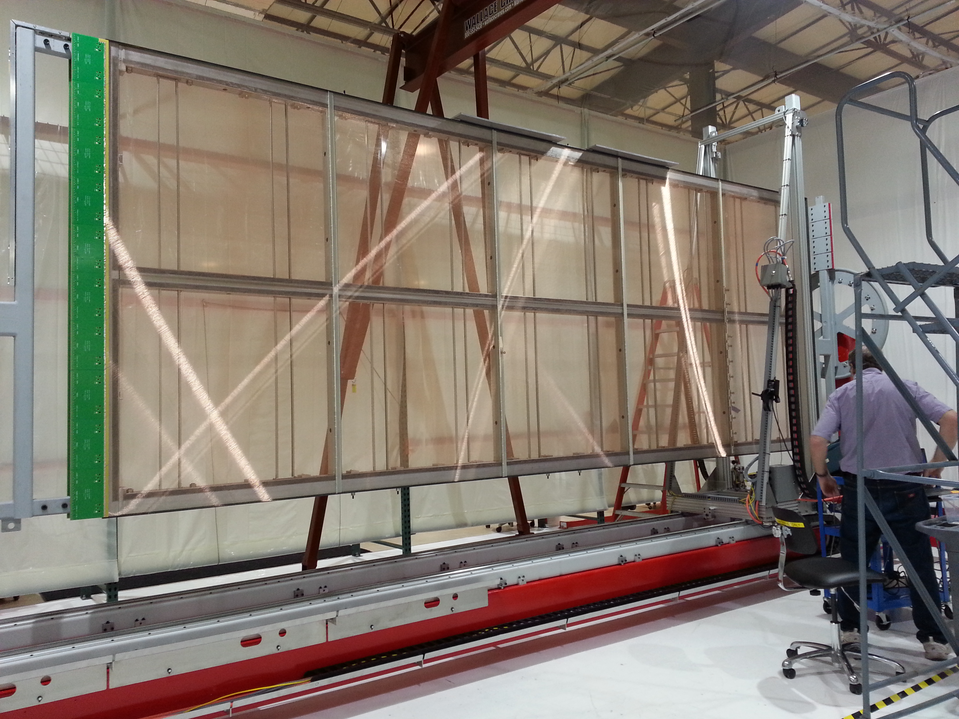
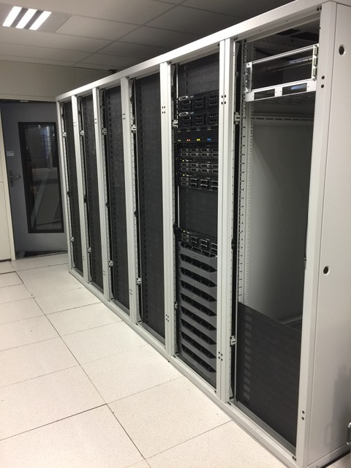
ProtoDUNE-SP Progress

Slide 51
ProtoDUNE-SP Schedule (March)
End of Beam
EHN1
Beneficial Occupancy
APA #1 @ CERN
Detector Installation Begins
Close TCO; Finish Installation
Start Filling & Commissioning
2016
Q4
2017
JAN
2017
FEB
2017
MAR
2017
APR
2017
MAY
2017
JUN
2017
JUL
2017
AUG
2017
SEP
2017
OCT
2017
NOV
2017
DEC
2018
JAN
2018
FEB
2018
MAR
2018
APR
2018
MAY
2018
JUN
2018
JUL
2018
AUG
2018
SEP
2018
OCT
Cryostat Installation
Cryogenics Installation
Clean
Room
Cold Box
Install DSS & Infrastructure
Install APA 1-3
Install CPAs/FCs
Install APA
4-6
Close Detector
APA Integration and Testing
System Testing
Detector Operations

Slide 52
ProtoDUNE-SP Schedule (June)
End of Beam
EHN1
Beneficial Occupancy
APA #1 @ CERN
Detector Installation Begins
Close TCO; Finish Installation
Start Filling & Commissioning
2016
Q4
2017
JAN
2017
FEB
2017
MAR
2017
APR
2017
MAY
2017
JUN
2017
JUL
2017
AUG
2017
SEP
2017
OCT
2017
NOV
2017
DEC
2018
JAN
2018
FEB
2018
MAR
2018
APR
2018
MAY
2018
JUN
2018
JUL
2018
AUG
2018
SEP
2018
OCT
Cryostat Installation
Cryogenics Installation
Clean
Room
Cold Box
Install DSS & Infrastructure
Install APA 1-3
Install CPAs/FCs
Install APA
4-6
Close Detector
APA Integration and Testing
System Testing
Detector Operations

Slide 53
ProtoDUNE-DP Progress
First operation of 1x1x3 m³ prototype following significant efforts to debug issues with cryostat
Setup of clean room in building 185 to initiate production of LEM modules
Substantial progress on the EHN1 facilities (Cryostat and Clean Room)

Slide 54
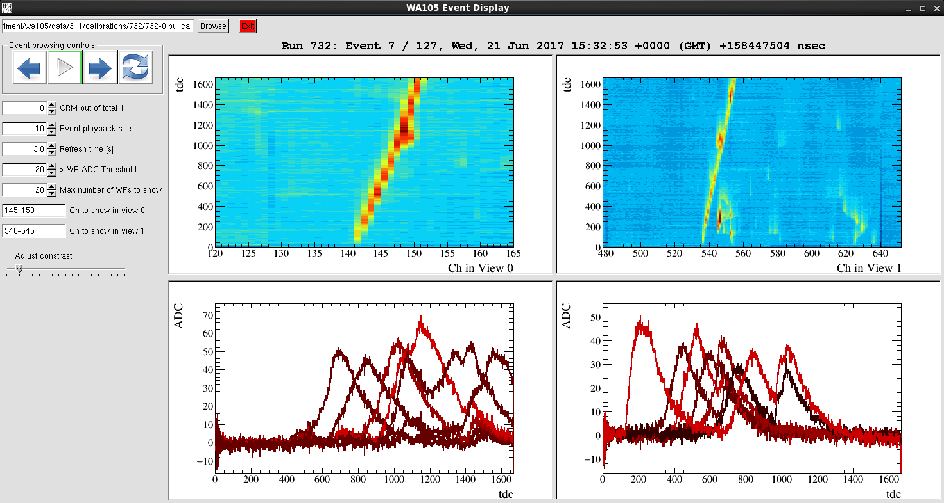
ProtoDUNE-DP Progress
First tracks observed in 1x1x3 m³ detector!

Slide 55
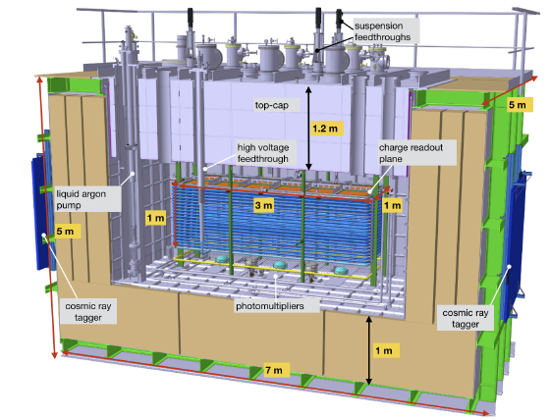
3x1x1 catalyzing progress on 6x6x6 m³:
Membrane vessel design and procurement
Cryogenics
Charge Readout Plane (CRP) detectors
CRP structure and hanging system
Feedthroughs
HV and field cage
Charge readout FE electronics + digital electronics
Light readout system + electronics
DAQ and online processing
Slow Control
Advanced state of design, prototyping and production preparation
For many items huge benefit from immediate application of a smaller 3x1 prototype LAr-proto
(minimal size of RO unit in 6x6x6)
Fully engineered versions of many detector components with pre-production and direct implementation (installation details and ancillary services)
First overview of the complete system integration: set up full chains for QA, construction, installation, commissioning
Anticipate legal and practical aspects related to procurement, costs and schedule verification
Retirement of several risks for PD-DP thanks to (1) identification of critical components (2) early detection of potential problems

Slide 56
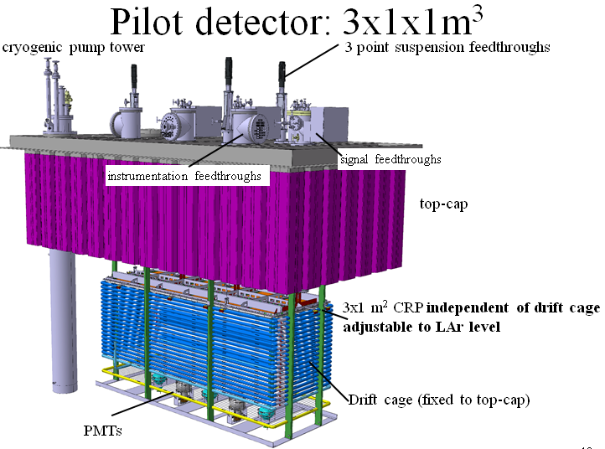
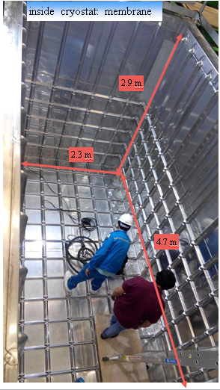
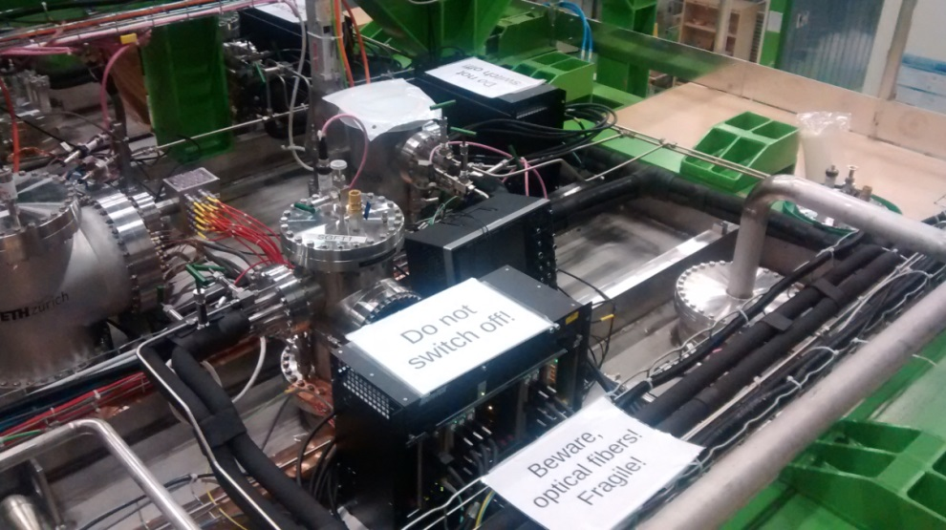
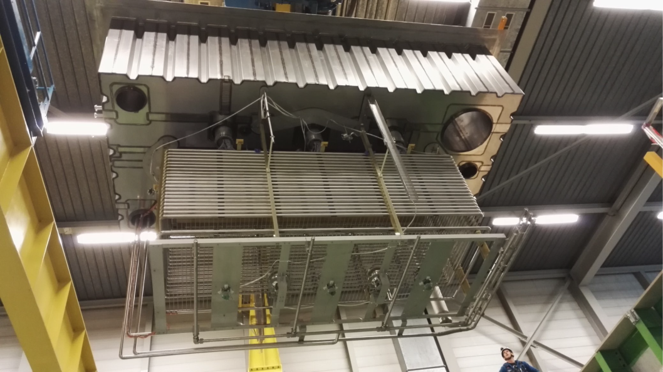
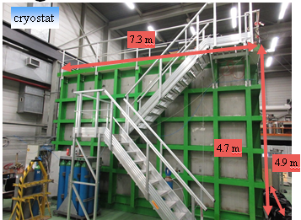
Detector installation completed during the fall 2016

Slide 57
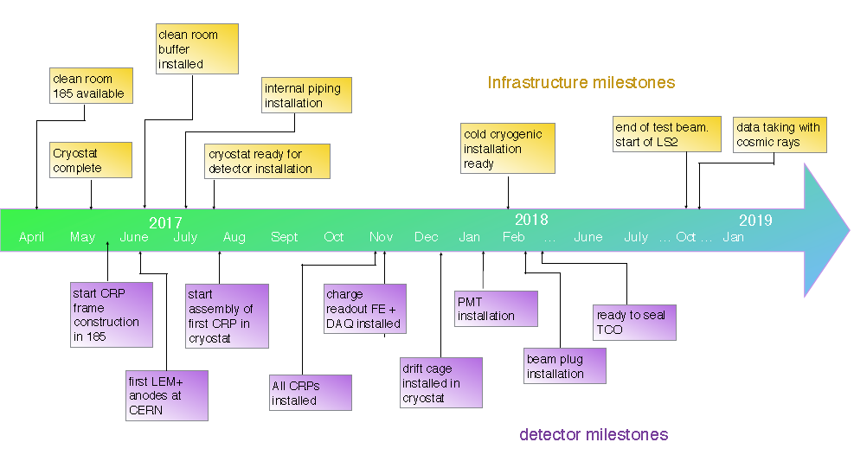
ProtoDUNE-DP Schedule (April)

Slide 58
ProtoDUNE-DP Schedule (June)
~2 month delay

Slide 59
Summary
DUNE is focused on its highest priority near-term objectives
  Operating the ProtoDUNE detectors at CERN in 2018
  Preparing Technical Design Reports for the first two far detector modules in advance of far detector baselining in 2019
Since the March LBNC meeting, there has been significant progress on all ProtoDUNE-related efforts
The schedule for collecting beam data in 2018 remains very tight and we continue to implement mitigation strategies as necessary to deal with delays that do manifest themselves

Slide 60
protoDUNE-SP schedule and planning: subgroup #3 (Proudfoot, Jenni, Heinemann, Huber, Lindgren, Pitts)
Comments:
  The LBNC is concerned that the cold and warm electronics will not be available on the necessary timescale for protoDUNE-SP, as many elements are late and are to be delivered “just in time”.
Recommendation:
  The LBNC recommends that the ProtoDUNE-SP CE System Manager should communicate with the Construction Coordinator on a weekly basis through this critical period (4-16 weeks).

Slide 61
protoDUNE-SP CE & TPC: subgroup #1 (Pitts, MacFarlane, Liu, Pallavicini, Monroe, Proudfoot, Mondal)
Comments:
  A long-term strategy for the overall future cold electronics development for DUNE should be developed. This should include a system design for redundancy study to improve the overall system reliability, and a large scale cold electronics testing facility for component and board level testing, evaluation and burn-in.
  The LBNC is concerned that the lack of direction on the final electronics system design, including the ADC, threatens the viability of the single phase detector as a TPC option for the far detector.
Recommendation:
  The LBNC expects a plan for the cold electronics system design to be presented at the next LBNC review meeting.

Slide 62
ProtoDUNE-SP-DAQ: subgroup #2 (Liu, Boehnlein, Pitts, Bhadra)
March
Comments:
  Getting the full DAQ system working together with a brand new detector over such a short time will be a major undertaking
  It is crucial that subsystems (or components) such as timing, WIB and SSP become available for DAQ development, testing and integration before May 2017, to make sure the DAQ system is ready for the initial cold box testing over the summer
Recommendations:
  None

Slide 63
protoDUNE-DP technical, schedule and planning: subgroup #9 (Monroe, MacFarlane)
Comments:
  The achievement of WA105 in observing cosmic ray tracks within 6 days of commencing cryogenic operations is outstanding. We congratulate the collaboration!
Recommendations:
  None

Slide 64
Summary
LBNC has evolved to a more in-depth review and advice on physics, technical, project execution & management
  Will also incorporate DUNE cost group as we move to DUNE technical Design Report and RRB funding matrix
  Establishing templates for monitoring schedule, recommendations, key manpower, risks, while maintaining 6 month look ahead
  First steps towards a comprehensive plan for TDR and cost/schedule/risk review for RRB in 2019
Concerns about DUNE’s transition to a fully functioning global collaboration with management authority to act in a decisive manner
Impressed by overall progress to constructing protoDUNEs, with some area of concern identified

Slide 65
Backup

Slide 66
Agenda: March 23-25 at Fermilab

Slide 67
Agenda: March 23-25 at Fermilab
https://indico.fnal.gov/conferenceDisplay.py?confId=14195

