Slide 1
9 O’Clock Meeting
Wednesday June 21, 2017

Slide 2
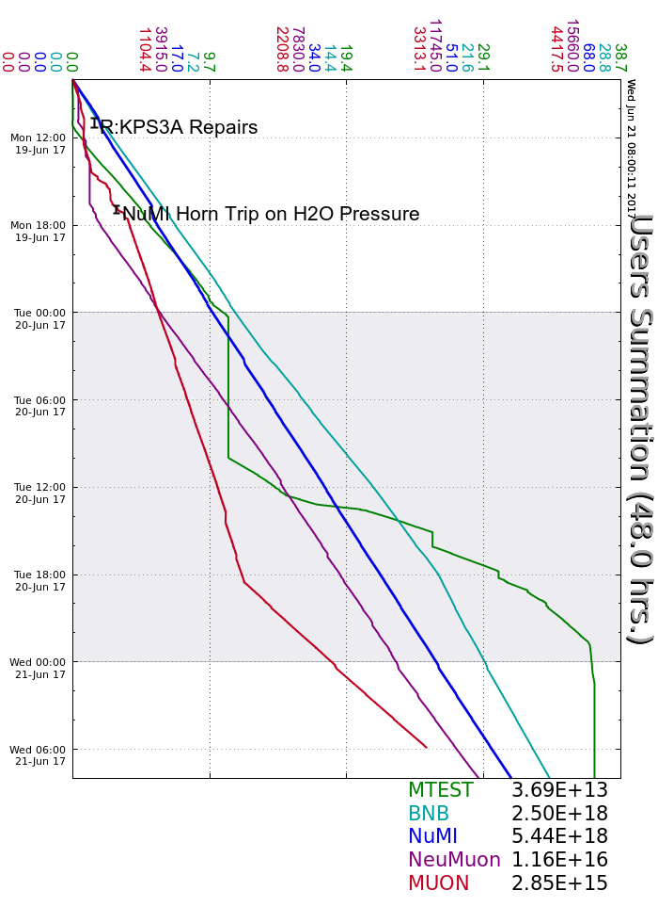
Monday:
R:KPS3A PFL series connector repair
D:BV015 locked open after vacuum issues
Tuesday:
R:KPS4C control power fuse failure
Updated FTP interface
Wednesday:
Delivery rings controlled
Rad Safety performing shielding study at AP0 (no keys until they’re finished)
MC-1 open access
Ongoing:
MI62 LCW leaks
MI30 Lower bend bus VCB issues
Beam to NuMI, BNB, SeaQuest

