Slide 1

Welcome to Fermilab!
Sergei Nagaitsev
17 June 2017

Slide 2
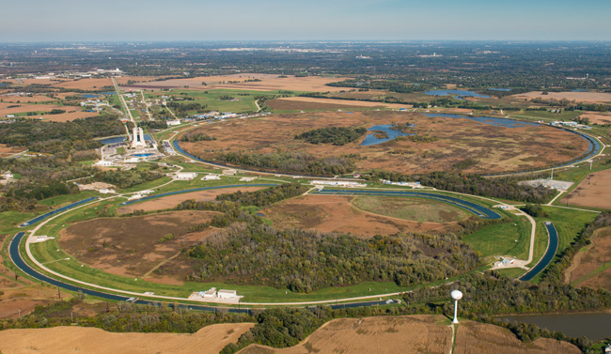
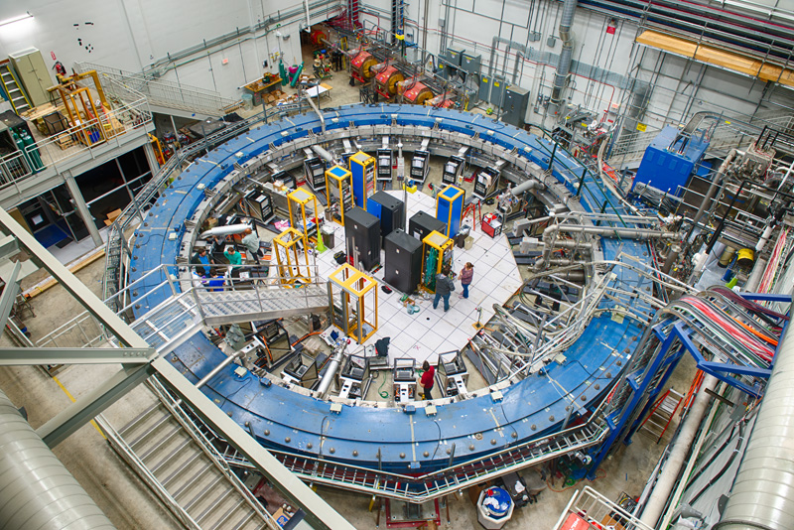
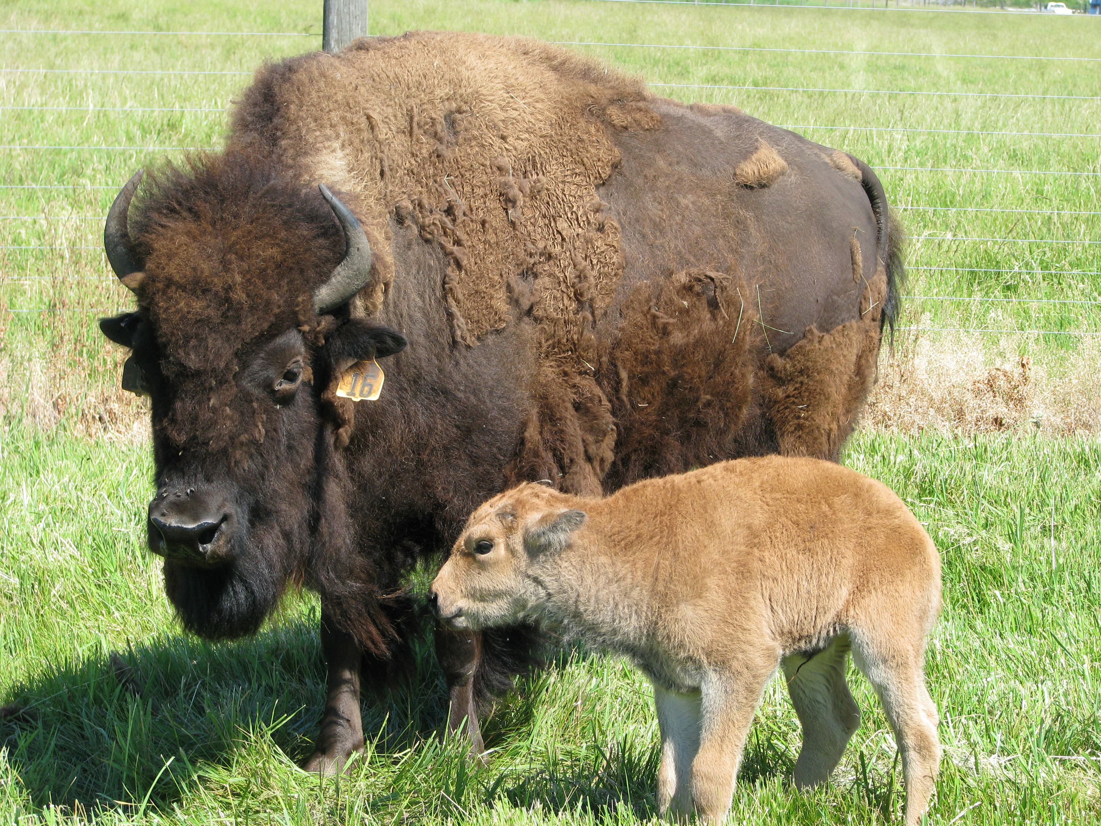
Fermilab-at-a-Glance
6,800 acres = 27 sq. km
~$400M operating budget
1,793 FTEs
3,245 facility users
Unique natural area,
prairie, wetlands, wildlife
Fermilab celebrates 50 years at the forefront of discovery in 2017 (top & bottom quarks, tau neutrino, …)
As we move into the next 50 years, our vision remains to solve the mysteries of matter, energy, space, and time for the benefit of all. We strive to:
Lead the world in neutrino science with particle accelerators
Lead the nation in the development of particle accelerators and colliders, and their use for scientific discovery
Advance particle physics through measurements of the cosmos

Slide 3
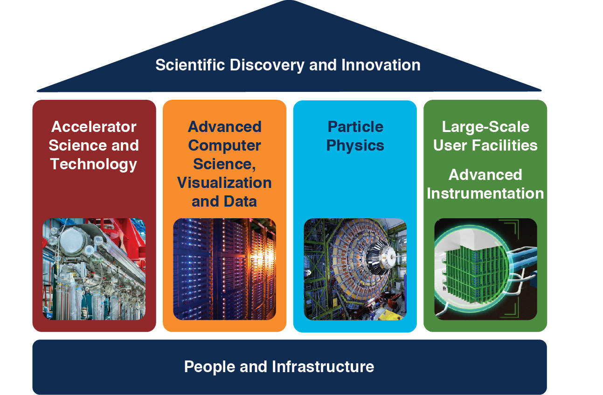
Fermilab’s Core Capabilities

Slide 4
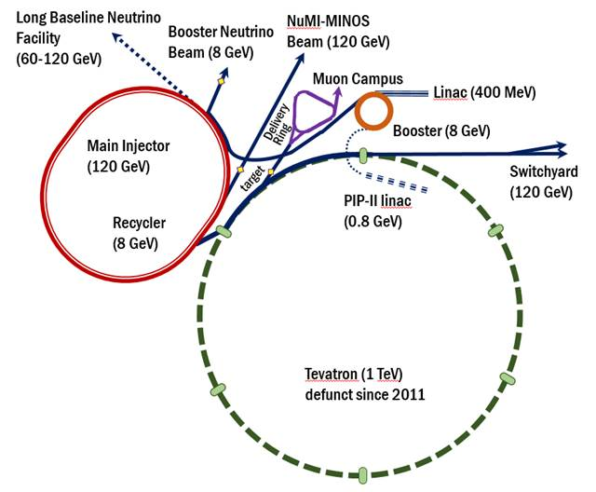
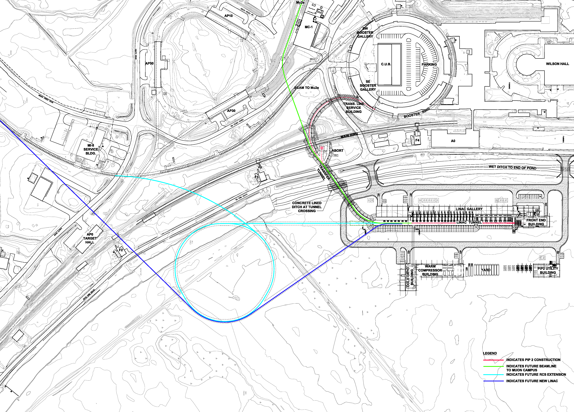
Fermilab accelerators
Delivering 8 GeV and 120 GeV
protons for neutrino experiments
Muon beams to the g-2 experiment
PIP-II
PIP-III

Slide 5
What is Fermilab known for?
(if you were to ask an accelerator scientist or engineer…)

Slide 6
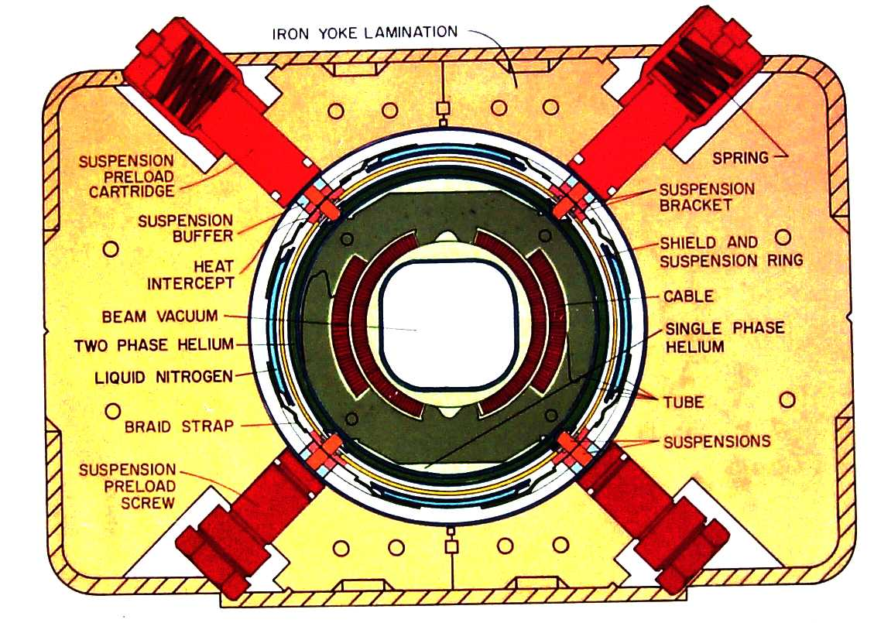
Technology: 4.5T SC Magnets

Slide 7
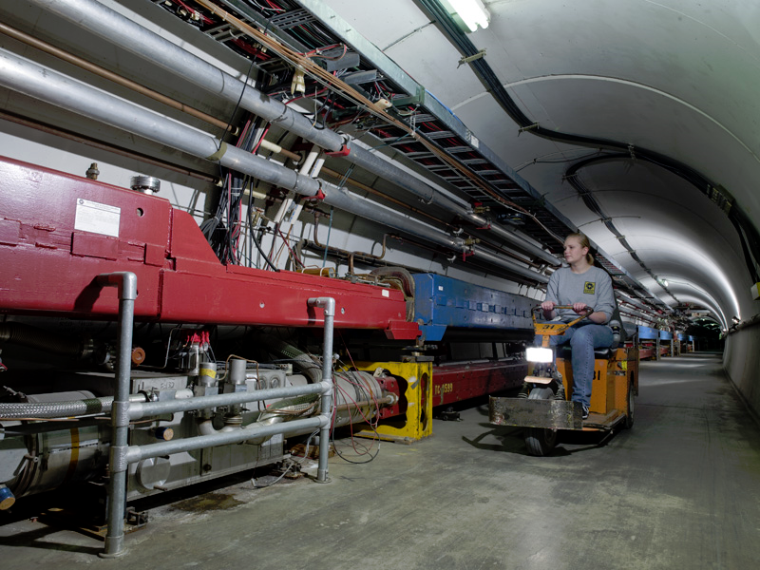
This is not the Tevatron!
-remnants of the Main Ring
(first separated-function synchrotron ever built)
This is the Tevatron!
C=6.28km, ~800 SC magnets @ 4.2 K,
7

Slide 8
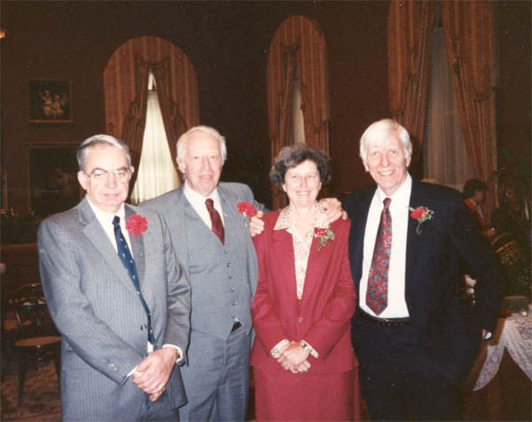
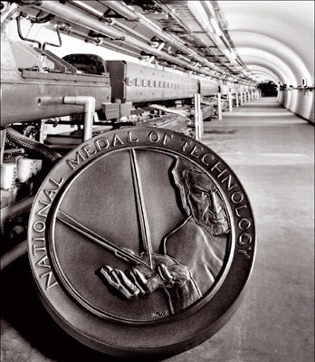
1989 NATIONAL MEDAL OF TECHNOLOGY
HELEN EDWARDS
RICHARD A. LUNDY
J. RICHIE ORR
ALVIN TOLLESTRUP
For their contributions to the design, construction and initial operation of the TEVATRON particle accelerator. The scientific instrument was designed to explore the fundamental properties of matter. The innovative design and successful operation of the TEVATRON has been crucial to the design of the Superconducting Super Collider, the planned next generation particle accelerator.

Slide 9
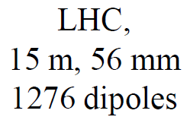
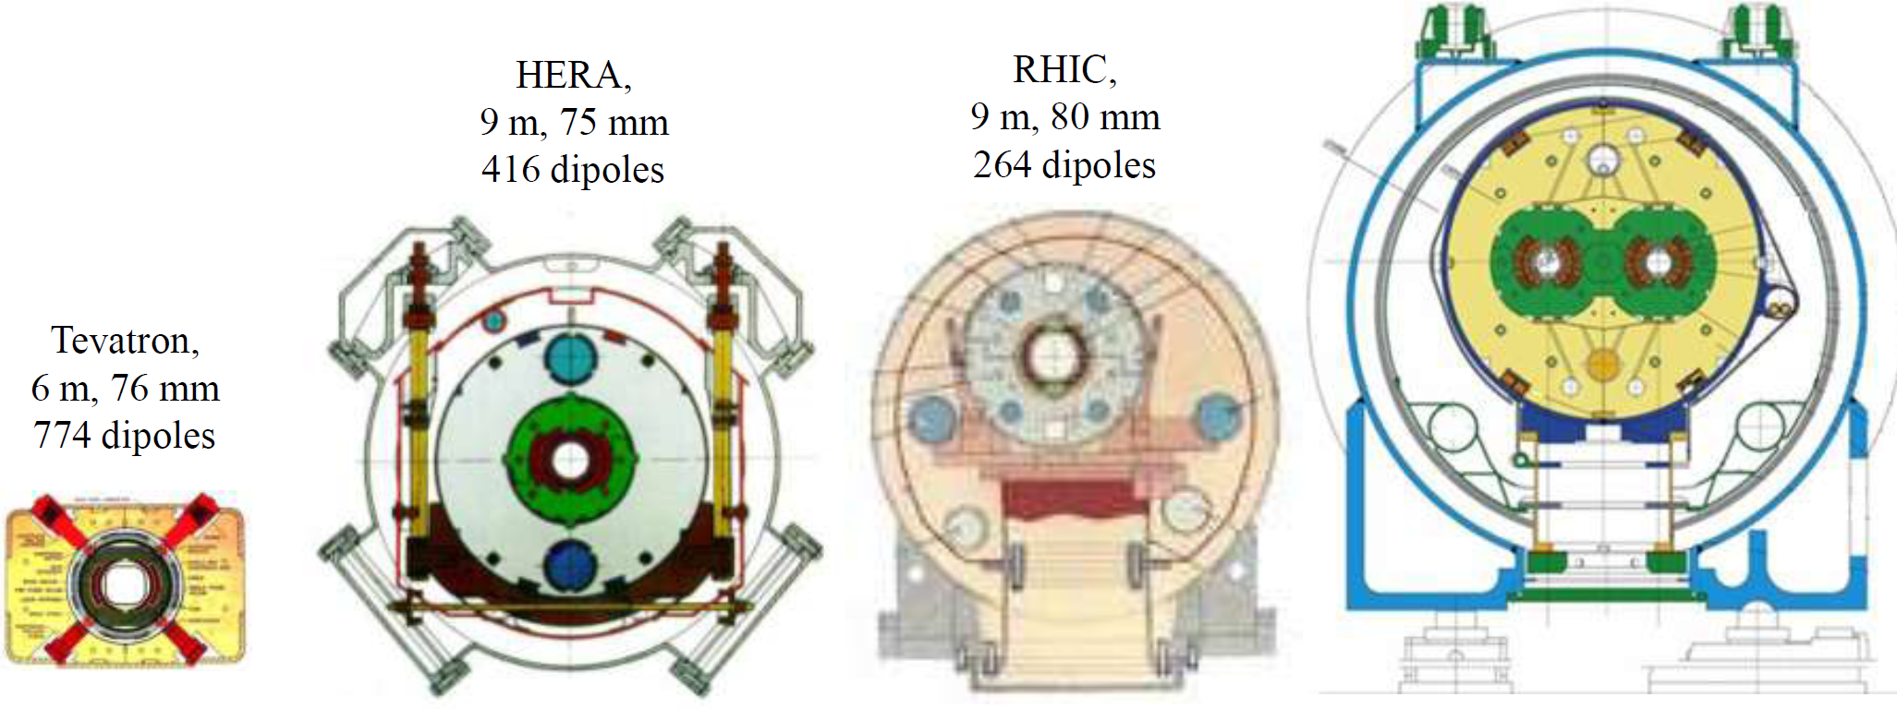
State of the Art SC Magnets: 3 Decades
8.3T
4.5T
5.3T
3.5T
4.5 K He, NbTi
+ warm iron small He-plant
NbTi cable
cold iron
Al collar
NbTi cable
simple &
cheap
NbTi cable
2K He
two bores

Slide 10
Accomplishment: IEEE Milestone Award
IEEE Board of Directors has approved a Milestone Award for the superconducting magnet system of the Tevatron
  “The IEEE Milestones program honors significant technical achievements in all areas associated with IEEE…Milestones recognize the technological innovation and excellence for the benefit of humanity found in unique products, services, seminal papers and patents.”
Ceremony at Fermilab planned for November 2017
Superconducting Magnet System for the Fermilab Tevatron Accelerator/Collider, 1983-1985
The first large-scale use of superconducting magnets enabled the construction of the Tevatron. By 1985, the Tevatron achieved energy above 1 Tera electron-volt (TeV) in proton-antiproton collisions, making it the most powerful particle collider in the world until 2009. The Tevatron construction established the superconducting wire manufacturing infrastructure that made applications such as Magnetic Resonance Imaging (MRI) viable.

Slide 11
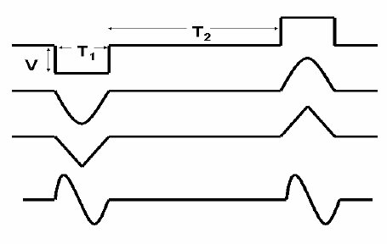
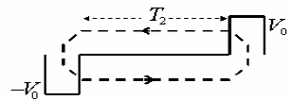
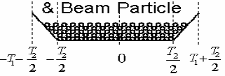
Fermilab Invention: RF Barrier Bucket
Broad band ~1kV RF, ferrite loaded
J. Griffin, FNAL 1983

Slide 12
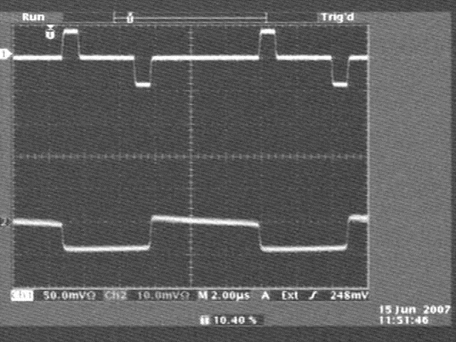
Technology: Pbar Momentum Mining in the RR for Collider Runs
Ch1=Barrier Waveform,
Ch2= Beam-WCM
Development would have been impossible without very sophisticated digital LLRF controls (B. Chase)

Slide 13
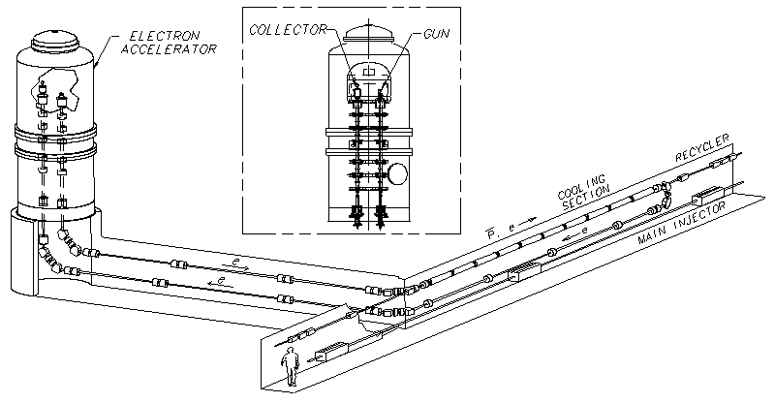
The Fermilab Electron Cooling System
Design parameters of the RR ECool
  Energy 4.3 MeV
  Beam current (DC) 0.5 Amps
  Angular spread 0.2 mrad
  Effective energy
  spread 300 eV
Electron beam power:
  4 MeV × 0.5 A = 2 MW DC
    Energy recovery scheme
    Very low beam losses are required
Beam quality:
  Transverse electron beam temperature (in the rest frame) should be comparable to the cathode temperature ~1400K
Development: 1996-2004
  Operations: 2005 – 2011

Slide 14
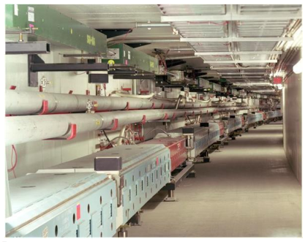
The Recycler (top) and the Main Injector (bottom)
rings installed in a common tunnel, 3.3 km long.
Gradient Dipole
Quadrupole
Dipole
Both rings are now used to deliver 700-kW beams
for neutrino experiments

Slide 15
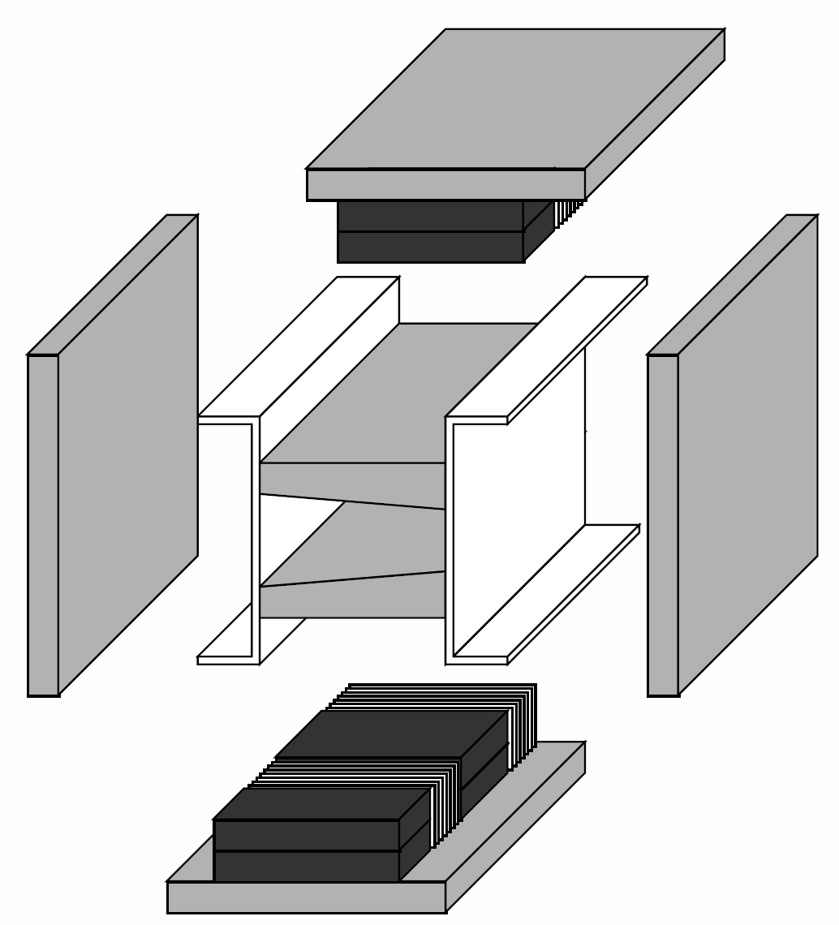
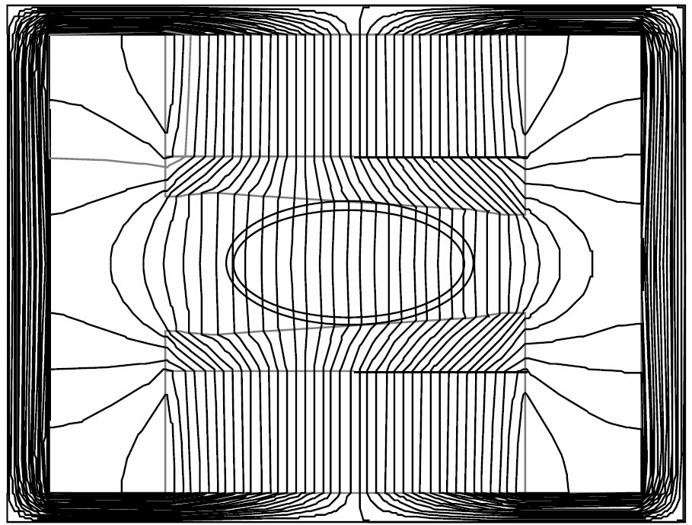
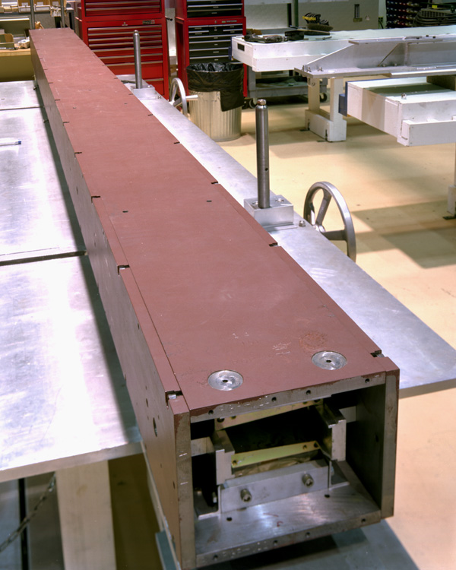
Recycler Permanent Magnets 1.5 T: ~2 km long
Sr-Fe + iron poles
B_max=1.45T
combined function
T-compensation
dB/B~0.01%

Slide 16
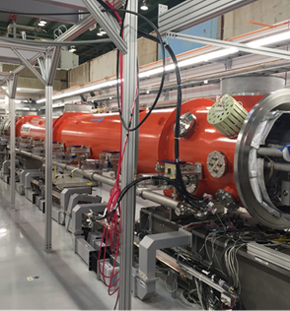
Fermilab SRF science and technology
R&D program is world leader in SRF science; pursuing fundamental understanding and “materials science” of SRF surfaces
Pioneered the most important latest advances in SRF such as N doping, N infusion, Magnetic Flux expulsion/retention
Great partnerships with other lab and university groups around the world
  Partner lab in the LCLS-II project at SLAC
CM03 at CMTS

Slide 17

FAST/IOTA at Fermilab
  Electrons and protons
  Ring and linacs
  SRF and nonlinear magnets
  Accelerator Science topics:
    Nonlinear beam dynamics
    Space-charge compensation with electron lenses and electron columns
    Optical stochastic cooling
    Radiation and phase-space manipulation in dense electron bunches
    Laser plasma wakefield injector for IOTA

Slide 18
Welcome to Fermilab!

