Slide 1
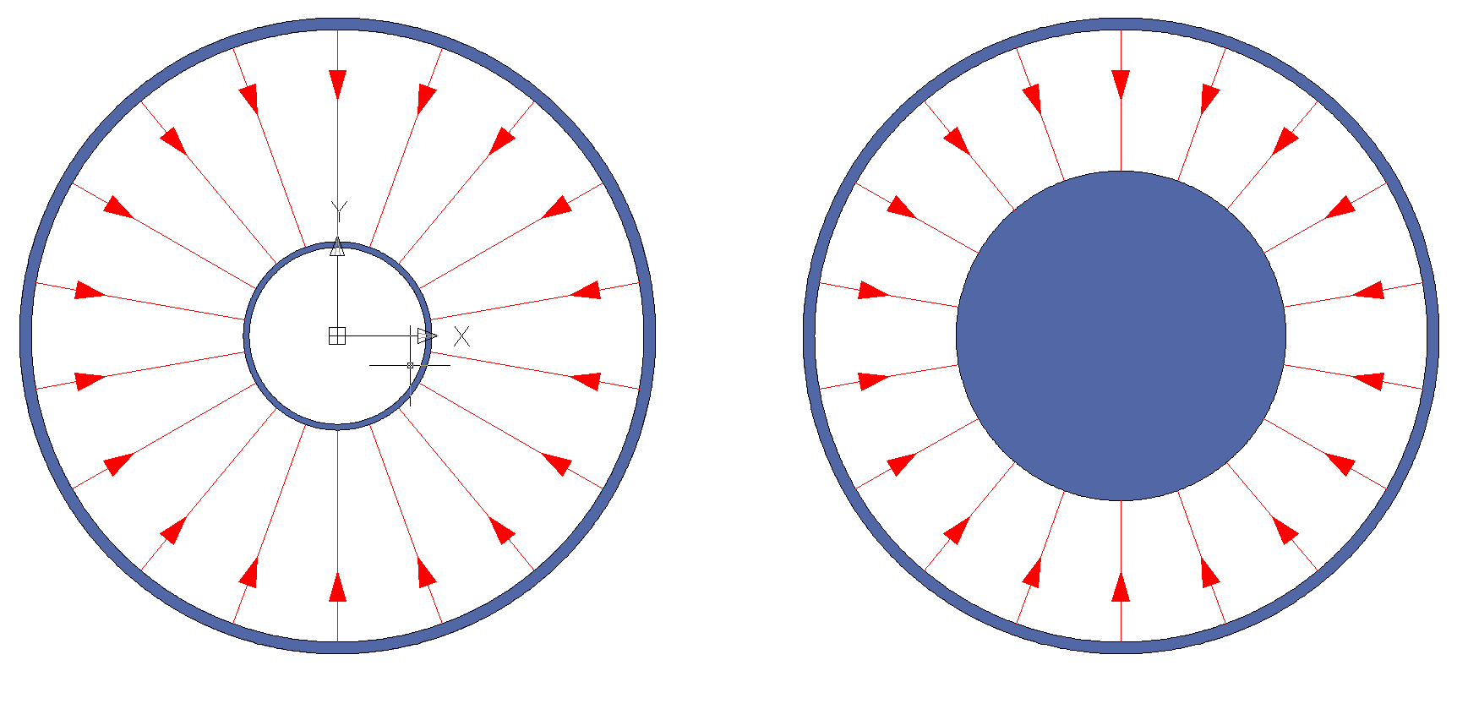
Dielectric strengths for Cables and HVFT UHMW PE
HV cable (Type 1): rated for 300kV, D(in conductor) = 2.25mm, D_{out}(dielectric material) = 19.3mm
Maximum E-field @ 300kV = 1241 kV/cm
HV cable (Type 2): rated for 320kV, D(in conductor) = 6.6mm, D_{out} (dielectric material) = 32.5mm
Maximum E-field @ 300kV = 570 kV/cm
Cable 1
(in use at present for the 311)
Cable 2 (X-Ray 2236)
(foreseen for the 666)
HVFT. Material : UHMW - PE 1000. Dielectric constant = 2.3, Dielectric strength = 450 kV/cm
D_{in} = 32mm – 56mm, D_{out} = 104mm
Maximum E-field @ 300kV = 173.1 kV/cm - 159.1 kV/cm
Maximum E-field @ 600kV = 346.2 kV/cm - 318.2 kV/cm
Laura MB & Franco

Slide 2
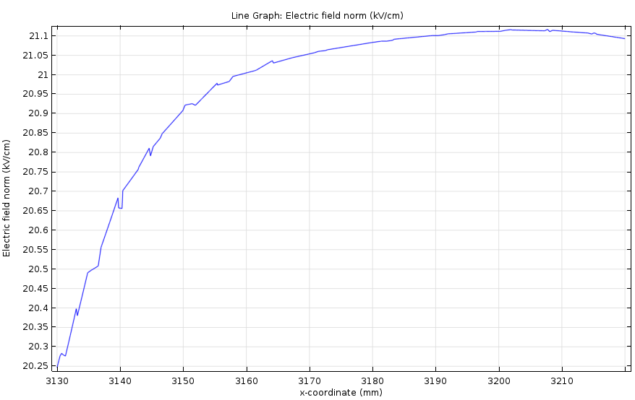
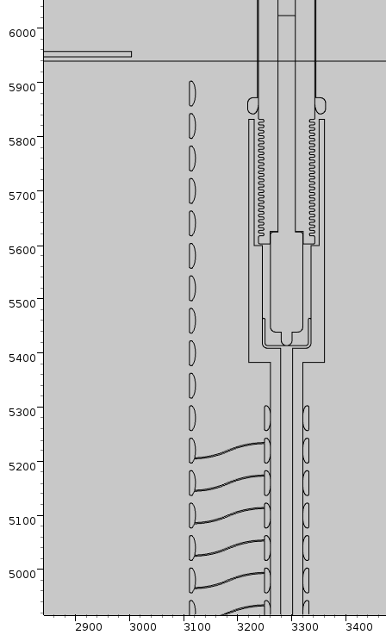
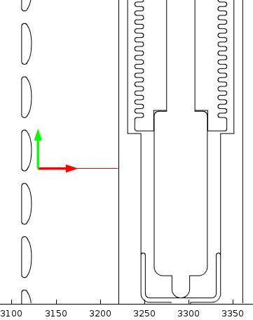
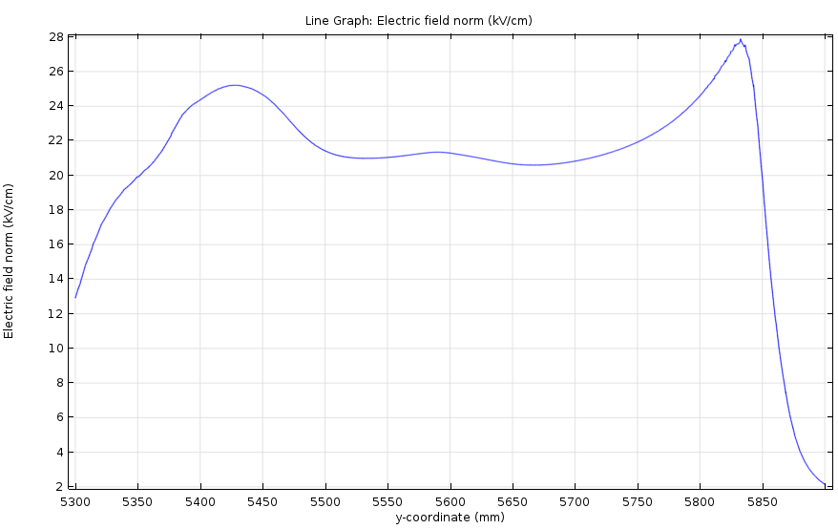
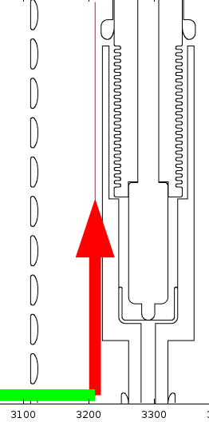


Field cage + HVFT
Simulations performed at 300 kV!
Y [mm]
x [mm]
x [mm]
Laura MB & Franco

