Slide 1
Technical Board Meeting, 5/7/2017

Slide 2
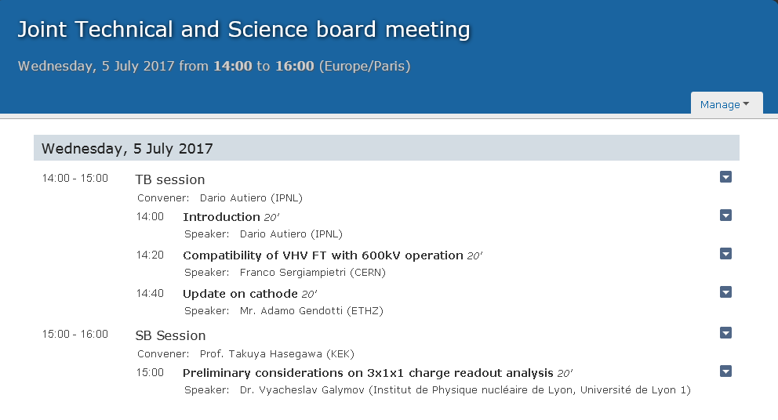

Slide 3
TB Session:
Finalization of cathode design and compatibility with 600 kV operation
Past discussions at TB meetings concerning the VHFT (Franco), Field Cage (→ voltage divider boards compatible with 600 kV: Jae,Animesh) and cathode design (Adamo, Laura) and also at the Technical Design Review
Issue concerning the finalization of cathode design for 600 kV raised at last integration meeting
Presentation by Franco recalling aspects related to the compatibility of the HVFT with 600 kV
Update by Adamo on cathode design
Lists of deliverables for construction of 10kton requested in the consortia meeting
(see https://indico.fnal.gov/conferenceDisplay.py?confId=14751)
Draft lists ready for CRP, FE electronics, DAQ, HV/FieldCage/Cathode
Se attached files to this presentation on this INDICO page
Lists under work for Photon Detection System and Slow Control

