Slide 1
Resource Loaded Schedule Status
Luisella Lari
PIP-II PMG meeting
26 July 2017
Thanks
To L3/L2 Managers,
To PIP-II Project Management Team

Slide 2
Outline
PIP-II RLS Status
PIP-II RLS News
PIP-II RLS Completion Strategy

Slide 3
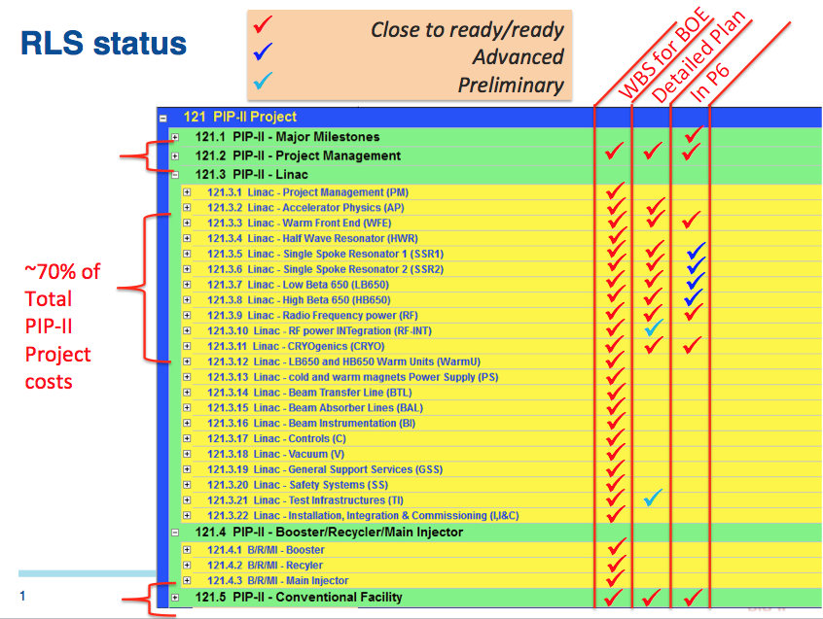
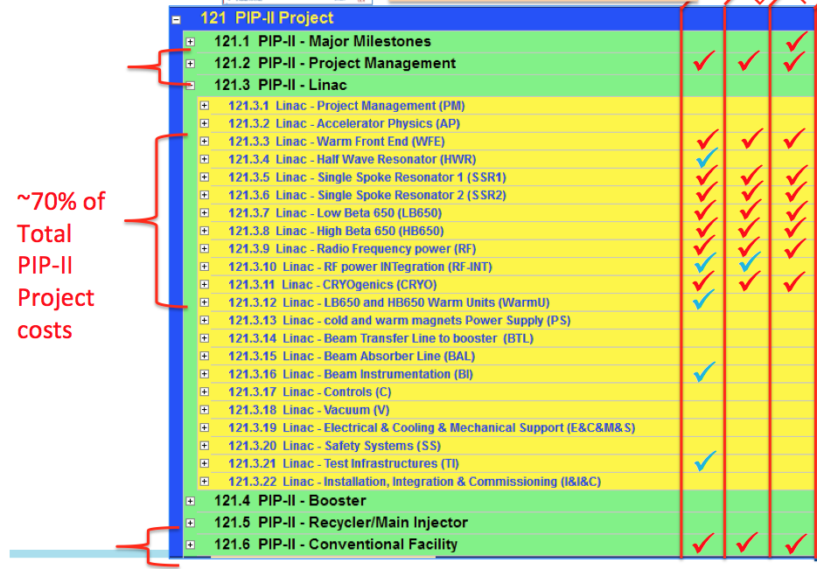
PIP-II RLS Status
PMG June 2017

Slide 4
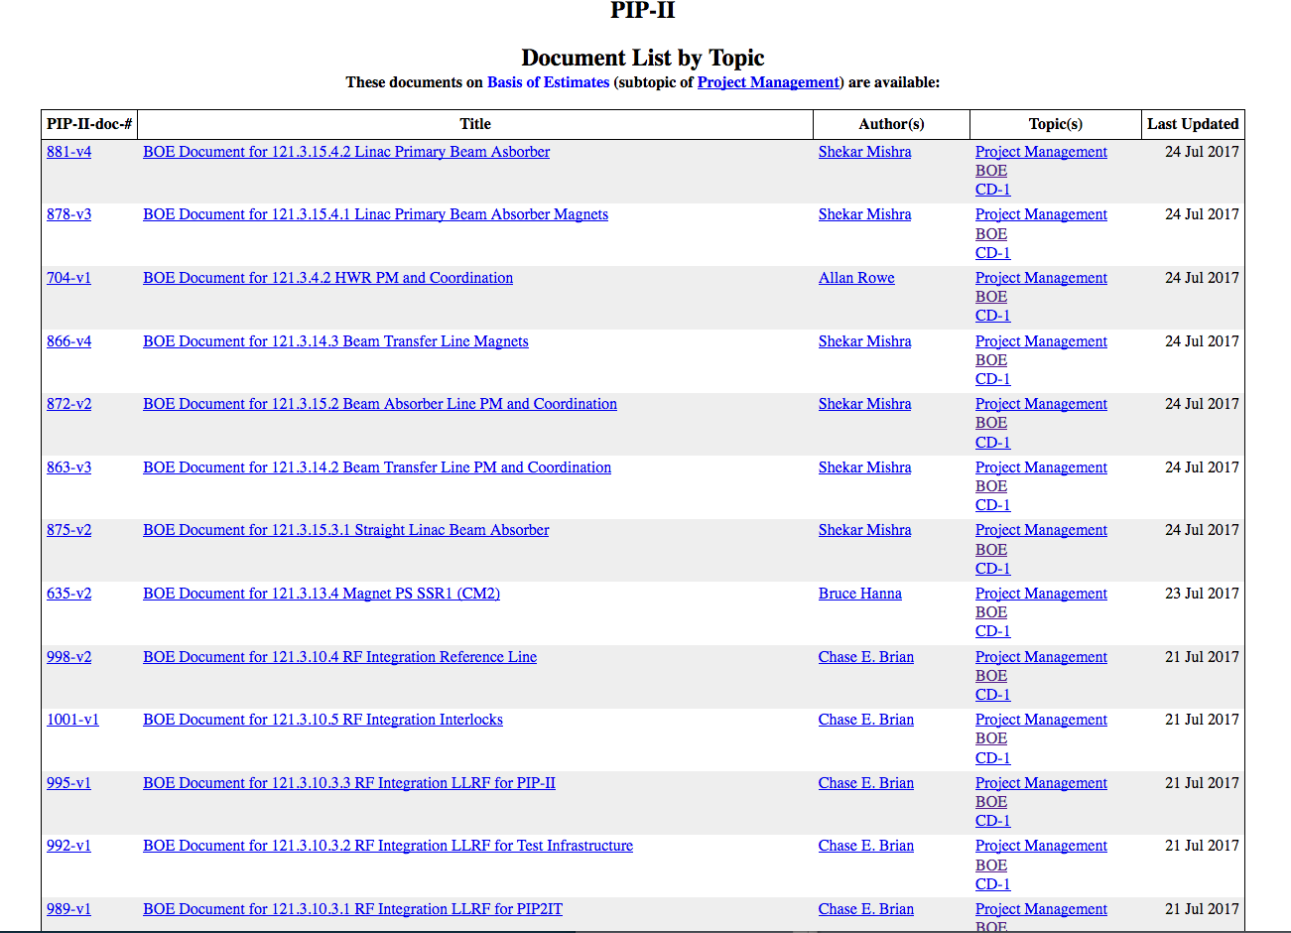
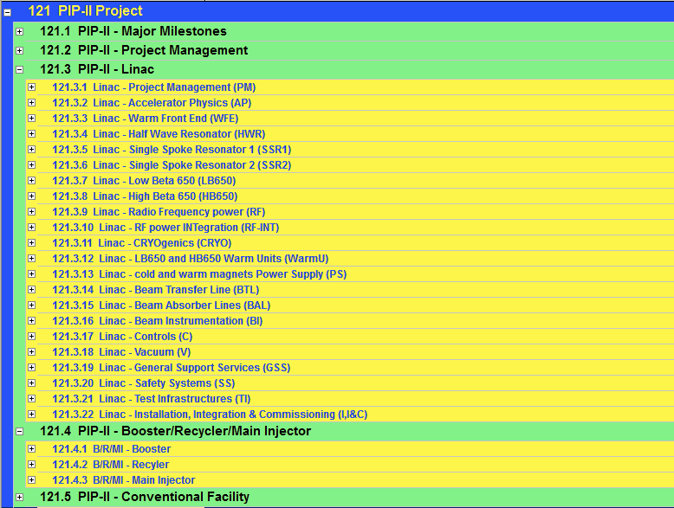
PIP-II RLS News (1/3)
Booster & Recycler and Main injector collapse to one L2 sub-project followed the PIP-II Organization Chart (i.e. one L2 Manager for both).
WBS implementation in P6 for all the sub-projects is in progress.
About 150 docs
Checked and Aligned to standard In P6

Slide 5
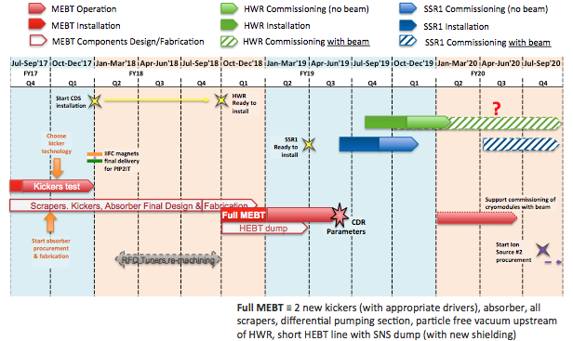
PIP-II RLS News (2/3)
RF Power SWF integrated in P6.
Strategy Defined for the Critical path depending by PIP2IT → CMs RLS alignment in progress
thanks to L. Prost, P. Derwent, A. Rowe, J. Steimel et al.

Slide 6
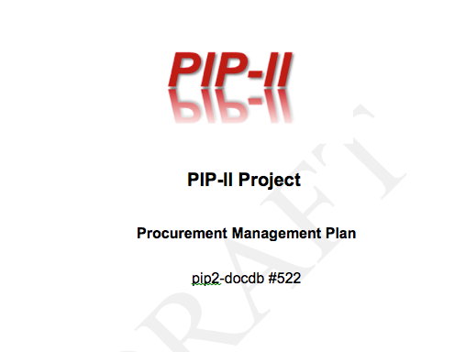
PIP-II RLS News (3/3)
Revised the numbers of Major (> 5 M$), Significant (> 0.5 M$) and Critical contracts.
Reminder: For PIP-II a Critical procurement is defined as a procurement that satisfies one or more of the following criteria:
    Procurement actions that require complex evaluation systems;
    Procurements that have high technical, cost, or schedule risk;
PMG May 2017
Major | 8
Significant | 25
Critical | 68
Total | 101
Major | 9
Significant | 20
Critical | 59
Total | 88

Slide 7
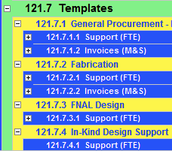
PIP-II RLS completion strategy
Definition of your WBS to level 5. Due July 14.
Definition of schedule durations at WBS level 5. Due July 31.
Completion of draft BOEs with supporting documentation, in docdb. Due July 31.
7-10 day iterative process with management after this, to get to approval by August 14.
Technically limited RLS complete by August 14.
After August 14 we align RLS with the funding profile.

Slide 8
PIP-II RLS Funding Profile
Cost Profile
PMG June 2017

