Slide 1
Week 1: Shutdown 2017
Cons Gattuso

Slide 2
July 14th Friday
13:00-15:00 MI LCW going off
Sometime week 4-5 Booster LCW system may be turned off for 1-2 days for the final isolation
09:00 Meetings
Week 1
Friday July 14th – One West
Week 2 + (starting July 18th )
Tuesdays and Fridays
Tuesday July 18th Curia II

Slide 3
Power/Controls outage reminder for this week
Saturday 7/15/17 6:00 am – Sunday 7/16/17 18:00 pm
CUB outage
Saturday Electrical
Sunday Mechanical
Controls outage
Sunday 7/16/17 07:00- 16:00 hr
X- Gallery
Linac L4 and L5
On Saturday July 15th at 6:00am the XGC-108 computer room will be powered off for cooling (CUB) and transformer maintenance.
The power will be restored on Sunday afternoon.
This means no access to ACNET control system, no access to Accelerator Division servers and no WiFi in Accelerator Division areas during this time.
Full restoration of services is expected about 3 hours after power is returned.

Slide 4
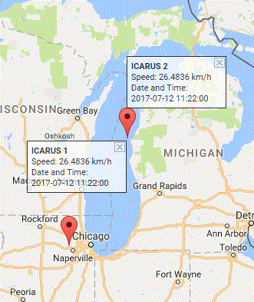
Road Closure/Limited access
Crane Usage
July 15th (Saturday)
F0 (Q703 ) and F1 (HVF12) transformer swop out MI-60 RR anode
August 5th (Saturday)
AP30 Transformer change out maybe 10 as well
Most like require road closure
ICARUS
Detector Delivery
Week of July 17th or
24th.
Coming in from MI
Construction entrance

Slide 5
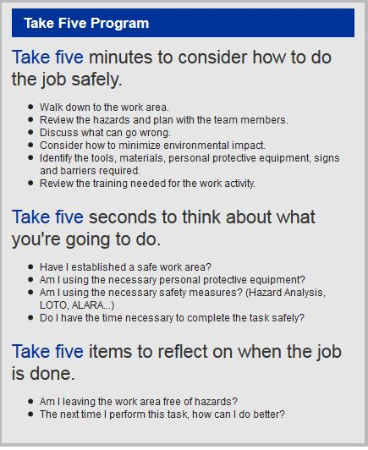
Remember !!!

