Slide 1
NuMI Shutdown Activity Summary
Week #1
Marty Murphy
09:00 Operations Scheduling Meeting
14 July 2017

Slide 2
Tasked Completed During Week-1
Opened Target Hall Wall
Repaired cracked nipple on LCW supply manifold in Pre-Target enclosure near Q115;
  Filling and restarting MI62 LCW system today.
Repaired cracked weld on Decay Pipe RAW system in Absorber Hall.
  Waiting on DI Water to fill system.
  PM of Target Pile fans and air filters replaced
Repaired broken belt on MI65 evaporation roof fan
Cranes inspected and electronics installed
Decay Pipe Vacuum skid PM.
BNB Spare Horn Pulsing complete – thanks for the water!
Installing cameras in Target Hall & Stripline inspections
Prepare for weekend CUB outage
Ate doughnuts

Slide 3
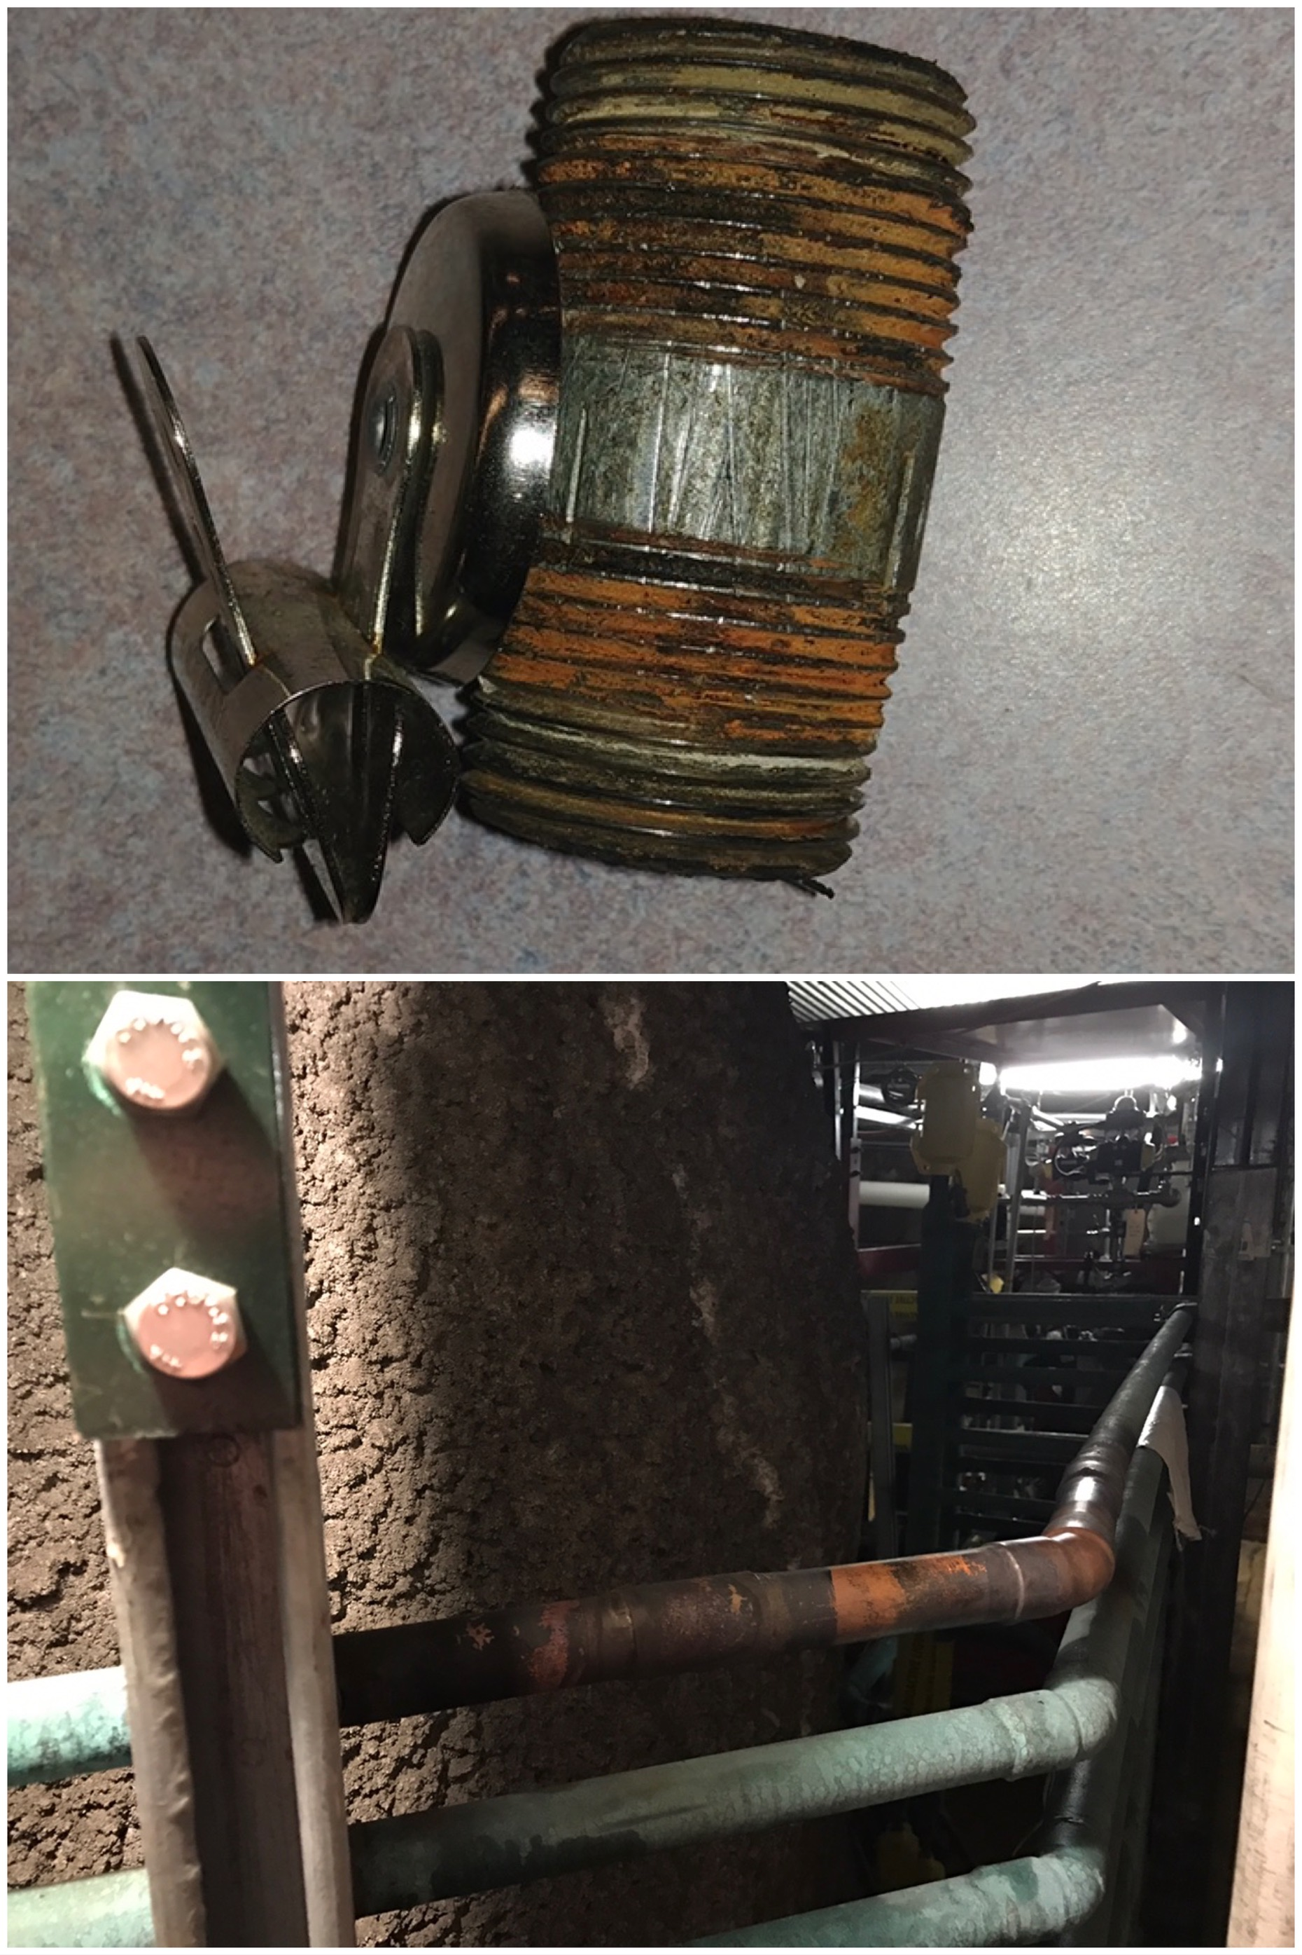
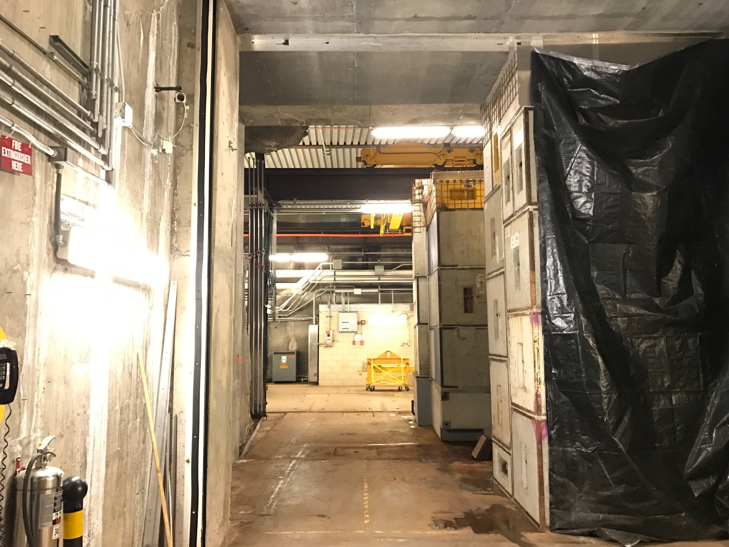
Pictures
Open Wall to Target Hall
Top: Cracked nipple on LCW supply manifold near Q115.
Bottom: Newly installed copper pipe in Decay Pipe RAW skid

Slide 4
Plan for Week-2
Remove morgue blocks and complete MET-01 radiation survey.
PM Absorber Hall Munter dehumidifiers.
MI65 elevator Maintenance Wednesday (July 19) afternoon.
PM on Target Hall Chase Munter Dehumidifier units.

Slide 5
Upcoming Jobs for T&M or Alignment
Week-3 (July 21): Electricians for Target Hall cable pulls
Week-7 (August 21):
  As-Found alignment of H1, H2 and Target.
  Multistack chiller heat exchanger installation – Fitters.

