Slide 1
Proton Source Week 1
Joe Compton
9am Meeting
7/14/2017

Slide 3
RIL/Linac
RIL
Sources will be turned off today
Inspected & cleaned
Testing new gas valves and pulsers
Testing Einzel lens to determine if it is causing interference with the Laser Notcher computer
Linac
Disassembly of LRF2 in progress
Wiring and labeling taking place
Cabinet walls down
Fluids group performing maintenance of water skids
Two parking spots at Linac north gallery will be occupied with dumpsters starting on Monday

Slide 4
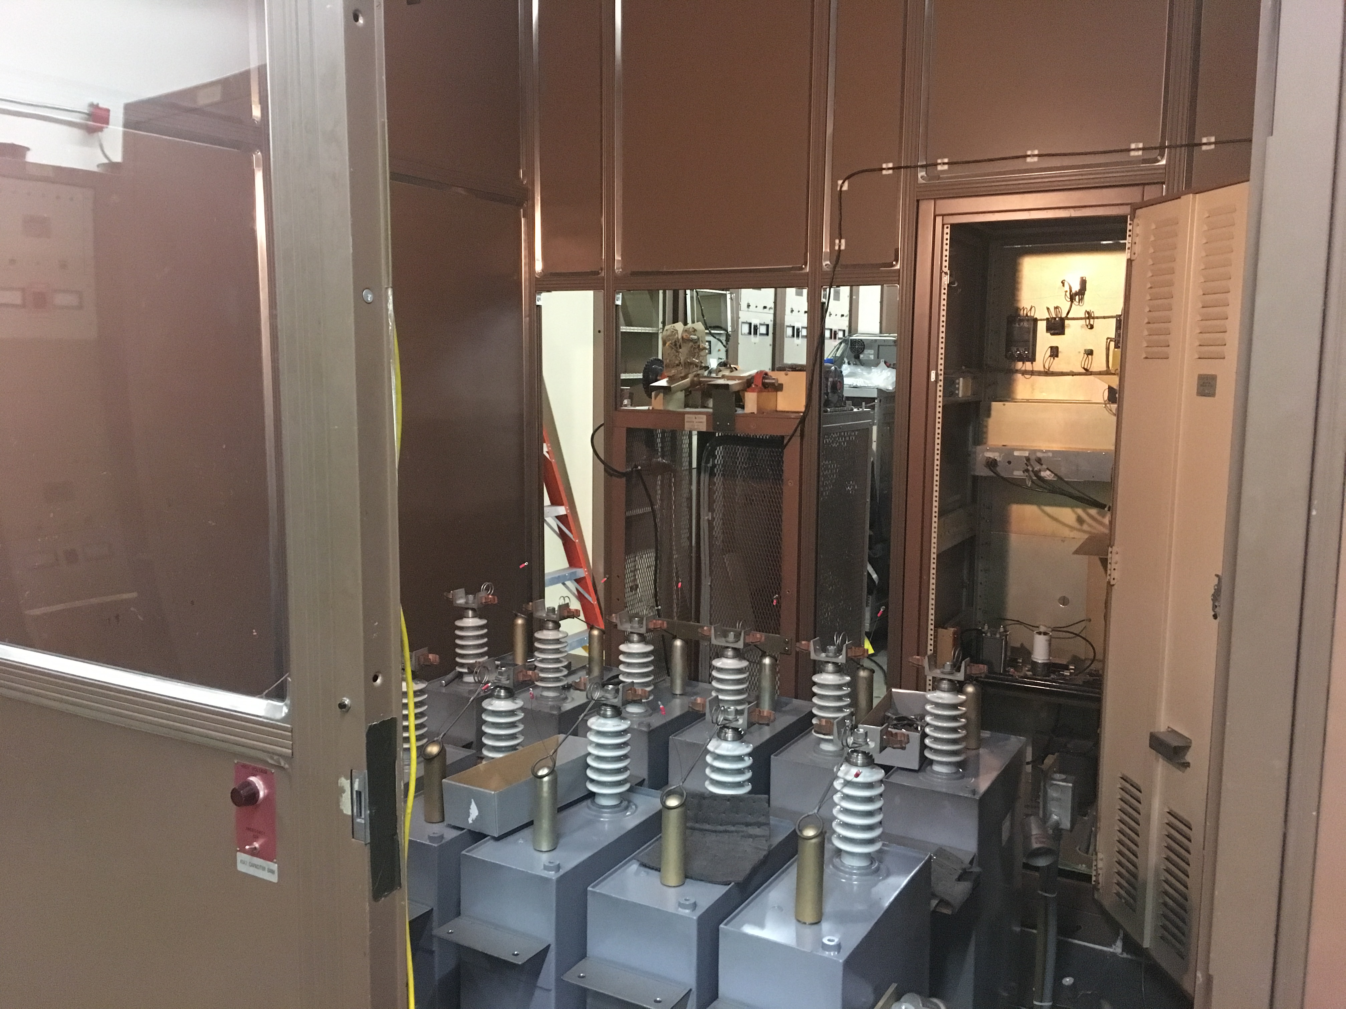
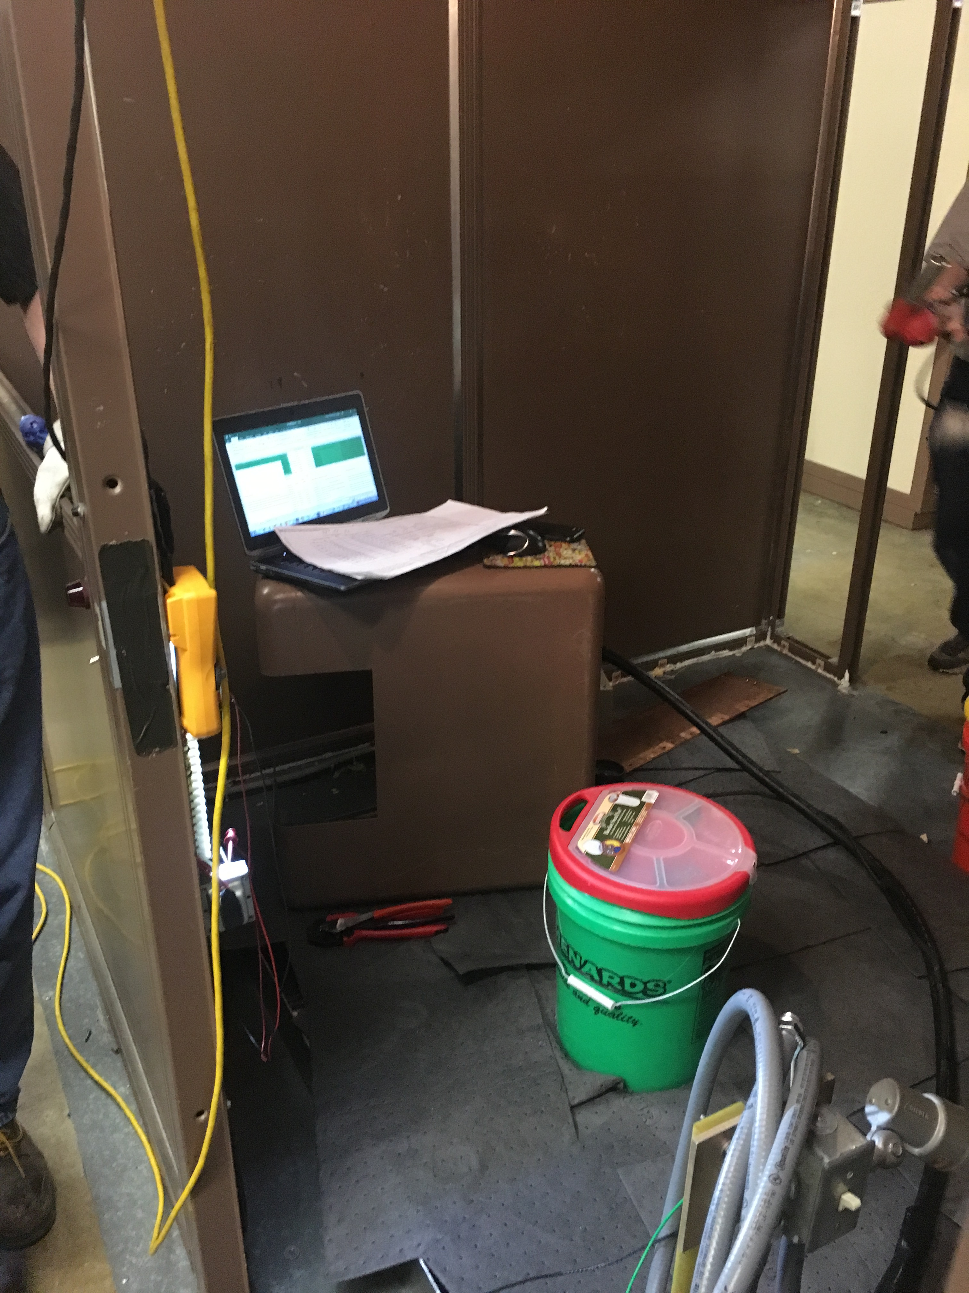
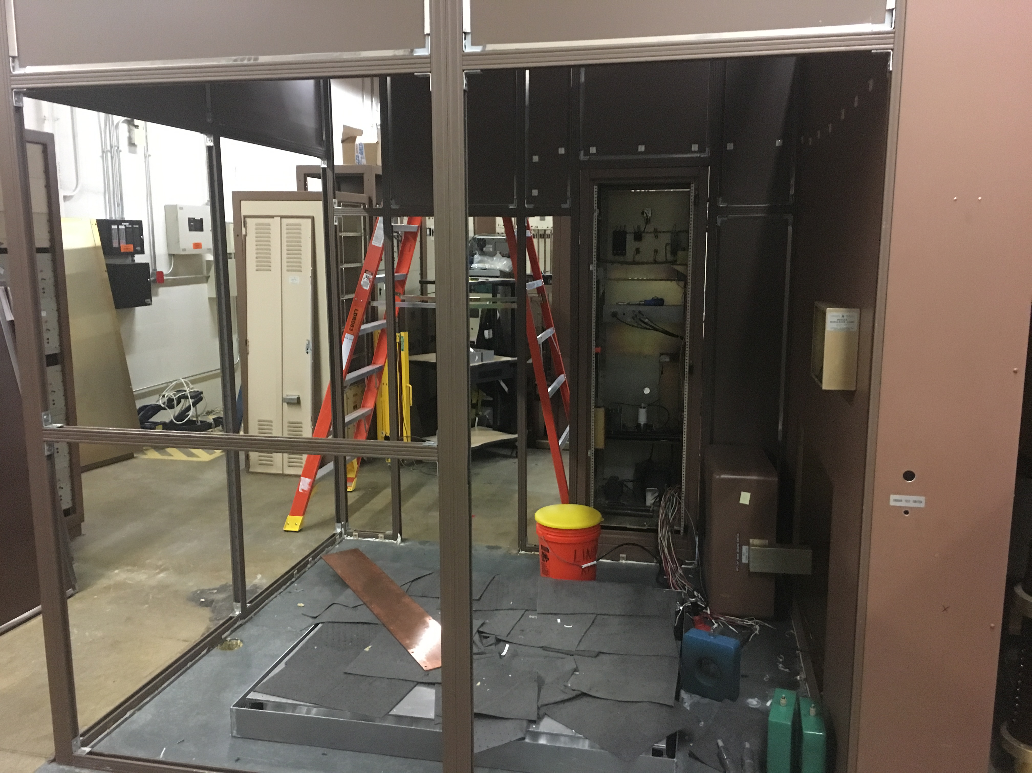
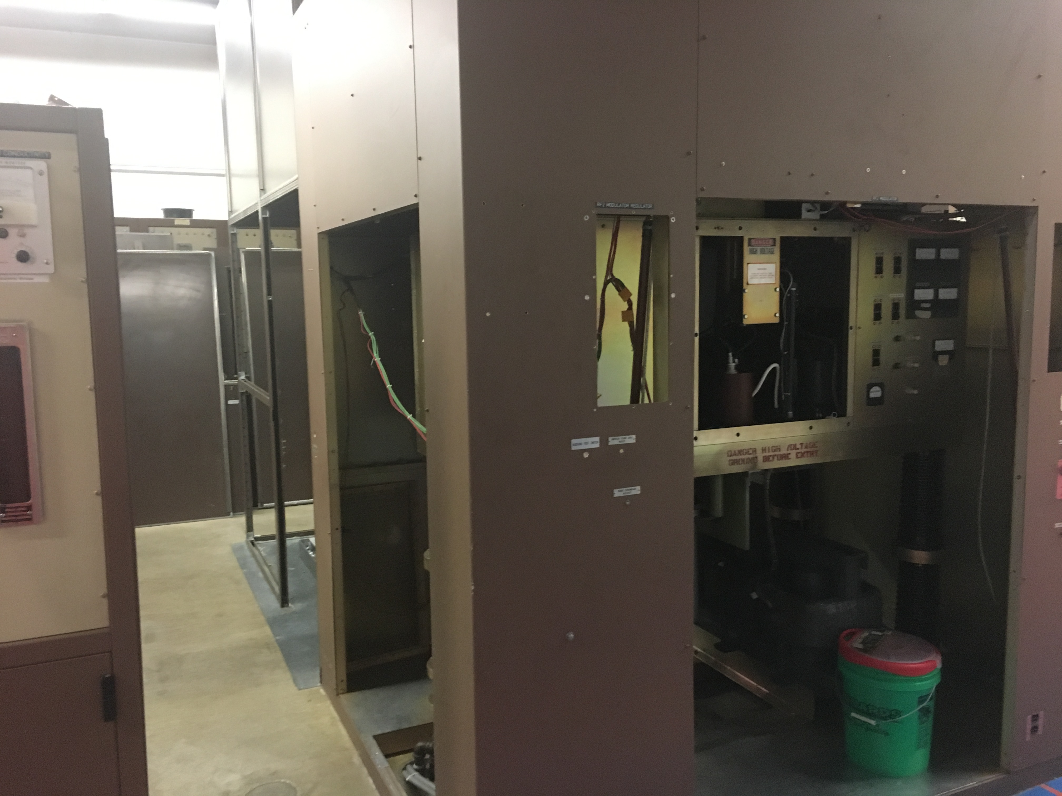
LRF2 Disassembly

Slide 5
Booster
RF pulse testing this week
Prepping PS room for station BRF22
Cavity for BRF22 testing at MI-60
One week
Kicker tube characterization studies ongoing
Correction element electrical measurements ongoing
Preparing for perpendicular RF cavity prep work
Cable pulls
Garnet test stand

