Slide 1
All Experimenter Meeting
7/17/17
Cons Gattuso

Slide 2
Shutdown Planning Guidance
Start Date
July 7th Friday
12:00 beam was turned off
July 10 Monday
Access to the tunnel commenced
Duration
~16 weeks duration
Turning on Week of October 23rd
1-2 Week of Start up/ Commissioning

Slide 3
Proton Source Shutdown Work list
RIL
Source maintenance
Einzel Lens maintenance
RFQ maintenance
General maintience
Linac
Marx modulator project -~8% Done
Fabrication and Testing underway
Planning to installed 2 modulator in 2017
Duration ~6-7 Weeks for the removal of old and installation of new
LE tasks (performed by Linac techs) ~40% Done
Modulator/driver maintenance
Inductrol maintenance
Water skid maintenance
HE tasks (performed by Linac techs) ~40% Done
CS & PFN maintenance
PFN cap bank maintenance
QPS PM
Water skid maintenance
Heat exchanger maintenance
Booster
BRF21 and BR22 installation ~6-8 weeks
IPM Installation
Controls Rack installation
Tunnel component installation
General Maintenance
Power supplies
Cooling Systems
Vacuum
~10% Done
~10% Done

Slide 4
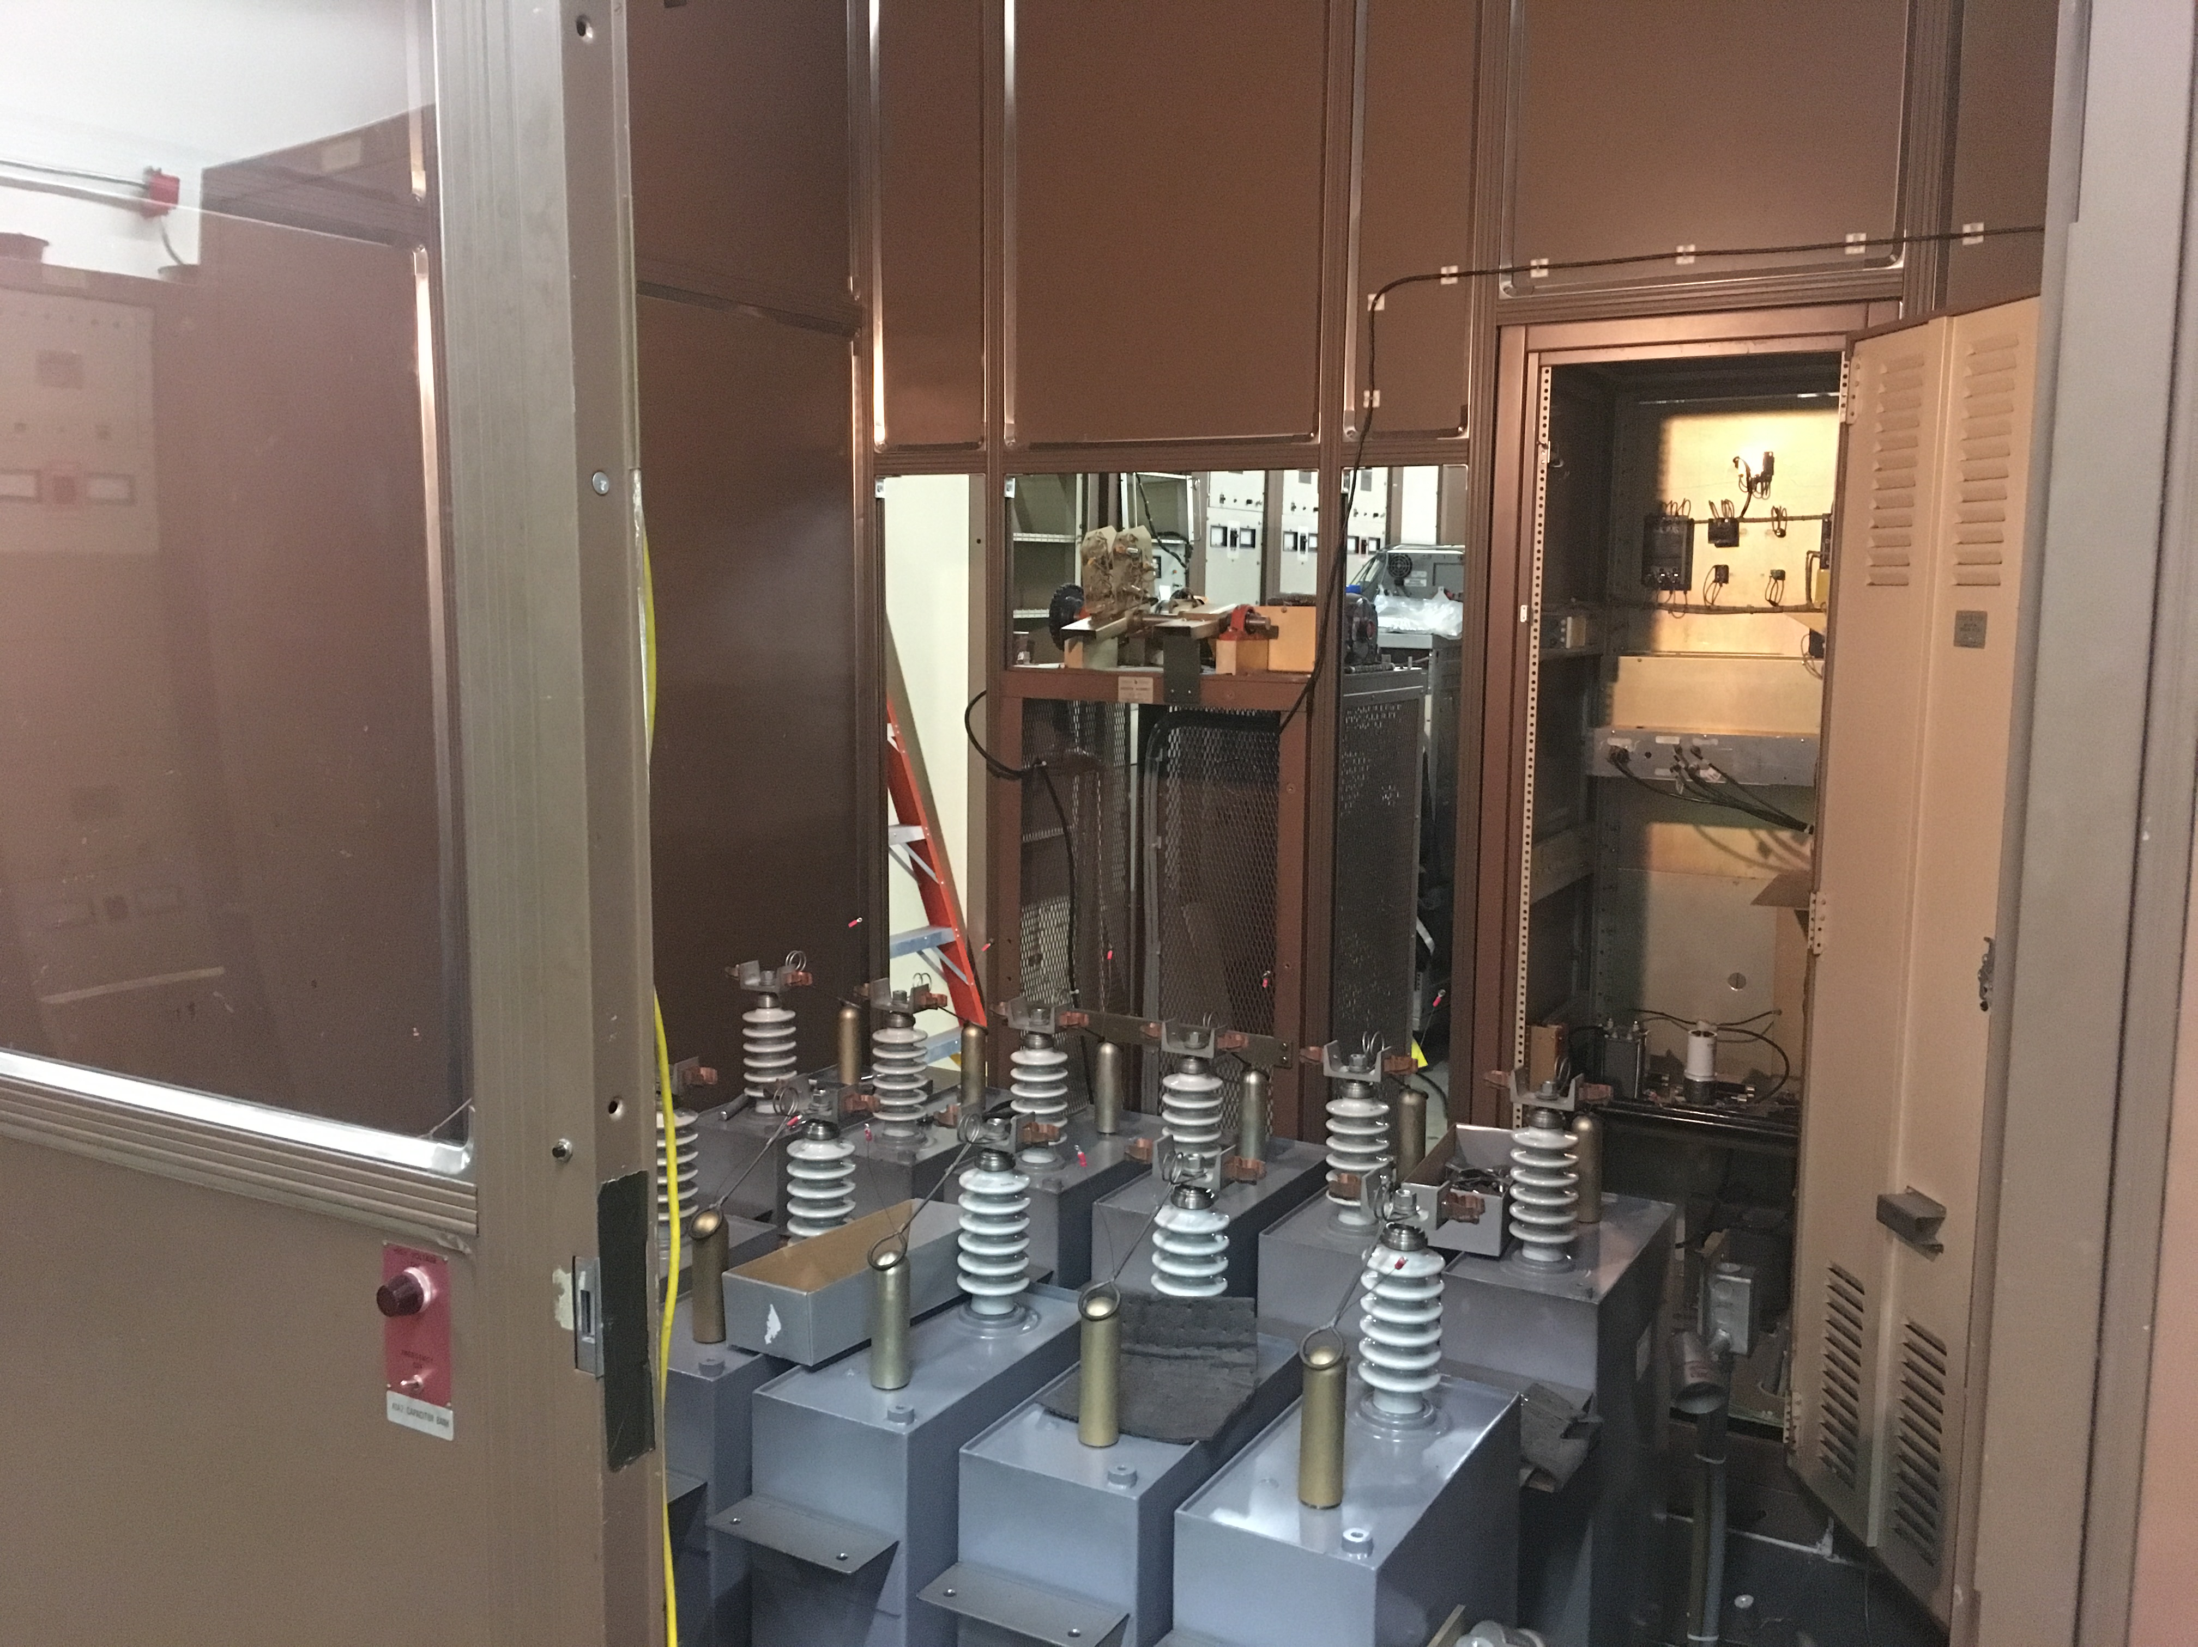
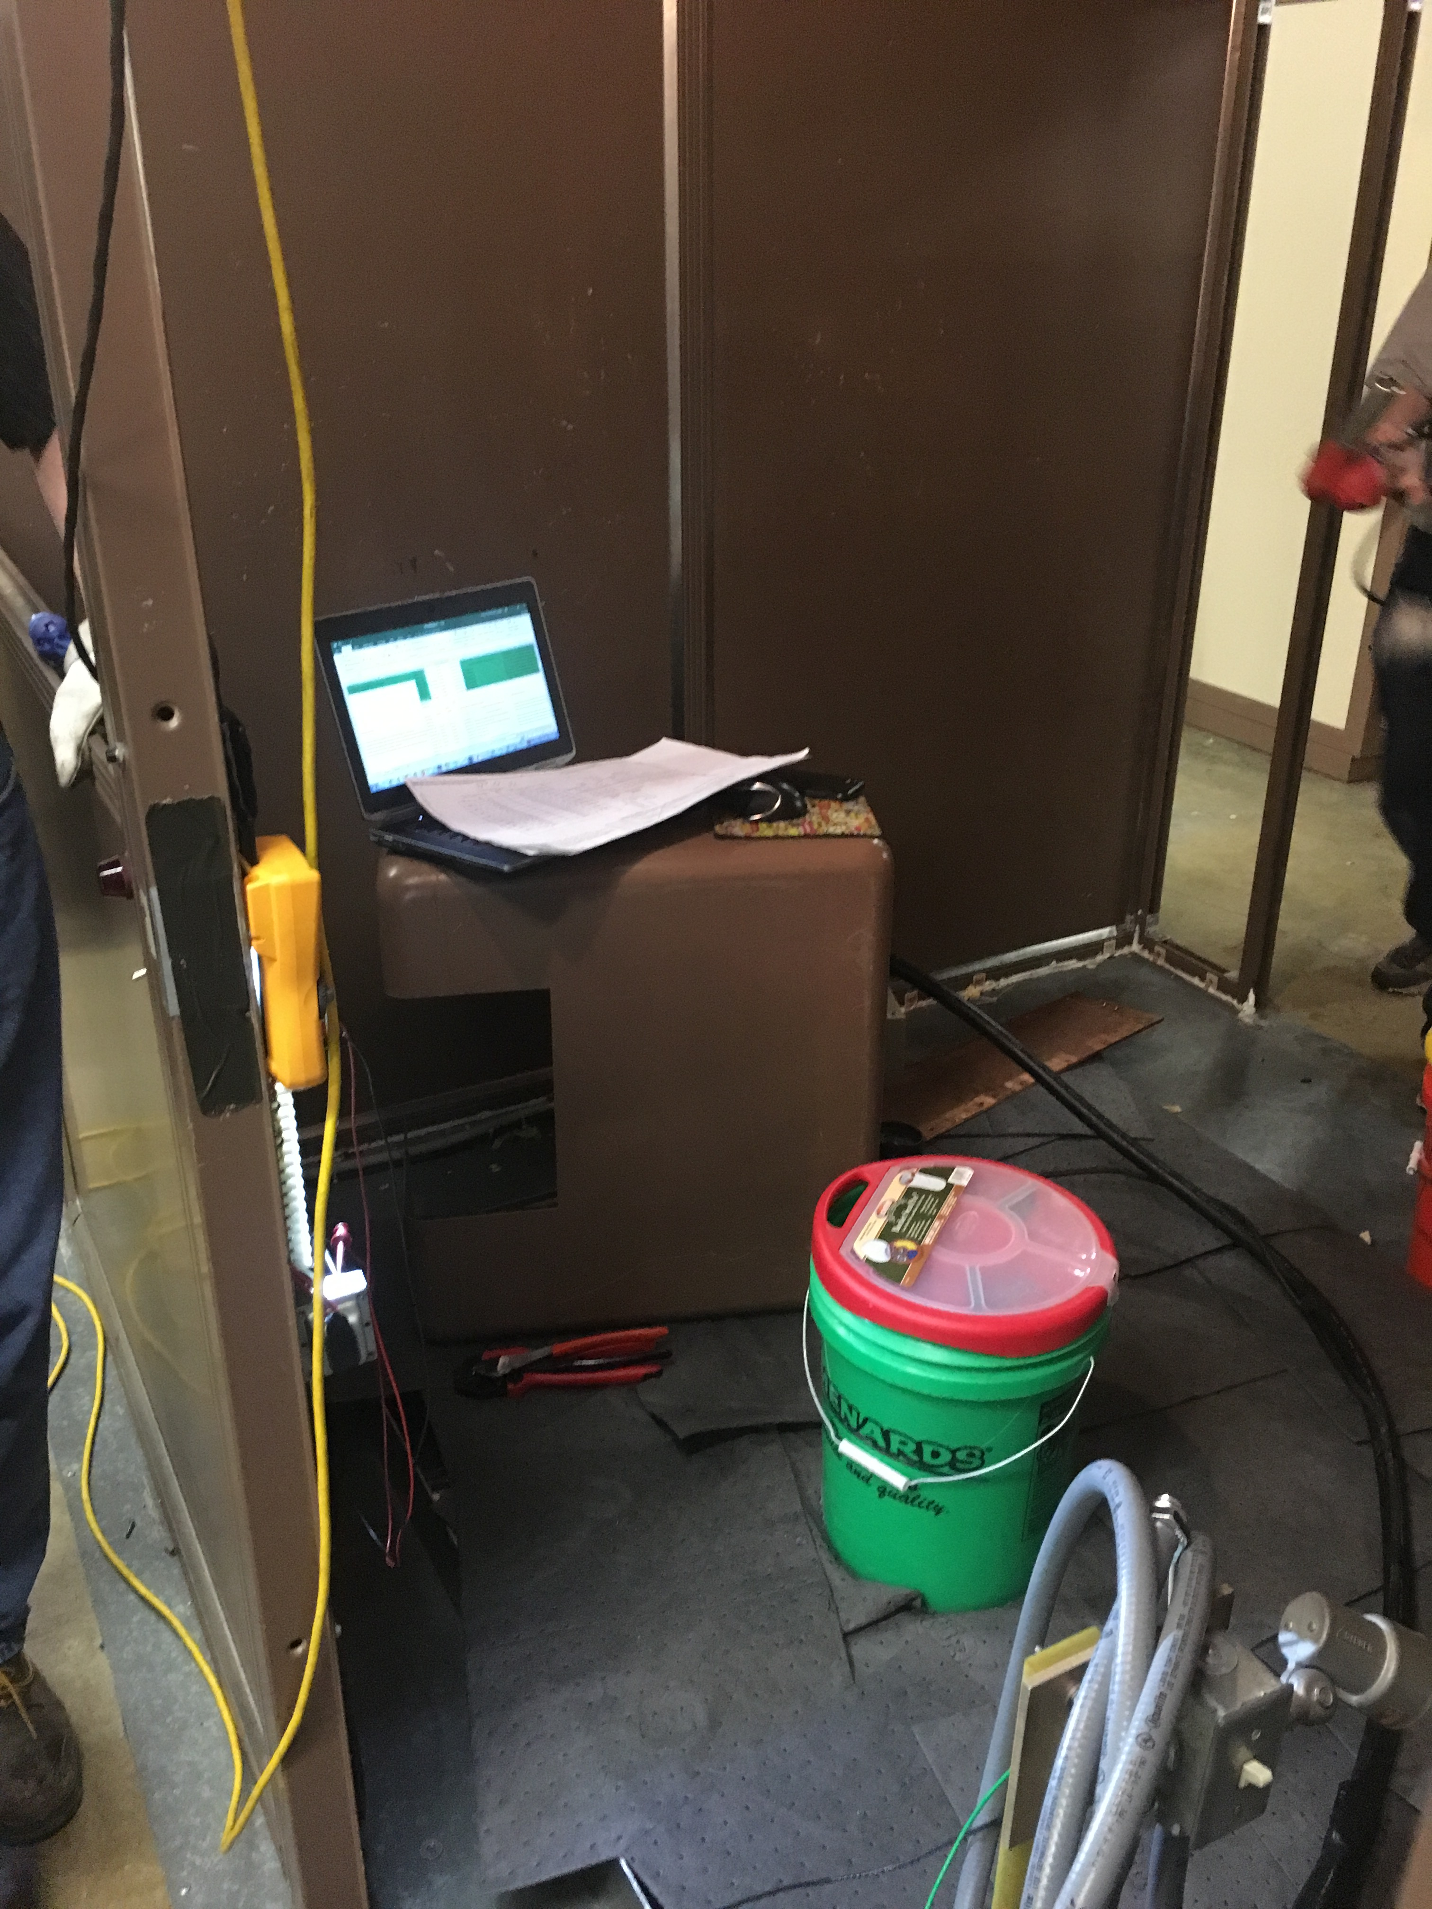
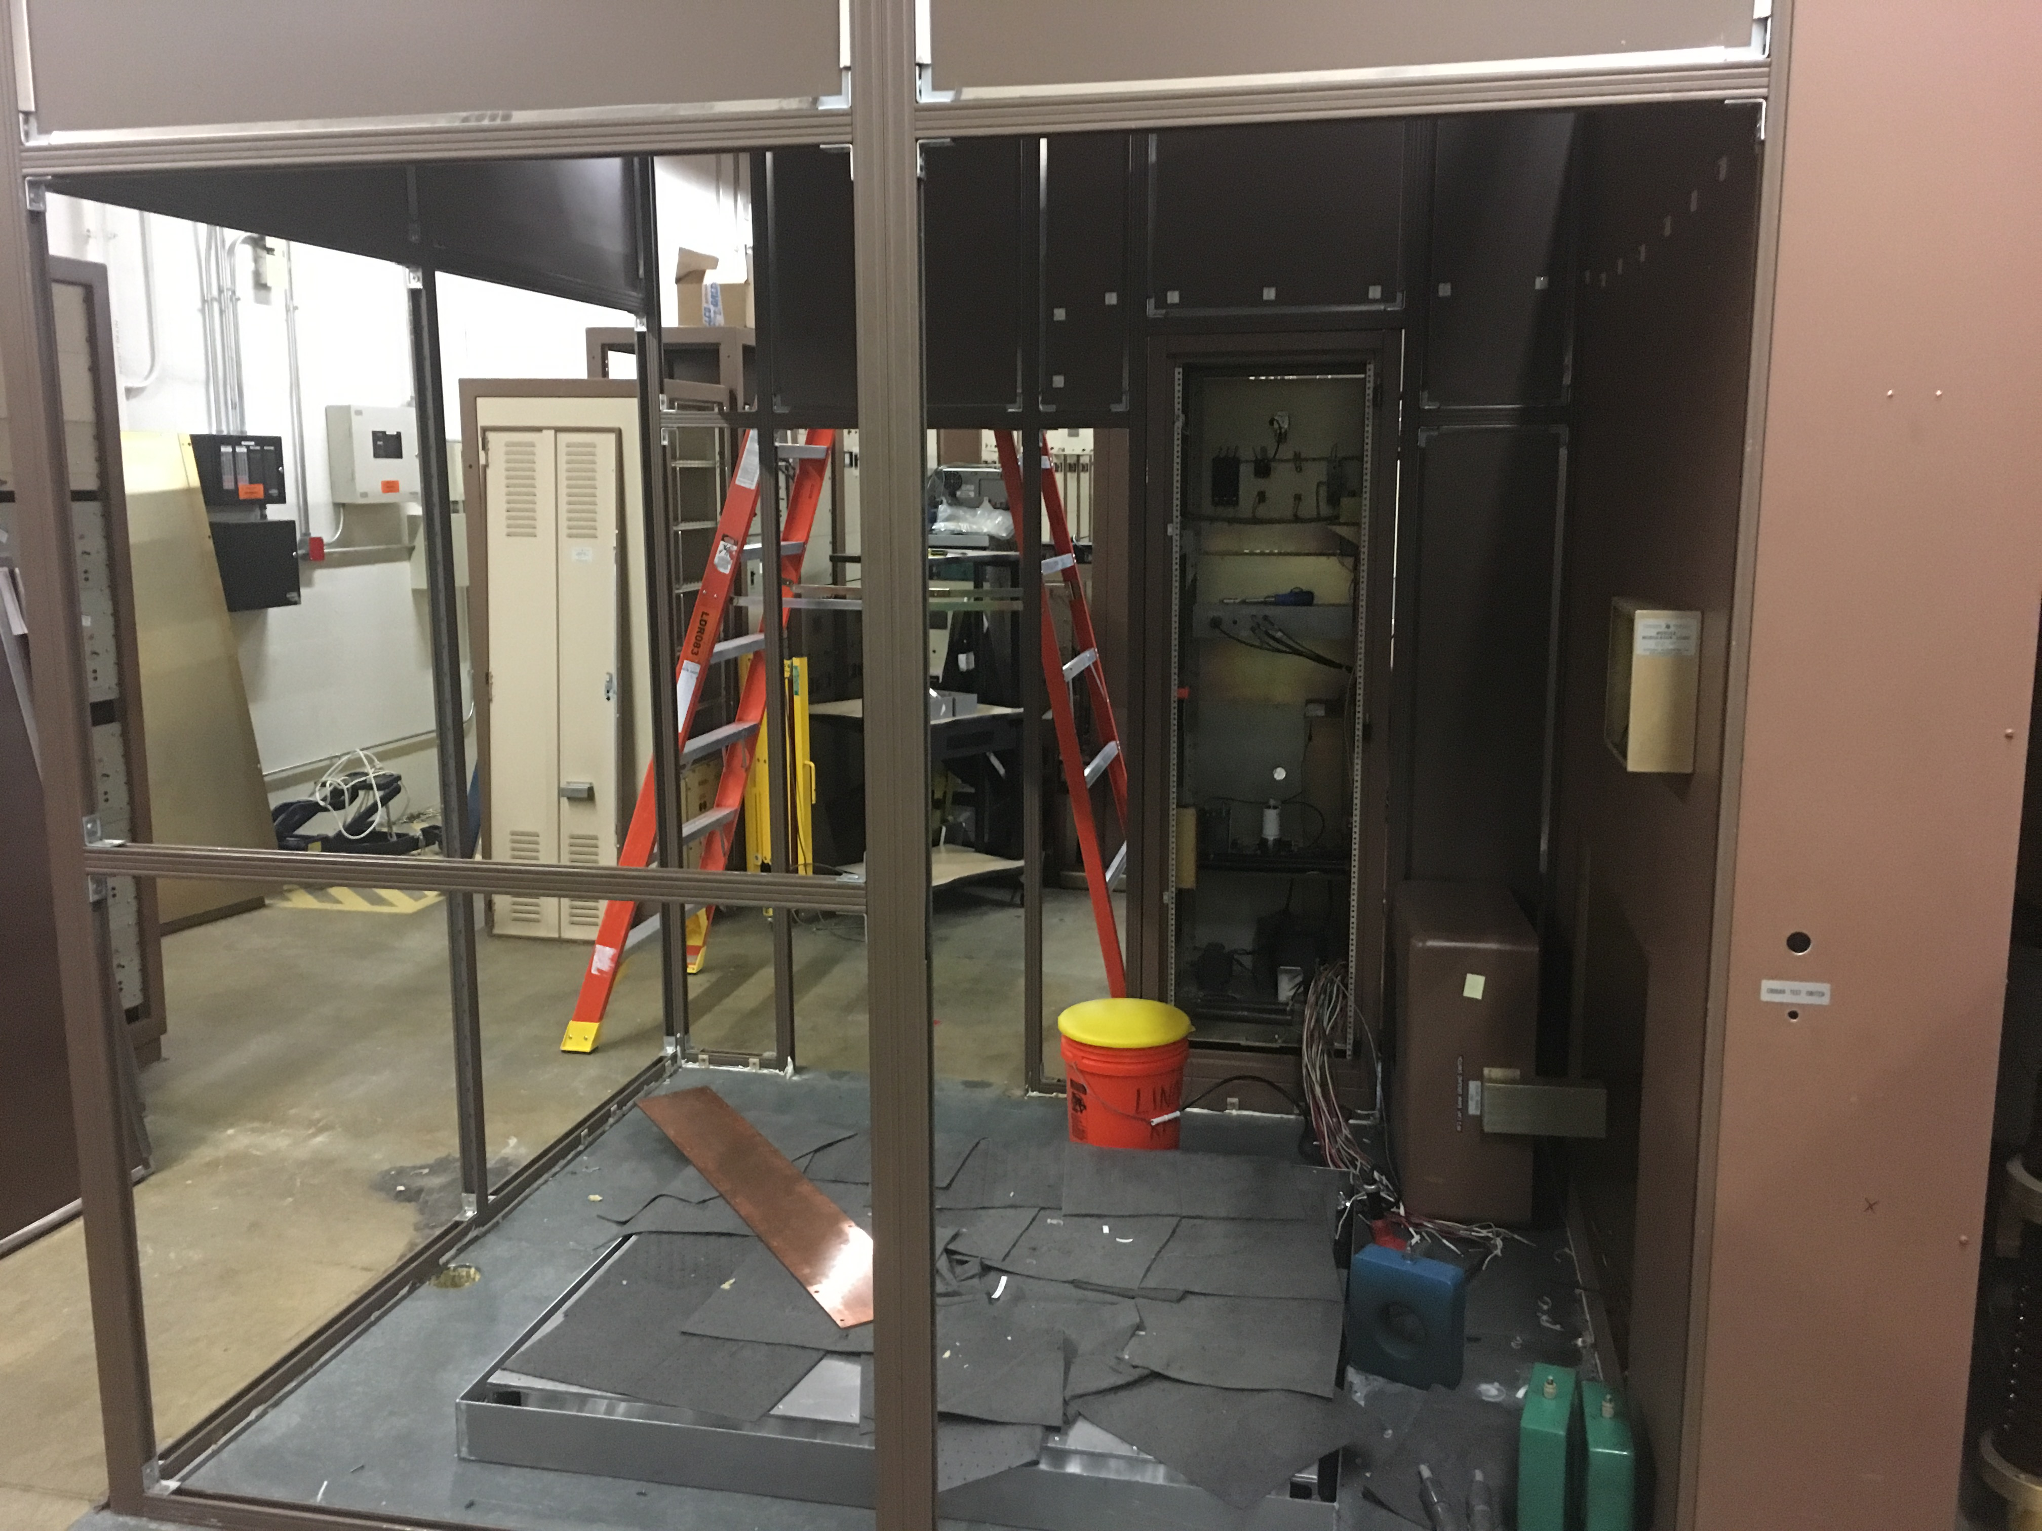
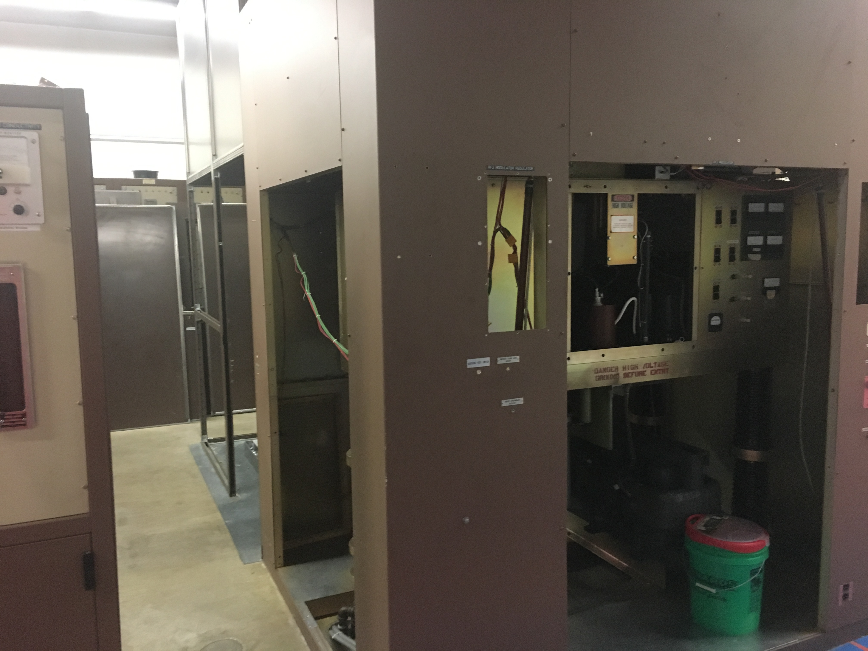
LRF2 Disassembly

Slide 5
Main Injector/Recycler
MI
Replace MI RF station 6 or 4 ~5% Done
~1.5-2 weeks
Ion pump maintience
~1-2 Weeks
8 Gev line
Ion pump Maintenance
~1-2 weeks
Vacuum leak check
~1-2 Weeks
Multi wire replacement (2)
~1 Week
General maintience for MI/RR ~5% Done
~2-3 weeks
Tunnel and service building
Replace the beam pipe in Q504 -50% Done
Vacuum leak on BPM feed through
Switching Flourinert in the MI-10 and 60 kicker systems
Replacing FC-77 to FC-40
RR
TSP upgrade from 106-229 -~12% done
10-11 weeks
Aperture improvement at the RR 402 and 520 locations
~3 weeks at the 402
~1.5 weeks at the 520 ~3% Done
Recycler Abort lamberstons replacement
~3 weeks at the 402
Recycler Sextupole stand change out ~2% Done
~3 weeks
New Pinger installation in the 10 region
Rebuilding and putting back into operations RRRF Anode power supply ~10% Done

Slide 6
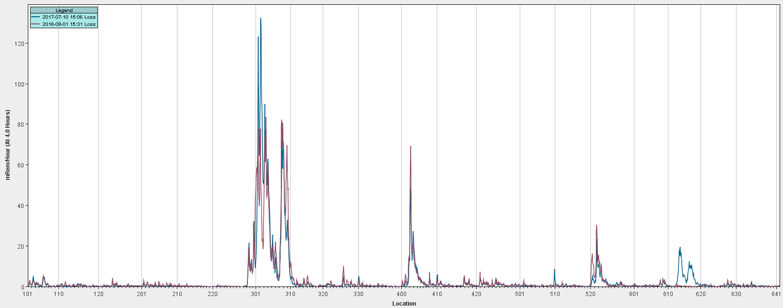
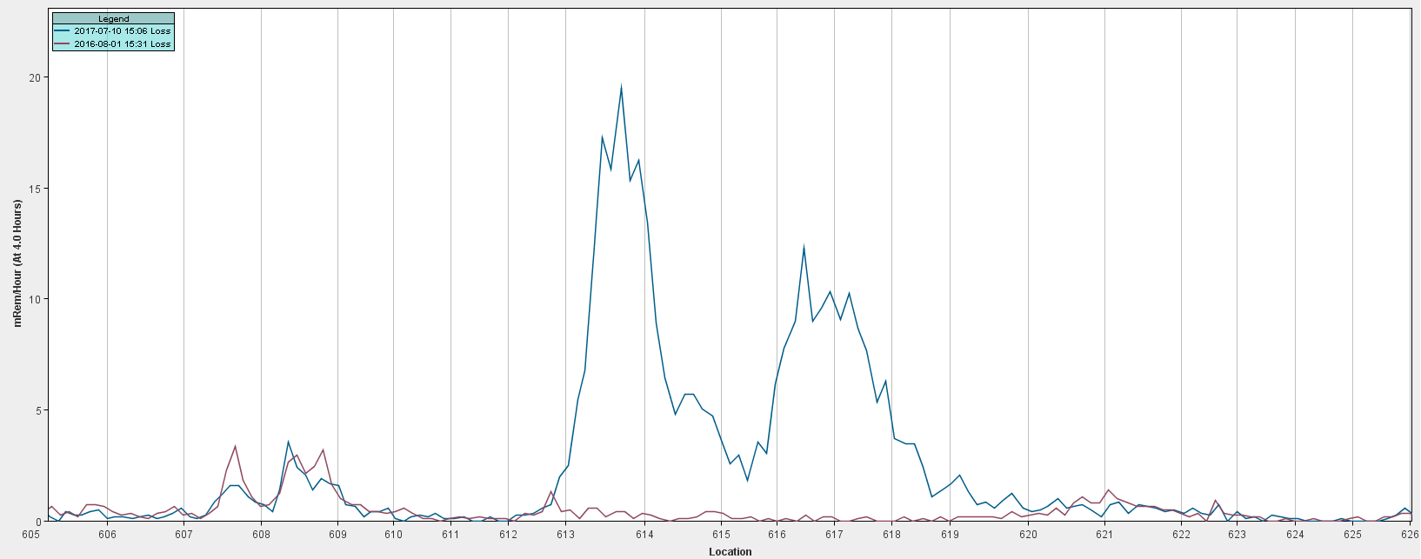
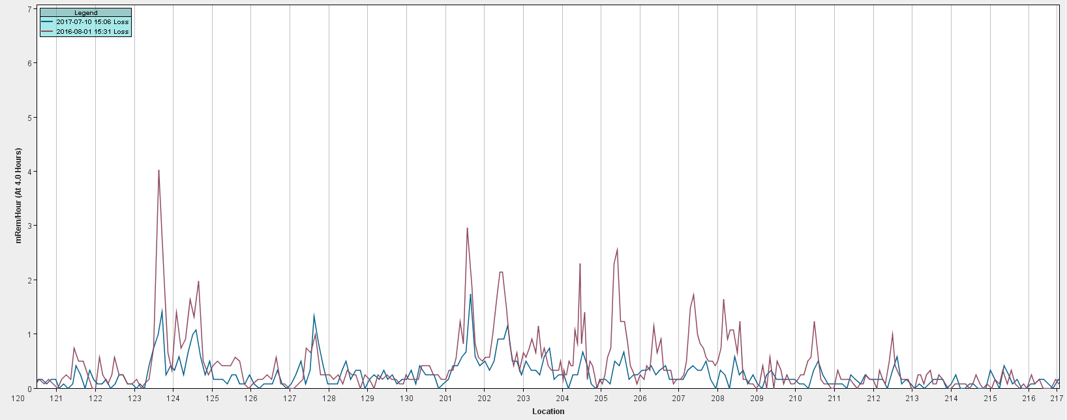
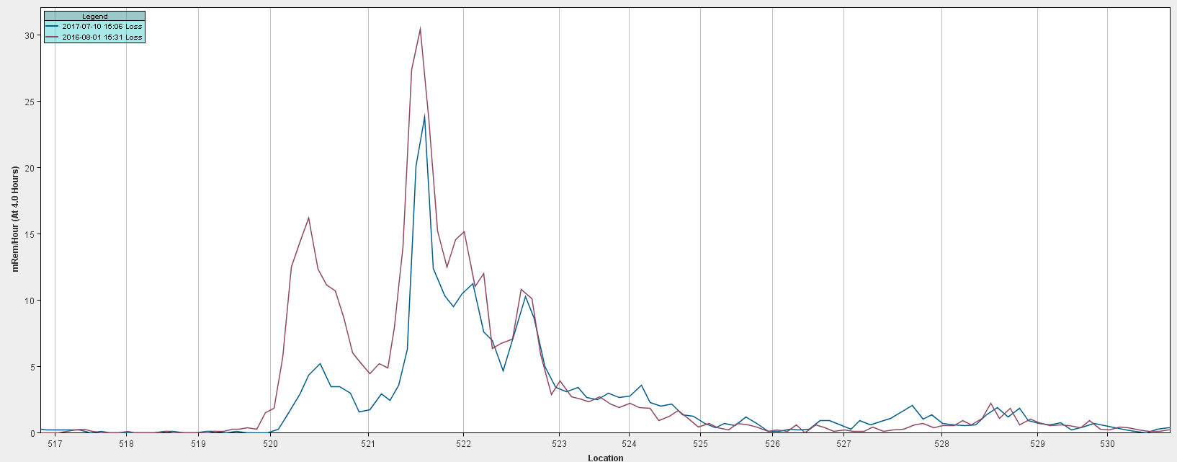
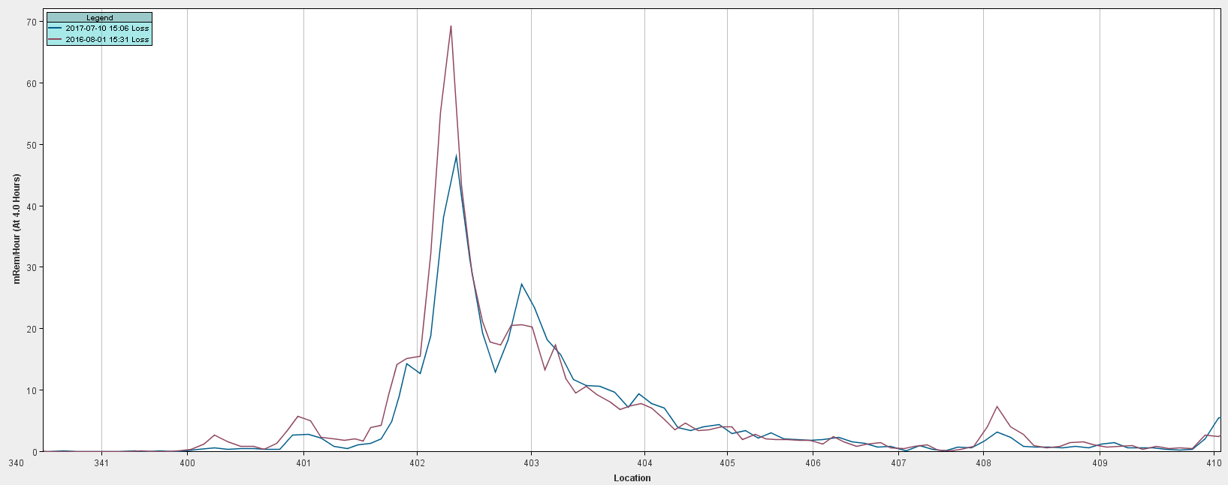
Tunnel Survey (comparing 8/1/16 and 7/10/17)
~30-40% Reduction
Tsp 2 IP dose reduce by ~1800 person-mrem

Slide 7
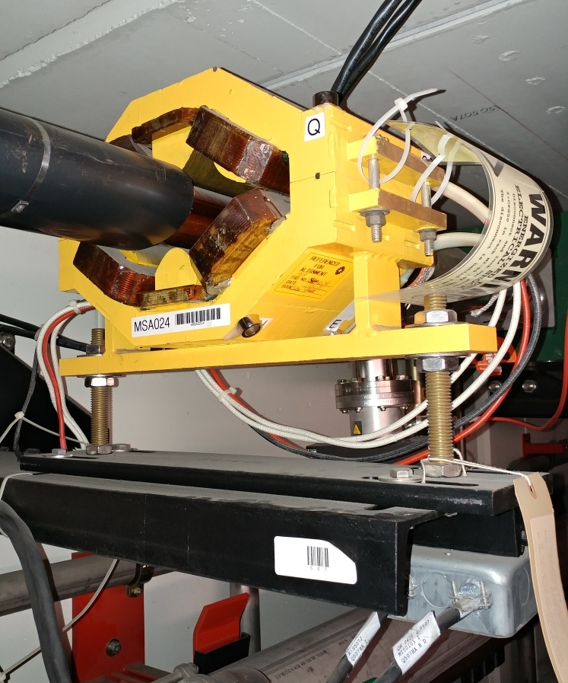
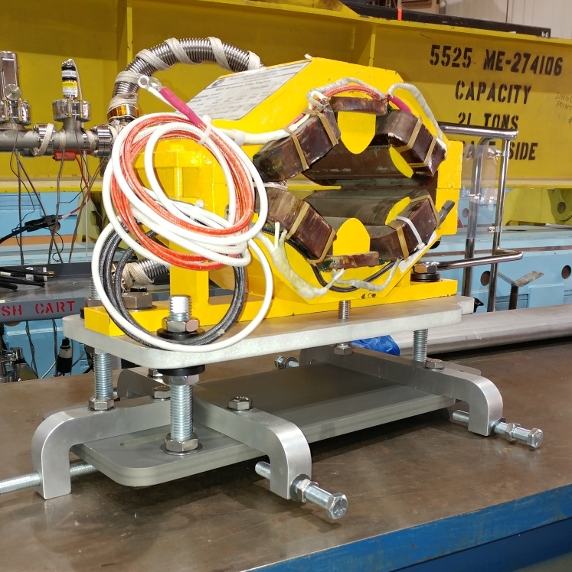
Tunnel Work
Installing first of 19 vertical sextupole stands in Recycler

Slide 8
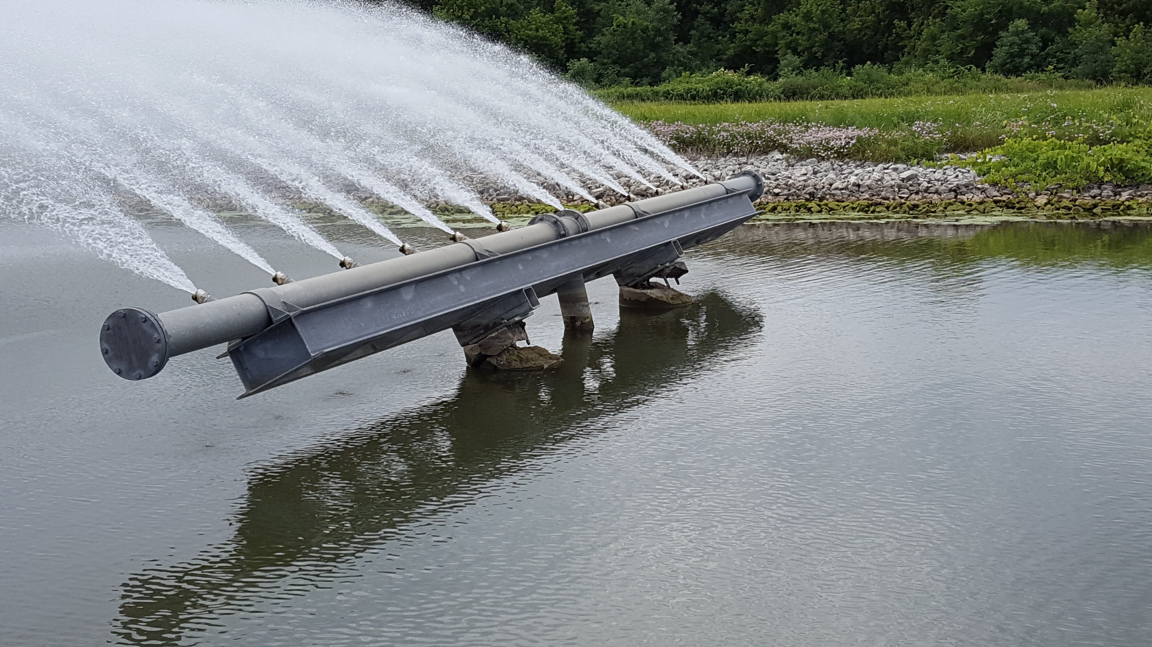
External Beam line
P3 rough vacuum ~5% Done
F3 House IP to Turbo Station upgrade (~2 weeks)
Run 4" vacuum pipe from service buildings down stairwells to tunnel
Install Roots blower stations in service buildings, one per house.
Switch controls over to Tevatron CIA crates, rename parameters
Remove and cap ion pumps.
Cable mitigation in the Meson and Neutrino Muon areas: (~6-7 weeks)
Separating the Booster 95 LCW system from Switchyard (~3-4 weeks)
Switchyard would be its own separate stand alone system. Feed from the F-Sector old MR system.
On hold until Mid August
Osprey Fly the coop
BNB
Relocation of the of the
DI bottles (~2 weeks)
~5% Done

Slide 9
External Beam line (continued)
NuMI (~10-12 weeks)
Target removal for beam scan of the horns
General maintience
Dehumidifiers
Replace Filter and water in the Absorber and Decay pipe cooling system
Drain tile cleaning
Ext.
Water system repair
Repaired cracked nipple on LCW supply manifold in Pre-Target enclosure near Q115.
Repaired cracked weld on Decay Pipe RAW system in Absorber Hall.
~10% Done
~90% Done

Slide 10
Pictures
Open Wall to Target Hall
Top: Cracked nipple on LCW supply manifold near Q115.
Bottom: Newly installed copper pipe in Decay Pipe RAW skid

Slide 11
Muon Campus Work
Mu2e work
M4 line installation ( first half to absorber) ~5% Done
Stand and magnet and cable pulls installation (7-9 weeks)
In support of g-2
Delivery ring straight section
Injection septa (1-2 weeks)
Removal and reinstallation of ring for the M4 line installation ~ Done
Rotate Q207 and Q210 BPMs ~ 2-3 days
Relocation of ELAM ~2-3 days
Abort line
Extraction septa (1-2 weeks)
Magnet replacement Internal water leaks
H212 ~ 1 week
Q211 ~2 days
V742 ~ 1 week ~ Done
Instrumentation Repair
PWC and IC’s ~ 1-2 weeks

Slide 12
Shutdown Duration Drivers
Linac Marx Modulator installation
Station 2 upgrade is underway
Station 3 will follow
RR TSP to IP conversion
Progressing
Muon Campus Overlap with Switchyard crews
Crew is responsible

