Slide 1
H2VLE Beam status
Y.Karyotakis
July 19th 2017

Slide 2
Beam simulation
Simulation is improved
add all known shielding
Exoskeleton plates and insulation and LAr
Each track crossing the LAr volume recorded for background
All tracks crossing a virtual plane of 10x10 m in front of the cryo recorded to be used as input to reco program. Mixing a beam and background track
26M events per energy available here @ CERN
/eos/experiment/neutplatform/protodune/npmcproddisk/beamgroupdisk/DP/v25c/*26M*.root

Slide 3
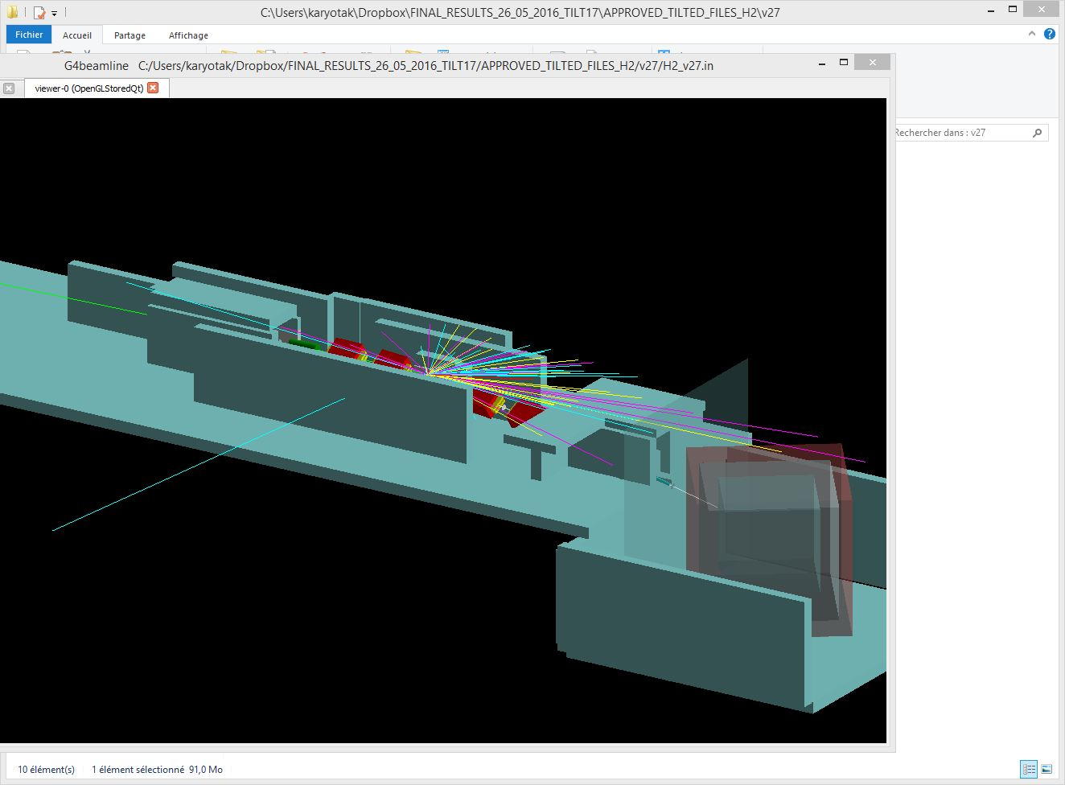

Slide 4
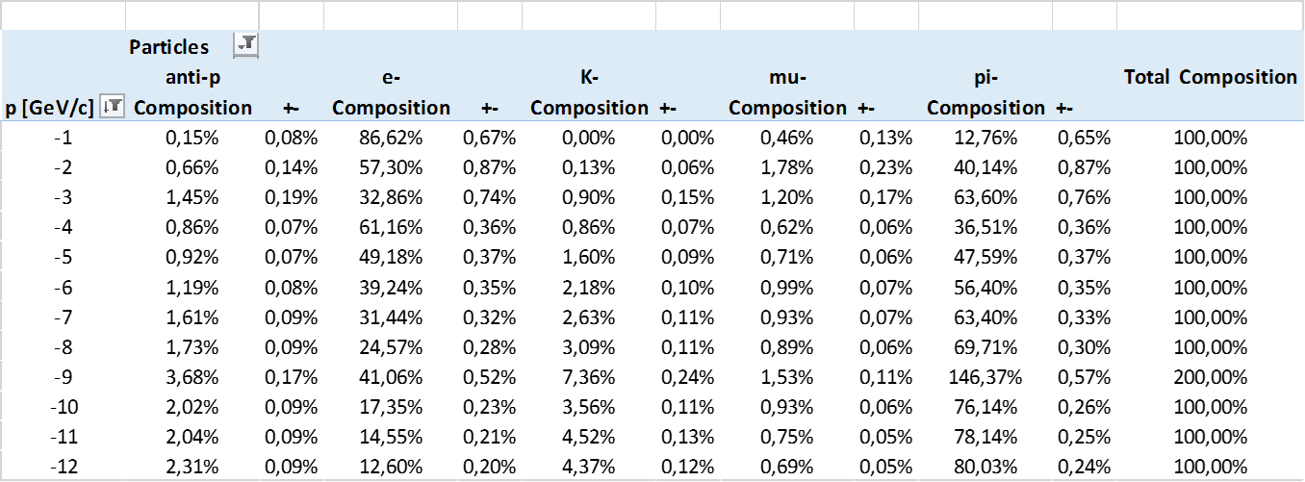
Beam Composition

Slide 5
Difference between published note and v25c

Slide 6
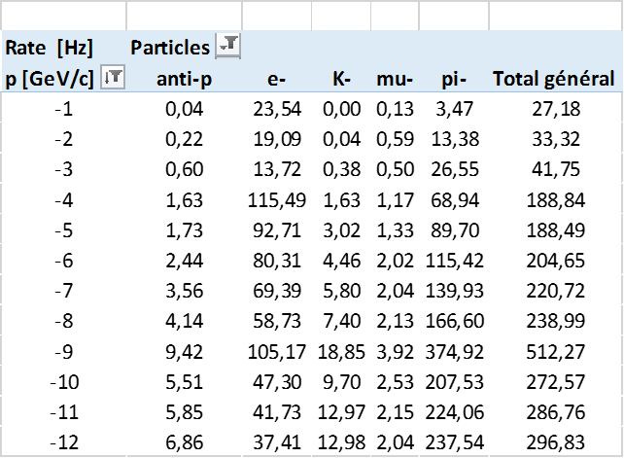
Rates

Slide 7
Background rates

Slide 8
Hardware
Beam position monitors and trigger counters under R&D, 1st prototypes in October
Cherenkov counters and infrastructure ready by December 2017
TOF
Exploring the ‘poo man’ solution, resolution 1-2 ns, using the trigger counters
Have set up a test bench to measure time resolution in the lab
WR master signals will be available in our counting room, from MCC
Beam Data Handling
SP people (Igor Vasilyevich Mandrichenko <ivm@fnal.gov>) have a reliable scheme to get the data and log them in a database
We (Inaki + Giulia+ BI guys) were able to read the TDC WR module, candidate for our TOF

Slide 9
Conclusion
Simulation effort slows down, have to wait for real data
Follow up of beam instrumentation construction and commissioning
Aim to test prototypes in October November at PS
Data handling

