Slide 1
Point about the chimneys cooling raised at last integration meeting 19/8/17 D.A.
Safety aspects in chimneys design related to (see Franco’s presentation today)
Some aspects related to detector operation:
Temperature inside chimneys in 3x1x1 is around 150 k with variations dominated by cryogenics operation (active cooling installed but not operational) → see next slide. This temperature could not be predicted a priori with calculations on the cryostat (as for the general heath input which turned out to be much larger than expected from calculations)
Temperature inside chimneys in 6x6x6 without active cooling cannot be predicted as well .We cannot rely on the 3x1x1 experience (different cryostat design). Temperature could be different.
Interest in limiting/understanding heath input via chimneys (see also TB discussion with Montanari on thermal screens for other penetrations): better LAr surface conditions, smaller temperature gradient in the gas. Active cooling is an extra handle to understand and to operate with respect to these issues
Optimal temperature for electronics around 110K. (~40% S/N improvement when going from room temperature to this temperature). Noise on 3x1x1 is already quite good. However the noise could be even better on the 6x6x6:
On 3x1x1 noise still dominated by some ground loops on slow control which should not be present on 6x6x6 (slow control grounding insulated from building grounding).
On 6x6x6 there is also no internal LAr pump (small additional noise contribution).
From 3x1x1 we also see little variation of the noise from 1m strips to 3m strips (see next slides). It does not correspond to nominal capacitance of 150pF for 1m strips and 450 pF for 3m strips. The internal capacitance of the anode , as also the inter-strips capacitance, is being understood however it seems that the amplifier does not see the predicted 150 pF/m but a lower capacitance (cables ?) which is similar for the 3m and 1m case. → The noise can be better than expected at lower capacitance
With lower noise there is interest also in reaching the nominal 110 K temperature in order to assess the ultimate noise performance
Noise also affects the compression performance and data volume of compressed data
→ At least at R&D level the possibility of cooling and controlling the temperature looks an interesting handle to understand the ultimate detector performance

Slide 2
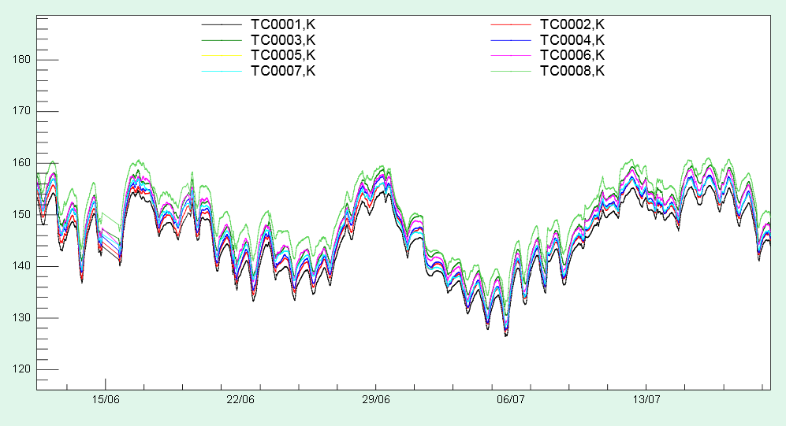
Electronics switched on 14/7 15:49 and switched off 18/7 16:49
Average temperature around 150 K. Variations dominated by cryogenics operation
Effect of electronics heath production was known to be small a priori (see Franco’s calculations) and it is difficult to disentangle an evidence of this contribution with respect to the global trend

Slide 3
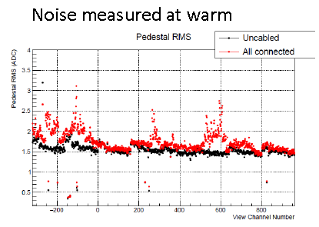
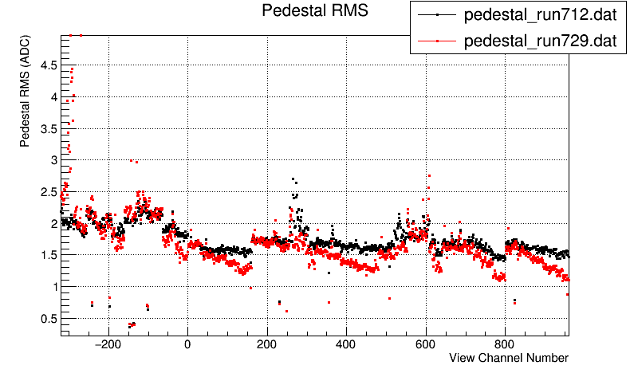
Once removed main slow control loops (black), similar noise contribution for 3m and 1m strips around 1.5 ADC counts RMS
Given the capacitance ratio the noise should be higher by a factor 2.1 on 3 m long strips (dashed line).
The 1m strips noise corresponds to slightly less than expected at warm (1.6 ADC RMS).
Noise warm-cold comparison, immediately before cooling down and with cryostat filled. External effects (Slow Control grounding, LAr pump) present
→ Probably without external spurious effects and at lower temperature ~1 ADC RMS could be achieved

